Slide 1
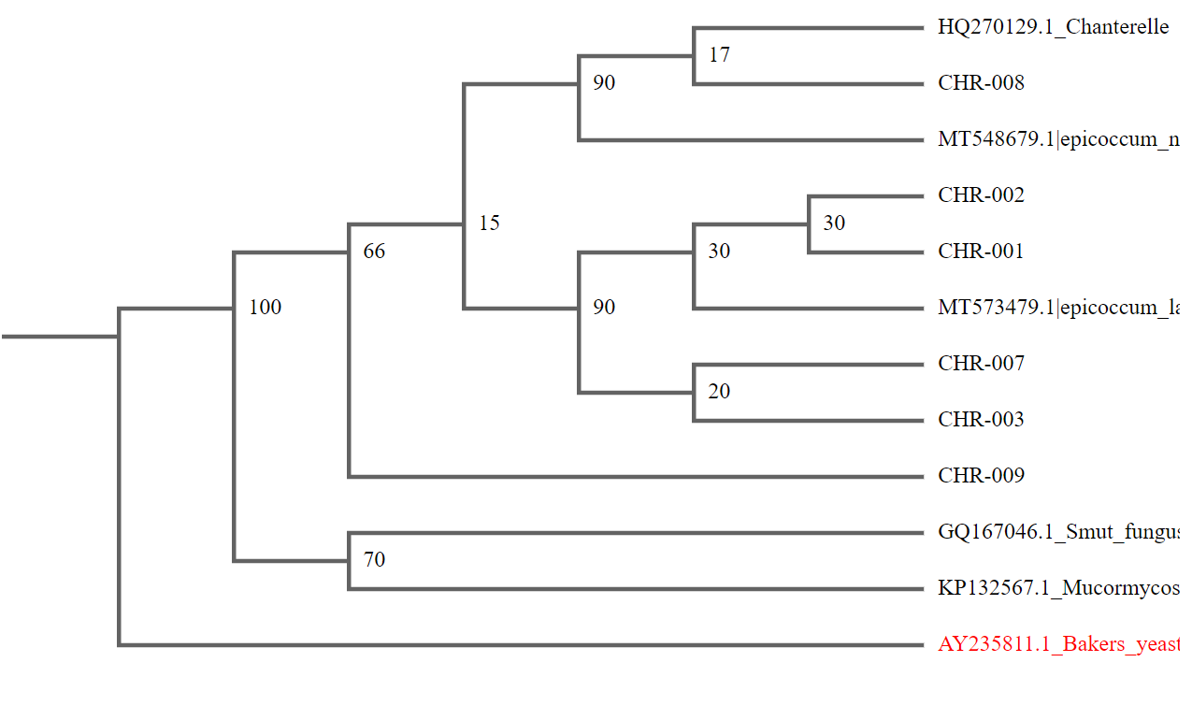
The Effect of the Anoplophora glabripennis Infestation on the Ecological Biodiversity in Long Island, New York
Emilia Berkowitz & Caitlyn Melaram
Lynbrook Senior High School
Abstract & Introduction
The Anoplophora glabripennis came to America through wood pallets on cargo ships. It has invaded numerous parts of Long Island, more specifically in Suffolk County (Cohen, 2022). The beetle does not contribute positively to the ecosystem as they cling to trees and damage them immensely. Anoplophora glabripennis may affect other arthropod diversity. We hypothesize that the infestation of this beetle is what causes significant damage to the habitats of other insects.
Materials & Methods
We surveyed the Rocky Point Walking Trail. We surveyed four different locations in the first half mile of the trail. Our locations for sampling were abundant with trees, logs, and rocks. We will aim for about five different samples at each location. We need to split our collection into two groups (control and sample). One should have an insect population affected by the Anoplophora glabripennis and the other one should not. We will catch these insects by using pitfalls, where we will dig considerably deep holes in the ground (so the insects cannot climb out) and cover them with leaves and twigs. We will then come back hours later to collect the insects.
Results
Figure 2- figure linking the sample localities with their placement in the phylogenetic tree
Discussion
Although we can not say for certain whether it was the Anoplophora glabripennis that is causing damage to our ecosystem on Long Island, it can be predicted, in support of our hypothesis, that the beetles leave behind toxins in the ecosystem. Our samples have been linked to various fungi, further supporting this point.
References
Cohn, D. A. (2022). Sugar Maple Decline: Climate Change Effects on Acer Saccharum and Subsequent Impacts on New York
Acknowledgements
We would like to thank Mrs. McAuley for all her help and support, as well as the BCLI team for this opportunity.
Figure 1- figure depicting JMC sample sequencing

