Slide 1
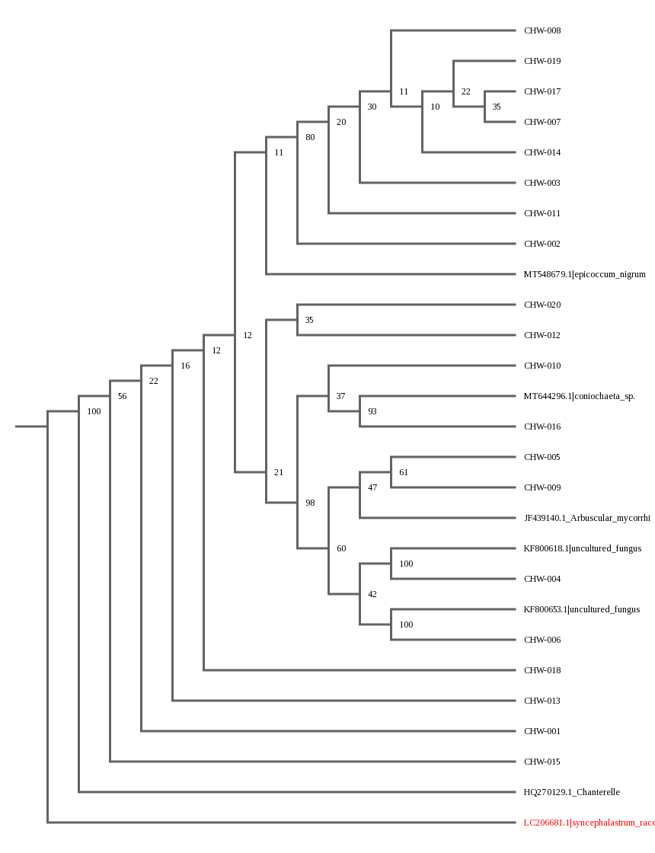
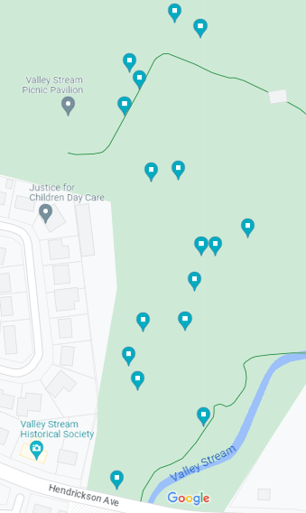
A Comparison Between Lichen Species Composition of Valley Stream State Park, Valley Stream from 1961 to 2022
Scarlett Dellacona, Rebecca Marzari, Ethan Palacio
Mentor: Mrs. McAuley
Abstract
Lichens are a composite organism composed of a fungus and a photosynthetic organism (Lutzoni & Miadlikowska, n.d.). There are over 18,000 species of lichen (S, n.d.), and are extremely sensitive to pollution (Lutzoni & Miadlikowska, n.d.). A complete overview of the lichen on Long Island was completed in 1961, however, this work has not been entirely updated since (Brodo, 1961). With suburbanization beginning in the 1950’s and the significant increases of pollution, temperature, and environmental changes, we believe there will be a change in the species composition on Long Island. We will be focusing on Valley Stream State Park, Valley Stream, where there were very few unique lichen species were catalogued in 1961 (Brodo, 1961). We will compare the species composition of the bog and the factors that affect the lichen presence such as the climate or average temperature, all of which were studied in the 1961 analysis, to determine possible causes of species composition differences.
Introduction
In 1961, I.M. Brodo published “A study of lichen ecology in central long island, new york,” cataloging lichen species across many locations on Long Island. In this publication, very few locations were on the west side of Long Island. This could have been due to the higher urbanization of Nassau County then Suffolk County. However, we wanted to determine if there was a lichen presence on the west end of Long Island, and if this presence indicated an increase in lichen biodiversity in the past sixty years. We chose to survey Valley Stream State Park, a location that contained no recorded lichen species in the 1961 study. Valley Stream State Park sits next to a highly-developed residential area offering picnic and play areas as well as nature trails. The park has a walking course with a half-mile loop as well as 15 stations for outdoor exercises.
Materials & Methods
We will not collect all lichen from one location to allow for recolonization of the space, and only take from areas in which there is a sufficient amount to leave behind. We will be wearing gloves during collection to reduce the risk of contamination. When collecting the lichen, it is necessary to first wet it to prevent breakage during removal. It will then be stored in either a paper bag or envelope.
Results
Discussion
Overall, most species were found to be closely related. Most results were most similar to uncultured Epicoccum, uncultured fungus, Phaeophyscia limbate, and Candelaria concolor. Interestingly, samples that were found most closely related on the phylogenetic tree were not immediately next to each other at sample sites. This could be because it is a relatively small park, so it is easy for the lichen to spread. Further testing should be completed in order to support the results. Possible future research includes a larger sample size or focusing on other locations named in the 1961 “A study of lichen ecology in central long island, new york.”
References
British Lichen Society. (n.d.). Collecting Specimens. The British Lichen Society. Retrieved November 28, 2022, from https://britishlichensociety.org.uk/learning/collecting-specimens
Brodo, I. M. (1961). A study of lichen ecology in central long island, new york. American Midland Naturalist, 290. https://doi.org/10.2307/2422957
Hayward, G. C. (1979). Collecting and Curating Lichens. The Bookshelf. Retrieved November 29, 2022, from https://www.thebookshelf.auckland.ac.nz/docs/Tane/Tane-25/19%20Collecting%20and%20Curating%20Lichens.pdf
Legebokow, C. (2016). RCRW Lichen Collection, Handling, Storage & Feeding Handbook.
Lichen Collection and Identification. (n.d.). https://www.fs.usda.gov/wildflowers/beauty/lichens/identification.shtml
Lutzoni, F., & Miadlikowska, J. (n.d.). Lichens. Current Biology, 19(03).
S, K. (n.d.). Lichens: Introduction and Classification | Botany. https://www.biologydiscussion.com/plants/lichens-plants/lichens-introduction-and-classification-botany/63962
US Forest Service. (n.d.). Lichen Collection and Identification. US Forest Service. Retrieved November 28, 2022, from https://www.fs.usda.gov/wildflowers/beauty/lichens/identification.shtml

