Slide 1
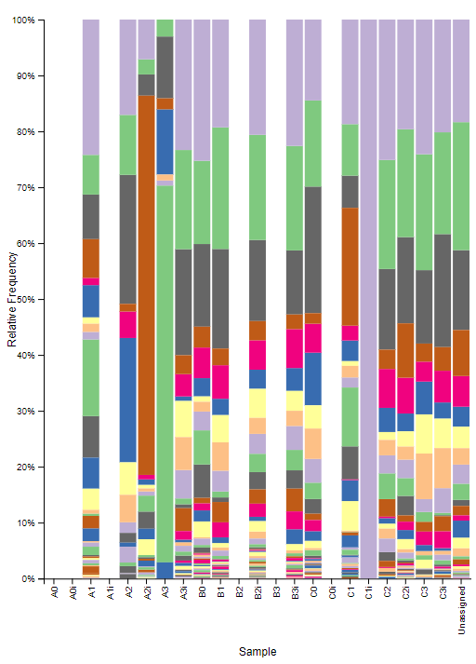
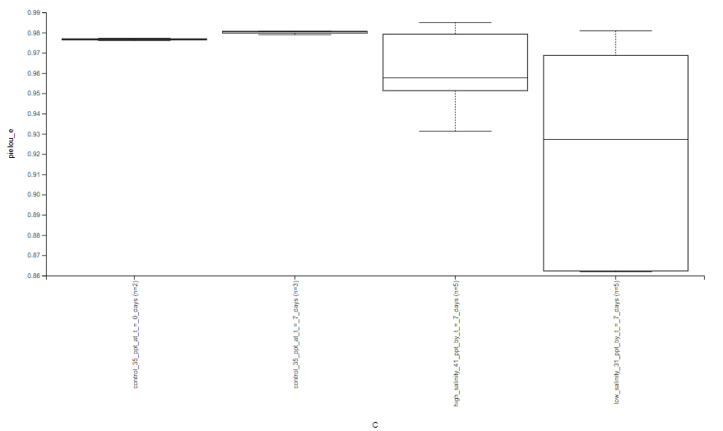
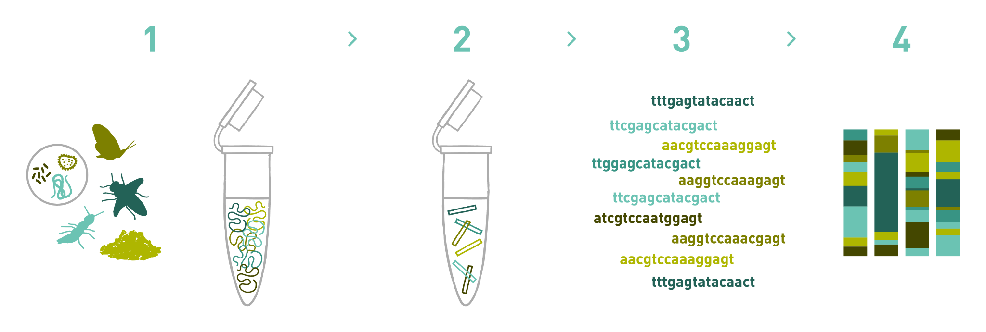
The Effects of Salinity on the Microbiome of Acropora
Author: Benjamin Browne, Kyle Caputo
Mentors: Luisa McHugh, Ph.D.
William Floyd High School
Abstract
As climate change continues to worsen, we are looking at the possibility of coral dying at high rates not seen before. Currently, there is limited information as to how coral and other organisms will respond to the increased stress of their environment. Acropora is a reef-building coral which forms a substrate for other organisms to live on and is an important part of ocean ecosystems. With the changing of the ocean environment, especially in relation to climate change, it is important to know how coral will be affected. Testing coral at different salinities and examining their microbiomes allows us to document how coral responds to this shift and if they can repopulate successfully. Within a short period of time it became immediately apparent that even a small increase in salinity adversely affected the coral, as bleaching was observed within the first 24 hours.
Introduction
Acropora is a reef-building coral that forms a substrate for other organisms to live on and is the basis of many food chains that support a variety of organisms including humans. This ability of Acropora to provide a habitat for organisms is especially important for endangered species to survive and repopulate. Environmental factors such as changing ocean salinity and rising ocean temperature have been attributed to global warming and are causing a decline in coral population . These changes in salinity are stressing the coral which can lead to increased bleaching. Acropora is beginning to require human intervention to keep these ecosystems in balance as there are already 10 different species listed as endangered. In order to best support coral’s microbiome, conducting experiments to mimic changes in their natural environment are essential.
Materials and Methods
Results
Discussion
The Alpha diversity and taxonomic results support the conclusion that as salinity strays from the normal coral environment, the microbiome loses diversity. This damaging effect on coral microbiome may lead to a chain of events over the long term, damaging ecosystems and hurting organisms that use reefs as habitats. In contrast, the Beta diversity was inconclusive as there is no clear decrease in diversity as salinity is increased. Although our results are mixed, the data does guide us to believe that an increase in salinity negatively affects the microbiome of Acropora. Therefore further research on testing salinity changes on Acropora is warranted.
Acknowledgements
Thank you to Jeffry Petracca of the DNA Learning Center at Cold Spring Harbor Laboratory and the Long Island Aquarium, Joseph Yaiullo, curator and co-founder of The Long Island Aquarium and Noel Heinsohn, Senior Aquarist at The Long Island Aquarium, who provided the Acropora and consistent help with conducting the experiment. Special thanks to Dr. Bruce Nash, Assistant Director for Science at the DNA Learning Center at Cold Spring Harbor Laboratory, for his help explaining DNA subway purple line and metabarcoding analysis. We’d also like to thank the DNA Learning Center at Cold Spring Harbor Laboratory for their generous supply of resources and for providing the opportunity to allow us to present our findings.
References
https://www.google.com/imgres?imgurl=https%3A%2F%2Fwww.allgenetics.eu%2Fimages%2Fdna-metabarcoding-service.png&imgrefurl=https%3A%2F%2Fwww.allgenetics.eu%2Fservices%2Fgenomics-for-researchers%2Fdna-metabarcoding&tbnid=-PJ7dAf3n68a3M&vet=12ahUKEwin0L6GuezwAhW9ajABHUANDYAQMygBegUIARDHAQ..i&docid=9b2EHyKVyEiafM&w=3440&h=1161&q=metabarcoding&ved=2ahUKEwin0L6GuezwAhW9ajABHUANDYAQMygBegUIARDHAQ
Endangered and Threatened Wildlife and Plants: Final Listing Determinations on Proposal to List 66 Reef-Building Coral Species and To Reclassify Elkhorn and Staghorn Corals. Federal Register. (2014, September 10). https://www.federalregister.gov/documents/2014/09/10/2014-20814/endangered-and-threatened-wildlife-and-plants-final-listing-determinations-on-proposal-to-list-66#h-3.
Samlansin, K., Chawakitchareon, P., & Rungsupa, S. (2020). Effects of Salinity and Nitrate on Coral Health Levels of Acropora sp. Thai Environmental Engineering Journal, 34(1), 19-26.
Scott, A., Harrison, P. L., & Brooks, L. O. (2013). Reduced salinity decreases the fertilization success and larval survival of two scleractinian coral species. Marine environmental research, 92, 10-14.
Hoegh-Guldberg, O., & Salvat, B. (1995). Periodic mass-bleaching and elevated sea temperatures: bleaching of outer reef slope communities in Moorea, French Polynesia. Marine ecology progress series, 121, 181-190.
Johnson, J. S., Spakowicz, D. J., Hong, B. Y., Petersen, L. M., Demkowicz, P., Chen, L., & Sodergren, E. (2019). Evaluation of 16S rRNA gene sequencing for species and strain-level microbiome analysis. Nature communications, 10(1), 1-11.
https://dnasubway.cyverse.org/

