Slide 1
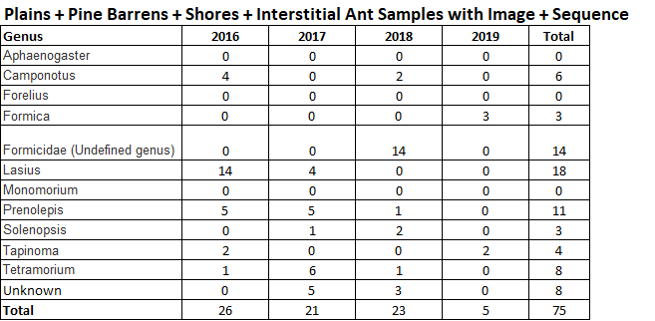
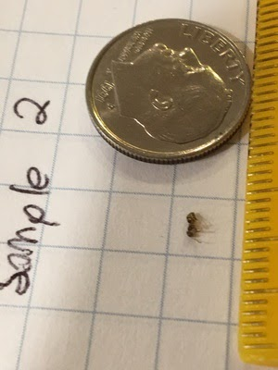
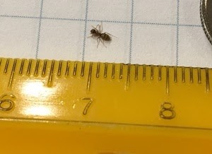
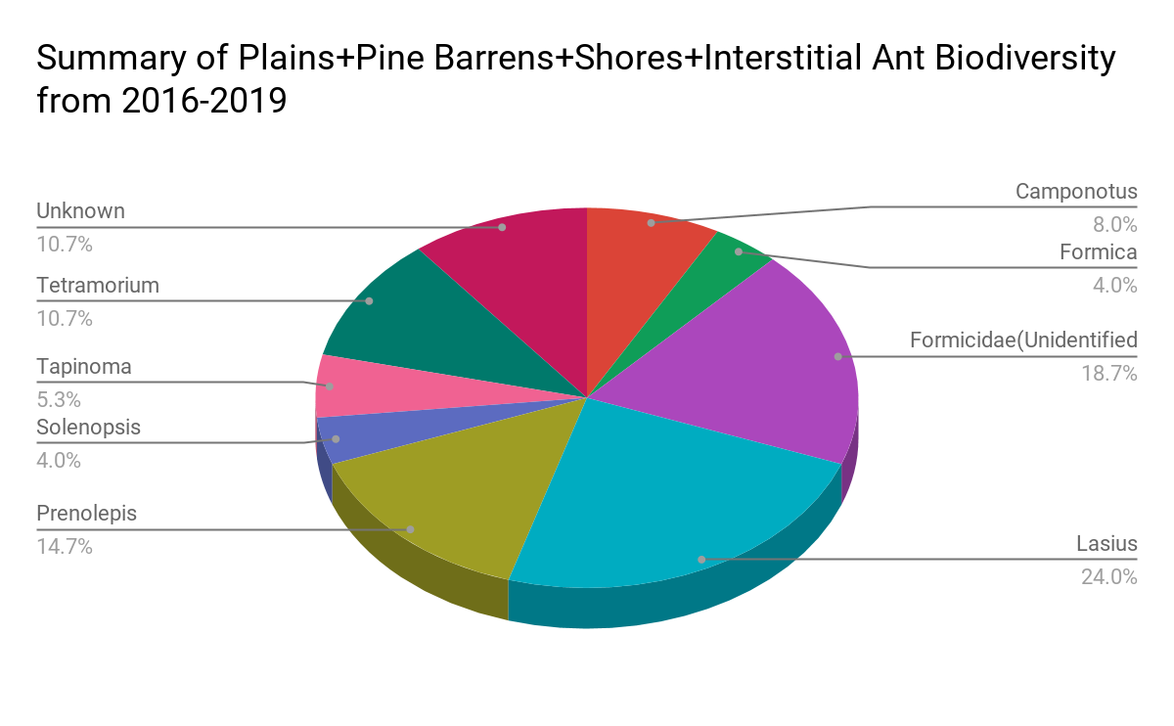
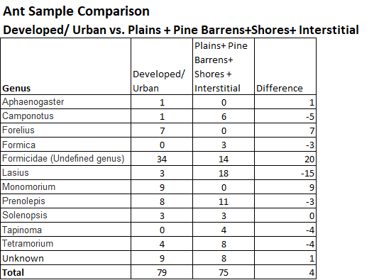
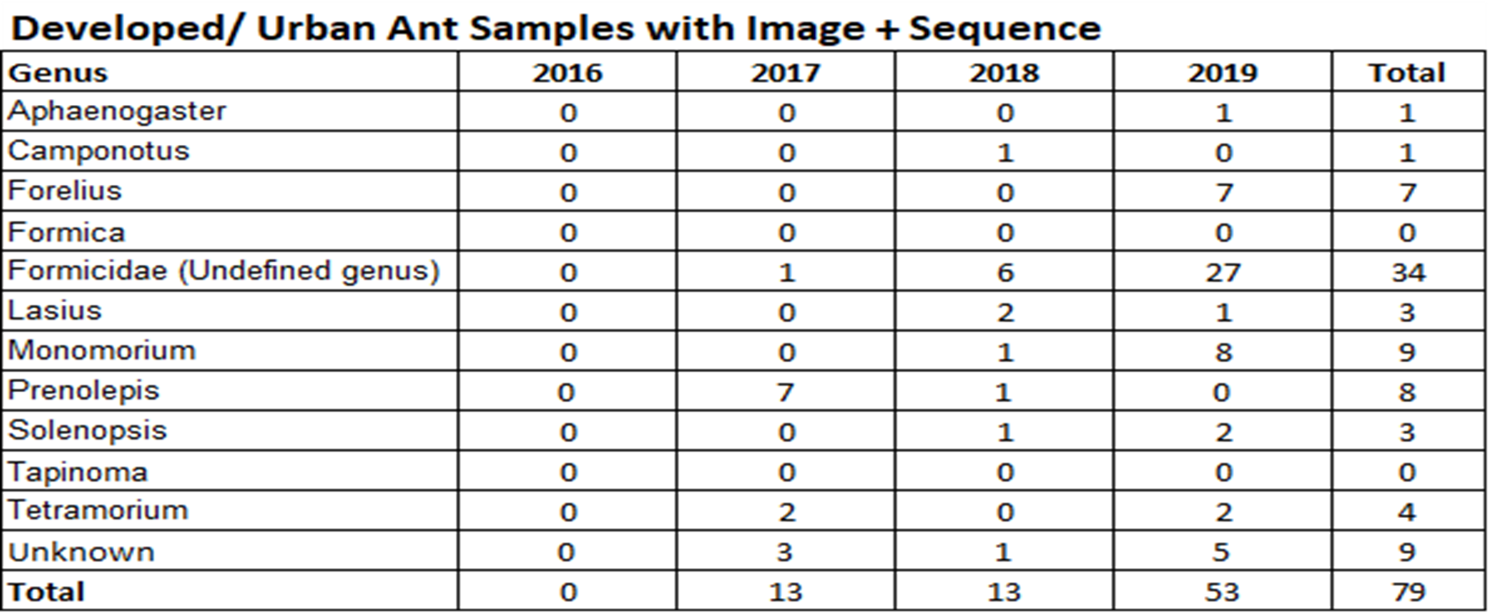
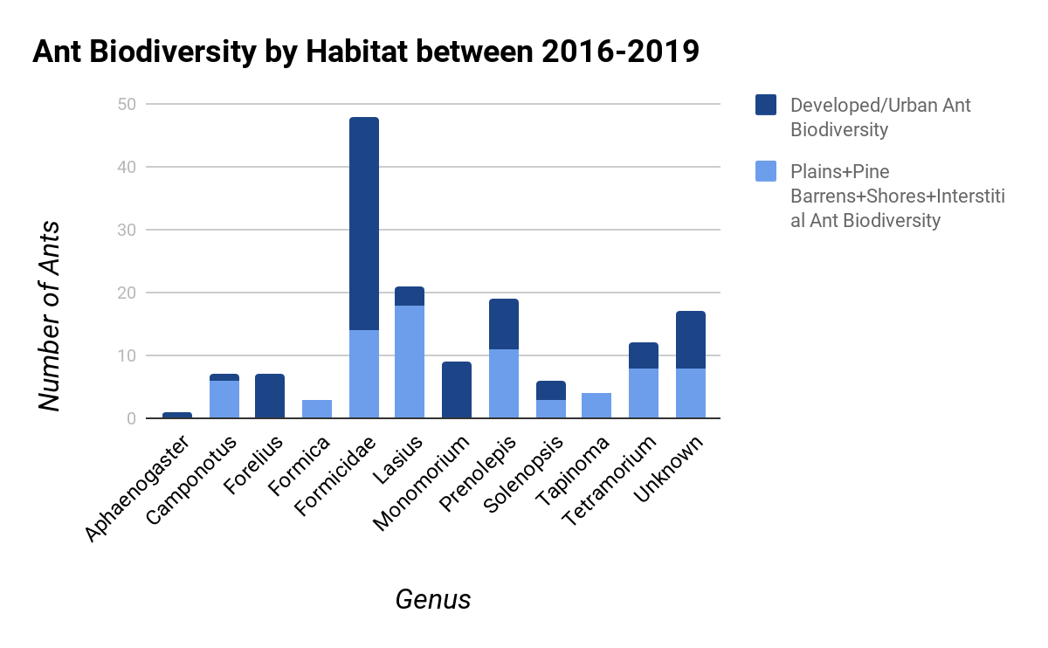
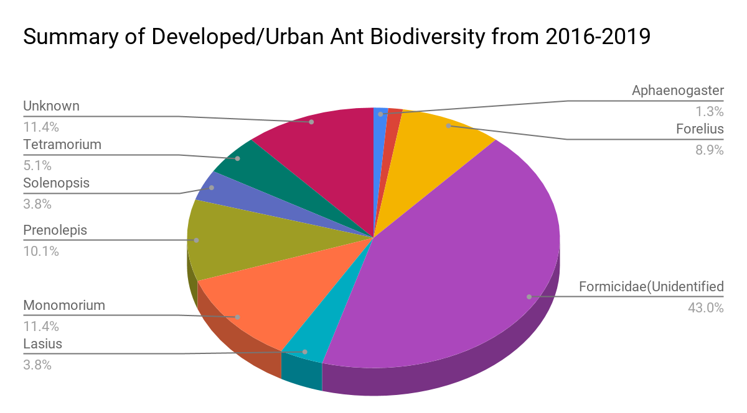
Does urbanization have an effect on ant biodiversity?
Developed/Urban vs. Natural Habitats
Zenon Ortiz, Nicholas Peranzo, Justin Ruggeberg
Mentor: Tracy Nellins
St. Dominic High School
Abstract
Materials and Methods
Results
Images
The goal of this research project was to determine if urbanization affects an ant population’s biodiversity. In order to determine the effects of urbanization on ant biodiversity, we selected two different types of habitats - a developed/urban habitat and more natural habitats including plains, pine barrens, shores and interstitial. We hypothesized that the effects of urbanization, such as, increased pollutants, fertilizers, industrialization, etc. would have an adverse effect on an ant population’s biodiversity, as indicated by the limited diversity of ant species found within an urban habitat. In turn, we expected there to be a greater level of biodiversity in less developed and more natural habitats such as plains, pine barrens, shores and interstitial.
Using the Cold Spring Harbor Laboratory DNA Learning Center Barcoding Sample Database (DNALC), we compared the biodiversity of ant DNA samples catalogued that had images and sequences from developed/urban habitats, with ant DNA samples catalogued that had images and sequences from plains, pine barrens, shores, and interstitial habitats for the years 2016-2019. Our comparative data research indicated that we were unable to sufficiently prove or disprove our hypothesis that urbanization had a negative effect on the biodiversity of ants. Further testing would be required in order to determine accurate results.
Materials:
GuHCl (lysis solution) aliquots (50uL each)
Wash buffer aliquots (200uL each)
TE buffer aliquots (30uL each)
Autoclaved pestles
Autoclaved toothpicks
Tweezers
Extra empty centrifuge tubes
80 tube tube-racks
Plastic bag for used pestles and tweezers
Biohazard bag
Whatman paper discs
Blank labels + Sharpie
Razor blades
Gloves
Plastic bag to hold samples
Methods:
Collect sufficient ant samples from relevant habitats.
Wear gloves when collecting specimens, placing each sample in its own container, and preserve them via freezing.
Take high quality pictures of each ant in its habitat and take latitude and longitude measurements. The pictures of the ants can then be used by a taxonomist to verify the species if necessary.
Enter samples into the DNALC.
Begin the barcoding process by removing a small piece of tissue from each ant and isolate the DNA. This will be done by using the rapid isolation method.
Send isolated DNA to the DNALC where the process of PCR Amplification Process takes place in order to amplify the desired region, the CO1 gene..
Analyze the amplified DNA, the process of gel electrophoresis will be used at the DNALC where the PCR was performed. An agarose gel will be created and it will be covered with buffer inside the electrophoresis box. The ant DNA samples will then be loaded, along with the stain, into different wells and turn on the current. If the bands in the gel appear correct, the DNA samples will be sent to be sequenced (DNALC 21).
Analyze data and observations
Confirm or reject hypothesis
Draw conclusions
Data Source: DNALC
Data: All samples that meet the criteria: ant+years 2016-2019+developed/urban habitat + has image + has sequence
Data Source: DNALC
Data: All samples that meet the criteria: ant + years 2016-2019+plains or pine barrens or shores or interstitial habitats + has image + has sequence
Comparisons:
Data: All samples that meet the criteria: ant+years 2016-2019+developed/urban habitat or plains or pine barrens or shores or interstitial habitats + has image + has sequence
Due to limitations from the COVID-19 pandemic, we were unable to use any of our own ant samples. However, we did have access to the online database from the DNALC that holds data samples categorized from past projects. We did not have access to the past project’s purposes and objectives, and therefore, the samples selected may have a bias. However, for purposes of our project, we were limited to the data available. We focused on ant samples from 2016-2019 and in habitats that were “developed/urban” and habitats that are more natural and “untouched” by urbanization such as plains, pine barrens, shores, and interstitial. Only those samples that met the above habitat requirements and included images and sequences were used in our data collection. However, the database had some samples that were marked unknown and others as “formicidae,” which means that the samples were ants but their genus were unable to be identified. The data tables to the left show the number of ant samples by habitat and the similarities and differences between them.
While acknowledging the limitations of the DNALC database, we concluded that there is an immaterial difference in the levels of biodiversity in developed/urban habitats (indicated by a minimum of 8 ant genus types being present), as compared to the natural habitats that include plains, pine barrens, shores, and interstitial habitats (as indicated by a minimum of 7 ant genus types being present). Additionally, we noted that 7 ant genus types were present in both developed/urban habitats and in the natural habitats including plains, pine barrens, shores, and interstitials. Furthermore, we noted that there were 2 unique ant genus types that only showed up in the developed/urban habitats. Similarly, the natural habitats also had 2 different unique types of genus.
From our limited data analysis and results, we are unable to sufficiently prove or disprove our hypothesis that urbanization has an effect on the biodiversity of ants. This may be due to the “formicidae” designation in both the developed/urban (as indicated by a count of 34) and natural setting (as indicated by a count of 14). Had the database been more descriptive with genus for all ants included in our test, there may have been sufficient justification to determine if urbanization does have an effect on the biodiversity of ants. As it stands, further detailed testing and data analysis would be required to prove or disprove our hypothesis and determine if urbanization does have an effect on the biodiversity of ants.
In conclusion, despite human impact in developed/urban habitats, ant biodiversity does exist..
- Bolton, B (1994) Identi®cation guide to the ant genera of the world. Cambridge, USA: Harvard University Press.
- Brian, M.V. (1978) Production Ecology of Ants and Termites. IBP 13, Cambridge, UK: Cambridge University Press.
- Buczkowski, Grzegorz, and Douglas S Richmond. “The Effect of Urbanization on Ant Abundance and Diversity: a Temporal Examination of Factors Affecting Biodiversity.” PloS One, Public Library of Science, 2012, www.ncbi.nlm.nih.gov/pmc/articles/PMC3410901/.
- “Camponotus Species by Subgenus.” AntWiki, www.antwiki.org/wiki/Camponotus_Species_by_Subgenus.
- Culver, David C., and Tanja Pipan. “Interstitial Habitats along Rivers and Streams.” Oxford Scholarship Online, Oxford University Press, 2014, www.oxfordscholarship.com/view/10.1093/acprof:oso/9780199646173.001.0001/acprof-9780199646173-chapter-6.
- “Ecosystems and Habitats.” Ecosystems and Habitats - Biodiversity Information System for Europe, biodiversity.europa.eu/topics/ecosystems-and-habitats.
- Folgarait, Patricia J. “Ant Biodiversity and Its Relationship to Ecosystem Functioning: a Review.” Eko.uj.edu, 6 Jan. 1998,
eko.uj.edu.pl/laskowski/ET_S800/Materialy/Ants_Folgarait_1998.pdf.
- HoÈ lldobler, B. and Wilson, E.O. (1990) The Ants. Cambridge, USA: Belknap Press of Harvard University Press.
- Roof, Jennifer. “Formicidae (Ants, Fourmis).” Animal Diversity Web, 2001, animaldiversity.org/accounts/Formicidae/.
- Tah. “SIGNIFICANT HABITATS AND HABITAT COMPLEXES OF THE NEW YORK BIGHT WATERSHED.” Long Island Pine Barrens, nctc.fws.gov/pubs5/web_link/text/li_pine.htm.
-“Using DNA Barcodes to Identify and Classify Living Things.” DNA Learning Center, DNALC, www.dnabarcoding101.org/files/using-dna-barcodes.pdf.
Discussion/ Conclusions
Introduction
Since species are interacting all around us, in all ecosystems throughout the world, all organisms live within ecological communities and have important relationships with one another. Additionally, within each ecosystem, there is biodiversity, or a variety of life, in that particular habitat or ecosystem. Ecosystems can be further broken down into managed and unmanaged ecosystems. A managed ecosystem is one where the biodiversity and ecosystem is modified by humans. Some examples of managed ecosystems include, farmland, ranges, and urban ecosystems. An unmanaged ecosystem is one that is managed by nature. Some examples of unmanaged ecosystems include, plains, pine barrens, shores, and interstitial.
Urbanization, or the process by which large numbers of people become permanently concentrated in relatively small areas, forming cities, is a major threat to biodiversity and is responsible for species extinctions and biotic homogenization. The disturbance created by urbanization can destroy the habitat of a wide array of unique indigenous species and often creates an attractive habitat for relatively few species able to adapt to urban conditions. As urbanization spreads rapidly across the globe, a key question for urban ecology and a basic challenge for conservation is to understand how it affects biodiversity.
Our research highlighted that arthropods, which includes ants, are excellent candidates for studying the effects of urbanization because they perform a wide range of ecosystem services and serve as important bioindicators of ecological change (Grzegorz Buczkowski and Douglas S. Richmond). It is for this reason that we used ants to help study urbanizations’ impact on biodiversity.
Ants are some of the most interactive creatures on Earth—they live in highly social societies and engage in diverse interactions with animals, plants, bacteria, and fungi. Ants are classified in a single family, the Formicidae, within the order Hymenoptera, and involve 16 subfamilies, 296 genera and 15,000 species, around 10,000 of which are described (Bolton, 1994). However, the number of species still remaining to be discovered and described is incredibly high (Holldobler and Wilson, 1990). Ants can be found in any type of habitat from the Arctic Circle to the Equator (Brian, 1978), although they are absent from Iceland, Greenland and Antarctica (Holldobler and Wilson, 1990). Additionally, the number of species declines with increasing latitudes, altitudes, and aridity. (Folgarait)
The goal of our research project was to determine if urbanization affects an ant population’s biodiversity. We hypothesized that the effects of urbanization such as, increased pollutants, fertilizers, industrialization, etc. would have an adverse effect on an ant population’s biodiversity, as indicated by the limited diversity of ant species found within an urban habitat as compared to more natural habitats, such plains, pine barrens, shores and interstitial.
Results
Bibliography

