Slide 1
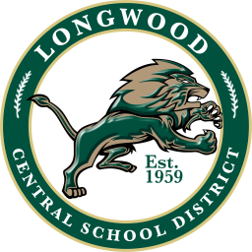




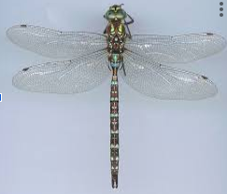
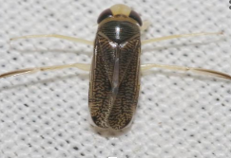
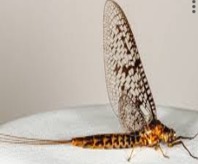
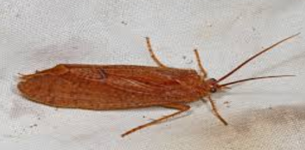
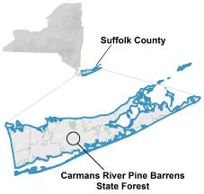
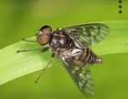
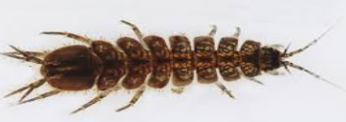
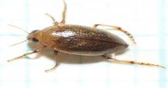
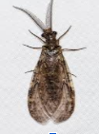

Carmans River: Macroinvertebrates
Sharika Emran¹, Faith Hinds², William Jackson³
Mentors: Noelle Oehler¹, Judith Lemire²
Longwood High School¹, Brookhaven National Laboratory ²
¹Cold Spring Harbor Laboratory’s DNA Learning Center ³, Carmans River, Brookhaven NY ⁴.
Abstract
Results
In September, specimen were obtained from Carmans River by the Environmental class. The samples were documented and they were visually identified in terms of their possible species, family, and order of the specimens by comparing them. DNA barcoding methods such as Gel electrophoresis and PCR (Polymerase Chain Reaction) at the Cold Spring Harbor and the Open Lab at Brookhaven National Laboratory to precisely identify the species of the specimens. The sequencing information was then used to infer the presence of wastes or contaminants in Carmans River, the biodiversity, or any invasive or non-native species and with research, the results were that all species are native.
SJC-001F
Aeshna Umbrosa
NATIVE
SJC-002
Trichocorixa Borealis
NATIVE
Aeshna Umbrosa
Trichocorixa Borealis
Ephemera Simulans
SJC-003
Ephemera Simulans
NATIVE
SJC-004
Ptilostomis Ocellifera
NATIVE
SJC-005
Chauliodes Sp
NATIVE
Ptilostomis Ocellifera
Atherix Variegata
Introduction
SJC-007
Atherix Variegata
NATIVE
SJC-008
Haliplus Immaculicollis
NATIVE
The Carmans River is a hybrid river with both freshwater and saltwater; The river mixes with the Great South Bay (1). The area of interest is to detect invasive or native species that entered the Carmans River. Resources were used to provide information and pictures of invasive or native organisms and invertebrate species in the Carmen’s River to provide a deeper specificity in sample collection, as shown in our results.
SJC-010
Caecidotea Racovitzai
NATIVE
Caecidotea Racovitzai
Haliplus Immaculicollis
Chauliodes Sp
Discussion
There is a great variation in the types of species found within Carmans River. Native species such as Aeshna Umbrosa and Atherix Variegata were found to be present in the river. The results from the DNA sequencing identified these eight species to be native to North America, including Long Island. Our findings, identifying eight native species to the Carmans River shows that it is unlikely that there is any risks of harm towards our local environment as there are no invasive species. As for future studies, samples could be collected at different times of year to evaluate how different seasons and temperatures affect the presence of invasive and native species. Additionally, samples can be collected in different regions of the Carman River to assess if select species are present in specific parts of the river.
Materials and Methods
Microscope
Plastic spoon
Paint brush
Petri dish
Glass jars
Hand collecting is a direct method of capturing insects using gloves, forceps, or small containers. This method allows for the targeted collection of individual insects observed on surfaces, vegetation, or in shallow water
Acknowledgements
References
Macroinvertebrate samples were collected, processed, and labeled by name to ensure each specimen could be identified correctly throughout the experiment. The samples had been grounded up for DNA extraction, where genetic material was isolated from the organisms. After the extraction, PCR (polymerase chain reaction) had been performed using primer to amplify the target DNA region. The amplified DNA samples ran through gel electrophoresis to confirm successful amplification and visualized the DNA bands. The samples were coated and processed by BNL for sequencing and analysis which allowed us to compare the DNA results and identify the macroinvertebrate species present.
We extend our gratitude to Cristina Fernandez Marco from the Cold Spring Harbor Laboratory Dolan DNA Learning Center,
Amanda Horn from Brookhaven National Laboratory

