Slide 1
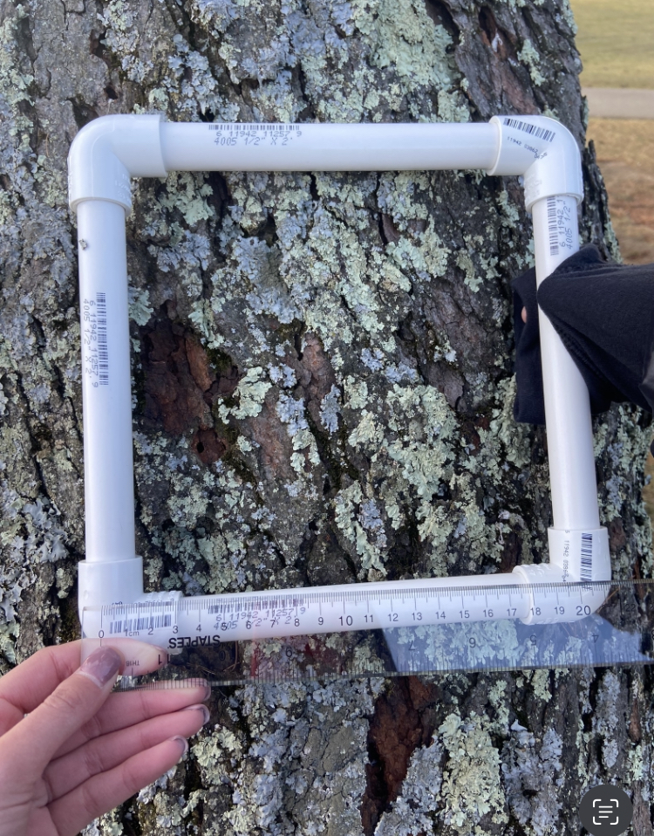
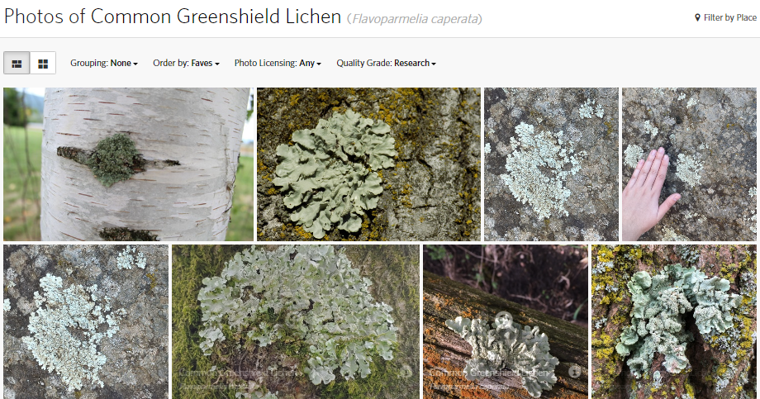
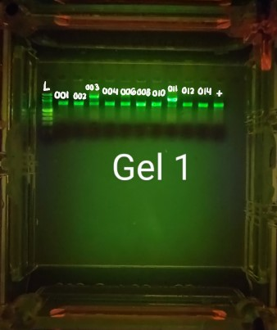
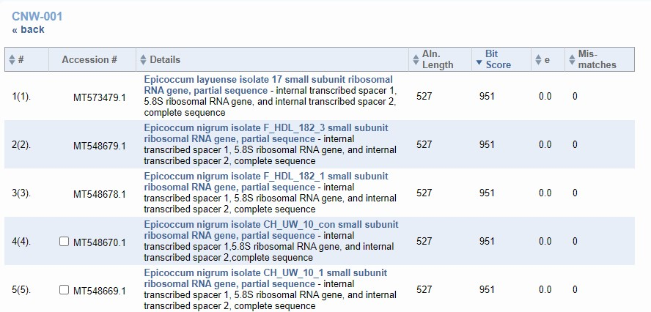
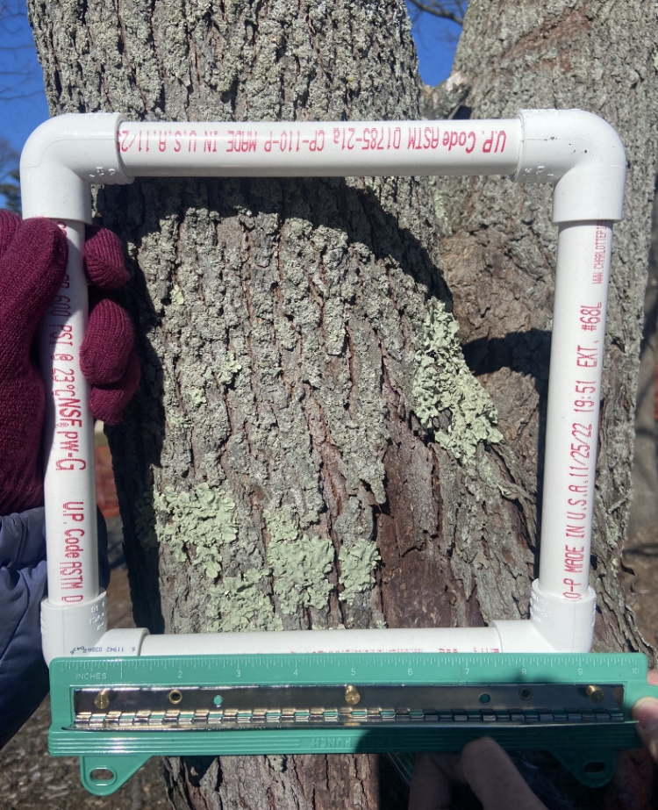
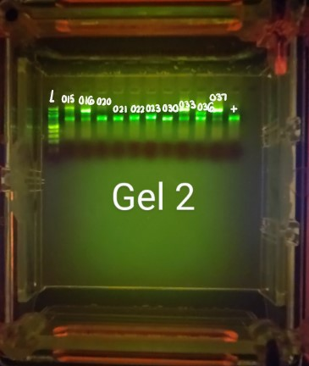
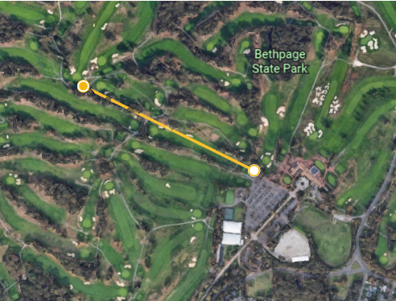
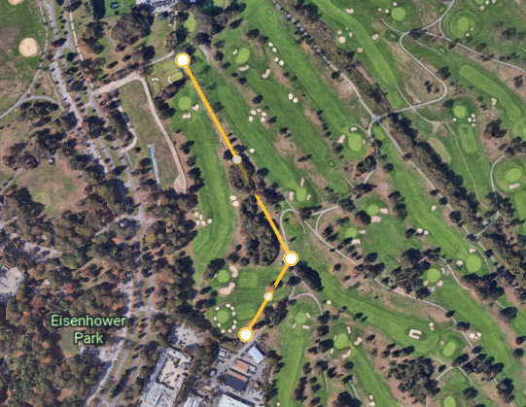
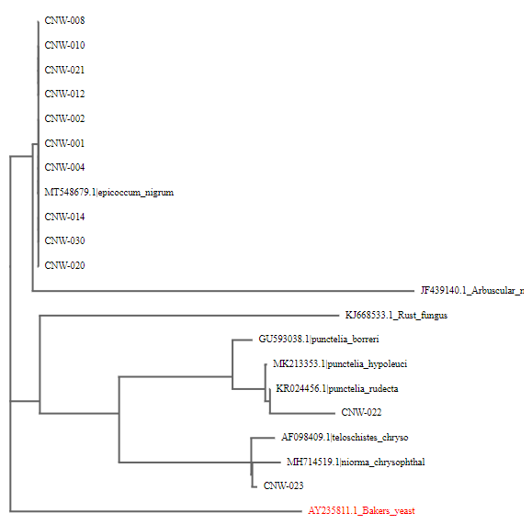
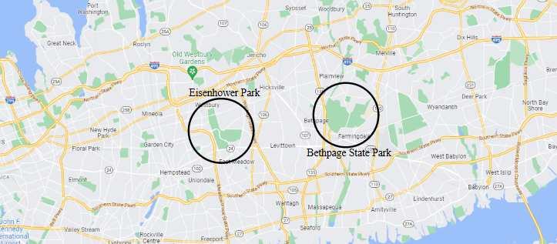
ABSTRACT
The Effect of Air Quality on the Biodiversity of Lichens on Long Island
Lichens are commonly used as indicators for pollution because of changes of lichen species in the presence of pollutants. The goal of this study was to determine the effect of air quality on the biodiversity of lichens on Long Island. 20 lichen samples were collected from Eisenhower Park and Bethpage State Park. It was hypothesized that the biodiversity at Eisenhower will be greater than the biodiversity at Bethpage because Bethpage has a lower air quality index than Eisenhower. The samples were scraped from trees and taken back to the laboratory to visually identify the samples using their physical features as well as identify them genetically with DNA barcoding. Initial results based on physical features indicated no difference in the biodiversity values of the two parks. After PCR, this conclusion was reinforced due to the low diversity in sequence samples. The results showed that 11 of the 12 samples matched a fungi of the genus, Epicoccum and the one different matched a lichen with the genus, telochistes.
Katy Gottlieb, Gabriella Ramirez, & Kate Santoli
Mentor: Stoycho Velkovsky
METHODS
Sample Collection
Visual Identification & Data Analysis
DNA Extraction & Amplification
Barcoding & Species Identification
DISCUSSION
No statistically significant difference between biodiversity values determined through visual identification
Limited air quality data - only had the inhalable Pm_{2.5} data
Limited sampling locations and surface types could have limited biodiversity
No biodiversity difference determined by barcoding because the samples were almost all identified as Epicoccum
Epicoccum is a fungi found on lichen, so all our lichens could have been infected
Figure 4: Quadrat 1 at Eisenhower Park
Figure 8: PCR Results for ITS Gene Amplification
Figure 10: Sample CNW-010 in consensus editor
BACKGROUND
Figure 6: Common Greenshield Lichen on iNaturalist.
Lichens are good indicators of pollution
Grow best in areas with clean air
Sensitive to the effects of air pollution
Biodiversity helps with biomonitoring
Some species are more sensitive
Diversity of species inversely related to pollutants
$$D=1−\frac{\sum{n\left(n−1\right)}}{N\left(N−1\right)}$$
Figure 7: Simpson’s Diversity Index Equation
Figure 5: Quadrat 9 at Bethpage State Park
Figure 9: PCR Results for ITS Gene Amplification
Figure 11: Sample CNW-001 in BLASTN
RESULTS
ACKNOWLEDGEMENTS
Figure 12: The Simpson’s Diversity Index of Eisenhower Park and Bethpage State Park
Figure 14: Cladogram of the lichen species after DNA barcoding
We would first like to thank the park rangers at Bethpage State Park. For all your time and effort in helping us collect our lichen we highly appreciate it. Furthermore, for the staff at Cold Spring Harbor Laboratory in Brooklyn thank you for teaching us the principles of DNA Barcoding.
Figure 1: Map of Eisenhower Park with Transect Line
Figure 2: Map of Bethpage State Park with Transect Line
REFERENCES
Ambient Air Quality Report 2021, (N.Y. 2021).
Cold Spring Harbor Laboratory. (2018). Using DNA barcodes to identify and classify living things. DNA Barcoding 101. Retrieved May 30, 2023, from https://dnabarcoding101.org/files/using-dna-barcodes.pdf
DNA Learning Center. (n.d.). Suggested sampling techniques. DNA Barcoding 101 Resources. Retrieved March 14, 2023, from https://dnabarcoding101.org/files/Suggested-Organism-Sampling-Techniques.pdf
Encyclopedia Brittanica. (2023, May 12). Lichen. Brittanica. Retrieved May 30, 2023, from https://www.britannica.com/science/lichen
Mount Ranier, National Park Washington. (2020, January 31). Fruticose lichens. National Park Service. Retrieved May 30, 2023, from https://www.nps.gov/mora/learn/nature/fruticose-lichens.htm
Nash III, T. H. (1976). Lichens as indicators of air pollution. Naturwissenschaften.
National Park Service. (2017, December 27). Lichens and air quality. Nps.gov. Retrieved March 14, 2023, from https://www.nps.gov/articles/lichens-and-air-quality.htm
Pollution indicator species: Lichen & invertebrates. (n.d.). School Work Helper. Retrieved May 30, 2023, from https://schoolworkhelper.net/pollution-indicator-species-lichen-invertebrates/
Suman, S. (n.d.). Lichens: Types and general characteristic. College Dunia. Retrieved May 30, 2023, from https://collegedunia.com/exams/lichens-types-and-general-characteristics-biology-articleid-1645
U.S. Forest Service. (n.d.). About lichens. Fs.usda.gov. Retrieved May 30, 2023, from https://www.fs.usda.gov/wildflowers/beauty/lichens/about.shtml
What does nitrogen oxide and sulfur dioxide make? (2019, December 10). Teachers Colleges J. Retrieved May 30, 2023, from https://teacherscollegesj.org/what-does-nitrogen-oxide-and-sulfur-dioxide-make/#:~:text=Acid%20rain%20is%20caused%20by%20industrial%20emissions%20of,comes%20from%20the%20burning%20of%20coal%20and%20oil.
What do lichens eat? (2022, August 9). Outdoor Moss. Retrieved May 30, 2023, from https://outdoormoss.com/what-do-lichens-eat
Wilson, J.-J., Sing, K.-W., & Jaturas, N. (2018). DNA barcoding: Bioinformatics workflows for beginners. Science Direct, 985-995.
Figure 13: Sequences compared to ITS reference data in alignment viewer
Figure 3: Map of Long Island with Eisenhower Park and Bethpage State Park labeled
Chosen because they’re both in the middle of Long Island, are used for the same purposes, and are located near air quality monitoring stations

