Slide 1
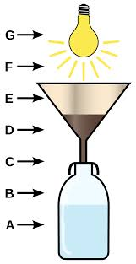
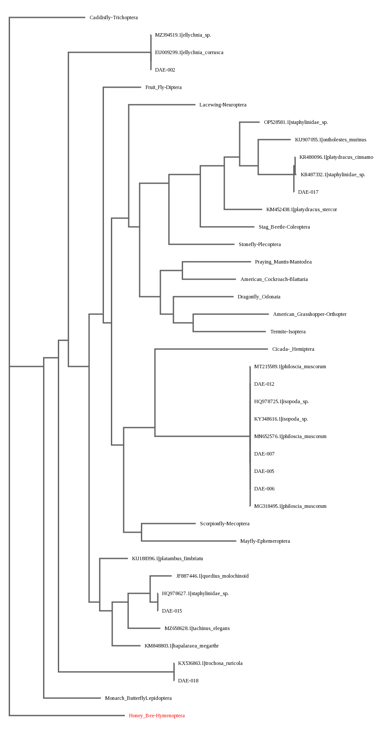
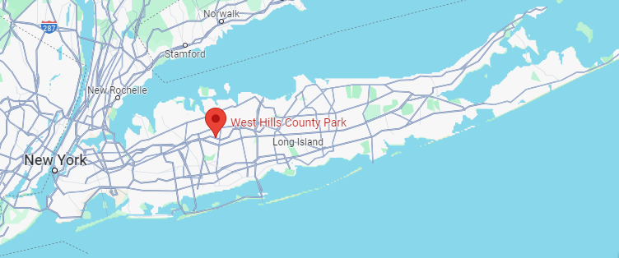
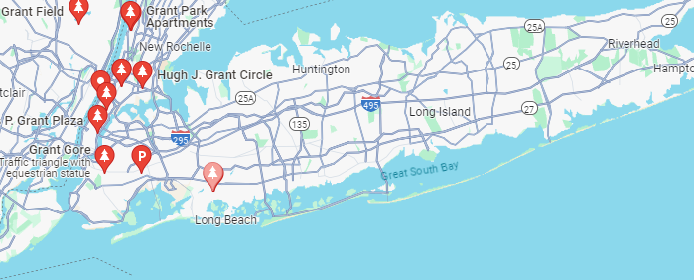
Evaluating the Effect of Topography on the Biodiversity of Beetles on Long Island using DNA Barcoding
Cathlyne Cueto, Elin Kim, Sofia Michelakos, Lara Vardar
Mr. Stoycho Velkovsky
Abstract
Discussion
Our research sought to investigate the effect of types of topographies, specifically varying elevations, on the biodiversity of beetles. Soil and leaf litter samples with beetles were collected from two locations: West Hills County Park, and Grant Park; the former is toward the north shore of Long Island and the latter is toward the south shore. After collecting soil and leaf litter samples, we obtained insects using the Berlese funnel method. The biodiversity was found using the method of DNA barcoding. We also utilized the Simpson’s biodiversity index formula for each location. Ultimately, our findings suggested a higher biodiversity of beetles in areas with higher elevation.
Materials and Methods
Due to the lack of beetles that were collected from our locations, we incorporated other insects into our calculated biodiversity.
West Hills County Park had a higher biodiversity, consisting of a firefly, a jumping spider, isopods, ground beetles, and a slug.
Grant Park had a lower biodiversity, consisting of mostly millipedes and spiders.
As the topography of the north shore has more hills and mounts, it can be inferred that insects inhabiting Long Island prefer and are more tolerant to higher elevations.
Collect soil and leaf litter from each location.
West Hills County Park: altitude of 122.19 m
Grant Park: altitude of 1.67 m
Figure 1: Berlese funnel
Berlese Funnel Method
Grind insects, add lysis solution, centrifuged tubes, and add silica resin to complete DNA extraction.
Gel electrophoresis. Send successful PCR to the laboratory to be sequenced.
Materials and Methods
References
Introduction
Figure 2: Phylogenetic tree
Figure 3: Sequences
Asian longhorned beetle (ALB). (n.d.). NYS Department of Environmental Conservation. Retrieved October 19, 2023, from https://www.dec.ny.gov/animals/7255.html#:~:text=The%20Asian%20longhorned%20beetle%2C%20(Anoplophora,poplar%2C%20horsechestnut%2C%20and%20willow.
Coblentz, D. D., & Ritters, K. H. (2004, June 7). Topographic controls on the regional-scale biodiversity of the south-western USA. Wiley Online Library. Retrieved October 19, 2023, from https://doi.org/10.1111/j.1365-2699.2004.00981.x
Common Beetles in Long Island. (n.d.). Arrow Exterminating Company. Retrieved October 19, 2023, from https://arrowexterminating.com/pest-info/beetles/
Entomology Section, Dept. of Systematic Biology. (n.d.). Beetles (Coleoptera). Smithsonian. Retrieved October 19, 2023, fromhttps://www.si.edu/spotlight/buginfo/beetle#:~:text=Many%20are%20on%20the%20ground,and%20a%20few%20are%20parasitic.
GISGeography. (2023, July 11). What is topography? A definitive guide. GISGeography. Retrieved October 19, 2023, from https://gisgeography.com/what-is-topography/
Ionescu, A. (2023, June 19). Beetle diversity is influenced by energy stored in dead wood. Earth.com. Retrieved October 19, 2023, from https://www.earth.com/news/beetle-diversity-is-influenced-by-energy-stored-in-dead-wood/
Johnson, M. P., Frost, N. J., Mosley, M. W. J., & Hawkins, S. J. (2003, January 14). The area-independent effects of habitat complexity on biodiversity vary between regions. Wiley Online Library. Retrieved October 19, 2023, from https://doi.org/10.1046/j.1461-0248.2003.00404.x
The Terminix International Company. (2023). Where do beetles live if they get in your home? Terminix. Retrieved October 19, 2023, from https://www.terminix.com/other/beetles/behavior/where-do-beetles-live/#:~:text=Unfortunately%2C%20this%20explains%20why%20they,flats%2C%20meadows%20and%20rain%20forests
Using DNA Barcodes to Identify and Classify Living Things. (2014). DNA Barcoding 101. Retrieved May 24, 2024, from https://dnabarcoding101.org/files/using-dna-barcodes.pdf
Beetles
Insect
400 known species
Heavily rely on their habitat and evolve over time to survive in their environment.
Topography
The study of land features, such as elevation
Elevation is higher toward the north shore of Long Island, and lower toward the south shore.
Previous studies
Suggests that topography significantly influences biodiversity from a regional to continental scale.
Goal
RQ: What is the effect of topography on the biodiversity of beetles?
Hypothesis: Locations with lower elevations will have a higher biodiversity of beetles.
DAE-18: spider
DAE-002: winter firefly
DAE-006, 005, 007, 012: common striped woodlouse
DAE-017, 015: rove beetle
Figure 4: West Hills
Figure 5: Grant
Acknowledgements
We would like to thank Mr. Velkovsky, as well as Cold Spring Harbor Laboratory for providing us with materials for us to execute the DNA barcoding process for our study.

