Slide 1
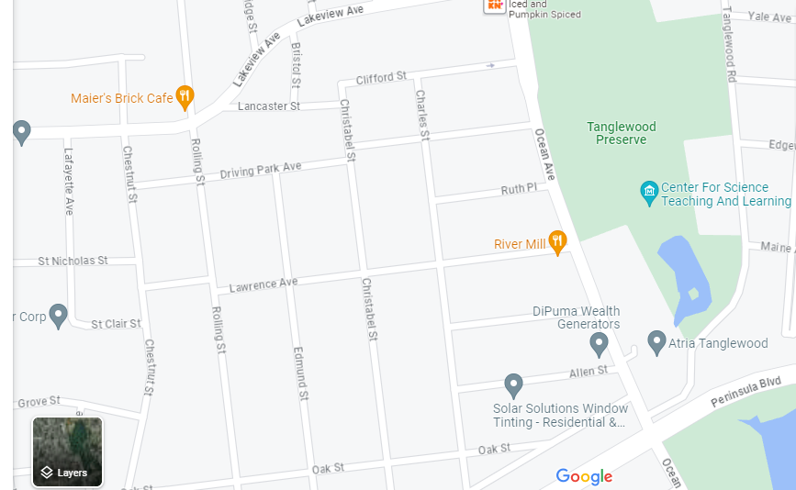
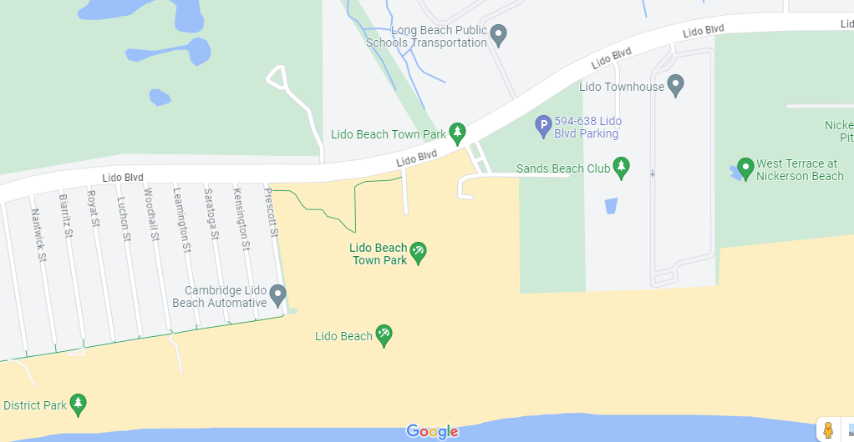
The Effect of Soil Salinity and Moisture on the Biodiversity of Coleoptera on Long Island
Ashian Islam, Blake Jaworowski and Mentor Stoycho Velkovsky
Abstract
For our experiment we had decided to collect Coleoptera, more commonly known as beetles for barcoding. During the Course of our experiment samples were collected from both Lido Beach Park and Tanglewood preserve. Unfortunately, due to time and material constraints we were unable to complete the experiment. Though Unsuccessful our experiment showed from our collections that areas with less soil salinity did not impact the population diversity of the area due to lack of samples in both areas.
II. Introduction
The Coleoptera Species also known as the beetle are breed of insects that can live in many different climates and conditions. Population can be found more densely on different types of soils, that broad assumption has never been specifically tested.
This study will cover the bases of effects from soil moisture and salinity on the effect of beetle population. Previous studies have shown that salt generally does not have a positive effect on population density (ScienceDirect, 2013).
The experiment will show if these two soil properties genuinely have an effect on the population density of the Coleoptera species.
Hypothesis: Extensive research shows that many different species can have an irregular immunity to salinity and moisture factors(NIH, 2013) which leads us to believe that soil moisture and salinity will have no effect on the biodiversity of Coleoptera on Long Island.
The Coleoptera species mainly obtain all nutrients through plants, seeds, fruit or, wood (Umich, 2020) and with their diet consisting of things with very little salt and water content the soil is most likely where they receive those bodily contents.
The Coleoptera is the largest describes species of insects with over 250,000 different species in its order (UNL, 2021). It is assumed that for every person on earth there are 1.4 billion insects (ROYESC, 2022) it is also assumed that beetles make up 25% of all living organisms on earth.
III. Materials & Methods
Berlese Funnel was used to collect some of the insect samples in the experiment.
A Berlese Funnel uses a heat source to dry out the soil sample forcing insects to travel to the bottom where they are preserved in a fluid such as ethanol alcohol (Berlese Funnel).
Insect samples were also handpicked due to the inefficiency of the Berlese Funnel method.
Materials used included leaf litter from 2 separate places, Lido Beach State Park and Tanglewood Preserve. These two places differ from each other as Lido Beach is closer to the water. Other materials like ethanol alcohol, plastic bags, and mini plastic tubes to store each insect individually
Tanglewood Preserve
Lido Beach Town Park
IV. Results
Results were limited because we did not have enough primers, which helps copy an exact copy of DNA, because of this the samples could not be barcoded. As well our lack of samples ultimately effected the accuracy of the data on diversity. From our seven samples, we got one beetle along with three spiders and three worms.
V. Discussion
The Objective of this project was to determine if soil moisture and salinity had any played factor in the biodiversity of Coleoptera on Long Island we were not able to individually determine that due to insufficient results and testing. Other testing regarding the same study in different countries have been conducted and in these studies scientists find that there is variability in population sizes along with change in salinity and moisture (Thotagamuwa, 2019).
This study could relate to our due to it’s sheer similarities but they are differences like the climates they were conducted in. We faced some challenges during the course of experiment like low sample counts and insufficient materials
VI. References
the berlese funnel. (n.d.). Soil Science Society of America. https://www.soils.org/
Cespedes, V., Pallares, S., Arribas, P., Millan, A., & Velasco, J. (n.d.). Water beetle tolerance to salinity and anionic composition and its relationship to habitat occupancy. Pub Med. https://pubmed.ncbi.nlm.nih.gov/23973816/
Cespedes, V., Pallares, S., Arribas, P., Millan, A., & Velasco, J. (2013). Water beetle tolerance to salinity and anionic composition and its relationship to habitat occupancy. Insect Physiology. https://www.sciencedirect.com/science/article/abs/pii/S0022191013001777
Myers, P., Espinosa, R., & Parr, C.S. (2020). Coleoptera. Animal Diversity Web. Retrieved December 6, 2023, from https://animaldiversity.org/critters/Coleoptera/
Order Coleoptera- Beetles. (2021). Department of Entomology. https://entomology.unl.edu/order-coleoptera-beetles
Organic Matter - Loss-On-Ignition Method. (2023). UC Davis Analytical Lab. https://anlab.ucdavis.edu/analysis/Soils/415#:~:text=This%20method%20semi%20quantifies%20the%20amount%20of%20oxidizable,a%20muffle%20furnace%20for%202%20hours%20at%20360%C2%B0C.
Soil Quality Indicators: Measures of Soil Functional State. (2011, September 19). Soil Qaulity. Retrieved December 6, 2023, from http://soilquality.org/indicators.html
Thotagamuwa, A. (n.d.). The effects of incident microclimatic and soil parameters on the population sizes of selected tiger beetle species in Sri Lanka. https://www.researchgate.net/profile/Nirmalie-Pallewatta/publication/337062151_The_effects_of_incident_microclimatic_and_soil_parameters_on_the_population_sizes_of_selected_tiger_beetle_species_in_Sri_Lanka/links/60c5dc3c299bf1949f54efec/The-effects-of-incident-microclimatic-and-soil-parameters-on-the-population-sizes-of-selected-tiger-beetle-species-in-Sri-Lanka.pdf
Notes:
IMPORTANT– posters should contain all of the information in this template, but do not need to be organized in this exact format. Posters with descriptive images and figures are preferred over text-heavy posters. Results do not need to be contained to the highlighted “Tables & Figures” box.

