Slide 1
Your BLI Summary Report title
Your names (in alphabetical order) & your mentor’s name
Institutional affiliations for each author
Tables & Figures
For example: Map of GPS coordinates where samples were collected
Pie charts to showing types/numbers of samples analyzed
Table of BLAST search results
Phylogenetic trees (using different methods)
Table showing sequence similarities among/within species or populations
Figure linking the sample localities with their placement in the phylogenetic tree
Please limit poster text – figures, charts, pictures, diagrams, tables, etc., make for a better poster
Abstract
A succinct summary of your project.
The abstract from your summary report can also be used as the abstract for your poster.
Introduction
What question was asked? This section provides background for the reader so that they can understand the precise question you are asking, and why your study is of scientific interest. Use your summary report's Introduction to develop the Introduction on your poster. On your poster you can add more details and better justify your research question.
Materials & Methods
How was the question answered? Use your summary report's Materials and Methods to develop this section and provide details of any modifications to the original protocol.
Results
What did you find? Show results for each one of the different experimental groups you mentioned in the Materials and Methods section.
Discussion
How does this answer your question? What do these findings mean? Be objective in the interpretation of your results. Avoid making judgments. Remember, openly discussing unexpected results, difficulties, or mistakes is central to the scientific process.
References
Document and credit all the sources of information you used for your project at the bottom of your poster. Whenever you state a fact that is based on the results of someone else’s research, you must cite their work in the proper format.
Acknowledgements
Thank people/organizations that assisted them in doing the research. These can include collaborators, funders and reviewers.
Notes:
IMPORTANT– posters should contain all of the information in this template, but do not need to be organized in this exact format. Posters with descriptive images and figures are preferred over text-heavy posters. Results do not need to be contained to the highlighted “Tables & Figures” box.

Slide 2
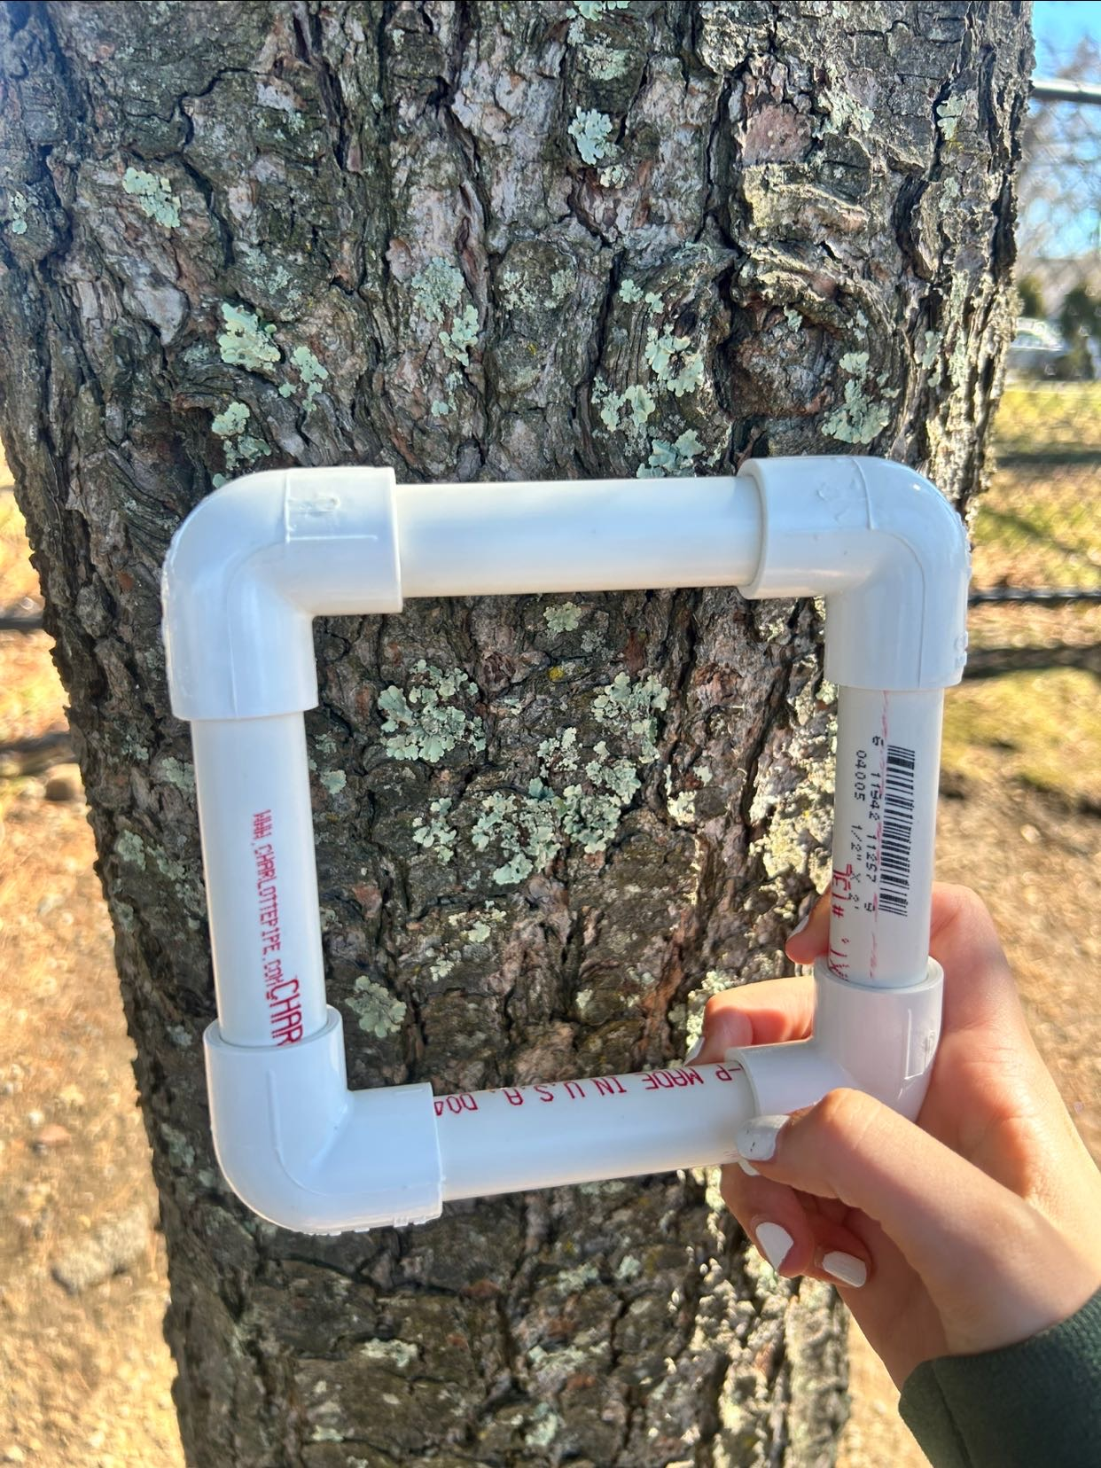
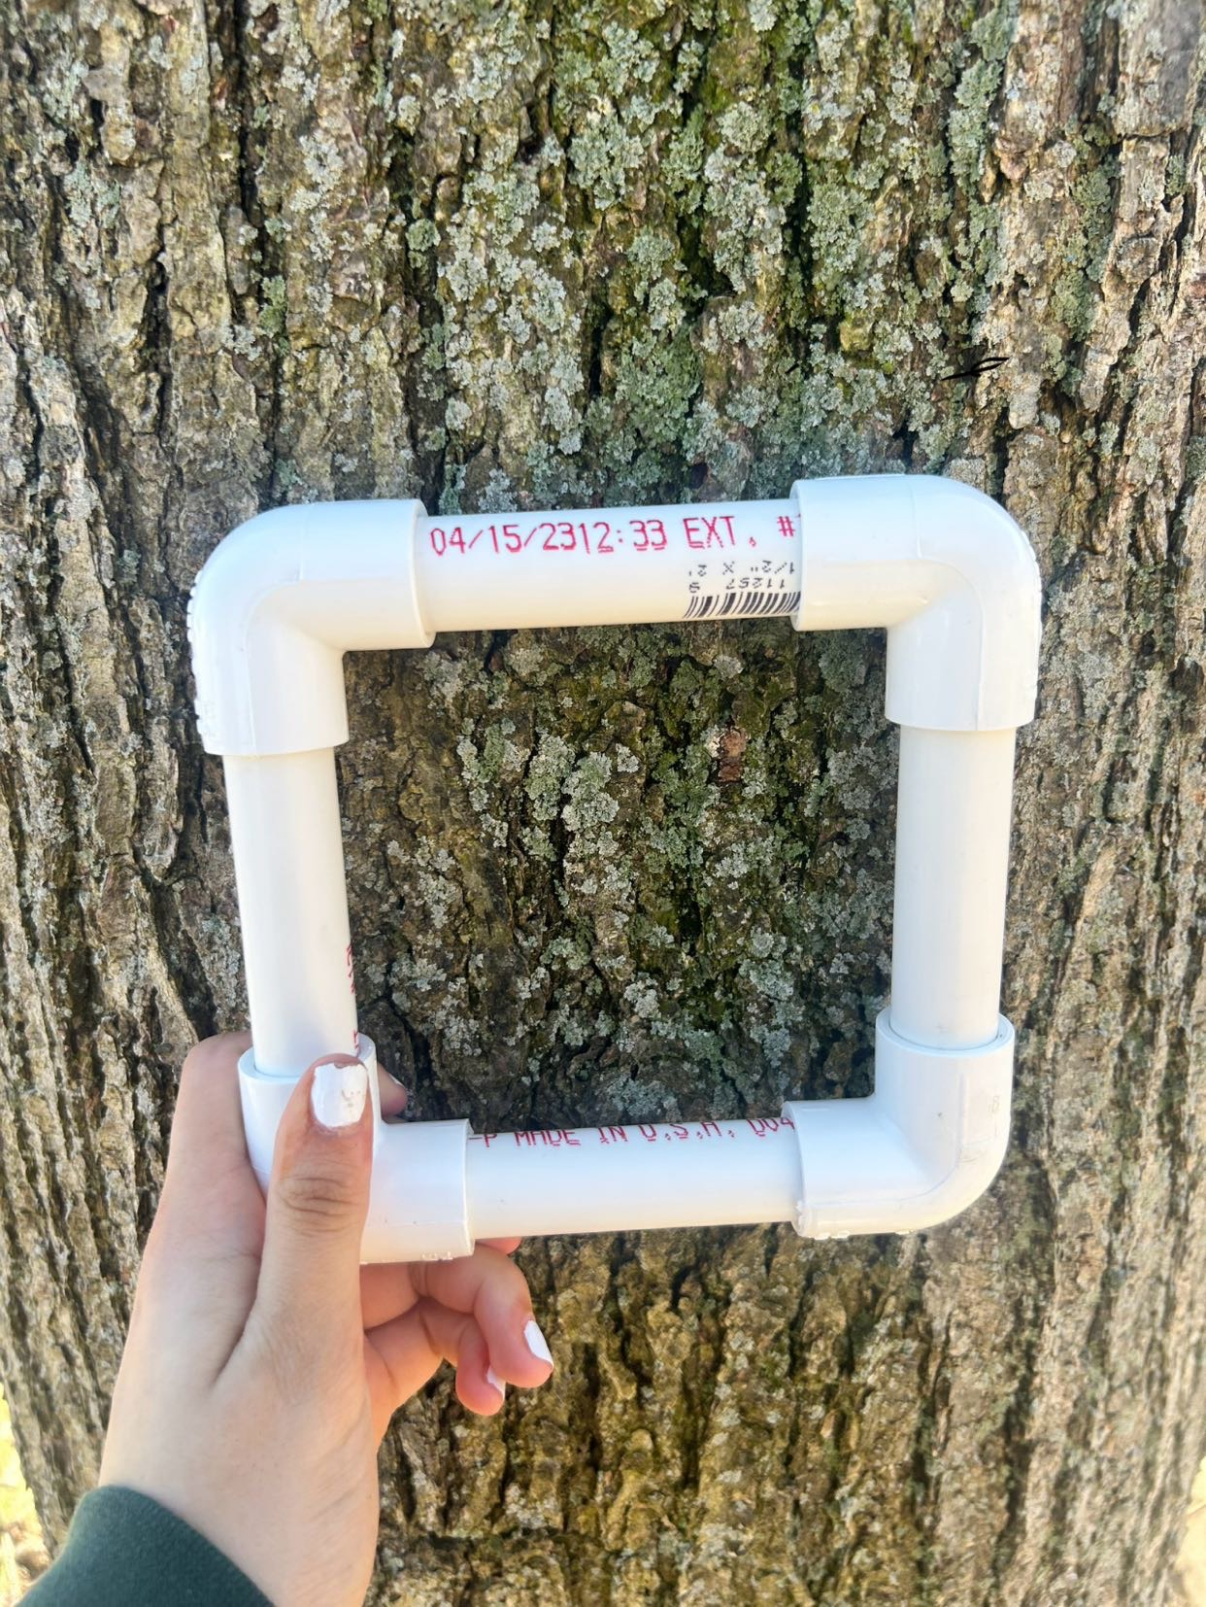
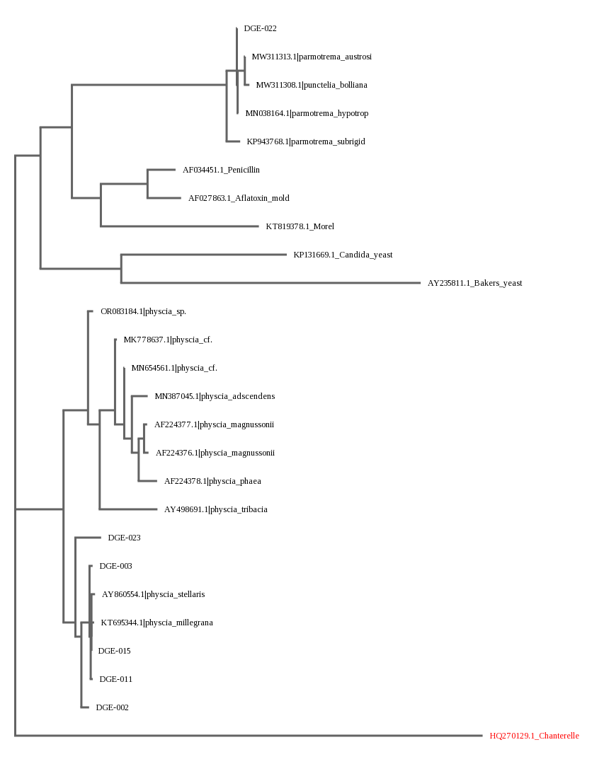
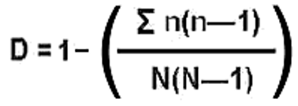
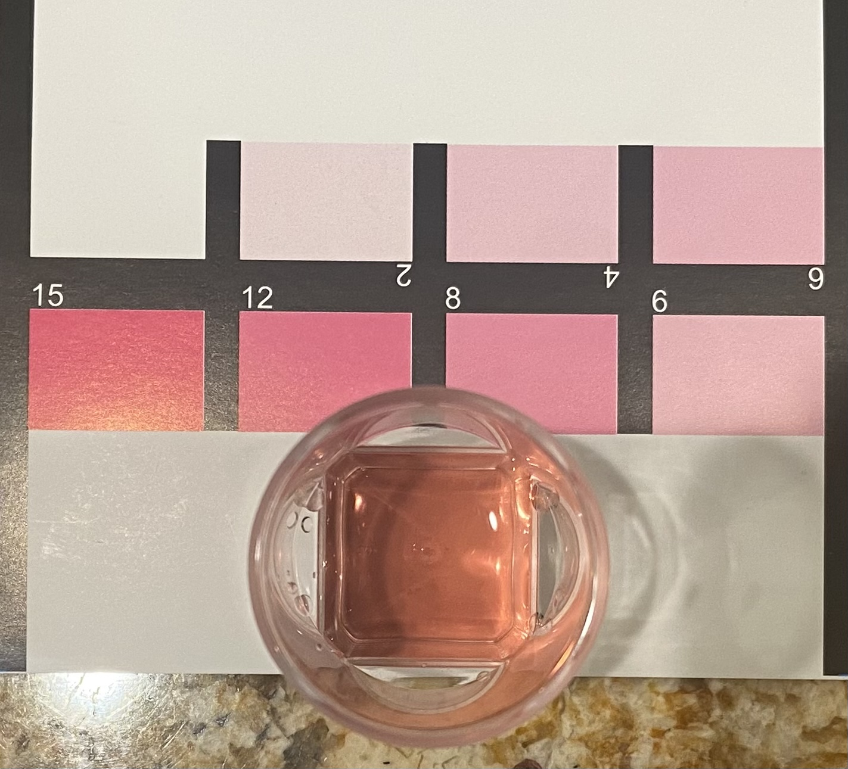
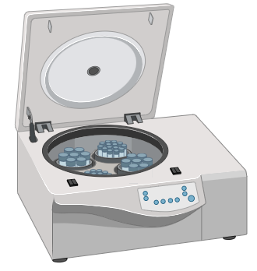
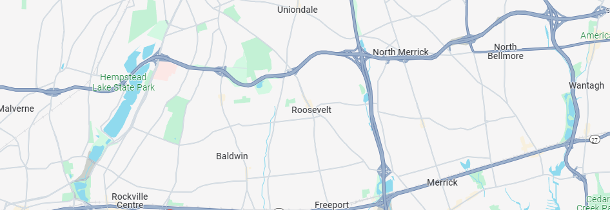
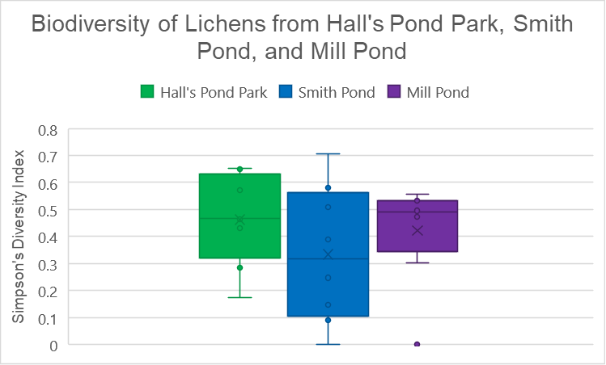
Introduction
Lichens are believed to be bioindicators which means that their health serves as an indicator of the overall health of an environment (NYBG, 2022). Additionally, they have been used in air quality studies because they can absorb pollutants (NYBD, 2022). Factors being taken into consideration: Water sites being close to major roads/highways – gas emissions, oil spills, etc. The presence of volatile organic compounds, or VOCs, which are compounds that have a high vapor pressure and low water solubility, and they are common-ground water contaminants (United States Environmental Protection Agency, n.d.) Water sprays during certain weather circumstances We hypothesized that proximity to polluted water will likely decrease lichen diversity at all selected sites. Assays: PH Nitrate content Nitrite content Carbonate & Dissolved oxygen
The Effect of Proximity to Polluted Water on the Biodiversity of Lichens on Long Island
By Ella Carroll, Dilnoor Nijjar, and Leah Pisano
Results cont’d
Figure 10: Results of ANOVA test measuring P-value for Simpson’s Diversity Index (data listed in Figure 7). Made using DataClassroom
Materials and Methods cont’d
Sampling
Data Analysis
Figure 11: Results of post-hoc Turkey test. Made using DataClassroom
Compared images to ones of lichens on ¡Naturalist
Analyzed physical characteristics
# of species = richness
Simpson’s Diversity Index
Figure 3: Quadrat 7 from Hall’s Pond Park
Figure 4: Quadrat 4 from Mill Pond
Took 8 samples from 8 different trees at each site
Collected samples in 15-foot intervals from water and previous tree
Held quadrat up to trees and took picture before sampling
Used spatula to scrape lichen samples off trees
Recorded data (results displayed in Data Tables below)
Collected water samples
Used test strips to test for four assays
Used dissolved oxygen test kit
Figure 5: Formula for Simpson’s Diversity Index
Figure 12: Tree of DNA results made from the BLAST using DNA Subway. Features all of the species that align with the sequence of DNA that was processed and ran through a database
Figure 6: Example of dissolved oxygen test for water sample from Smith Pond
Figure 1: Test strips used to measure pH, Nitrate content, Nitrite content, Carbonate Hardness, General Hardness, and Dissolved Oxygen
We then followed PCR protocols in order to isolate desired sequences of DNA
Figure 7: Example image of centrifuge used for PCR protocols. Made using BioRender
Figure 8: Image of gel electrophoresis gel of samples DGE-001 to DGE-009. Only 5 of the sequences were successful, which can be interpreted to have altered the results.
Discussion
Limitations: Could not always meet goal of taking samples in 15-foot intervals Possibility for inaccurate species identification Limited sampling locations (only in Nassau County) Future Research: Collect samples on transect line Analyze proximity to major roads Pick all sites that are densely populated with trees Make a more accurate water quality scale
Materials and Methods
Collection: Pre-labeled microcentrifuge Test tubes Testing strips Dedicated pipettes Gloves Parafilm Quadrats Spatula
PCR:
ITS primer pairs
Lysis buffer
Microcentrifuge tubes
Centrifuge
Micro-pipettes
Results
tubes
Hall’s Pond Park
Smith Pond
Mill Pond
Quadrat # | Richness | Total Abundance (N) | Diversity Index
1 | 2 | 24 | 0.43115942
2 | 3 | 46 | 0.650241546
3 | 2 | 7 | 0.571428571
4 | 3 | 20 | 0.652631579
5 | 2 | 10 | 0.466666667
6 | 3 | 32 | 0.284274194
7 | 2 | 22 | 0.173160173
8 | 3 | 8 | 0.464285714
Quadrat # | Richness | Total Abundance (N) | Diversity Index
1 | 2 | 22 | 0.246753247
2 | 2 | 26 | 0.147692308
3 | 2 | 9 | 0.388888889
4 | 3 | 48 | 0.581560284
5 | 2 | 43 | 0.090808416
6 | 1 | 19 | 0
7 | 3 | 15 | 0.704761905
8 | 2 | 38 | 0.507823613
Quadrat # | Richness | Total Abundance (N) | Diversity Index
1 | 3 | 14 | 0.472527473
2 | 2 | 39 | 0.302294197
3 | 1 | 44 | 0
4 | 2 | 21 | 0.495238095
5 | 2 | 10 | 0.555555556
6 | 2 | 10 | 0.533333333
7 | 2 | 10 | 0.533333333
8 | 2 | 22 | 0.484848485
References
About lichens. (n.d.). U.S. Forest Service. Retrieved November 15, 2023, from https://www.fs.usda.gov/wildflowers/beauty/lichens/about.shtml Chang, J. C., & Hanna, S. R. (2004). Air quality model performance evaluation. Meteorology and Atmospheric Physics, 87(1-3). https://doi.org/10.1007/s00703-003-0070-7 Five fun facts about lichen. (2016, March 3). Deschutes Land Trust. Retrieved November 15, 2023, from https://www.deschuteslandtrust.org/news/blog/2016-blog-posts/five-fun-facts-about-lichen Kress, W. J., & Erickson, D. L. (2008). DNA barcodes: Genes, genomics, and bioinformatics. Proceedings of the National Academy of Sciences, 105(8), 2761-2762. https://doi.org/10.1073/pnas.0800476105 Lendemer, J. C., Harris, R. C., & Ruiz, A. M. (2016). A review of the lichens of the dare regional biodiversity hotspot in the mid-atlantic coastal plain of north carolina, eastern north america. Castanea, 81(1), 1-77. https://doi.org/10.2179/15-073r2 Lichens: Home. (2022, February 28). New York Botanical Garden. Retrieved October 18, 2023, from https://libguides.nybg.org/c.php?g=884442 The secret life of lichens. (2016, November 24). Cambridge Butterfly Observatory. Retrieved November 15, 2023, from https://www.cambridgebutterfly.com/the-secret-life-of-lichens/ Simpson's Biodiversity Index. (2023, July 4). Barcelona Field Studies Centre. Retrieved November 15, 2023, from https://geographyfieldwork.com/Simpson'sDiversityIndex.htm What are volatile organic compounds (VOCs)? (2023, March 15). United States Environmental Protection Agency. https://www.epa.gov/indoor-air-quality-iaq/what-are-volatile-organic-compounds-vocs
Data Table 1: Biodiversity of Hall’s Pond Park
Data Table 2: Biodiversity of Smith Pond
Data Table 3: Biodiversity of Mill Pond
Hall’s Pond Park
Water Quality
Site | pH | Nitrite (mg/L) | Nitrate (mg/L) | General Hardness (mg/L) | Carbonate Hardness (mg/L) | Dissolved Oxygen (mg/L)
Hall’s Pond Park | 7 | 0 | 0 | 60 | 40 | 7
Smith Pond | 6.5 | 0.5 | 0 | 60 | 40 | 9
Mill Pond | 6.5 | 0.5 | 0 | 60 | 40 | 8
Smith Pond
Mill Pond
Figure 2: Map of Long Island with Hall’s Pond Park, Smith Pond, and Mill Pond Labeled
Data Table 4: Measurements of Water Quality at all four sites
Figure 9: The Simpson’s Diversity Index of Lichens from Hall’s Pond Park, Smith Pond, and Mill Pond

