Slide 1
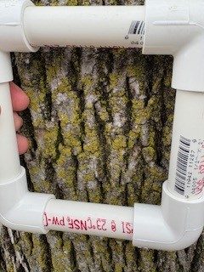
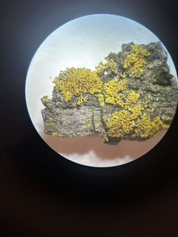
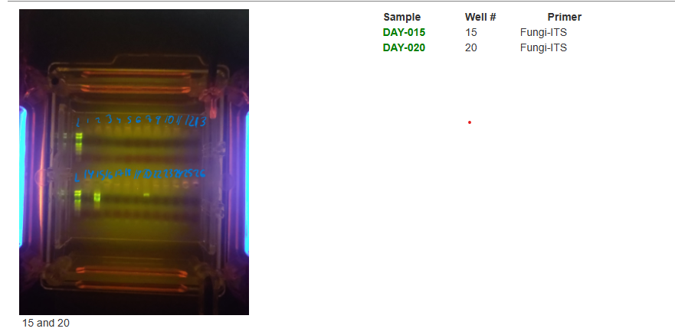
The Effect of Traffic Numbers on the Biodiversity of Lichens
Sadie Aragona, Shannon Bludoy, Olivia Ramirez, Jessie Vuotto
Mentor: Stoycho Velkovsky
ABSTRACT
MATERIALS & METHODS
DISCUSSION
Lichens are tremendously sensitive to environmental impacts, especially concerning atmospheric pollution, eutrophication, and climate change. Increases in air pollutants can poison and kill sensitive lichens. Lichens benefit humans because they trap particulate matter in the air such as dust, while simultaneously absorbing diminutive pollutants such as sulfur, mercury, and nitrogen. This experiment will take place in 3 different parks: Hempstead State Lake Park, Greis Park, and Grant Park. Roads near these parks are densely populated with cars, leading to fossil fuels burning. Bay Park will also be tested for air pollution, as it may have the least amount of air pollution. A limited number of lichens will be collected so the lichens are not removed from the environment completely. The lichens will be damped before the removal process to prevent breakage and stored in paper bags for long term storage. Pictures will also be taken to document these samples. The locations chosen to sample the lichens are Greis Park, Bay Park, Hempstead Lake State Park, and Grant Park. A silica DNA isolation technique will be used, and the ITS gene will be amplified in the PCR. The DNA sequences of the lichens will be compared to a database to determine the species identification of the samples. This will be done using gel electrophoresis. A data table will be made to correlate the location of each park and the traffic numbers in that area. A scatter plot graph will be made to determine the relationship between traffic numbers and the biodiversity of the lichens. Lastly, once the species are identified, we will be able to find out how many different species are found at each park.
Sample Collection
Visual Identification & Data Analysis
Barcoding & Species Identification
Greis Park had the lowest biodiversity
Results are all based off visual identification since only samples 15 & 20 had successful PCR
Samples collected from Grant Park, Greis Park, and Bay Park
INATURALIST was used to identify type of lichen
All samples were posted to DNA barcoding database.
DNA Extraction & Amplification
C
ACKNOWLEDGEMENTS
Sequencing request sent to Cold Spring Harbor Laboratory
Gel Electrophoresis
We would like to thank our teacher and mentor, Mr. Velkovsky, for his support and help throughout the duration of conducting this experiment! We would also like to thank the owners of each of the parks we went to, for allowing us to collect data samples!
INTRODUCTION
Figure 1: image of quadrat of our 26th sample we collected. Image taken by student researchers.
Figure 2: image of microscope of our 34th sample we collected. Image taken by student researchers.
Lichens are tremendously sensitive to environmental impacts, especially concerning atmospheric pollution, eutrophication, and climate change
Increases in air pollutants can poison and kill sensitive lichens
Lichens trap particulate matter in the air such as dust, while simultaneously absorbing diminutive pollutants such as sulfur, mercury, and nitrogen
There is a strong correlation between highways and air pollution, due to fossil fuels being burned by vehicles
The most common gases emitted by fossil fuels being burned are carbon dioxide, nitrous oxide, and carbon monoxide, which are all very toxic greenhouse gases
Air pollution harms many organisms, such as trees, since sulfur and nitrogen pollution decrease their growth and chances of survival, leading to a decrease in biodiversity
To observe the impact of air pollution on the diversity of lichens, DNA barcoding will be utilized
RESULTS
REFERENCES
2/26 Samples were approved from our sequencing request
bout Lichens. (n.d.). U.S. Forest Service. Retrieved October 1, 2024, from https://www.fs.usda.gov/wildflowers/beauty/lichens/about.shtml Asta, Juliette & Erhardt, W. & Ferretti, Marco & Fornasier, Maria Francesca. (2002). European guideline for mapping lichen diversity as an indicator of environmental stress. The British Lichen Society. 1-20. Bell, M., Quinn, E. F., & Taylor, K. (2023, December 29). How to Assess Air Pollution's Impacts on Forests. National Park Service. Retrieved October 8, 2024, from https://www.nps.gov/articles/000/how-to-assess-air-pollutions-impacts-on-forests.htm#:~:text=Declines%20in%20growth%20and%20survival,too%20can%20function%20as%20indicators.&text=Nitrogen%20and%20sulfur%20deposition%20can,which%20can%20actually%20harm%20trees. Burning of fossil fuels. (n.d.). Understanding Global Change. Retrieved October 8, 2024, from https://ugc.berkeley.edu/background-content/burning-of-fossil-fuels/#:~:text=Releasing%20the%20greenhouse%20gases%20carbon,decades%20to%20hundreds%20of%20years. Cold Spring Harbor Learning Center. (2023, September). Retrieved October 9, 2024, from https://dnabarcoding101.org/files/using-dna-barcodes.pdf Hempstead Lake State Park. (n.d.). Parks, Recreation, and Historic Preservation. Retrieved October 9, 2024, from https://parks.ny.gov/parks/hempsteadlake#:~:text=Pet%20Policy:%20A%20maximum%20of,produced%20if%20requested%20by%20staff. How is air quality measured? (2022, September 22). UN Environment Programme. Retrieved October 9, 2024, from https://www.unep.org/news-and-stories/story/how-air-quality-measured#:~:text=Air%20quality%20monitors%20are%20outfitted,or%20emitted%20by%20the%20Earth. Kress, W. J., & Erickson, D. L. (2012). DNA barcodes: methods and protocols. Methods in molecular biology (Clifton, N.J.), 858, 3–8. https://doi.org/10.1007/978-1-61779-591-6_1 Kress, J. W., & Erickson, D. L. (2008, February 19). DNA barcodes: Genes, genomics, and bioinformatics. National Library of Medicine. Retrieved October 7, 2024, from https://www.ncbi.nlm.nih.gov/pmc/articles/PMC2268532/ Lichen Collection and Identification. (n.d.). U.S. Forest Service. Retrieved October 8, 2024, from https://www.fs.usda.gov/wildflowers/beauty/lichens/identification.shtml#:~:text=Wet%20the%20lichen%20first%20to,paper%20bag%20or%20paper%20envelopes. Lichen - The Little Things That Matter. (2018, May 21). National Park Service. Retrieved October 1, 2024, from https://www.nps.gov/articles/lichen-and-our-air.htm#:~:text=Lichen%20trap%20particulate%20matter%20in,air%20for%20us%20to%20breathe. Lindsey, R. (2024, April 9). Climate Change: Atmospheric Carbon Dioxide. Climate.gov. Retrieved October 8, 2024, from https://www.climate.gov/news-features/understanding-climate/climate-change-atmospheric-carbon-dioxide#:~:text=Without%20carbon%20dioxide%2C%20Earth's%20natural,causing%20global%20temperature%20to%20rise. Near roadway air pollution and health: frequently asked questions. (2014). EPA. Retrieved October 2, 2024, from https://www.epa.gov/sites/default/files/2015-11/documents/420f14044_0.pdf Overview of Greenhouse Gases. (2024, April 11). United States Enviornmental Protection Agency. Retrieved October 8, 2024, from https://www.epa.gov/ghgemissions/overview-greenhouse-gases Place to Fish Hempstead Lake, Hempstead Lake State Park. (n.d.). Department of Environmental Conservation. Retrieved October 9, 2024, from https://dec.ny.gov/places/hempstead-lake-hempstead-lake-state-park#:~:text=Fish%20Species:,Yellow%20Perch%2C%20Carp%2C%20Goldfish. Southern State Parkway Among the Deadliest in New York. (n.d.). Buttafuoco. Retrieved October 9, 2024, from https://www.1800nowhurt.com/southern-state-parkway-among-the-deadliest-in-new-york/#:~:text=Today%2C%20over%20200%2C000%20cars%20a,issues%20associated%20with%20specific%20exits
SPECIFIC AIMS
The experiment was conducted at locations near busy roads such as:
Greis Park- near Sunrise Highway
Grant Park- near Broadway
Bay Park- not surrounded by busy roads and close to water
Our hypothesis is the lichens located at Greis Park will have the lowest biodiversity because it is near a very busy road: Sunrise Highway
Densely populated area which will negatively affect the air quality at that location
These roads near these parks are very busy and densely populated which burn fossil fuels and negatively affect air quality:
Broadway -18,000 cars drive on this road each day
Sunrise Highway- 34,257 cars are present every day
Bay Park- 945 cars
Figure 4: an image of our database sequencing only having two samples successful out of the 37 submitted to cold spring harbor laboratory. Screenshot was taken off the database website.
Grant Park had an average diversity of 0.04
Greis Park had an average diversity of 0.30
Bay Park Average diversity was not able to be calculated due to shortage of time
P-value: .004<.05 which rejects the null hypothesis

