Slide 1
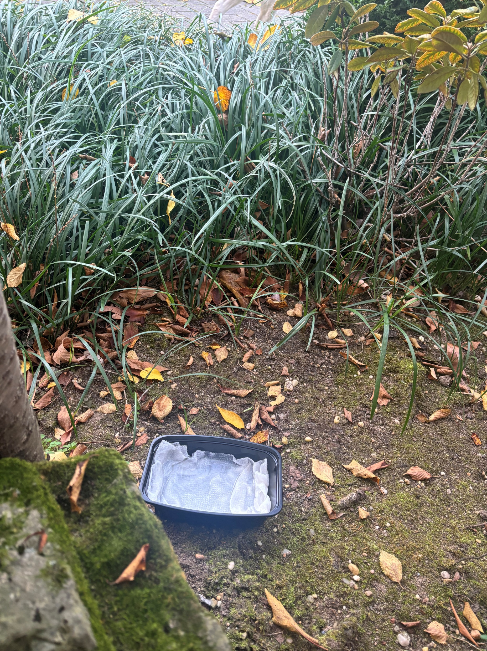
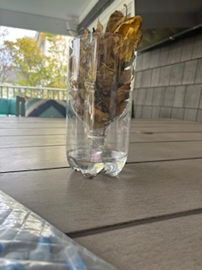
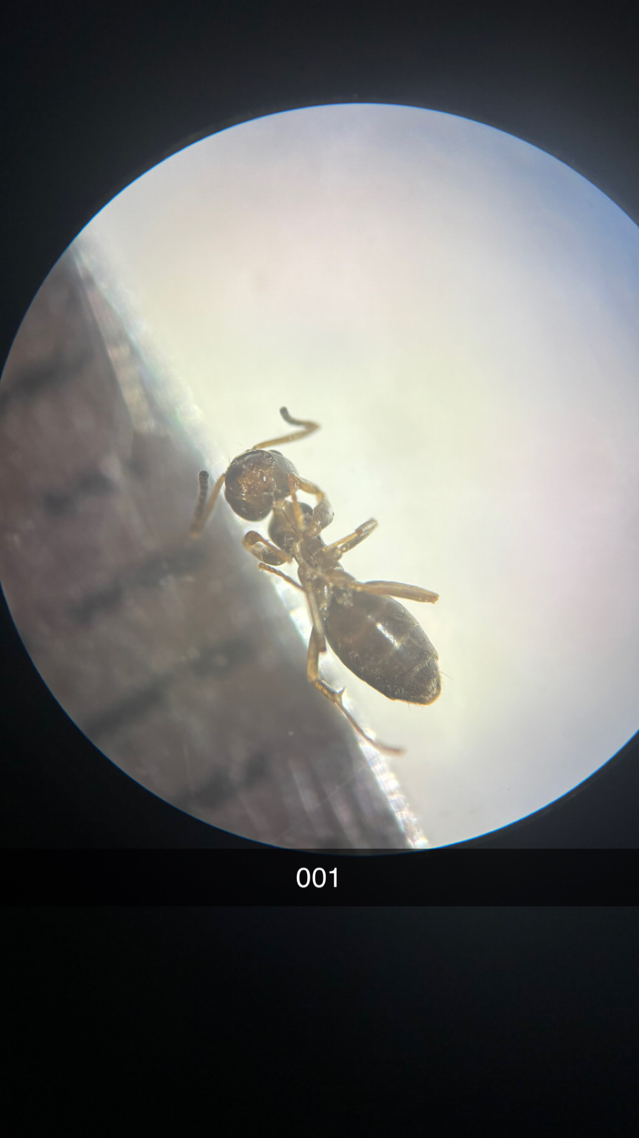
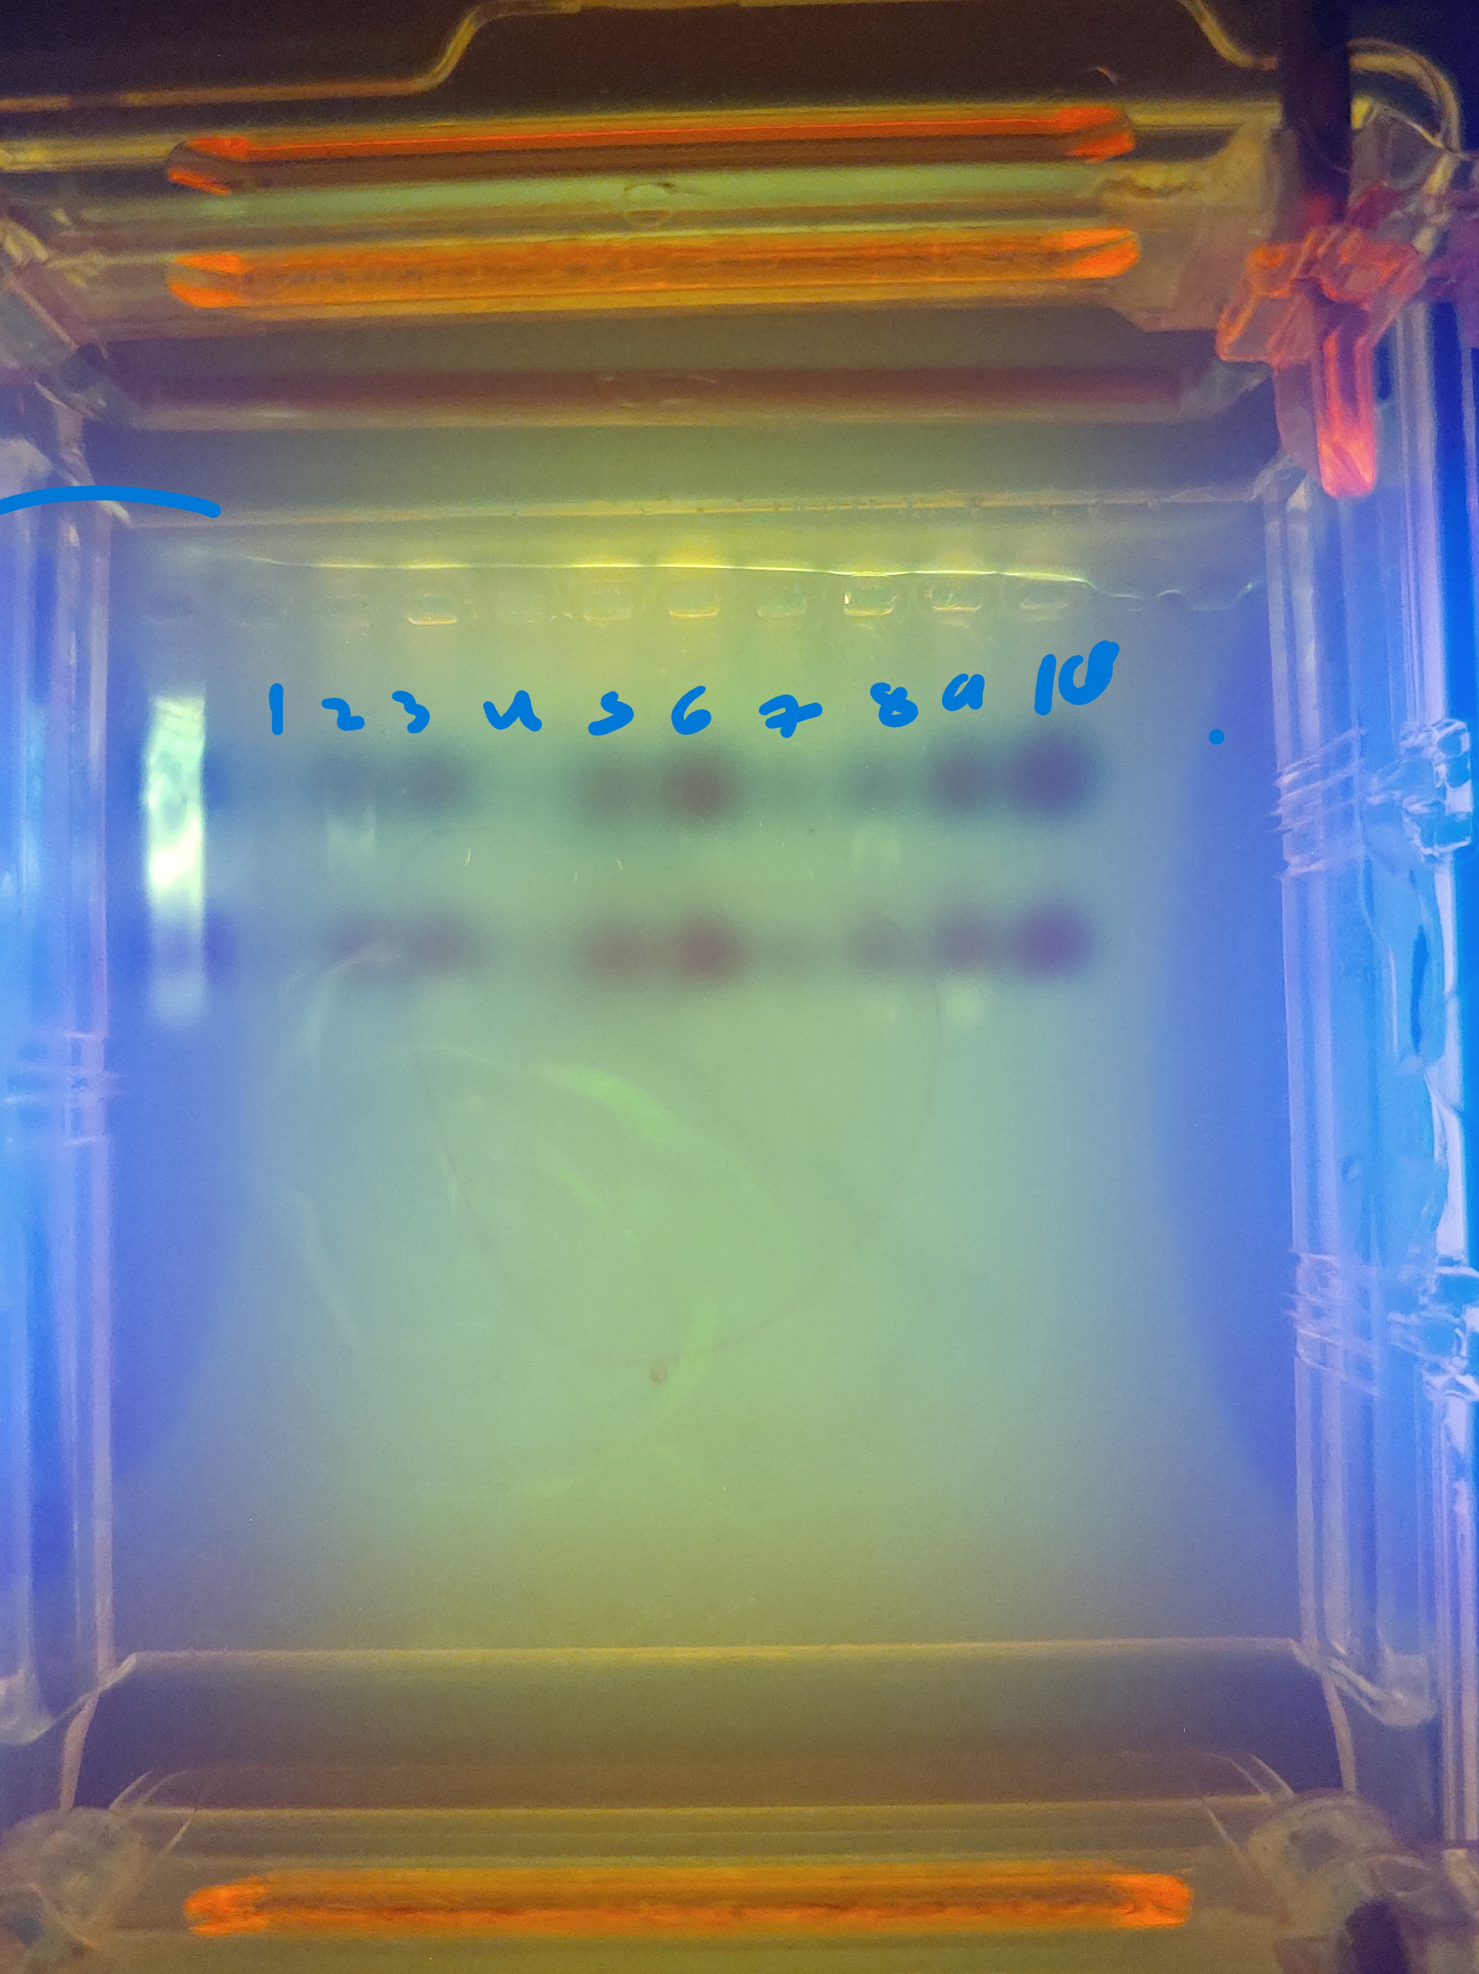
Kelsey Ambrosio and Samantha Horowitz
Mentor: Stoycho Velkovsky
Institutional affiliations for each author
The Effect of Different Habitats on The Biodiversity of Formicidae in Lynbrook
Kelsey Ambrosio and Samantha Horowitz
Mentor: Stoycho Velkovsky
DISCUSSION
ABSTRACT
MATERIALS & METHODS
Researchers conducted an experiment to determine the association of different habitat types on the biodiversity of ants. Researchers looked at locations such as residential backyards located in the town of Lynbrook. There are several factors that could lead the researchers to believe certain habitat types would harbor a great diversity. Some of the factors consist of structural complexity, resource availability and moisture and climate. The different types of habitats the researchers will investigate are fields of grass, trees, and bushes. They used different techniques to try and collect the ants. The first was to set a trap. They set up a sugar water trap, and this was how they collected their data. The researchers hypothesized that the biodiversity of the ants will be highest in field grass. Though there were many complications with the researchers being out numerous times throughout the span of their data collection, they were unable to conclude exact results. The researchers did not get any biodiversity among the ants that they were able to collect.
Use different location
Multiple backyards and outdoor areas
Increase the number and diversity of insects
bigger sample size
More diverse species of insects
Worms, beetles or flies
Contribute more to data collection
Sample Collection
Data Analysis
DNA Extraction
Ants were collected from residential backyards using Berlese funnel and sugar traps that were left for 3 hours
Pictures submitted into iNaturalist and the BLI Sample Data Base
ACKNOWLEDGMENTS
Gel electrophoresis of sample were sent to Cold Spring Harbor Lab
We would like to thank Mr. Velkovsky for all of his help during this project. His guidance and support really helped with so much especially when we were struggling to collect data. He has also been so lenient through every sickness, vacation, etc. So, thank you.
INTRODUCTION
Formicidae
typically known as ants
Live in organized colonies
2-225mm
Have a short life span
Habitats
Where organisms make homes
40% of world habitats have been damaged from humans
Figure 1: trap set up
Figure 2: funnel trap set up
Figure 3: ant under microscope
REFRENCES
RESULTS
ant. (2024, October 4). britannica.com. Retrieved October 5, 2024, from https://www.britannica.com/animal/ant#:~:text=ant,%20(family%20Formicidae),%20any%20of%20approximately%2010,000%20species%20of%20insects
Bay Park. (n.d.). askarcnassau.com. https://www.askarcnassau.com/2789/Bay-Park#:~:text=Bay%20Park%20has%20been%20in%20the%20Nassau%20County%20park%20system
Biodiversity. (n.d.). education.nationgeographic,org. https://education.nationalgeographic.org/resource/biodiversity/
Gries Park Map. (n.d.). mapcarta.com. https://mapcarta.com/22584580#:~:text=Type:%20Park;%20Description:%20park%20in%20Nassau%20County,%20New%20York,%20United
Habitat. (n.d.). education.nationalgeographic.org. https://education.nationalgeographic.org/resource/habitat/
Pittman, T. (n.d.). Ant Lifespan: How Long Do Ants Live. misfitanimals.com. https://misfitanimals.com/ants/how-long-do-ants-live/
16 Different Types of Habitats Around the World. (n.d.). ourendangeredworld.com. Retrieved September 26, 2023, from https://www.ourendangeredworld.com/types-of-habitats/
Hypothesis was declined
Results were shown to be inconclusive
Lack of Biodiversity
Ants that were collected were all front the same colony
Some ants died
2 ants were diverse
SPECIFIC AIMS
The experiment the researchers conducted took place in different locations of their backyards such as trees, bushes, grass patches, and dirt. They used the sugar water trap and their way to catch them.
Figure 4: DNA gel
Notes:
IMPORTANT– posters should contain all of the information in this template, but do not need to be organized in this exact format. Posters with descriptive images and figures are preferred over text-heavy posters. Results do not need to be contained to the highlighted “Tables & Figures” box.

