Slide 1
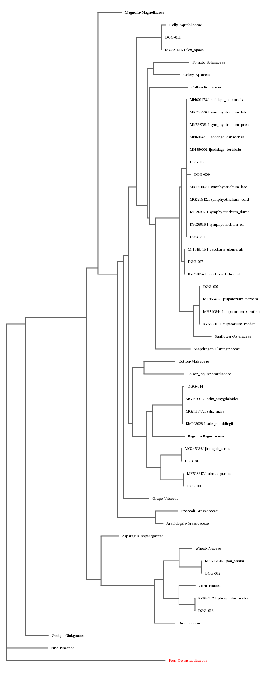
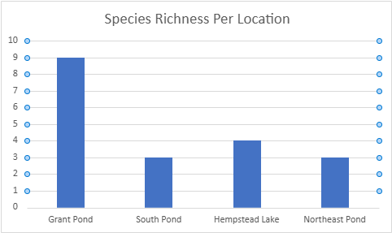
The Effect Of Phosphorous Concentration on Littoral Plant Biodiversity
Charles Podlaski, Jonah Rolnick, Mr. Velkovsky
Abstract
Phosphorus is a nutrient often used within fertilizers. However, excess phosphorus found in fertilizer runoff can damage plant growth. The littoral region of a body of water is where water goes up to two feet of depth. We hypothesize that bodies of water with higher phosphorus concentrations will have less plant biodiversity in the littoral region. We used Grant Pond and Hempstead Lake State Park, tested phosphorus concentration, then collected leaves from littoral region plants. We isolated the DNA of the plant samples and sequenced the gene sequences. To analyze the data, species richness was utilized. This was done because of sampling bias present in our data. Samples were collected on a semi-random basis, rather than a fully random basis. Due to this, species richness numbers were skewed, however, the biggest difference came in sample sizing. This meant that only general conclusions, about minor effects in biodiversity, could be drawn.
Introduction
Phosphorus is a nutrient that is abundant inside of fertilizers; and these fertilizers are prone to running off into nearby bodies of water, such as lakes or other freshwater bodies.
While Phosphorus is beneficial to plant growth in small amounts, excess Phosphorus that is common in fertilizer runoff can damage plant growth and biodiversity significantly (NYSDEC, 2024).
Phosphorus has been found to be in excess in many bodies of water on Long Island. For example, in Hempstead Lake State Park, phosphorus concentration was found to be higher than the NYSDEC guidance value (Berger, 2018.)
Since these plants are submerged in the water, if phosphorus is present within the water, the plants within the littoral region will have been exposed to the phosphorus. Plants within the littoral region receive full sunlight and water from the lake.
This study plans to determine the effect phosphorus concentration in freshwater bodies has on its plant biodiversity in the littoral region. We hypothesized that that bodies of water with higher phosphorus concentrations will have less plant biodiversity in the littoral region.
Materials & Methods
The lakes chosen for this experiment were Grant Pond, Hempstead Lake, and its neighboring South Pond and Northeast Pond.
To determine the concentration of phosphorus within the lakes, we used the Natural Chemistry Consumer Phosphate Test Kit from Natural Chemistry. This testing kit tests from 0 ppb – 2500 ppb concentration of phosphorus.
To collect samples, we reached into the littoral region of the lake and removed a leaf from each of the various plants found.
Samples were then labeled based off where they were found, and the order they were collected in. The samples were then refrigerated to be preserved.
We used the DNA isolation technique by the Cold Spring Harbor DNA Learning Center (Using DNA barcodes to identify and classify living things). Then, we ran a PCR on the rbcL genes obtained from the DNA isolation technique.
To identify each species, we used the sequenced DNA barcode to identify the species using the DNA Subway. DNA Subway is a database that is run by Cold Spring Harbor Laboratory that you can compare the plant DNA barcode to in order to identify the species.
Results
Samples were collected from the four locations, ten from grant pond, three from South Pond, four from Hempstead Lake, and three from Northeast Pond.
In order to analyze our data, we chose to use species richness.
The Simpsons diversity index proved to not be meaningful due to the way we collected our data.
Species richness numbers came out to, nine at Grant Pond, three from South Pond, four from Hempstead Lake, and three from Northeast Pond (See Graph)
Figure 1: Phylogenetic Tree of Samples
Figure 2: Species Richness Per Location Bar Graph
Discussion
Our results had significant sampling bias, we collected samples in different locations if they looked different, and did it semi-randomly, as opposed to fully randomly.
This affected the Simpsons biodiversity index scores, as it measures how many of each plant there was, and since there was only about one of each plant (except for samples 005 and 010), it gave back numbers way higher than they would probably be.
Species richness would give similar numbers, however due to a low sampling size, these results also did not prove interesting.
Even with random sampling, it would be likely that the numbers would be equivalent, due to the low sampling size at the ponds around Hempstead Lake, and Hempstead Lake itself.
From the little data we collected, and the difficulty of sample collection at Hempstead Lake and its adjacent ponds. A more general conclusion can be drawn, that the phosphorus concentration may minorly affect the number of present plants, and in turn, minorly affect species richness.
References
Berger, L. (2018, October 5). Hempstead lake state park environmental assessment. Retrieved October 6, 2024, from https://hcr.ny.gov/system/files/documents/2023/07/hempstead-lake-state-park-environmental-assessment.pdf
Bureau of Water Assessment and Management. (n.d.). Water Quality Standards And Classifications. New York Department of Environmental Conservation. Retrieved October 9, 2024, from https://dec.ny.gov/environmental-protection/water/water-quality/standards-classifications
Littoral Vegetation Survey Protocol – Lake County SWCD Staff. (2021, March 19). Retrieved October 9, 2024, from https://www.co.lake.mn.us/wp-content/uploads/2023/12/Littoral-Vegetation-Survey-Protocol.pdf
LONG ISLAND NATIVE PLANTS [Fact sheet]. (n.d.). Retrieved October 6, 2024, from https://www.huntingtonny.gov/filestorage/13749/13847/16804/99881/41072/41080/LI_Native_Plants.pdf
Native Buffer Plants to New York State. (n.d.). Retrieved October 6, 2024, from https://www.solitudelakemanagement.com/beneficial-buffers-native-plants-for-ponds-lakes-for-new-york-state/
United State Environmental Protection Agency. (2024, May 30). Indicators: Phosphorus. United State Environmental Protection Agency. Retrieved October 9, 2024, from https://www.epa.gov/national-aquatic-resource-surveys/indicators-phosphorus#:~:text=Too%20much%20phosphorus%20can%20stimulate,macroinvertebrates%20and%20other%20aquatic%20life.

