Slide 1
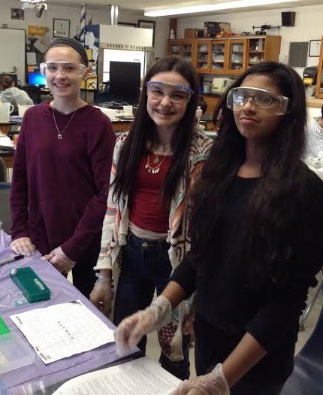
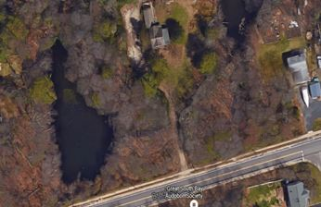
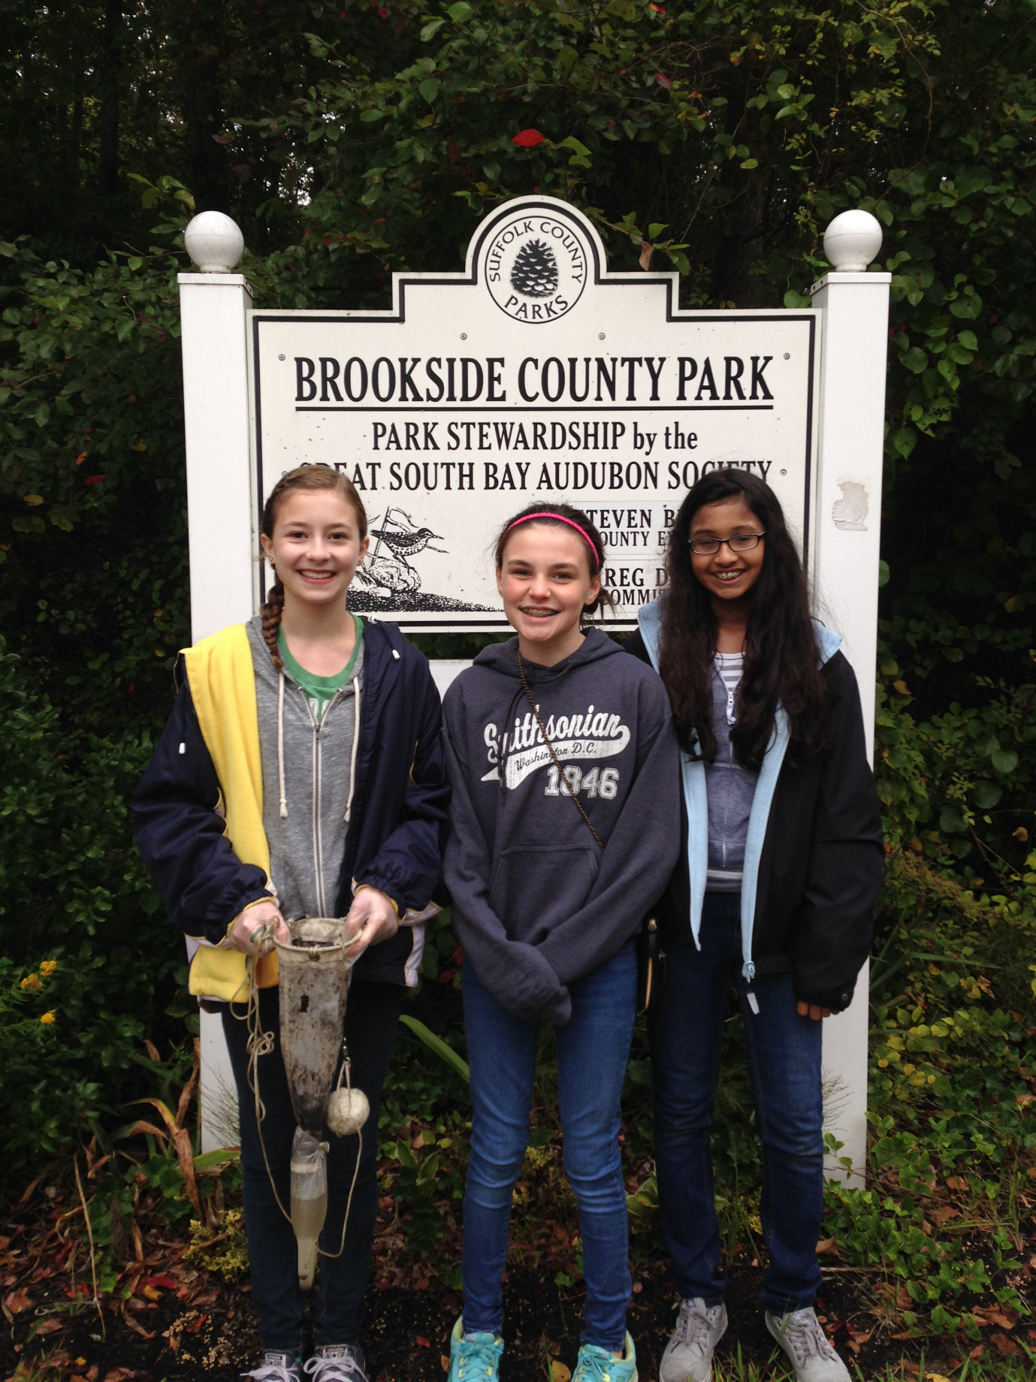
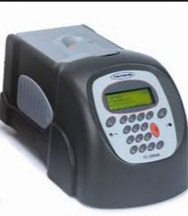
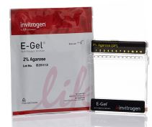
Barcoding Limnetic Zone Invertebrates from Green’s Creek, Brookside County Park, West Sayville, N.Y.
Mackenzie Damon, Nita George, Amy Tomko – *Sayville High School
Mentor: Maria Brown*
Abstract
Results
Barcoding is the process by which organisms, based on their genetic markers, are identified to species level. This is necessary for biodiversity studies to best understand evolutionary relationships and genetic variability within and between species. Permits were acquired and organisms were collected in the freshwater portion of Green’s Creek using a plankton tow and sampling jars. In the laboratory, taxonomic keys were used to identify organisms using a dissecting microscope and photographing them using a Vernier™ ProScope. DNA were extracted using Qiagen™ Dneasy kits. Primers adopted from Saux, Simon & Spicer (2003) using the 12S gene were used in PCR. PCR product was purified using a Qiagen PCR Purification kit. Samples were sent to Genewiz, Inc. for sequencing. . Bioinformatics and tree topology were constructed using Cold Spring Harbor Laboratory’s DNA Subway, Blue Line. In the end, we found the potential for two novel barcodes. More barcoding will be necessary to better understand the biodiversity of the organisms that are part of the freshwater systems on Long Island.
2-1
2-2
Introduction
DNA barcoding has been used to assess macroinvertebrate biodiversity in freshwater ecosystems (Pfender, et al, 2010). According to (Stein et al, 2014) DNA barcoding improved statistical power to assess small changes in stream conditions based on biodiversity when DNA barcoding was added to standard taxonomic identification methods.
Materials & Methods
Figure 3: Maximum Likelihood Tree generated in MEGA 6.0 and DNA Subway Blue Line along with barcodes for each of our samples and the BLAST closest match samples in Genbank. Photo taken by mentor in our high school laboratory.
Goals
Identify novel barcodes in Genbank using the DNA Subway
Blue Line and bioinformatics techniques identified in Using
DNA Barcodes to Identify and Classify Living Things.
Discussion
Throughout our research, we’ve worked with many different primers, until we were successful. Originally, we used the Barcode Long Island Footlocker Method and COI/ COII invertebrate cocktail primers. These primers failed to provide us with data. We then used the 12S gene (fruit fly) primer with the Qiagen™ Dneasy Blood & Tissue Kit for DNA extraction and were successful for 2 samples and found two novel barcodes. Sample 2-1 was closest in distance to Polypedilum vande. From microscope observations and taxonomic keys, we originally viewed these two organisms as the same (2-1 and 2-2), but as a result of the ML tree represented in Figure 3, we now know they are distinctly different. Their barcodes show some similarities, but multiple SNPs exist.
Future Work:
We will analyze our organisms with the reverse primers to ensure that they are novel barcodes. From that point, we will enter them into Genbank. We will need to work with experts to identify these organisms since the Pennak’s taxonomic keys for freshwater invertebrates are difficult to analyze.
Study Location
Proposal submission to CSHL
Permit Acquisition
Field Collections
DNA Preparation
(Qiagen Kits/12S Gene)
Sequencing at Genewiz, Inc.
Bioinformatics
DNA Subway – Blue Line
(CSHL)
Figure 1: Study location at Brookside County Park Preserve,
West Sayville, NY.
References
Cold Spring Harbor Laboratory (2014). Using DNA Barcodes to Identify and Classify Living Things. pp1-41.
Pfrender, M. E., Hawkins, C.P., Bagley, M., & Courtney, G.W. (2010). Assessing macroinvertebrate biodiversity in freshwater ecosystems:Advances and challenges in DNA-based approaches. The Quarterly Review of Biology 85, pp320-340.
Smith, D., G. (2001). Pennak’s Freshwater Invertebrates of the United States. John Wiley & Sons., New York.
Stein, E.D., White, B.P., Mazor, R.D., Jackson, J.K. & Battle, J.M. (2014). Does DNA barcoding improve performance of traditional stream bioassessment metrics? Freshwater Science 33 (1), pp 302-311.
Sweeney, B.W., Battle, J.M., Jackson, J.K., & Dapkey, T. (2011). Can DNA barcodes of stream macroinvertebrates improve descriptions of community structure and water quality? Journal of North American Benthological Society 30 (1): 195-215.
Saux,C., Simon C., & Spicer,G.,S. (2003). Phylogeny of the dragonfly and damselfy Order Odonata as inferred by mitochondrial 12S ribosomal RNA sequences. Ann. Entomol. Soc. Am, 96(6), 693-699.
Smith, D., G. (2001). Pennak’s freshwater invertebrates of the United States (2001). John Wiley & Sons., New York.
Figure 2: Methods schematic
Acknowledgements: Mrs. Maria Brown, Our Families, and the Barcode Long Island Staff at DNALC

