Slide 1
Something’s Fishy
By Victoria Eavis and Rebecca Mantel
Mentored by Patrice Buckley

Slide 2
Introduction
DNA barcoding has uncovered a new aspect of taxonomy in which genetic sequences are used for identification, providing a more accurate method of classifying species. Originally introduced in 2003 by Paul Herbert, DNA barcoding utilizes a method where a standard region of the genome is extracted and examined to determine a specific and short gene sequence for each organism. In the case of animals, the mitochondrial region of cytochrome c oxidase gene 1, otherwise known as COI, is extracted. This method sets forth an exact representation of the nucleotides that are unique for each species and unlike from any other. With the knowledge of the DNA sequence, accuracy in identifying organisms is improved.
By the method of DNA barcoding, we will identify the different species of fish that are being sold to consumers. A trip to the supermarket yielded a few “different” species of fish that look similar. By sequencing the DNA of specific species of fish, an accurate representation of the COI region of the specific genome will be displayed. With this sequence, we will be able to accurately determine the species of the said fish. Without the DNA being extracted, the tiny physical characteristics and tastes of the fish might be overlooked or mistaken. The use of DNA sequencing will provide an efficient way to identify the species to those who trust what they are putting on their plates is what the supermarkets say it is.

Slide 3
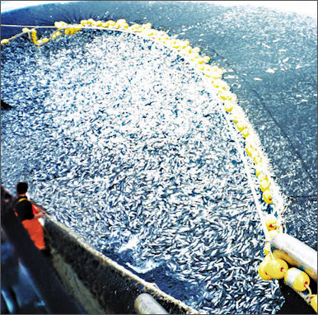
Hypothesis
We hypothesize that due to the overfishing of certain kinds of fish, grocery stores have begun to mislabel certain fish with similar looking and tasting fish

Slide 4
Materials/Methods
We will collect multiple types of raw white fish fillet from upscale supermarkets on the Upper West Side of Manhattan. Three corresponding types of fish will be bought from these supermarkets and stored in 38 degrees fahrenheit. Fish will be labeled with both the common names and the species, such as cod (G. morhua), chilean sea bass (D. eleginoides), or catfish (I. punctatus). Small pieces from each species and supermarket will be used for DNA extraction.
Once all of the fish are collected we will begin the process of extracting their DNA. First small pieces of fillet meat are removed and placed into 1mL tubes. Next, nuclei lysis solution is added to the sample and the meat is crushed with a pestle. Then the tube is incubated for fifteen minutes at 65 degrees Celsius and RNAse is added. After that, the tube is incubated again at 37 degrees Celsius for fifteen minutes and at room temperature for five minutes. Next, protein precipitation solution is added and the tube is chilled for five minutes. Then the tubes are centrifuged at high speed and transferred into a new tube with isopropanol. The tubes are centrifuged for a second time and then the supernatant is aspirated. Subsequently, ethanol is added and the tube is centrifuged for a third time and the ethanol is removed. Next, the “pellet” or solid matter is left in the tube to dry before adding the rehydration solution. The tube is then rehydrated at 4 degrees Celsius overnight. In order to analyze the newly extracted DNA, gel electrophoresis must be completed. First, the gel is poured into trays and following addition of the samples, an electric current will pass through the gels. These gels will run for thirty minutes. If gel electrophoresis indicates that the samples are adequate, the samples will be sent for sequencing. We will then compare our gene sequences to the known DNA sequences of different fish, such as a white fish Sea Bass. If it is found that a specific fish is labeled as one thing, but contains multiple or completely different DNA sequences, then it will be known that the fish may be incorrectly labeled

Slide 5
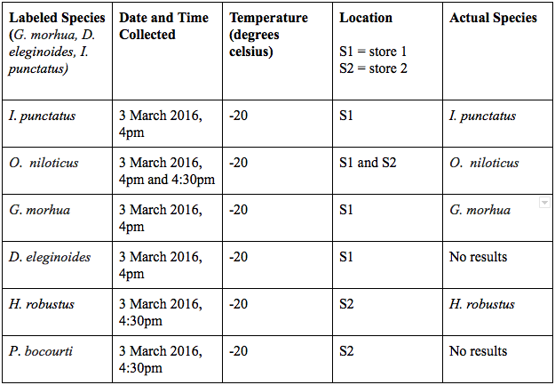
Results:
Table 1: Fish samples from two stores and species identification
The table shows the data that will be collected. From the data, it will be determined if the fish is mislabeled. It is possible that they are not aware of the fact that the fish are mislabeled, but their supplier may be incorrectly labeling the fish. Some species might be what they are labeled, some might be a completely different type, and some might be a mixture of species. Finally, if it is found that the supermarkets are mislabeling, the stores will be made aware

Slide 6
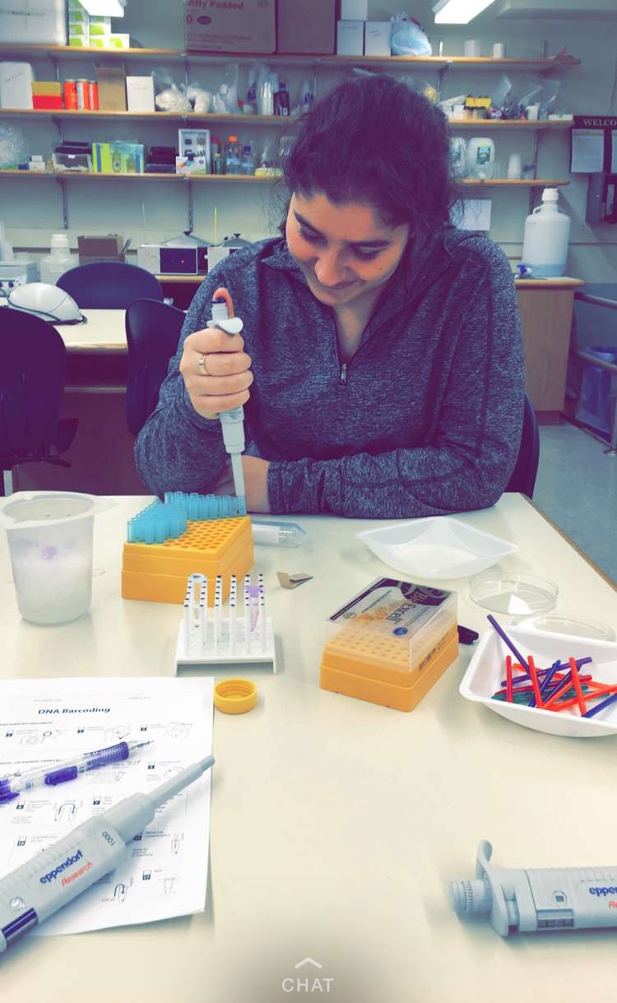
Discussion
All of this data was collected through PCR and gel electrophoresis. Data was achieved for five out of the seven samples collected. This data was then analysed on DNA subway and put into phylogenetic trees. Although it was not found that species were mislabeled, it was shown that some of the species were more closely related. Because DNA was only extracted for H. robustus, G. morhua, I. punctatus, and both samples of O. niloticus, these were the samples that were arranged on the phylogenetic trees. The trees illustrate that both samples of the O. niloticus are closely related, that I. punctatus and G. morhua are closely related, and that these two pairs share a common ancestor of H. robustus

Slide 7
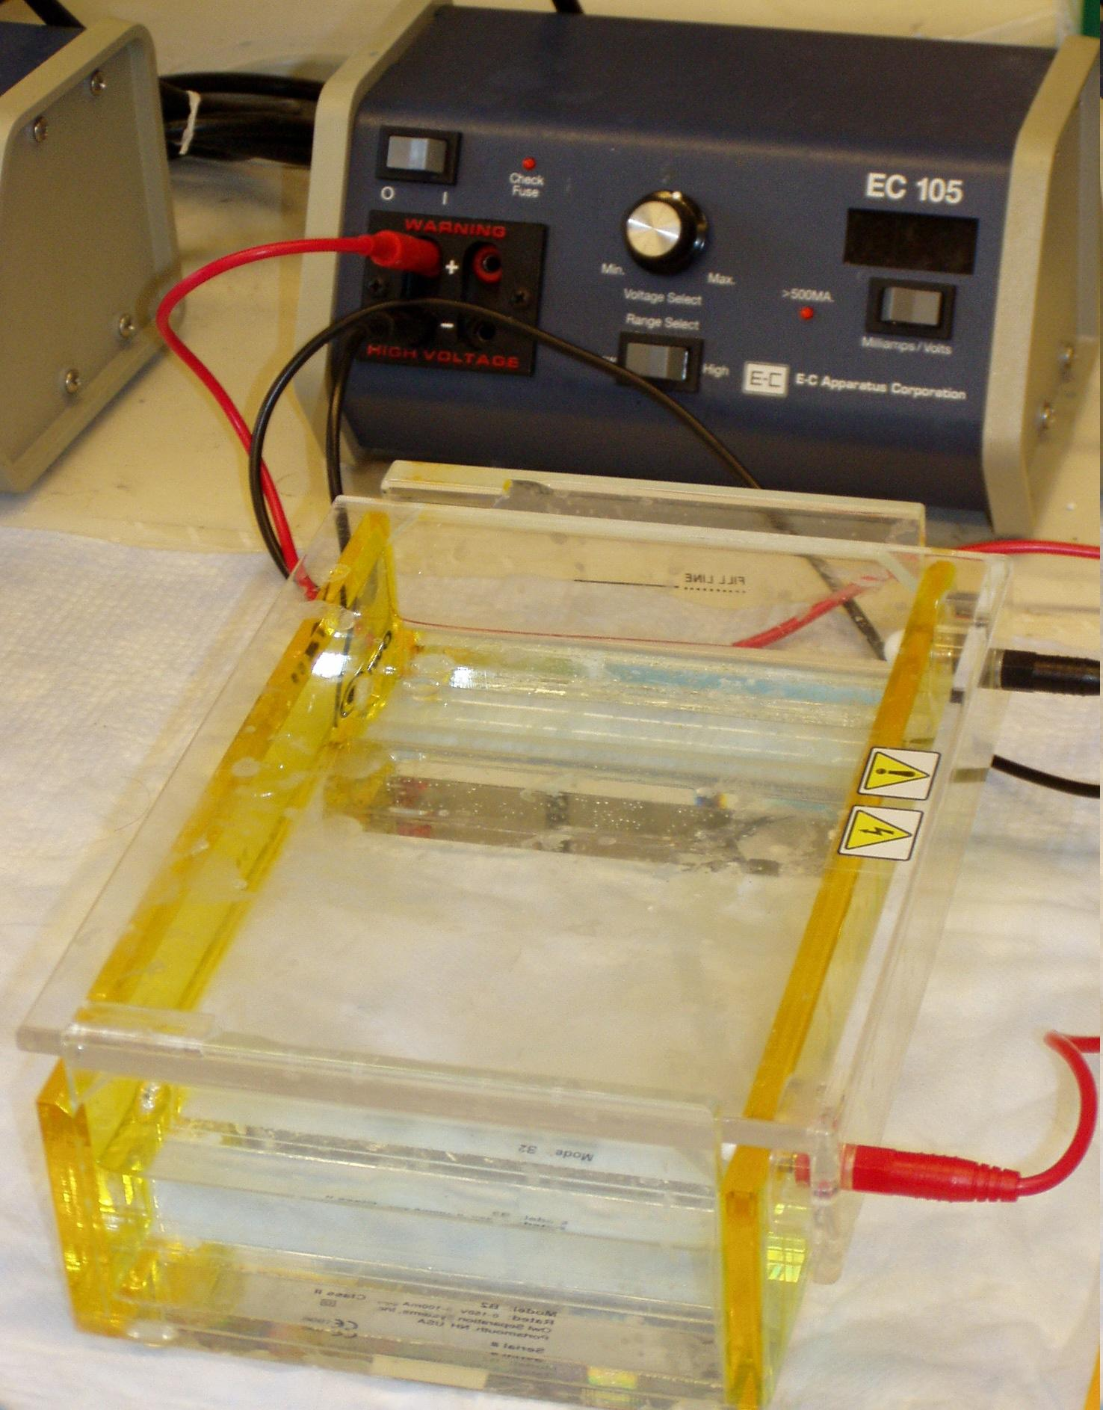
Conclusion
While performing this project, there were a number of errors that could have occurred. First, because this process is very tedious and requires an extremely small amount of lab liquids, it is very probable that an incorrect amount was used. Second, running the gel electrophoresis it is easy to insert the extracted DNA too far into the wells, which may result in unreadable DNA. At the beginning of this project, we wanted to prove that some of the species of fish were mislabeled in the supermarkets because of overfishing or cost of certain types. While we proved that the ones we found DNA for were correctly labeled, it was still an enriching process

Slide 8
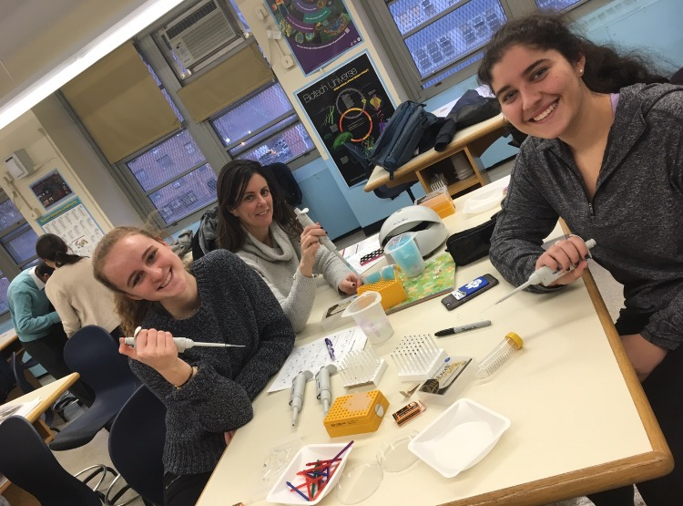
Acknowledgements
This project was funded by Columbia Grammar and Preparatory school. Thank you Patrice Buckley for overseeing the experimentation.

