Slide 1
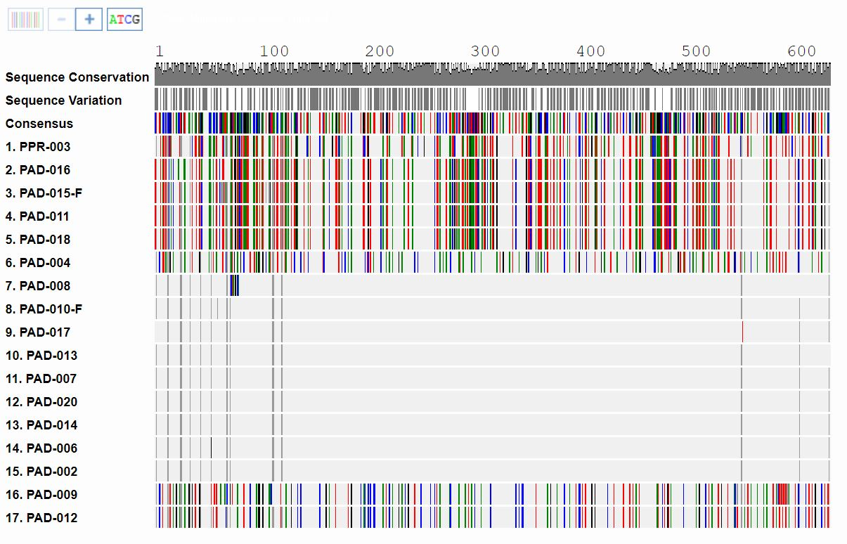
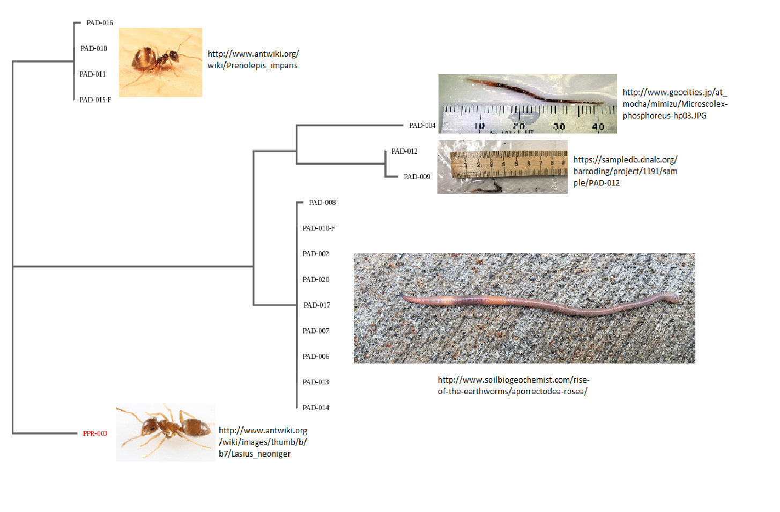
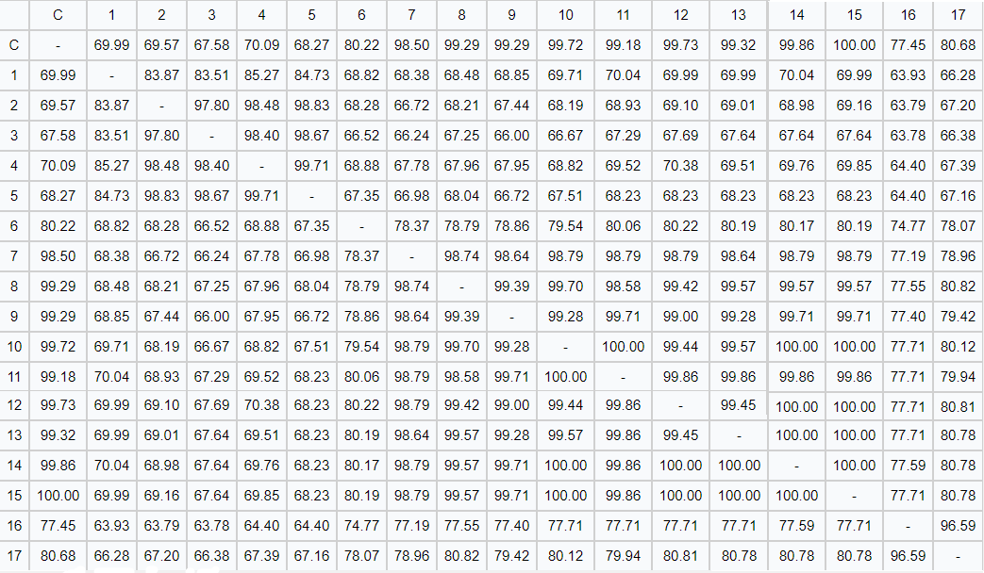
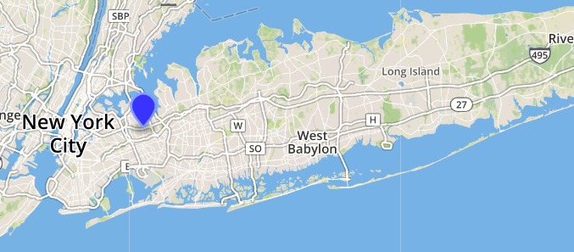
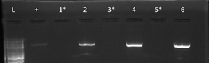
The Effect of Introduced Flora on Invertebrate Biodiversity
Authors: Gina Nagib, Katrina Too, Allison Wong
Teacher: Jessica Cohen, Ph.D.
Francis Lewis High School
Abstract
DNA Barcoding is the process of analyzing the DNA sequences of species. Previously, scientists used taxonomy keys to classify species. Taxonomy, however, unreliably depends on an organism’s physical characteristics, which are subject to change. In the courtyard of Francis Lewis High School, garden beds are cleared in the fall and new flowers are planted in the spring. It is hypothesized that the introduction of new flora will increase the diversity of species inhabiting the area. Samples were collected before the replacement of flora and then identified using a taxonomic key. DNA was isolated, amplified, and PCR products were analyzed using gel electrophoresis. The data collected was analyzed using the program “DNA Subway” to determine if there were any novel sequences. One novel sequence was found in several worm samples. To track the development of the area’s flora, the study will span for two years. Introduction Taxonomy is the process of categorizing species based off of their physical characteristics, such as: color, number of legs, fur, etc. Despite its long practice and the many dichotomous keys created, taxonomy alone is now proven unreliable and can lead to the miscategorization of organisms (Hebert et al. 2004). If the physical appearance of the organism is altered, (i.e. a leg is missing, or a wings are damaged) then the organism can be categorized incorrectly. Advancements in technology have made it possible to overcome inconsistencies in taxonomy by the use of DNA barcoding (Herbert et al. 2004). DNA barcoding is the extraction, isolation, amplification, analysis, and cataloging of specific DNA sequences found in organisms. Francis Lewis High School (FLHS), in Fresh Meadows, Queens, has a private courtyard with various grasses and weeds. During the spring, the newly formed FLHS Gardening Club sow new flowers in the area, replacing many weeds and grasses. The modification of flora and soil may have adverse effects on the surrounding organisms. Beetles and other flying insects can live deep within the soil (sciencing.com). Invasive garden pests such as aphids, can live and feed off of host plants. In this study, the careful sampling of surrounding soil, plant leaves, and flowers, may allow us to uncover more species than previously thought to reside in Queens gardens, indicating that such gardens may contain more biodiversity than previously thought. Observation can also be used to determine if different plants attract different beneficial or harmful invertebrates. In this long-term study, we will observe if the biodiversity of invertebrates that live in the courtyard before the placement of new plants will differ from the biodiversity after, by identifying them using taxonomy and DNA barcoding. We will follow up on this project in the future so that the effects of factors such as temperatures and seasons can be observed. We will also determine whether or not the organisms found in the courtyard are beneficial or harmful to the school community.
Materials & Methods
Invertebrate samples were collected every five feet around the perimeter of Francis Lewis High School’s courtyard. These locations were chosen for sampling because they were garden beds that would soon be replaced with different flora. Samples were collected from early to late March using gardening trowels. In total, 20 samples of invertebrates were collected and placed in clear plastic bags. For each sample, the longitudinal and latitudinal coordinates determined by phone GPS, sample number, and date were recorded. The 20 samples were then photographed and euthanized in the freezer.
DNA was extracted from samples and isolated. COI primers were added and amplified through PCR. Results underwent gel electrophoresis to determine if successfully amplified. PCR products were sent to Genewiz for sequencing. Once returned, a blue line DNA Subway on Cyverse was created to compare the relationships between sequences collected and sequences that are published.
Figure 4.
Alignment of sequences. PPR-003 was set as an out-group.
Figure 5.
Sequence Similarity Chart. This provided the sequence similarity between samples. Sequence similarities greater than 95% suggest a match.
Figures 7 and 8.
Novel sequenced samples PAD-008 and PAD-014, respectively.
Figure 6.
PHYLIP ML Phylogenetic tree was constructed on DNA Subway. The tree shows that most of the samples shared a common ancestor.
Figure 9. A map showing where samples were found.
Discussion
After analyzing sequences, it was determined that a total of 4 different species were found in the FLHS courtyard. One species of ant, Lasius Neoniger, was an out-group on the phylogenetic tree as it was mixed up with a different experiment during sequencing (erroneously uploaded into our account). Three of these species were variants of earthworms and one was a species of ant. Of the three species of worms, one was novel as there were over 80 mismatches in the DNA of already known sequences determined by BLASTN. This novel species is closely related to Aporrectodea rosea, a species of earthworm prominent in Europe (eol.org). Two other species of earthworm were found: Microscolex phosphoreus (eol.org) with little known information and Aporrectodea limicola, a species found mostly in Northern Europe (discoverlife.org). The single species of ant found, Prenolepis imparis, is also known as the false honey ant that favors cold weather (entnemdept.ufl.edu). The abundant presence of earthworms indicates that the soil around the courtyard is nutrient filled and healthy for other plants to grow.
Throughout the experiment there were some limitations with regards to the weather. During this year, the weather was unusually cold before the deadline to collect and analyze samples. Therefore, only certain species that were able to survive in cold, rainy weather were found and may not be an accurate representation of all the species that reside in the courtyard. For example, the only species of worm found was Prenolepis imparis, a species of ant that thrives in cold temperatures (entnemdept.ufl.edu). Because this is a long-term experiment, more samples will be taken during different temperatures and seasons in the future. Resources
Buchanan, G. A., C. S. Hoveland, M. C. Harris, 1975. Response of Weeds to Soil pH. Weed Science 23(6): 473-477.
Dawnay, P., R. Ogden, R. McEwing, G. R. Carvalho, R. S. Thorp,, 2007. Validation of the barcoding gene COI for use in forensic genetic species identification. Forensic Science International 173(1):1-6.
Encyclopedia of Life. Discover Life: Point Map of Aporrectodea rosea. 2012. Available from: http://eol.org/data_objects/21890738
Herbert, P., P. H. Erin, J. Burns, D. H. Janzen, W. Hallwachs, 2004. Ten species in one: DNA barcoding reveals cryptic species in the neotropical skipper butterfly Astraptes fulgerator. Proceedings of the National Academy of Sciences 101(41): 14812–14817.
Sciencing. Insects that live underground. 2017. Available from: https://sciencing.com/bugs-insects-live-underground-8147167.html
Discover Life. Map of Aporrectodea limicola. Available from: http://www.discoverlife.org/mp/20m?kind=Aporrectodea+limicola&guide=Earthworms
Encyclopedia of Life. Microscolex phosphoreus overview. Available from: http://eol.org/data_objects/21890738
University of Florida. Winter ant: Prenolepis impairs. Available from: http://entnemdept.ufl.edu/creatures/misc/ants/Prenolepis_imparis.htm
Figure 1. Samples PAD-002, PAD-004, and PAD-006 were usable PCR sent out for sequencing.
Figure 2.
Samplaes PAD-007 through PAD-013 were usable PCR products sent out for sequencing.
Figure 3.
Samples PAD-014 through PAD-020 were usable PCR products sent out for sequencing.
Acknowledgements We thank Dr. Cohen, Mrs. Jaipershad, Dr. Marmor, the FLHS Science Research Department, and Cold Spring Harbor Laboratory

