Slide 1
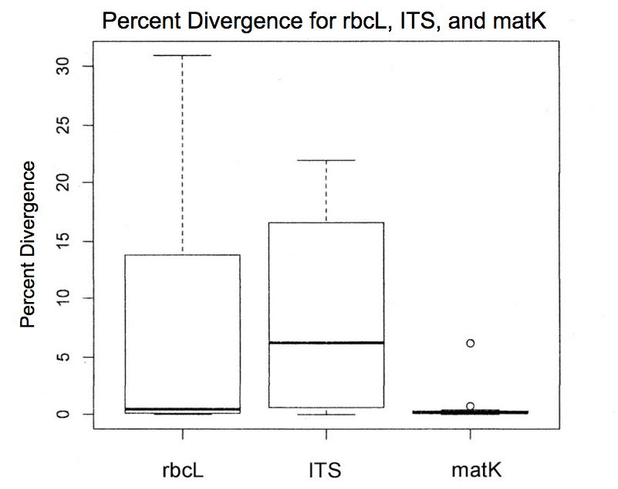
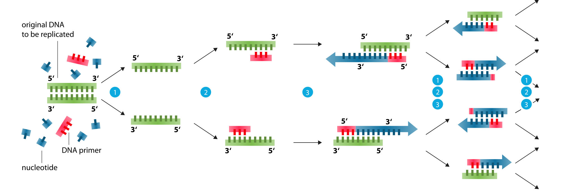
Analysis of Three Plant Primers: rbcL, plant ITS, and matK,
to Determine the Ideal Universal Plant Primer
By: Kang Min Shin
Abstract
Hypothesis
Discussion cont.
A universal plant primer is essential for the DNA classification of all plant species, which is significant for regulation of illegal plant species trafficking and medicinal research. The purpose of this study was to test three different plant primers: rbcL, plant ITS, and matK, to determine the ideal universal plant primer. In this experiment, nine species each of angiosperms and gymnosperms and eighteen species of cryptogams (nine species each of ferns and mosses) were collected. Their DNAs were purified, and the three primers were added to each of them for separate Polymerase Chain Reactions (PCR) to amplify them. The resulting samples were tested with gel electrophoresis to test if they were successfully amplified, then sent out for sequencing. Using DNA Subway program and BLAST algorithm, the sequence quality and percent divergence with target species were determined. The results of the experiment showed that rbcL had high amplification rates and produced high-quality accurate sequences for all plants. However, it had lower discrimination power than the matK. Meanwhile, matK only amplified and produced high quality sequences for angiosperms, although it had the highest discriminating power. Lastly, the plant ITS results were of poorer quality than that of the rbcL, making it the least desirable.
We hypothesize that rbcL will be a strong candidate for a universal plant primer since it has the ability to be used for almost all plants and can differentiate plants to at least the genus level.
A similar study was done by Dr. Hollingsworth, which showed
rbcL is one of the most versatile primer for plants (similar to the results of our experiment)
matK can’t be used for many species, but it can differentiate between species well
a combination of matK and rbcL could be created as a standard plant primer, highlighting the ideal qualities of both
Methods
36 different species of plants from each group: 9 angiosperms, 9 gymnosperms and 18 cryptogams (9 ferns + 9 mosses), were collected from indiscriminate locations in Tenafly
The samples were placed in separate labeled Ziploc bags to avoid cross contamination and refrigerated for storage.
Each sample was placed in a separate tube and ground into fine fragments to facilitate digestion of cell components by GuHCl; the mix was then centrifuged to isolate the DNA in the supernatant. The DNA was then bound by silica resin and purified through repeated use of wash buffer and centrifugation, after which dH₂O released the purified DNA from the silica into the supernatant.
The samples were placed in a thermal cycler for PCR to take place.
Gel electrophoresis was run to analyze the DNA from the PCR
The successful samples from the gel electrophoresis were sent to sequencing.
The DNA Subway website was used to:
view the results of sequencing (in the form of a list of base pairs)
trim the primers from each of the sequences.
match forward and reverse sequences to create a consensus sequence
The consensus sequence for each successful sample was placed in a BLAST algorithm to search through gene databases to find a close match.
The percent divergence was calculated based off the amount of matches between the original sequence and the database sequence.
This information was expressed in a chart, as seen in Figure 3 and in a box plot in Figure 4.
Primers were judged by:
Percent divergence values
Versatility
Consistency of results
Conclusion
The rbcL primer is the most ideal universal plant primer at this point because of its accuracy and universality.
In a future project, a mixture of matK and rbcL could be tested in a similar experiment for re-evaluation of percent divergence.
References
Introduction
Alvarez, I. Ribosomal ITS Sequences and Plant Phylogenetic
Inference. National Center for Biotechnology
Information. N.p., 29 Dec. 2003. Web. 14 July 2015.
Burleigh, Gordon J. "Exploring Diversification and Genome Size Evolution in Extant Gymnosperms through
Phylogenetic Synthesis." Hindawi Journal of Botany. N.p.
2 July 2011.Web.14 July 2015.
Forrest, Alan. Plant DNA Barcoding Using MatK: Some Work
on New Primer Sets. DNA Barcodes. N.p., 2011. Web. 14
July 2015.
Gielly, Ludovic. The Use of Chloroplast DNA to Resolve Plant
Phylogenies: Noncoding versus RbcL Sequences. Oxford
Journals: Molecular Biology and Evolution. N.p., 1994.
Web.15 July 2015.
Hilu, K. The MatK Gene: Sequence Variation and Application in
Plant Systematics. National Center for Biotechnology
Information. N.p., June 1997. Web. 14 July 2015.
Hollingsworth, Peter M. A DNA Barcode for Land Plants.
Proceedings of the National Academy of Sciences in the
United States of America. N.p., 27 May 2009. Web. 16
July 2015.
Hollingsworth, Peter M. Choosing and Using a Plant DNA
Barcode. PLOS One. N.p., 26 May 2011. Web. 15 July
2015.
Kress, John W. Use of DNA Barcoding to Identify Flowering
Plants. Proceedings of the National Academy of Sciences
in the United States of America. N.p., 15 Apr. 2005. Web.
14 July 2015.
Nepokroeff, Molly. "Angiosperms." Biology Reference. N.p.,
2015.Web. 18 July 2015.
Yu, Jing. New Universal MatK Primers for DNA Barcoding
Angiosperms. Journal of Systematics and Evolution. N.p.,
16 May 2011. Web. 14 July 2015.
Angiosperms - the most diverse group of plants; reproduces through pollination (i.e. flowers)
Gymnosperms - the oldest group of plants; reproduces by creating seeds in cones (i.e. pine trees)
Cryptogams - plants that reproduce through the production of spores (i.e. ferns and mosses)
Primers - short strands of DNA sequences of 18–30 base pairs; initiate the DNA synthesis process by binding to a target gene and allowing a DNA polymerase to synthesize complementary strands of nucleotides, duplicating the specific gene region.
Most Common Types of Plant Primers:
Ribulose-bisphosphate carboxylase (rbcL)
Internal transcribed spacer (ITS)
Maturase K (matK)
Due to the high diversity of plants and the high rates of recombination in the plant genome, scientists still cannot find and agree upon a universal plant primer, even though animal and fungi both have one.
Why is a universal plant primer needed?
To regulate illegal plant species
To aide in forensic investigation (by identifying certain species one can pinpoint to the location of a crime)
To distinguish toxic plants from similar looking nontoxic ones
Results
Type of Plant | Primer | Average Percent Divergence
Angiosperm | rbcL | 0.10%
Gymnosperm | rbcL | 17.19%
Moss | rbcL | 4.30%
Fern | rbcL | 3.81%
Angiosperm | ITS | 9.02%
Gymnosperm | ITS | 4.68%
Moss | ITS | 14.23%
Fern | ITS | N/A
Angiosperm | matK | 0.28%
Gymnosperm | matK | N/A
Moss | matK | N/A
Fern | matK | N/A
Percent Divergence for rbcL, ITS, and matK
30
25
Figure 1. Images of Each Plant Type Tested
http://socratic.org/questions/can-i-get-some-point-explaining-pteridophyta-gymnosperms-angiosperms
20
15
Percent Divergence
10
5
0
Figure 2. Visual Representation of How Primers Work in Polymerase Chain Reaction https://en.wikipedia.org/wiki/Polymerase_chain_reaction
rbcL
ITS
matK
Figure 3. Chart of the average percent divergence values of each primer and plant type
Figure 4. Box plots showing the average percent divergence for rbcL, ITS, and matK
Discussion
Acknowledgments
The rbcL primer worked for all types of plants, but the percent divergence was inconsistent, ranging from 0% ~ 31%.
Out of the three plant primers tested, rbcL was the only primer that could be used for all plant types, making it the most likely to be used as the universal plant primer.
The ITS primer had a percent divergence that was slightly more consistent than that of rbcL. However, its results are not as consistent as the percent divergence for matK, and it failed to amplify fern sequences.
The ITS primer had the highest average percent divergence out of the three primers indicating it is the most inaccurate, and it couldn’t be used for all plant types, making it undesirable as the universal plant primer.
The matK primer worked incredibly well with consistent and very low percent divergences. However, it only amplified angiosperm sequences.
The purpose of a universal plant primer is to identify all plants, which excludes MatK from being the universal plant primer.
I would like to thank Dr. Melissa Lee for allowing my team to use the equipment in the Harlem DNA Learning Center for the project, my teacher Mrs. Helen Coyle for motivating me throughout this project, and Dr. Kenneth Wurdack of the Smithsonian Institution for his aid in the calculations for percent divergence. I would also like to thank my partner in this project, Kaitlyn Espiritu. Finally, I would like to thank my parents as well as my fellow science research students for their support.

