Slide 1
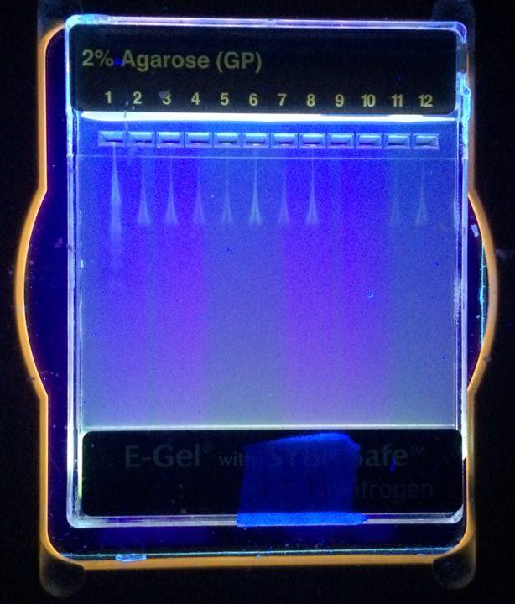
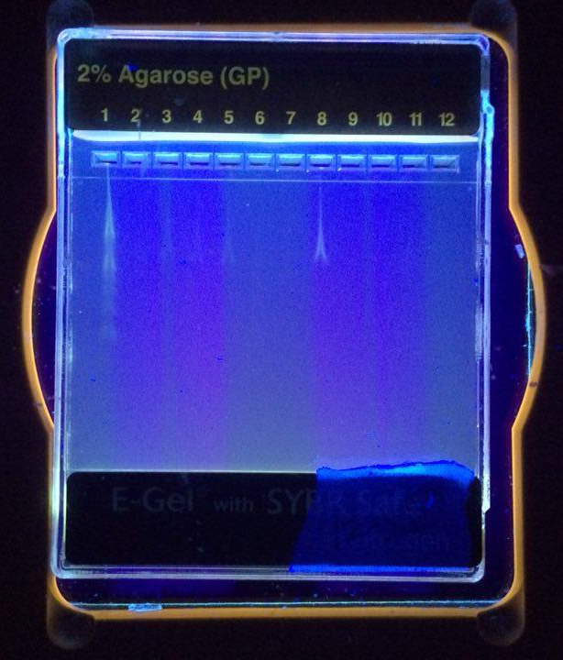
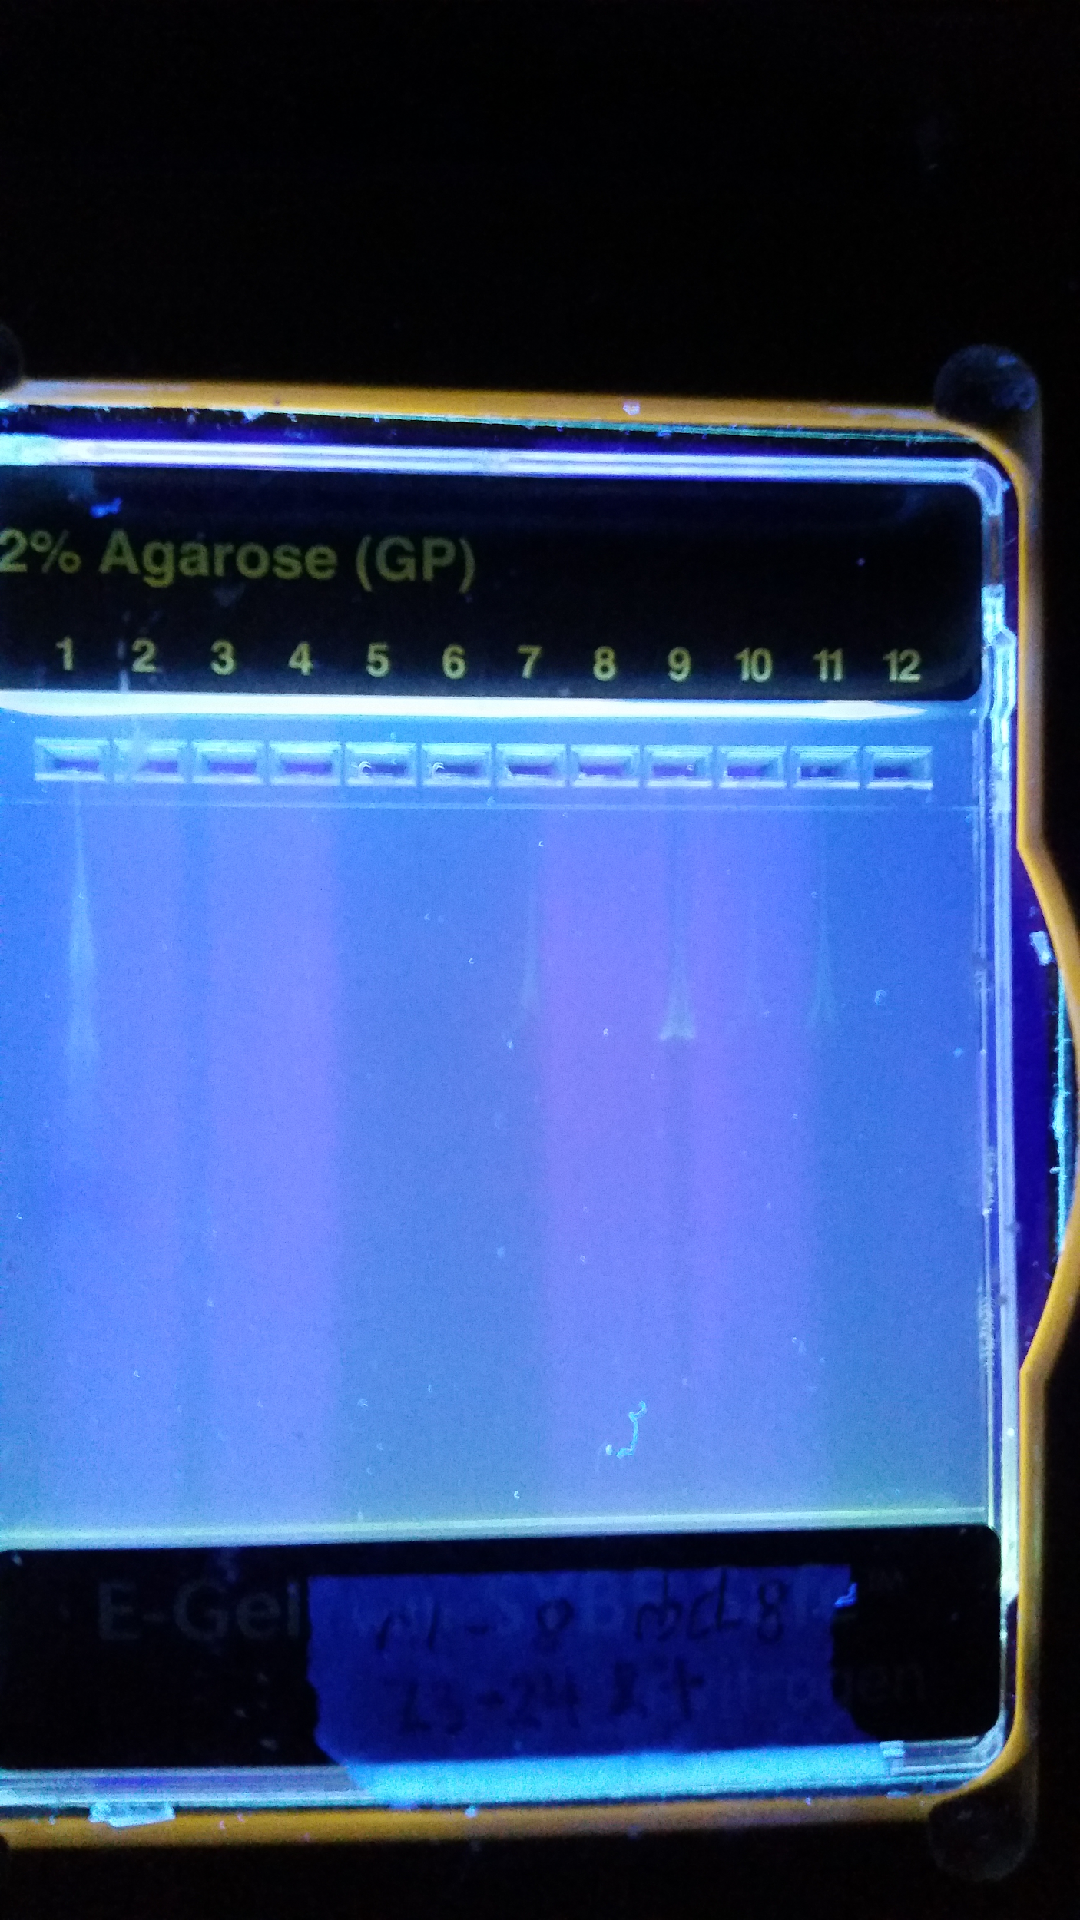
Abstract
Effect of Microwave Exposure on
the DNA of Carrot Food Products
Conclusion
Despite their presence in 90% of American homes, there is controversy on the usage of microwave ovens. Popular belief is that microwave ovens affect the structure of food. To study the effect of microwave radiation on the genetic structure of food products, three different types of carrot food products were microwaved and their DNA was analyzed. Carrots were chosen for this experiment, as they are inexpensive, widely available, nutritious, and high in water concentration (87% water). Microwave ovens work most efficiently on food products with higher water concentrations. Samples of organic raw baby carrots, conventional raw baby carrots, and baby carrot puree were sequenced after exposure to different intervals of time in a microwave oven. 25 different samples of carrot DNA were sequenced and analyzed with the primer rbcl for Polymerase Chain Reaction (PCR). Results show that exposure of carrot food products to microwave oven radiation does not alter their genetic material. Few base pair mismatches were identified in each sample and all samples were identified as Daucus carota (carrot). Future work may include use of a different primer, other than rbcl, to examine other parts of the carrot DNA strand.
Emily Press, Katherine N. Sung, Zemei (Emma) Zhou
Tenafly High School
This experiment’s goal was twofold:
To determine whether or not exposure to the radiation of microwave ovens genetically alters carrot food product DNA.
Studies show genetic alteration effects of plant DNA after exposure to UV rays and other electromagnetic waves:
An increased growth rate of plant roots.
Double Strand Breakage (DSB) in DNA (which can be lethal to cells).
No preliminary research found during performed literature research on the effects of microwave oven exposure on food products.
To conclude whether or not a sample of carrot baby food product contained actual carrots.
Microwave oven radiation does not affect the DNA of carrot food products
Determined through analysis of base pair mismatches between samples before and after exposure to the microwave oven.
All sequenced products were identified as Daucus carota (carrot) including the baby food samples.
Determined through analysis of base pair mismatches between samples and accepted carrot DNA.
Previous studies have suggested that microwave ovens are a perfectly safe alternative to conventional preparation methods.
Energy conservation.
Nutrition conversation.
Results of our experiment support microwave safety.
No genetic alteration of food products.
Methods
Figure 1: E-Gel with SYBR Safe Sample #1-11 | Figure 2: E-Gel with SYBR Safe Sample #12-22 | Figure 3: E-Gel with SYBR Safe Sample #23-25
Carrots (organic and conventional) and carrot puree were organized into three groups: organic carrots, conventional carrots, and baby food carrot puree.
Each group (organic, conventional, puree) had a total of 6 samples, microwaved for varying intervals of time.
Prepared samples were ground in solution to breakdown cellular composition and release DNA. Samples were incubated after each addition of reagents, including lysis solution, silica resin and distilled water. When the final supernatant containing the isolated DNA was procured, the tubes were placed in a container of ice and stored for three days at -20 degrees Celsius.
After three days, 12.5 µl of Taq mix and 10.5 primer mix were added to each tube, which already contained 2µl of isolated DNA sample. Polymerase Chain Reaction (PCR) was run in a thermal cycler to amplify the DNA samples.
After PCR, gel electrophoresis was used to analyze the DNA samples and determine which were qualified for sequencing.
Sequences were compared with the accepted carot genome on file for GenBank through DNA Subway (an online application used to compare sequenced strands of DNA).
Percent mismatches were recorded through MUSCLE (Multiple Sequence Comparison by Log-Expectation) - a software within DNA Subway.
Experimentation occurred at both Cold Spring Harbor DNA Lab and Tenafly High School.
iPlant Collaborative's online DNA Subway program used the GenBank database to match sample carrot DNA sequences to accepted carrot DNA.
The small number of base pair mismatches, found using the online program DNA subway to compare sample sequences, supported the hypothesis that a microwave oven would not have a significant effect on carrot product DNA.
MUSCLE found percent similarities between the sample sequences and an accepted carrot DNA sequence.
All samples were identified as Daucus carota (carrots).
According to Table 1, despite varied time intervals in a microwave oven, the amount of base pair mismatches did not change significantly.
The amount of exposure time in the microwave oven is not related to the genetic alteration of food product.
Introduction
All food processing results in a loss of nutrients.
Issues of sustainability have led to an effort to find innovative solutions to nutrient and energy conservation, e.g. in food processing.
Despite FDA approval, there are stigmas associated with the use of microwave ovens, but previous studies support that microwave ovens are safe, nutritionally conservative and electrically efficient.
90% of American homes today possess at least one of these appliances.
It is important to understand their reheating process and how it affects food structure and nutritional value.
This study aimed to investigate the relationship between microwave oven exposure and genetic material of food products.
A microwave consists of three parts; a magnetron, waveguide and food chamber.
Magnetron produces electromagnetic microwaves, waveguide directs waves into the food chamber, and chamber in turn heats food.
Electromagnetic waves with a wavelength from 1 mm to 30 cm.
Uses dieletic heating to directly heat food.
Operates at 600-1650 watts.
Uses 60% of their energy.
Conventional growth - plants grown with the use of fertilizers.
Organic growing methods - plants grown without any synthetic chemicals or genetically modified organisms (GMOs).
Conventional raw carrots, organic raw carrots and carrot baby food puree, were exposed to different intervals of time in microwave oven and studied.
Hypotheses:
There would be no significant base pair mismatches in a comparison of the sample carrot DNA with an accepted carrot DNA sequence, regardless of exposure time in the microwave oven.
Both the raw baby carrots and carrot baby food puree would be correctly identified as Daucus carota (carrots).
DNA was sequenced before and after exposure.
DNA extraction and amplification, polymerase chain reaction (PCR), gel electrophoresis and DNA sequencing were performed
The number of base pair mismatches for each sample was recorded and compared with the accepted carrot genome.
Acknowledgements
TRIFOLD AREA – THIS GUIDE WILL BE REMOVED BEFORE PRINTING – TRIFOLD AREA – THIS GUIDE WILL BE REMOVED BEFORE PRINTING – TRIFOLD AREA – THIS GUIDE WILL BE REMOVED BEFORE PRINTING – TRIFOLD AREA – THIS GUIDE WILL BE REMOVED BEFORE PRINTING – TRIFOLD
TRIFOLD AREA – THIS GUIDE WILL BE REMOVED BEFORE PRINTING – TRIFOLD AREA – THIS GUIDE WILL BE REMOVED BEFORE PRINTING – TRIFOLD AREA – THIS GUIDE WILL BE REMOVED BEFORE PRINTING – TRIFOLD AREA – THIS GUIDE WILL BE REMOVED BEFORE PRINTING – TRIFOLD
We would like to thank Dr. Melissa Lee for sharing her urban barcoding expertise with us and supervising all lab procedures.
Also, we would like to thank our teacher, Mrs. Helen Coyle, for dedicating much of her time and effort to guide us in conducting our own original research. We are grateful for the support and encouragement of our classmates and families.
Results
Discussion
Despite scientific evidence of microwave safety and efficiency, popular belief is still that microwave ovens cause molecular damage to food products. The result analysis of this experimentation does not support this popular belief, but instead supports the hypothesis that microwave oven exposure does not alter the genetic composition of DNA in carrot food products.
Carrot food products have high water content.
Allow them to be heated quickly and efficiently.
Future study may include:
The development of potential microwavable food products.
Modification of water concentration.
Minimization of nutrient loss.
Primers target specific sections of sample DNA for replicatio.n
It is not definitively known that all carrot DNA in this study was unaltered.
Further exploration with other primers may provide new information.
More targeted studies may include:
Sequencing the part of the carrot genome connected to growth rate.
Experimenting with primers to search for Double Strand Breakage (DSB).
Electromagnetic microwaves create nodes within the food chamber - the relationship between the strength of microwave exposure and the genetic material of food products could be explored in future studies.
Concerns include:
Whether or not to make microwave radiation uniform.
Carrot samples experienced microwave exposure in the same way that food products consumed do.
Manipulating how the electromagnetic waves reach the carrot could skew results and disrupt the study.
References
Table 1: Results Showing the Successful Sequenced Samples
Sample Number | Sample Description (all samples purchased 12/4/15) | Time in Microwave (s) | # of Mismatches | Species Identified
1 | Organic Baby Carrot | 0 | 0 | Daucus carota
3 | Organic Baby Carrot | 0 | 4 | Daucus carota
5 | Organic Baby Carrot | 0 | 0 | Daucus carota
7 | Non-Organic Baby Carrot | 0 | 0 | Daucus carota
11 | Non-Organic Baby Carrot | 0 | 0 | Daucus carota
13 | Baby Food | 0 | 2 | Daucus carota
15 | Baby Food | 0 | 1 | Daucus carota
2 | Organic Baby Carrot | 60 | 4 | Daucus carota
14 | Baby Food | 60 | 0 | Daucus carota
4 | Organic Baby Carrot | 120 | 0 | Daucus carota
10 | Non-Organic Baby Carrot | 120 | 0 | Daucus carota
6 | Organic Baby Carrot | 240 | 0 | Daucus carota
18 | Baby Food | 240 | 0 | Daucus carota
"Nutritional Effects of Food Processing." – NutritionData.com. Condé Nast, 2014. Web. 25 Jan. 2016.
<http://nutritiondata.self.com/topics/processing>.
"Microwave Cooking and Nutrition." - Harvard Health. Harvard Health Publications, 02 Jan. 2015. Web. 25 Jan. 2016.
<http://www.health.harvard.edu/staying-healthy/microwave-cooking-and-nutrition>.
O'connor, Anahad. "The Claim: Microwave Ovens Kill Nutrients in Food."The New York Times. The New York Times, 16 Oct. 2006. Web. 25 Jan. 2016.
<http://www.nytimes.com/2006/10/17/health/17real.html?_r=1&>.
"Stove versus Microwave: Which Uses Less Energy to Make Tea?" Scientific American. N.p., 11 June 2009. Web. 26 Jan. 2016.
<http://www.scientificamerican.com/article/stove-versus-microwave-energy-use/>
(n.d.). Retrieved December 9, 2015, from
<http://dictionary.reference.com/browse/microwave>
Liegey, P. (2001, October 16). Microwave Oven Regression Model. Retrieved November 19, 2015, from <http://www.bls.gov/cpi/cpimwo.htm>
"How a Microwave Oven Works." YouTube. YouTube, 26 June 2012. Web. 25 Jan. 2016.
<https://www.youtube.com/watch?v=kp33ZprO0Ck>.
Microwave oven. (2015, December 4). Retrieved December 9, 2015
<https://en.wikipedia.org/wiki/Microwave_oven>
Rastogi, Nina Shen. "Microwave or Conventional Ovens: Can Nuking Your Food Help Save the Planet?" Washington Post. The Washington Post, 06 Aug. 2009. Web. 26 Jan. 2016.
<http://www.washingtonpost.com/wp-dyn/content/article/2009/08/05/AR2009080501317.html>.
Experiment Protocol | DNA Barcoding 101. (n.d.). Retrieved November 19, 2015,
<http://www.dnabarcoding101.org/protocol_collecting_specimens.html>
Conventionally grown. (2015, October 15). Retrieved December 9, 2015, from
<https://en.wikipedia.org/wiki/Conventionally_grown>
DNA Sequencing Fact Sheet. (2015, November 3). Retrieved December 9, 2015,
<https://www.genome.gov/10001177>
"List of Fruits & Vegetable With a High Water Content." Healthy Eating. N.p., n.d. Web. 25 Jan. 2016.
<http://healthyeating.sfgate.com/list-fruits-vegetable-high-water-content-8958.html>
Cold Spring Harbor Laboratory DNA Learning Center. Using DNA Barcodes to Identify and Classify Living Things. N.p.: n.p., 2014. Print.
Ramezani, V., A, M., T, N., & S, A. (2012, August 1). Study of Effects of Extremely Low Frequency Electromagnetic Radiation on Biochemical Changes In Satureja Bachtiarica L. Retrieved November 23, 2015, from
<http://www.ijstr.org/final-print/August2012/Study-of-Effects-of-Extremely-Low-Frequency-Electromagnetic-Radiation-on-Biochemical-Changes-In-Satureja-Bachtiarica-L.pdf>
Gill, S., Anjum, N., Gill, R., Jha, M., & Tuteja, N. (2014, November 4). DNA Damage and Repair in Plants under Ultraviolet and Ionizing Radiations. Retrieved October 8, 2015,

