Slide 1
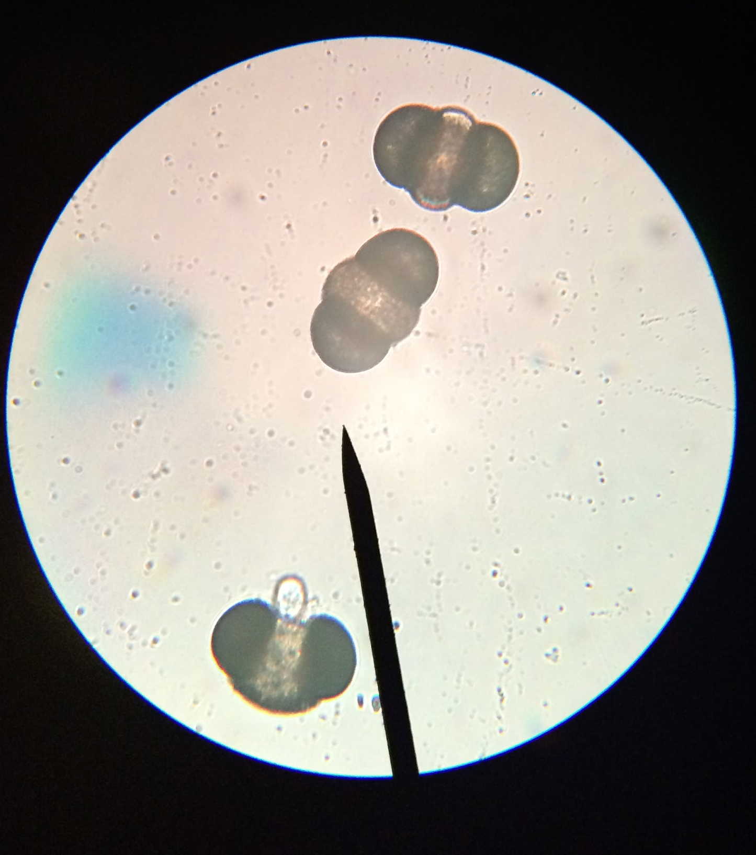
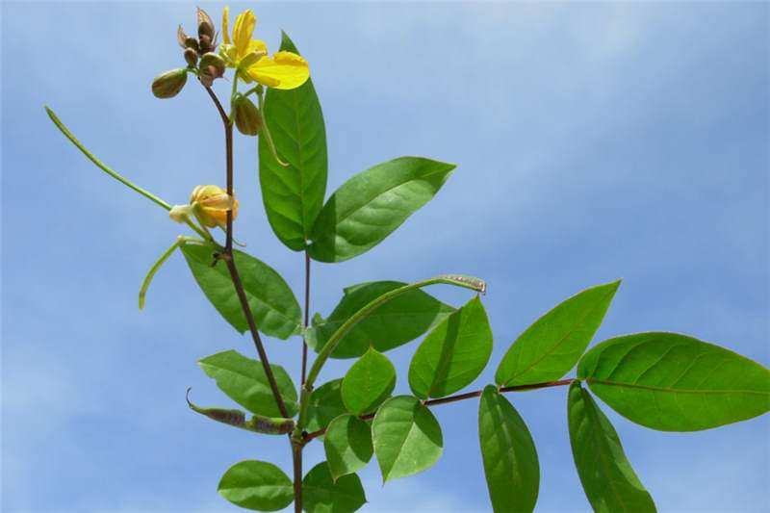
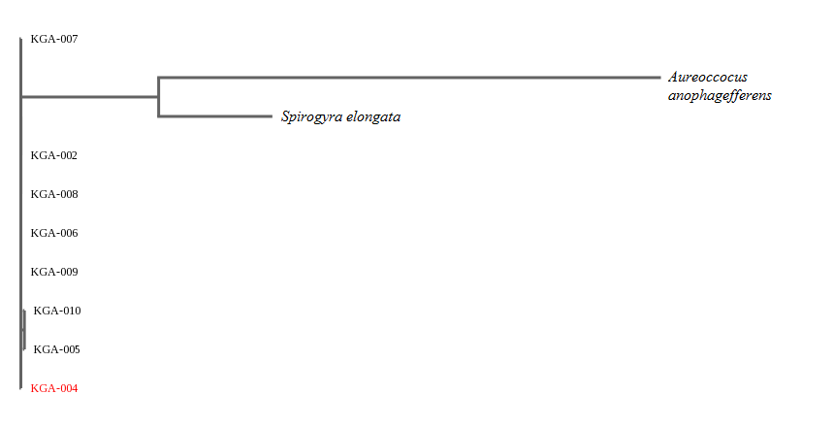
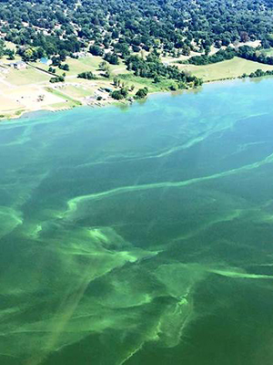
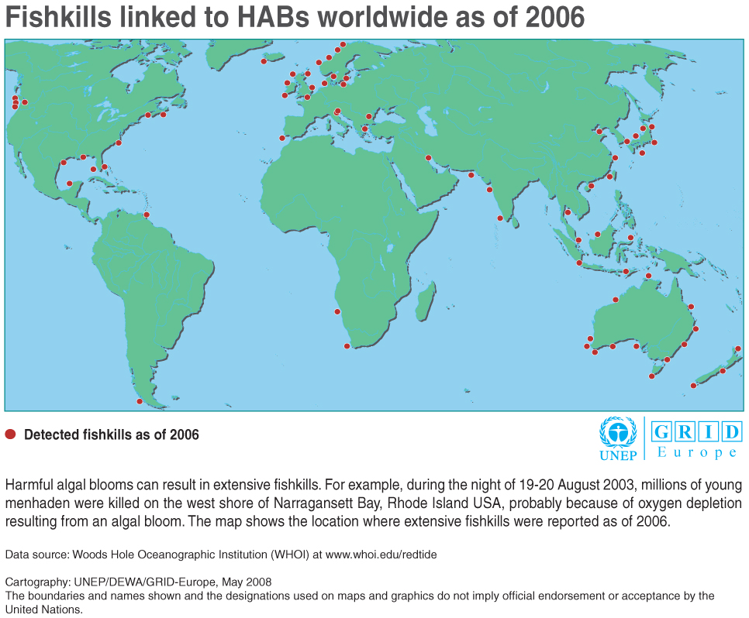
Harmful Algal Blooms in the Hudson River: an analysis of the use of rbcL primer on algae
Maya Amitai, Vivian Kim, and Dr. Christine Marizzi
ABSTRACT
HYPOTHESIS
DISCUSSION
Algal blooms are rapid increases in the population of algae in an aquatic system. Harmful algal blooms (HABs) are toxic algal blooms that damage the ecosystem of marine environments generally caused by dinoflagellates. HABs are colloquially known as red tides. In 2010, the Hudson River experienced a red tide outbreak. Due to recent progress made by environmental advocacy groups in the area, we sequenced algae samples in various locations in the Hudson River. Upon coming up with unrealistic results, we compared our data with imported sequences of algal species that are common to the Hudson River; we did this in order to gauge the effectiveness of the rbcL primer used to sequence our samples. We then used tufA algal primer to sequence different samples.
We hypothesize that we will find a diverse range of algae species but no evidence of harmful algal blooms.
The species found in the Senna genus were flowers rather than algae. They are not common to the NYC metropolitan area. In fact, they are naturally found in Australia, eastern Africa, and southeastern United States. Senna occidentalis, nicknamed Coffee Senna, is a small slender shrub. Senna auriculata, used to make tea., is a legume tree that occurs in the dry regions of India and Sri Lanka. The deviations in terms of habitat and characteristics led us to the assumption that our resilts were unrealistic.
METHODOLOGY
We collected samples along the New Jersey side of the Hudson River in 10ml test tubes. Once we collected our samples, we observed them under microscopes and preserved them with Lugol’s solution, which is comprised of one gram of iodine crystals and two grams of potassium iodide for every 300 ml of water. Three drops of the solution were used per 100 ml.
We then extracted and sequenced our samples, following standard procedures. After extracting the DNA we began the process of amplifying by PCR using rbcL primer. We placed our test tubes in a thermal cycler which amplified the DNA. Once the DNA was amplified, we analyzed the product by gel electrophoresis to see which samples were successfully extracted. Next, we sent our samples out for sequencing and analyzed the results using bioinformatics. At this point we were able to identify which species we had collected. We did not get the results we expected from our sequences; consequently, we used GenBank to import sequences of algae obtained with the use of rbcL and compared them to the sequences we had obtained.
Due to our original results, we resequenced our samples using the tufA algal primer but did not get any results. Instead, we recollected samples from the Piermont pier in New York. We chose to do so because we believed our erroneous results were caused by the rbcL primer not being specific enough and picking up other plant life in our samples, thus skewing our results.
Figure 3.1
This photo displays a Senna occidentalis flower.
INTRODUCTION
Algal blooms are rapid increases in the population of algae in an aquatic system. Though blooms can occur naturally, they can also be caused by an excess of nutrients, such as nitrogen and phosphorous, which can be linked to pollution. Harmful algal blooms (HABs) are toxic algal blooms that damage the ecosystem of marine environments and are colloquially known as red tides. These red tides have been associated with large-scale mortality events in marine environments; they produce neurotoxins which kill fish, sea turtles, and seabirds. Humans can be killed by ingesting seafood contaminated by algal blooms. In the United States, HABs have occurred in multiple geographic regions.
In 2010, the Hudson River experienced a red tide outbreak, and all boaters and swimmers were encouraged to stay away from the water. We sequenced algae samples from the Hudson River, and used our results to generate a better understanding of the health of the river.
CONCLUSION
Figures 1.3, 1.4
These figures show our samples under 40x magnification.
The use of the rbcL primer with our samples led us to overall unrealistic results. However, our recollected samples which were analyzed using tufA primer did not yield results. We now think they may have been contaminated with pollen due to the time of collection. In the future, we will recollect and resequence our samples using algal primers.
RESULTS
Nine out of our ten samples were identified using rbcL. However, contrary to expectations, all results produced were in the Senna genus, a genus of flowering plants common in tropical regions. We compared our results using Phylip ML in DNA Subway with two species found in the Hudson River: Spirogyra elongata, a unicellular green algae, and Aureococcus anophagefferens, the first known species to cause an algal bloom in the Hudson River using GenBank to create a phylogenetic tree.
REFERENCES
Bastin, P. (n.d.). Water Quality - Running Cleaner? Retrieved October 10, 2015. http://www.dec.ny.gov/docs/remediation_hudson_pdf/hresoh15p04.pdf
Entwisle, T., & Nairn, L. (Eds.). (n.d.). How to Preserve FW Algae. Retrieved October 4, 2015.
http://plantnet.rbgsyd.nsw.gov.au/PlantNet/fwalgae/Introduction/preserve.htm
How is the Hudson Doing? (n.d.). Retrieved October 8, 2015.
http://www.dec.ny.gov/lands/77105.html
Perlman, H. (n.d.). Nitrogen and Water. Retrieved October 13, 2015 http://water.usgs.gov/edu/nitrogen.html
What causes algal blooms? (n.d.). Retrieved October 3, 2015
http://www.cees.iupui.edu/research/algal-toxicology/bloomfactors
Figure 2.1
This figure shows a phylogenetic tree comparing our samples to Aureococcus anophageferens, a species of algae prevalent in HABs.
http://hermannfall2015ohs4100.blogspot.com/2015/11/harmful-algae-blooms.html
Figure 1.1
Figure 1.2
This figure shows sites where HABs have directly caused fish kills.
This figure shows a green
algal bloom in the Ohio River in 2015.
Figure 2.3
This figure shows a phylogenetic tree comparing our samples to both Aureococcus anophageferen and Spirogyra elongata.
Figure 2.2
This figure shows the phylogenetic tree compar our samples to Spirogyra elongata, a species of algae commonly found in the Hudson River.
Notes:
We sequenced the samples by pipetting the algae out from the bottom of the test tube. Then, we placed each sample in a tube and added the lysis solution. Once the solution was added, we ground the sample to break the cell wall. After incubating the sample for ten minutes at 65℃, we centrifuged our sample for one minute so that the particles were separated based on their size. Then, we transferred the supernatant to a fresh tube to separate the lysis from the solids still present in our original tube. We then added silica resin to the new tube. Silica resin binds to the DNA and removes it from solution. After mixing, we incubated the sample once more for 5 minutes at 57℃ and then centrifuged again. By doing this, we ensured that the solid was below the liquid. At that point, the solid pellet at the bottom of the test
tube was what contained the DNA we were looking for. We then removed the supernatant by inverting the test tube. Following that, we added a wash buffer. Then we vortexed the test tube and inserted it into a centrifuge, remove the supernatant by inverting the test tube a second time, and add more wash buffer. We removed the supernatant once more, added dH₂O, and mixed by pipetting in and out. After incubating for 5 minutes at 57℃ and centrifuging for 30 seconds, we transferred the supernatant to a fresh tube.
After extracting the DNA we began the process of amplifying it by PCR. We first used a test tube with a primer mix to each of which we will add 2 microliters of DNA. We placed the test tube in a thermal cycler which amplified the DNA. Once the DNA is amplified we analyzed the product by gel electrophoresis, to see which samples were successfully extracted. We began by pouring gel into a container and letting it set for 20 minutes. We then loaded the gel with the PCR products and electrophoresed it at 130 volts for 30 minutes.
Next, we sent our samples out for sequencing and analyzed the results using bioinformatics. At this point we were able to identify which species of algae we had collected.
notes - rbcl primer, tufA primer, PCR

