Slide 1
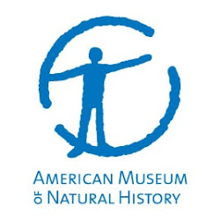



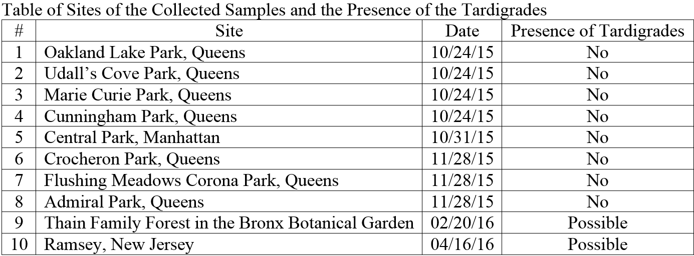
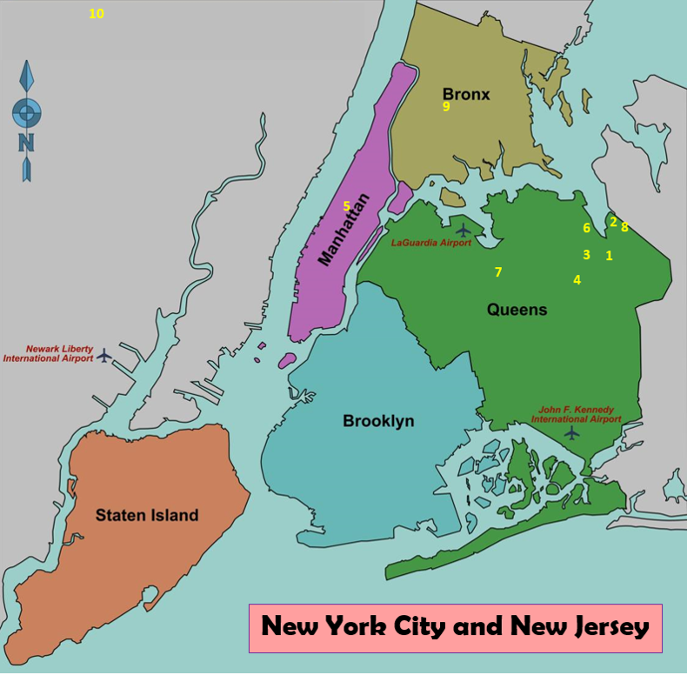
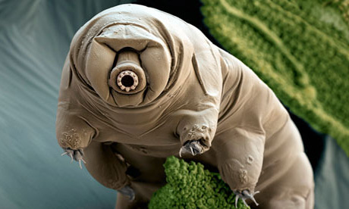
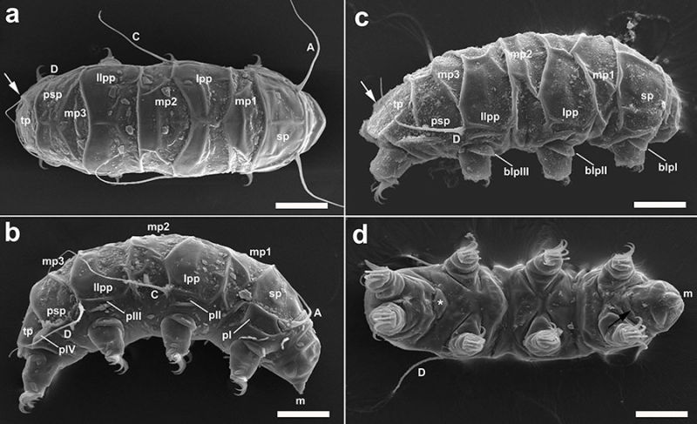
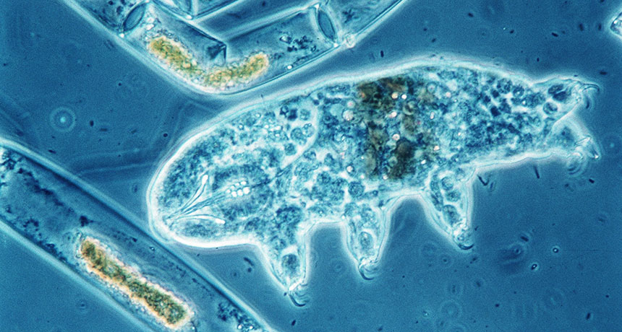
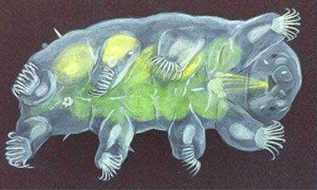
Tardigrades of New York City: Decline of Polyextremophile Diversity in an Urban Ecosystem
Authors: Edwin Lin¹ & Patricia Weinstein²
Mentor: David Kizirian³
¹Bronx High School of Science, ²Fiorello H. LaGuardia High School of Music & Art and Performing Arts
³The American Museum of Natural History
abstract
Materials and methods
Tardigrades are incredibly resilient micro metazoans that can survive in environments inhospitable for most organisms. With these amazing abilities to endure the extremes, it would seem logical then to live in New York City despite the high pollution. Our main goal was to determine if there were any populations of these tiny creatures in or around the city, and if there were any to see how large those groups were. We collected samples at the Thain Family Forest in the New York Botanical Garden and in several other city parks. Samples were also collected in New Jersey to test the success of our sampling techniques. No tardigrades were found in any of the city localities where samples were collected, but one was found in the New Jersey sample. Therefore, it could be concluded that the techniques used to sift through the samples and separate tardigrades were successful. Furthermore, there were just none to be found. There are various reasons why no tardigrades were found in New York City samples, such as the weather or pollution. However, it is possible for the areas of the city where we collected samples to not have large tardigrades populations.
The materials used in this study included knives, plastic bags, Petri Dishes, pipettes, spring water, microscopes, PCR machine, pestles, test tubes, water bath, centrifuge, UV light box, buffer, and silicon.
The specific places we collected samples were in the Thain Family Forest in the Botanical Garden, Central Park in Manhattan, several parks in Queens, a suburb of New Jersey (see the map in the Results).
All of our samples were collected between the hours of 11 am and 4 pm throughout the year (see the table in the Results for the collection dates).
Samples would be collected by either scraping with a knife (for lichens) or softly removing moss using gloved hands in large amounts on trees and rocks.
The moss or lichens would each be placed in separate plastic bags each labeled in marker, and then stored in a refrigerator in closed bags before analysis.
During analysis, the samples would then be placed in spring water to sit for 10 to 15 minutes. After this time, the moss or lichen would be squeezed tightly over the water multiple times and removed.
The water containing smaller debris would then be poured into Petri Dishes to be analyzed under a microscope.
Once the tardigrades were identified under the microscopes, the samples were collected into small tubes.
After that, we used the DNA Barcoding Procedure to separate and analyze any DNA of tag found in our samples.
The final steps involved using PCR to amplify the tardigrade genetic sequences and running a Gel Electrophoresis to sort out the DNA fragments.
At the end, the samples were sent for sequencing to a bio-technology company receive the bioinformatics results back from the company, to analyze the biodiversity of tardigrades in New York City.
INTRODUCTION
  Tardigrades are micro metazoans, or tiny multicellular creatures from mesic habitats worldwide are known for their capacity to withstand extreme environmental conditions.
  Some species can survive without water in a state called cryptobiosis for up to 10 years.
  While in this cryptobiotic state, tardigrades are able to withstand temperatures of over 300 degrees Fahrenheit and under -400 degrees Fahrenheit, as well as high levels of radiation, and low levels of water.
  Because of their capacity for tolerance of extreme habitats, it is possible some species exist in urbanized environments (Bordenstein, 2014).
  Perhaps they can be used for further studies on their genome in “hopes of uncovering the most basic of underpinnings of the creature’s extreme survival strategies.”
  Past research showed that on a beach on Rockaway Point, Queens County, where tardigrades were found in 1972 (Martinez, 1975).
  The question we focused on was, “Have tardigrades remained in New York City after 1970?”.
  The proposed hypothesis was that if tardigrades had been found in the city in the past, then they could still remain in reasonably sized populations because they are incredibly durable and resilient creatures.
DISCUSSION
Several possible reasons why there were only a few samples that potentially contain tardigrades.
There were both time and area limits to collecting the samples.
After collecting samples from the Thain Family Forest in the Bronx Botanical Garden, the park staff reported that there was an unusual growth spike in lichens inside the forest. This could have been caused by our unintentional disturbance of that environment that changed its ecology.
The Thain Family Forest in the Bronx Botanical Garden and Ramsey, New Jersey are more likely to have tardigrades because at these sites, the land is less developed and thus remain close to their pristine condition.
We didn’t find samples of tardigrades in the other 8 sites in Manhattan and Queens, possibly because they are located in more developed environments with relatively higher levels of pollution than the Bronx and New Jersey sites. Since these samples were collected from city parks, which contain smaller areas of vegetation.
Compared with the presence of tardigrades in New York City in 1972 (Martinez, 1975), none were found in this project during the 2015-2016-time period. The reasoning behind this difference can be explained by the growing human development of the areas previously mentioned.
results
The table and map show the 10 sites where and when the samples were collected.
The sites were distributed across Queens, Manhattan, Bronx, and New Jersey. Several bags were collected at each of the sites.
Out of these 10 sites, only the Thain Family Forest in the Bronx Botanical Garden and Ramsey, New Jersey showed possible presence of tardigrades.
Those samples were sent to a bio-technology company for sequencing to see if these samples do contain tardigrade DNA. We are currently waiting for the results to come back.
On the contrary, the rest of the 8 sites in Manhattan and Queens showed no presence, but there were plenty of other microorganisms such as diverse worms and bacteria, and plant matter.
REFERENCES
Bordenstein, Sarah. 2014. Tardigrades (Water Bears). Marine Biological Laboratory.
Dean, Cornelia. 2015. “The Tardigrade: Practically Invisible, Indestructible ‘Water Bears”. NY Times.
Martinez, E. 1975. Marine meiofauna of a New York City beach, with particular reference to tardigrada. Estuarine and Coastal Marine Science 3:336-348.

