Slide 1




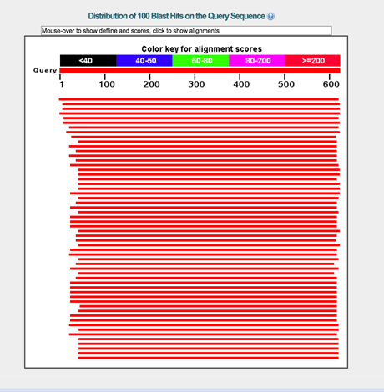
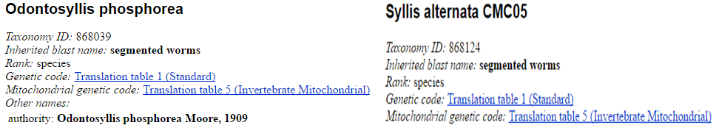
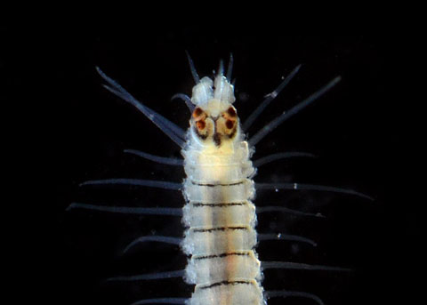
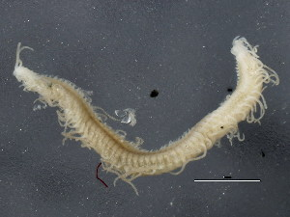
Biodiversity of Persian Gulf Worms through DNA Barcoding and Bioinformatics
Crandol C¹, Liyanage IG¹ , Verdes A², Gorson J² and Krampis K³*
^{1.} Science Research Program, Francis Lewis High School, Queens, NY; ^{2.} Department of Chemistry, Hunter College of The City University of New York, NY; ^{3.} Department of Biological Sciences, Hunter College of The City University of New York, NY
Abstract
Biological specimen identification using DNA barcoding is a taxonomic method that uses short genetic markers in an organism’s DNA to identify a particular species in combination with bioinformatics tools. Our goal is to identify the genetic diversity of the population of unidentified genus of the Syllidae marine sponge worms collected from the intertidal zone in Florida. Through the use of barcoding for identification of the species in our samples collected and in comparison with data from earlier studies, we tracked the evolution of worm populations in the area over time. In our samples, we amplified the mitochondrial cytochrome c oxidase I (COI) through PCR and compared them by performing a nucleotide BLAST (Basic Local Alignment Search Tool) to the GenBank reference sequence database (http://blast.ncbi.nlm.nih.gov/). By identifying species which match our COI sequence within the same genus, we found that Odontosyllis phosphorea and Syllis alternata (99%) had the highest sequence match (99%). In contrast, their E. values (3e-171 vs 4e-120) showed that Odontosyllis phosphorea was more related to the samples we collected. By looking at the overall BLAST results, we concluded that the diversity of a species population in a specific area can depend on evolution, an organism can begin to die out if it fails to adapt to the competition and environment around it, but often, the extinct species are replaced with newer ones.
Results
Data analysis shows many organisms demonstrating a high sequence similarity value has the least differences in base pairs. Out of the six Florida samples from the Nucleotide BLAST database, both Odontosyllis phosphorea (99%) and Syllis alternata (99%) had highest Query cover. However their E. values (3e-171 vs. 4e-120) signified that Odontosyllis phosphorea importance compared to other species because of a smaller E-value. Therefore, Odontosyllis phosphorea has the closest similarities to the unknown sequence.
Figure 2. The Query sequence is demonstrated through this color key alignment scores. Each color reps. sequence. The longer the red band, the more similar the sequence resents the similar base pairs shared by the databased organisms and are between each sample.
Introduction
Understanding interspecies interactions can be determined by DNA Barcoding. It helps tie different species together evolutionarily, by measuring the genetic variation and changes in taxonomy.
BLAST (Basic Alignment Search Tool) compares different species based on their DNA sequence. For example, we can use the “Nucleotide Collection (nr/nt)” database that allows a narrow search on all nonredundant nucleotide databases at NCBI, by selecting the search to be restricted as narrow as to species within the same genus type or as broad as kingdom classification.
The score of the alignment of the unknown species from an organism in the database determines how related the two are. The score for each alignment is calculated by adding together the scores for the individual base pairs in the alignment. Higher score values show closer relationships.
Expect Value (E-value) Determines the probability for the hit to the database and alignment to be by chance. The lower the value, the more related the unknown species is to the known species. The higher the value, the less related the unknown species Query Cover.
Percent similarity between the query and subject sequences over the length of the coverage area
List of different species from most similar to least similar that appears on the BLAST page is called a Hit.
Discussion
We discovered new genus of the Phyllodocida worms which assess that biodiversity of the ecosystem is growing due to selective pressure near the intertidal zone.
Due to coevolution of similar protein functions across different species, the nucleotide bases are similar, but the species are not related.
Comparing the taxonomy of the Odontosyllis phosphorea (Taxonomic ID: 868039) and Syllis alternata (Taxonomic ID: 868124) there are closely similar however they are genetically diverse since there are two different genus. However, should any human DNA be found in the BLAST results, it shows the samples were contaminated and the results are invalid. However, it does show that BLAST works consistently.
Odontosyllis phosphorea
Syllis alternata
Acknowledgements
We would like to thank the Urban Barcode Research Program for all of their assistance. We would also like to thank all family memeber who put up with all of late night researching!
References
Ali, M. A., Gyulai, G., Hidvégi, N., Kerti, B., Hemaid, F. M., Pandey, A. K., & Lee, J. (2014).
The changing epitome of species identification – DNA barcoding. Saudi Journal of
Biological Sciences,21(3), 204-231
BLAST help. (2007, April 16). Retrieved January 08, 2016, from
http://www.ncbi.nlm.nih.gov/blast/Why.shtml
Deheyn, DD, Latz MI. 2009. Internal and secreted bioluminescence of the marine polychaete
Odontosyllis phosphorea (Syllidae). Invertebrate Biology. 128: 31-45.
Thomas, T., Gilbert, J., & Meyer, F. (2012, February 9). Metagenomics - a guide from sampling
to data analysis, from http://www.ncbi.nlm.nih.gov/pmc/articles/PMC3351745/
Valentini, A., Pompanon, F., & Taberlet, P. (2009). DNA barcoding for ecologists. Trends in
Ecology & Evolution, 24(2), 110-117
Materials & Methods : DNA Extraction Protocol
To isolate the DNA, we have to mince the sample and transfer it into a 1.5 mL microcentrifuge tube.
Using a vortex, the solution is mixed thoroughly and incubated at 55ºC in a water bath for ten minutes then the DNA is then isolated using a centrifuge.
To maintain a constant pH value, BL Buffer is added, and following incubation pure ethanol is addedt as well.
The DNA is washed using DNA Wash Buffer and using a HiBind DNA Mini Column is transferred ino a nuclease-free 1.5 mL microcentrifuge tube with 100-200 µL elution buffer.
After the elution steps and centrifuging is repeated for a second time, and then store we store our eluted DNA at -20ºC for the barcoding.
We performed the gel electrophoresis and in all but one sample, we were about to see the CO1 gene being expressed in the gel.

Slide 2
Biodiversity of Persian Gulf Worms through DNA Barcoding and Bioinformatics
Crandol C1, Liyanage IG1 , Verdes A2, Gorson J2 and Krampis K3*
Institutional affiliations for each author
Introduction
DNA Barcoding
- A method used for understanding interspecies interactions
- Helps to tie different species together evolutionarily
- Measures the genetic variation and changes in taxonomy
BLAST (Basic Local Alignment Search Tool)
Compares different species based on their biological sequences
Quick and efficient when sequencing DNA
Score
- The score of the alignment of the unknown species from an organism in the database determines how related the two are
Expect Value (E. value)
Determines the probability for the hit to the database and alignment to be by chance
The lower the value, the more related the unknown species is to the known species
The higher the value, the less related the unknown species Query Cover
Percent similarity between the query and subject sequences over the length of the coverage area
Hits
-List of different species from most similar to least similar that appears on the BLAST page
Materials & Methods
DNA Extraction Protocol
To isolate the DNA, we have to mince the sample and transfer it into a 1.5 mL microcentrifuge tube.
Using a vortex, the solution is mixed thoroughly and incubated at 55ºC in a water bath for ten minutes then the DNA is then isolated using a centrifuge.
To maintain a constant pH value, BL Buffer is added, and following incubation pure ethanol is addedt as well.
The DNA is washed using DNA Wash Buffer and using a HiBind DNA Mini Column is transferred ino a nuclease-free 1.5 mL microcentrifuge tube with 100-200 µL elution buffer.
After the elution steps and centrifuging is repeated for a second time, and then store we store our eluted DNA at -20ºC for the barcoding.
We performed the gel electrophoresis and in all but one sample, we were about to see the CO1 gene being expressed in the gel.
Results What did you find? groups you mentioned in the Materials and Methods
Show results for each one of the different experimentalection.

Slide 3
Your UBRP Summary Report title
Your names (in alphabetical order) & your mentor’s name
Institutional affiliations for each author
Abstract
A succinct summary of your project.
The abstract from your summary report can also be used as the abstract for your poster.
Introduction
What question was asked?
This section provides background for the reader so that they can understand the precise question you are asking, and why your study is of scientific interest. Use your summary report's Introduction to develop the Introduction on your poster. On your poster you can add more details and better justify your research question.
Materials & Methods
How was the question answered?
Use your summary report's Materials and Methods to develop this section and provide details of any modifications to the original protocol.
Results
What did you find?
Show results for each one of the different experimental groups you mentioned in the Materials and Methods section.
Tables & Figures
For example: Map of GPS coordinates where samples were collected
Pie charts to showing types/numbers of samples analyzed
Table of BLAST search results
Phylogenetic trees (using different methods)
Table showing sequence similarities among/within species or populations
Figure linking the sample localities with their placement in the phylogenetic tree
Discussion
How does this answer your question? What do these findings mean? Be objective in the interpretation of your results. Avoid making judgments. Remember, openly discussing unexpected results, difficulties, or mistakes is central to the scientific process.
References
Document and credit all the sources of information you used for your project at the bottom of your poster. Whenever you state a fact that is based on the results of someone else’s research, you must cite their work in the proper format.
Acknowledgements
Thank people/organizations that assisted them in doing the research. These can include collaborators, funders and reviewers.

