Slide 1
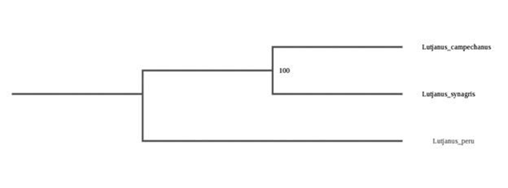
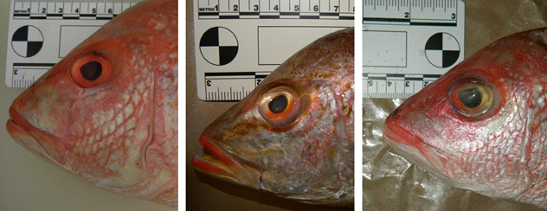
Using DNA Barcodes to Identify Mislabeled Red Snappers Sold in New York City Fish Markets
Ajenae Jackson¹, Darvin Huang², Richard Li³
¹ NYC Museum School, ²Hunter College High School, ³John Jay College of Criminal Justice
Abstract
The practice of substituting species of fish can have an economic impact on consumers. Namely, more expensive fish are substituted by cheaper ones. Red snapper is one of the most common fish related to seafood mis-labeling. In this study, the species of substituted fishes were successfully identified utilizing CO1 barcoding technique. Our findings were consistent with our previous studies in our laboratory. To improve the success rate of CO1 DNA barcoding technique, two fish barcoding primer sets were compared for the identification of red snappers. Among all three Lutjanus species, our results showed that the Baldwin primers performed better than the Fishcocktail primers in barcoding results.
Introduction
Mislabeled fish were often found in New York City fish markets (Wong & Hanner, 2008). Usually more expensive fish are substituted by cheaper ones. Previously, a pilot study carried out in our laboratory suggested that red snapper is a common fish related to seafood mis-labeling in New York City fish markets (Chan et al., 2014). In the States, the only species that can be officially considered the red snapper is Lutjanus campechanus (Gomes et al., 2008). L. campechanus is a reef fish found in the Western Atlantic off the Southern U.S. coast and the Gulf of Mexico (Rasmussen and Morrissey, 2008). L. campechanus is often substituted by the less expensive fishes in the Lutjanus family. Visual examination is not easy to distinguish these closely related species.
In this study, we carried out additional studies to confirm if the substitution of red snapper was an on-going problem. Additionally, to improve the success rate of CO1 DNA barcoding technique, two fish barcoding primer sets were compared for the identification of red snappers.
Discussion
Our results revealed that mislabeled red snappers were found in local fish markets. Our findings were broadly consistent with our previous studies. Often, more expensive fish, L. campechanus, was substituted by cheaper ones: L. peru (pacific red snappers) and L. synagris (lane snappers). Our sequence analysis confirmed that they were closely related species in Lutjanus family (Figure 1). Additionally, these species exhibited similar morphological characteristics (Figure 2); thus it was difficult to distinguish them visually. Additionally, two primer sets for fish barding were compared in our experiments. Among all three Lutjanus species, our results suggested that the Baldwin primers performed better than the Fishcocktail primers in barcoding results. This study can potentially make a contribution to the field of food forensic science and to the investigation of a wide variety of cases involving illegal seafood mis-labeling.
References
Baldwin C, Mounts J, Smith D, Weigt L (2009) Genetic identification and color descriptions of early life-history stages of Belizean Phaeoptyx and Astrapogon (Teleostei: Apogonidae) with comments on identification of adult Phaeoptyx. Zootaxa: 1-22
Chan L, Arteage R, Li R. (2014) Mislabeled Red Tailed: DNA Barcoding of Red Snappers Found in New York City Fish Market. Urban Barcode Research Program, Cold Spring Harbor Laboratory, Summary Report.
Gomes G, Santos S, Vallinoto M, Schneider H, Orti G, I S (2008) Can Lutjanus purpureus (South red snapper) be “legally” considered a red snapper (Lutjanus campechanus)? Genet Mol Biol 31(Suppl. 1): 372-376
Rasmussen RS, Morrissey MT (2008) Application of DNA-Based Methods to Identify
Fish and Seafood Substitution on the Commercial Market. Comprehensive Reviews in Food Science and Safety 8: 118-154
Wong E, Hanner R (2008) DNA barcoding detects market substitution in North American seafood. Food Res Int 41: 828–837
Acknowledgements
This project was supported by Urban Barcode Research Program. We thank Dr. Christine Marizzi (DNA Learning Center, Cold Spring Harbor Laboratory) for helpful assistance.
Table 1. Primers used in this study.
Primer Name |  | Direction | Sequence
Baldwin | Fish-BCL | Forward | 5'-TCAACYAATCAYAAAGATATYGGCAC-3' (M13 sequence not shown)
 | Fish-BCH | Reverse | 5'-ACTTCYGGGTGRCCRAARAATCA-3' (M13 sequence not shown)
Fish Cocktail | VF2_t1 | Forward | 5'-TGTAAAACGACGGCCAGTCAACCAACCACAAAGACATTGGCAC-3'
 | FishF2_t1 | Forward | 5'-TGTAAAACGACGGCCAGTCGACTAATCATAAAGATATCGGCAC-3'
 | FishR2_t1 | Reverse | 5'-CAGGAAACAGCTATGACACTTCAGGGTGACCGAAGAATCAGAA-3'
 | FR1d_t1 | Reverse | 5'-CAGGAAACAGCTATGACACCTCAGGGTGTCCGAARAAYCARAA-3'
Table 2. The identification of the species of fish samples collected.
Species Identified | Number of Sample Sequenced and analyzed
Lutjanus campechanus | 4
Lutjanus peru | 12
Lutjanus synagris | 6
Table 3. A comparison of the barcoding success using two sets of primers.
Fish Species | Baldwin Primers | Fish Cocktail Primers
Lutjanus campechanus (true red snapper) | 100% | 50%
Lutjanus peru (pacific red snapper) | 100% | 92%
Lutjanus synagris (lane snapper) | 83% | 67%
Materials & Methods
Fish samples were randomly collected from fish markets in the New York City boroughs. The DNA was extracted from approximately 0.1 g of specimen using the QIAamp DNA Micro Kit (QIAGEN) according to the manufacturer’s protocols. The extracted DNA was amplified with the CO1 primers. Two sets of primers were used (Table 1): Baldwin primers according to Baldwin et al. (2009) and Fishcocktail primers according to UBRP procedures. The amplified products were verified using gel electrophoresis using the UBRP procedures. The samples were then analyzed using Sanger sequencing at GENEWIZ. The sequence analysis was performed using DNA Subway software.
Figure 1. Phylogenetic analysis of the fish samples collected. The DNASubway software was used to obtain this phylogenetic analysis.
Results
Three fish species were identified among the samples collected (Table 2). True red snappers--L. campechanus were found (18% of sample collected). Additionally, mislabeled fishes were found: L. peru (pacific red snappers; 55% of sample collected) and L. synagris (lane snappers; 27% of sample collected). Barcoding results using two primer sets also were compared. The success rates of barding using the Baldwin primers were higher than that of the Fishcocktail primers in all three fish species (Table 3).
Figure 2. Representative photographs of the fish samples collected. From left to right: L. campechanus, L. synagris, and. L. peru.

