Slide 1


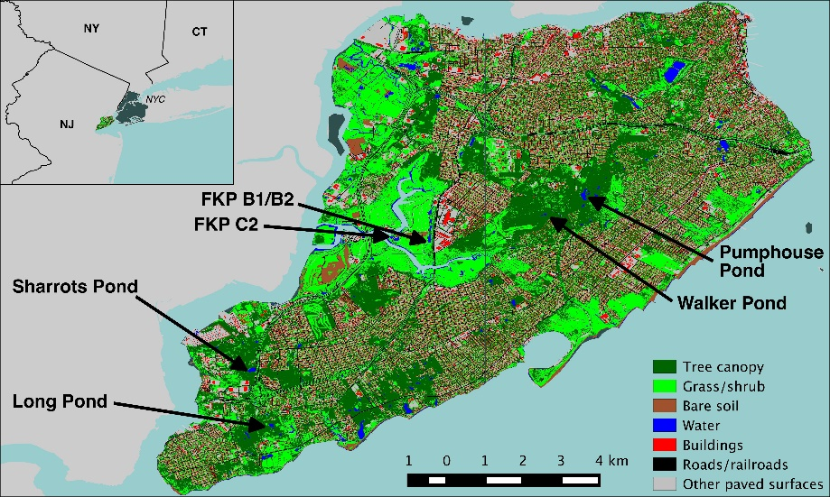
Aquatic Plants and Algae growth in Freshwater Ponds on Staten Island, New York
Nada Ahmed and Salma Ahmed Co-Mentors: Eugenia Naro-Maciel, Seth Wollney
Tottenville High School, College of Staten Island
Abstract
Our main objective was to explore aquatic plants and algae on Staten Island in two approaches, the first of which is that we barcode the samples and then compare them with current literature. Aquatic plants and turtle shell algae were collected in the summer of 2015 on varying areas on Staten Island. C. picta and C. serpentina, also known as the painted turtle and the snapping turtle, respectively, are two known species that carry epizoic algae that we investigated. The materials needed are the Rbcl primer and the GE beads to aid in the DNA extraction process. Twelve out of thirteen results were successfully barcoded and the samples included six genera of aquatic plants. Even though our successful sequences did not include algae, it gave us much more information on the topic as a whole. With these results it was interesting to find invasive aquatic plants within Long Pond, which is considered one of the most natural places on Staten Island.
Introduction
C. picta and the C. serpentina, also known as the painted turtle and the snapping turtle, respectively, are two known species that carry epizoic algae. The green algae Basicladia chelonum is mostly epizoic in fresh water turtles, and was commonly found on the shells, as well as the heads and tails of these species of turtle. To this day, only one species of Basicladia chelonum has been found occurring regularly on fresh water turtles. In some cases the turtle is merely seen as a substrate, where it only provides an area for the algae to grow and disperse. Algae can also benefit the turtle by serving as a supplemental food source, though this is likely not the case with Basicladia chelonum. Other studies have shown that algal association with fresh water turtles may in fact provide insight into some history of these communities. Past studies have barcoded and identified the certain types of algae that grow on snapping and painted turtles. Our main objective comes in two parts: the first is to barcode and sequence the algae we collected and compare them with the current literature. The second main objective was to explore aquatic plants on Staten Island ponds using DNA barcoding.
Materials & Methods
The aquatic plants and turtle shell algae were collected in the summer of 2015 on varying areas on Staten Island. Turtle shell algae was collected from Sharrott’s Pond and Walker Pond, while the pond algae and aquatic plants were collected in Long Pond and Fresh Kills C2 Rain Water Basin. Figure 1 shows a map of Staten Island and depicts all the different lakes and ponds where the samples were collected. The samples that were collected were: algae from the backs of turtle shells, pond algae, and aquatic plants. The pond algae and aquatic plants were collected with dip nets and the turtle shell algae was scraped from the backs of turtles. In total there was twelve samples collected. The twelve samples of algae and aquatic plants were subjected to PCR using GE beads and a primer. After the samples went through the PCR process they were run through gel electrophoresis then sequenced at Genewiz. The results were then edited and BLASTed using DNA Subway.
Figure 1: This image depicts Staten Island and the various ponds and parks in which the samples were from. Credit to "Anthony Cak - ASRC, CUNY".
Results
Out of thirteen samples twelve were successfully sequenced using an rbcl primer (Table 1). Four were identified as being from the genus Myriophyllum. Three of the four were of the same species, M. heterophyllum, and one of them differed and was part of the M. simulans species. Five samples were from the genus Ludwigia, four were from the species L. adscendens, and one was from the species L. peploides. We also had an Abies firma, Nuphar advena, Potamogeton alpinus, and Lemna japonica, which were all one of a kind finds.
Tables & Figures
Table 1:This table is a representation of all the samples collected, the identified genus and species with common name, and the number of mismatches found from DNA Subway.
Discussion
Our two main objectives was to barcode algae from turtle shells and to explore aquatic plants on Staten Island through the use of DNA barcoding. Based on the results from DNA subway we were surprised to find out that out of the twelve samples barcoded none of the samples were algae. Instead all the samples were varying aquatic plants and one sample was a fir plant. One reason we might not have gotten algae is the primer we used. Rbcl is less reactive to algae than to aquatic plants, and one hypothesis is that Rbcl is more susceptible to plant material rather than algae. So instead of the algae sample was amplified the aquatic plant was. This shows that in future studies with algae Rbcl is not a good primer to work with.
References
Garbary DJ, Bourque G, Herman TB, Mcneil JA. Epizoic Algae from Freshwater Turtles in Nova Scotia. Journal of Freshwater Ecology. 2007; 22(4):677–685.
Neil WT, Allen ER. Algae on Turtles: Some Additional Considerations. Ecology. 1954; 35(4):581–584.
Acknowledgements
We would like to thank both our mentors Eugenia Naro-Maciel and Seth Wollney who were always there to help us throughout our DNA extraction. In addition, we would like to thank the College of Staten Island for providing a space for us to work in ever week. Finally we would like to thank the Urban Barcoding Research Program for giving us this opportunity to do this research. Without this program none of this research would have been possible.
ID Number | Species | Common name | Blast Results | Number of Mismatches
CPPT-L12L10R12 | Myriophyllum simulans | Watermilfoil | 100777 | 22
FK023-C | Abies firma | Fir | 15647 | 0
FKC-P1 | Ludwigia adscendens | Water primrose | 100712 | 0
FKC-P2 | Ludwigia adscendens | Water primrose | 100712 | 0
FKC-P3 | Nuphar advena | Pond lily | 69501 | 0
FKC-P4 | Myriophyllum heterophyllum | Watermilfoil | 100788 | 1
LP15-138 | Myriophyllum heterophyllum | Watermilfoil | 100788 | 1
LP15-139 | Ludwigia adscendens | Water primrose | 100712 | 0
LP15-140 | Potamogeton alpinus | Pondweed | AB196845 | 0
LP15-142 | Lemna japonica | Duckweed | AY034233 | 1
WP15-009 | Ludwigia adscendens | Water primrose | 100712 | 0
WP15-014 | Ludwigia peploides | Water primrose | 100727 | 16
HRST-L1R8 | Myriophyllum heterophyllum | Watermilfoil | 100787 | 27

