Slide 1



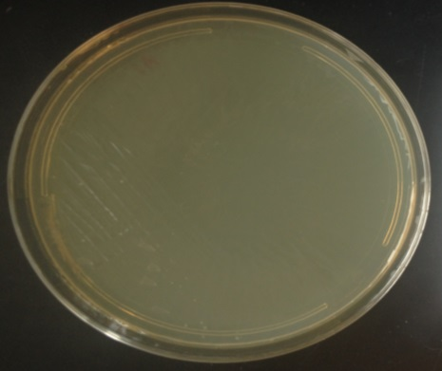
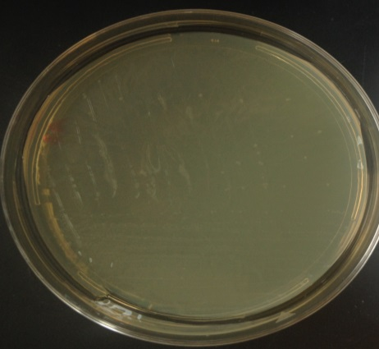
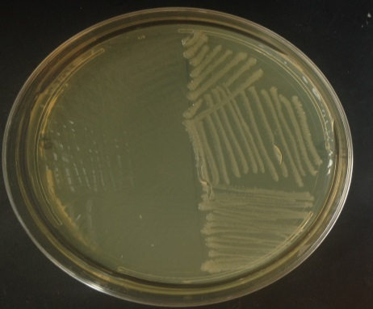
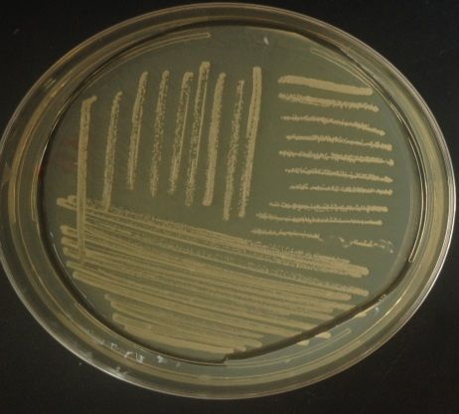
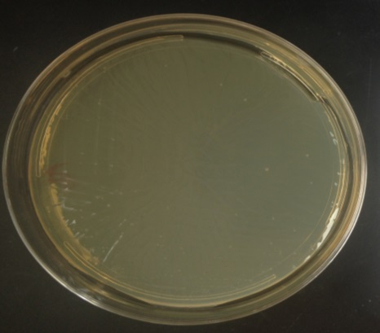
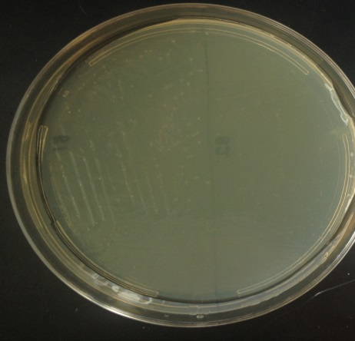
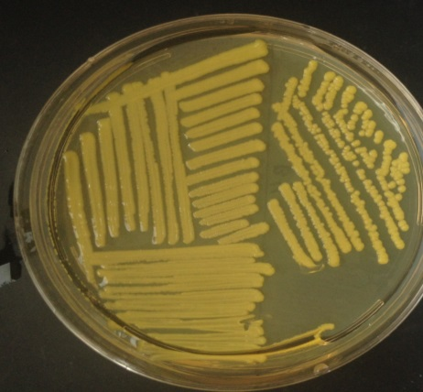
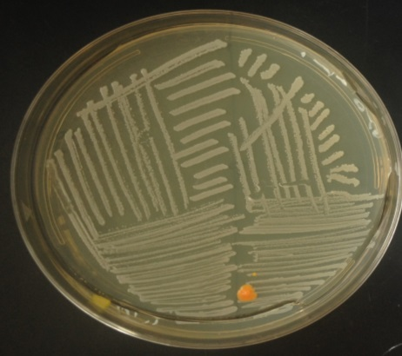
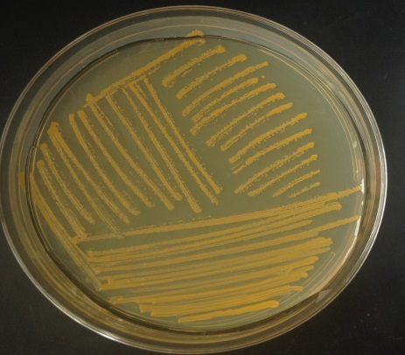
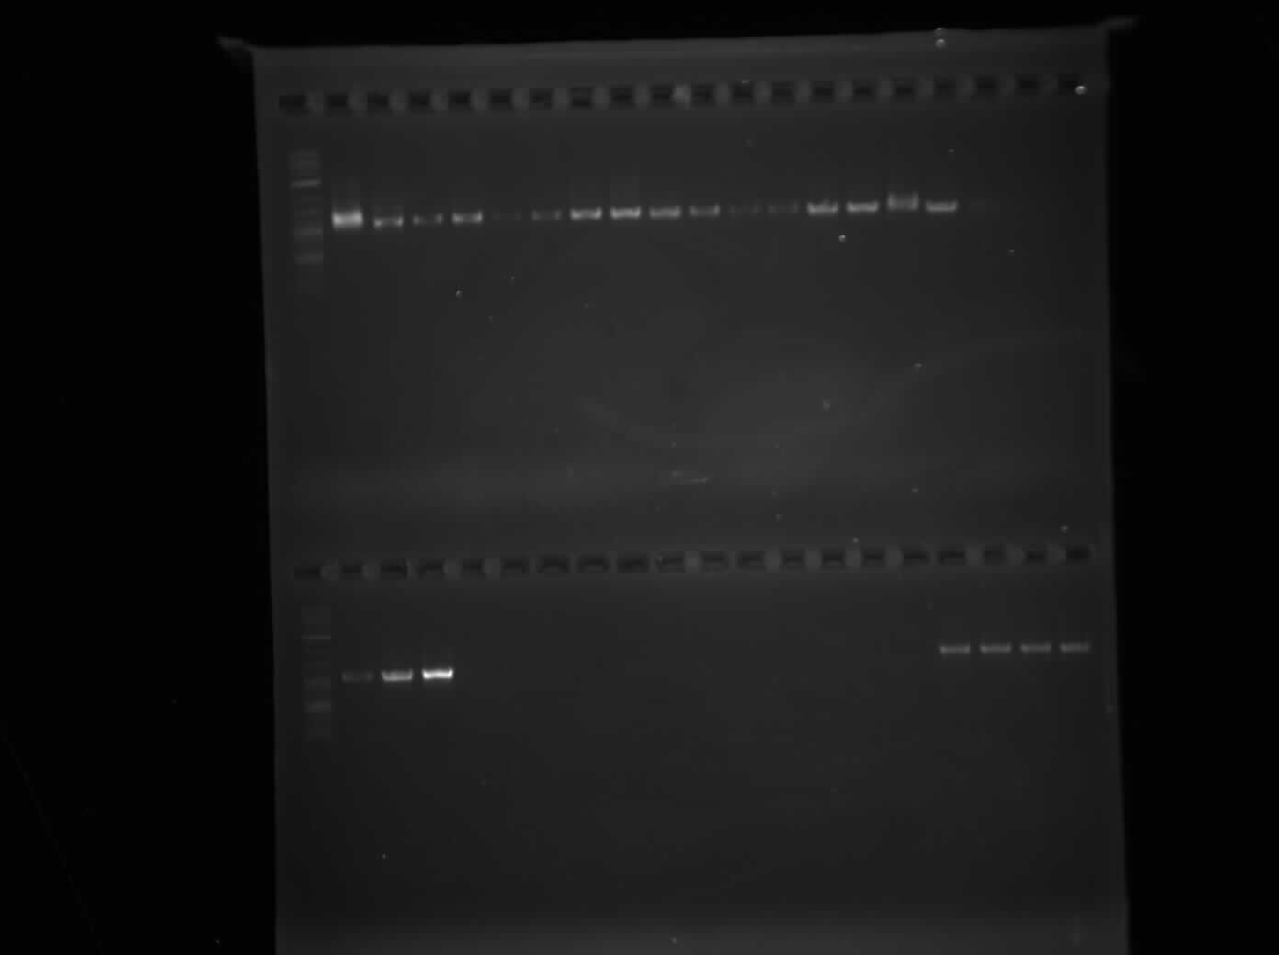
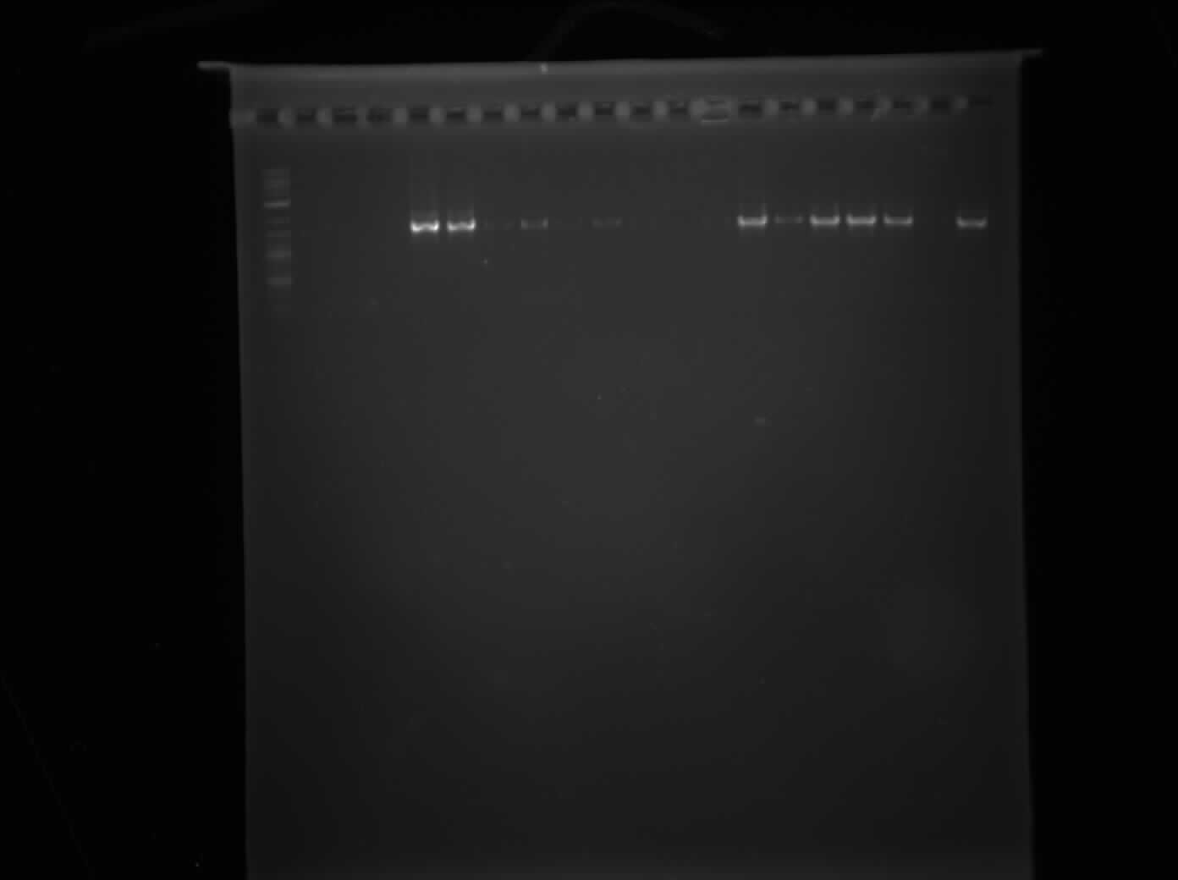
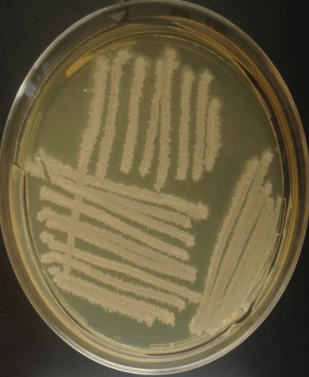
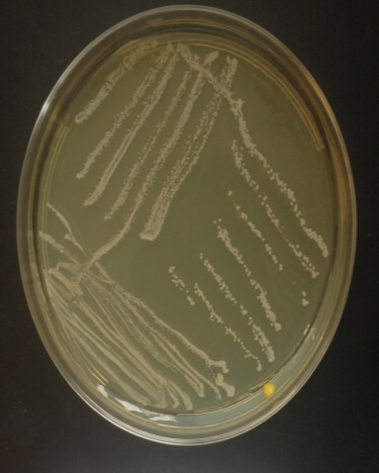
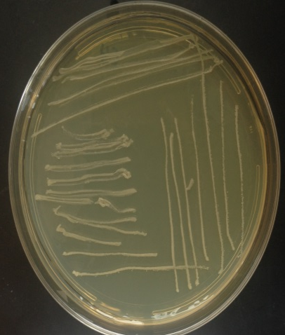
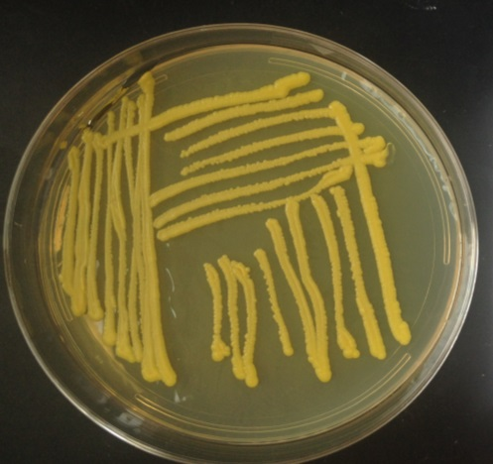
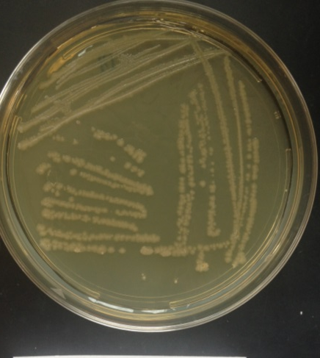
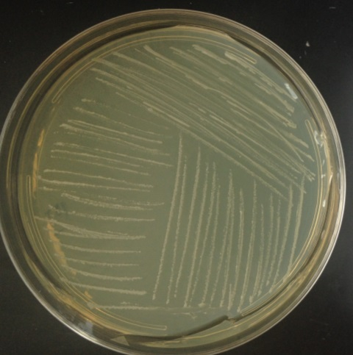
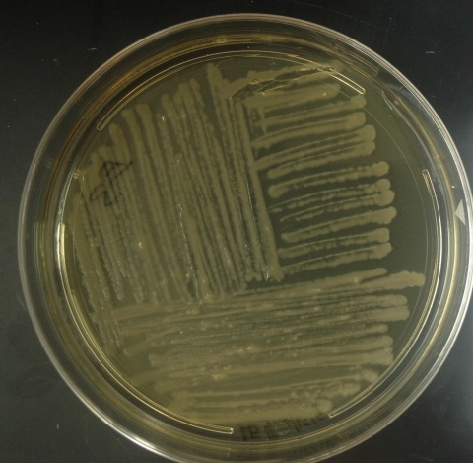
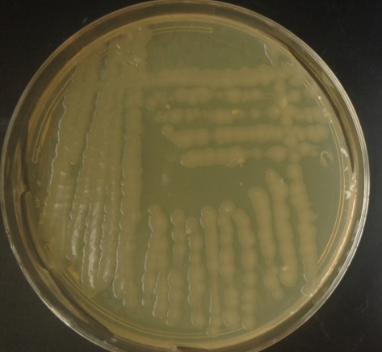
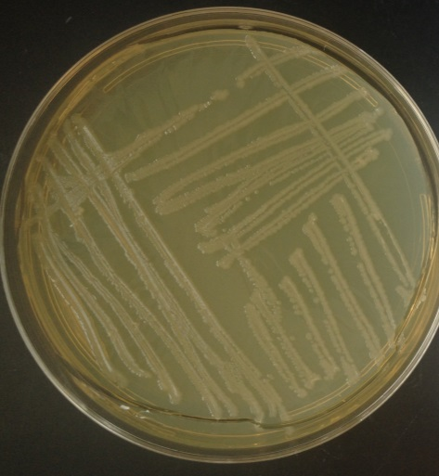
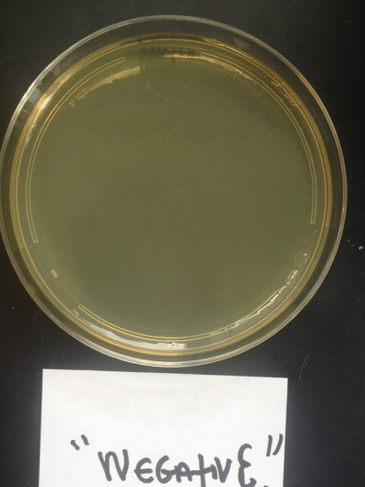
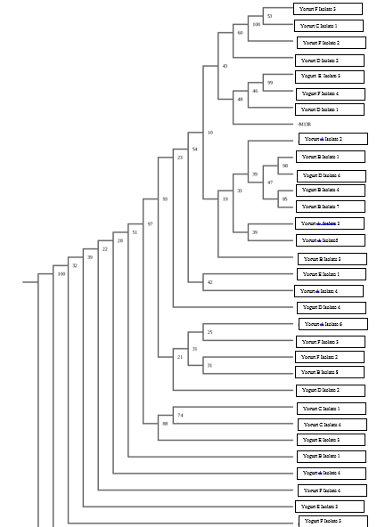
Detecting and Confirming the Presence of Probiotics in Yogurts
Authors: Emily Lo, Iris Yu
Mentors: Karen Conrad, Dr. Jason Rauceo, Ph.D.
Bronx High School of Science, Francis Lewis High School John Jay College Department of Sciences (CUNY), 524 West 59th St, New York, NY, 10019
Abstract
Defined as live microorganisms which confer a health benefit on the host, probiotics have been used to treat a wide range of diseases and ailments that affect humans and animals, including digestive, gastrointestinal, and immune system problems. Many probiotics are found in yogurts, a popular dairy product. The most common probiotics found in yogurts include those under the Lactobacillus, Streptococcus, and Bifidobacterium genera. DNA barcoding was utilized for this study to confirm the presence of probiotics in yogurts. Bacteria were isolated from the samples, and their DNA was extracted, amplified, sequenced, and analyzed using the DNA Subway software. Our results show bacteria are present in yogurts tested; however; these species were not as advertised. Instead of L. bactillus, which was the most widely advertised bacteria, a number of other bacteria were present, including Athrobacter globiformis, Bacillus coagulans, and chlorophyta.
Introduction
The yogurt industry is a multibillion dollar industry, with millions worldwide consuming yogurt products on a regular basis. Whatever the reason is for consumption, there is no doubt that one of these reasons include the health benefits of these products with claims of a plethora of probiotic bacteria in these yogurts. Probiotics have been used to both advertise and treat a wide range of diseases and ailments that affect humans and animals, including digestive, gastrointestinal, and immune system problems. The most common bacteria found in yogurts include those under the Lactobacillus, Streptococcus, and Bifidobacterium genera. With no clear indication as to whether or not these probiotics indeed exist in these yogurts, there is an urgent need to have a clearer validation of microbes present in these products.
Materials & Methods
Bacterial Isolation Results
DNA Extraction & Amplification Results
Yogurt A
Yogurt B
A1 A2 A3
A4 A5 A6
B1 B2 B3 B4 B5 B7 B8 B9 C1 C3
Isolate 1
Isolate 2
Isolate 3 & 4
Isolate 5
Isolate 6
Isolate 1 & 2
Isolate 3 & 4
Isolate 7 & 8
Isolate 9
C4 C5 D1
D5 E1E3F2F3 F4
D2 D4 Neg Pos
Yogurt C
Yogurt D
Yogurt E
Figure 2: Results of PCR reaction. DNA was extracted from bacteria and amplified via PCR. Samples were visualized on a 1.0% agarose gel stained with Ethidium Bromide. Neg= negative control (no DNA added). Pos = Positive control (DNA from E. coli bacterial cells)
Isolate 1 & 2
Isolate 3
Isolate 4 & 5
Isolate 1 & 2
Isolate 4 & 5
Isolate 1
Isolate 3
Yogurt F
Negative Control
Summary and Conclusions
Using BLAST results from the DNA Subway program, we were able to answer the question “What bacteria is really inside of yogurt?” However, the bacteria we found were not the ones listed and labeled on the yogurts. Bacteria such as Lactobacillus acidophilus, Streptococcus thermophilus were listed on the yogurts, but were not present in the results found. Rather, six types repeatedly came up: two unspecified strains from the Bacillus genus, Arthrobacter globiformis, uncultured Chlorophyta, Bacillus coagulans, Bacillus amyloliquefaciens, and Bacillus subtilis. Besides Bacillus coalugens, which may have probiotic uses, the other three aren’t what we typically expect to be in our foods. Arthrobacter globiformis is a bacteria found in soil. Bacillus coalugens is a lactic-acid forming bacteria. In humans, this is supposedly used to improve vaginal floral, abdominal pain and bloating in irritable bowel syndrome. Bacillus amyloliquefaciens produces a number of enzymes including a natural antibiotic protein barnase alpha amylase which is used in starch hydrolysis, the protease subtilisin in detergents, and the BamH1 restriction enzyme which is used in DNA research. This surprisingly show that there is a great presence of food mislabeling, and more confirmation and investigation into mislabeling is needed to clarify what goes in our bodies.
References
Beasley DE, Koltz AM, Lambert JE, Fierer N, Dunn RR, 2015. The Evolution of Stomach Acidity and Its Relevance to the Human Microbiome. PLoS ONE 10(7): e0134116. doi:10.1371/journal.pone.0134116
Salminen S, Gibson C, Bouley MC, et al. Gastrointestinal physiology and function: the role of prebiotics and probiotics. Br J Nutr 1998;80(Suppl 1):147-71.
Zivokovic M. Cadez N. et al. Evaluation of probiotic potential of yeast isolated from traditional cheeses manufactured from Srebia and Crotia. Scope Med
Acknowledgements
We thank Dr. J. Rauceo, K. Conrad, P. Fernandez, Cold Spring Harbor Laboratory, the Pinkerton Foundation, A. Florio, M. Lee, and C. Marizzi from the Urban Barcode Research Program.
Isolate 2
Isolate 3 & 4
Figure 1: Bacteria from the genera Bacillus isolated from yogurts. Bacterial samples were streaked onto LB plates. Single colonies were collected and re-streaked onto Lactobacillus selective plates (above). Cells collected from LB plates were used for DNA analyses.
Isolation
Bacterial samples were diluted and plated onto nutrient LB medium and Lactobacillus selective plates and grown for 24 hours at 37°C.
Genotyping
DNA was extracted from bacteria using QIAmp DNA Mini Kit
Sequencing
Amplified DNA was sent to the GeneWiz company for sequencing
Extracted DNA was amplified via PCR using two primer sets
DNA was visualized via gel electrophoresis on 1.0% agarose gels
Sequenced DNA was analyzed using the DNA Subway software
Figure 3: Phylogenetic tree. Generated from DNA Subway analyses. A: This illustrates the relationships between the bacteria that were streaked and the BLAST results. Once the data returned to us, we were able to use a phylogenic tree to see which bacteria were closely related to one another.

