Slide 1
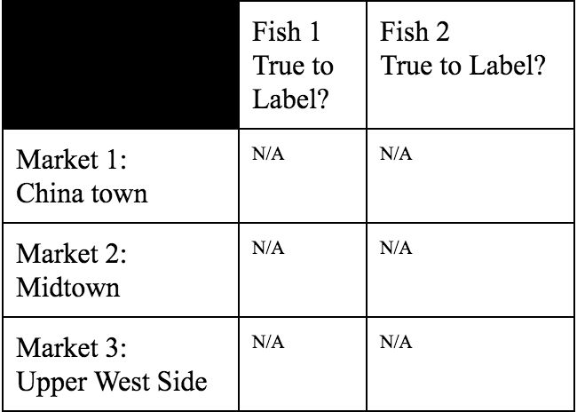
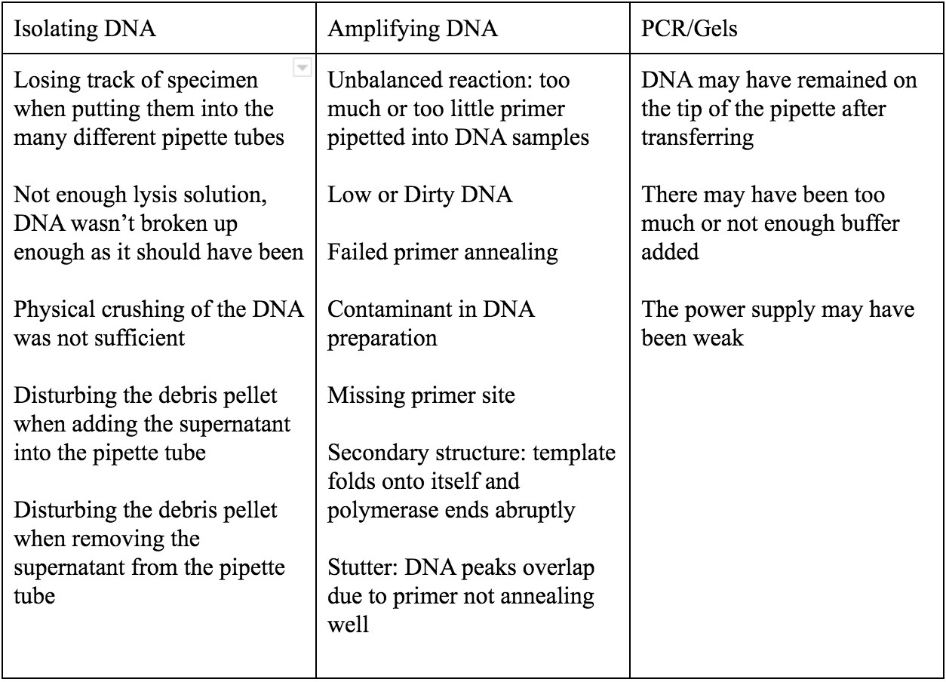
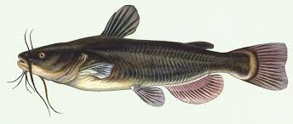
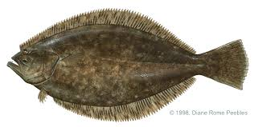
Fishy Labels
Zoe Antell, Eliza Epstein and Sarah Rockhill: Howard Waldman
Ethical Culture Fieldston School
Abstract
Lately there have been many rumors about fish markets mislabeling their products, generally selling cheaper fishes at the price of a higher quality fish. We decided to test this out, but from a more economic standpoint than many of the leading fish fraud experiments.The goal of our project is to see if there is any correlation between fish fraud and the price at which the fish is sold. In testing three different types of fish from different price ranges, from three different markets, we hope to support or disprove these rumors. We extracted DNA from each sample of fish, amplified it. The goal was to research the DNA and then compare the results the species of fish on their labels, but we were unsuccessful in our attempt. We were able to extract DNA from six of samples, however the DNA strands were not strong enough to yield any results.
Introduction
Have you ever doubted the label of the species of fish you were purchasing? Unfortunately, there are more scenarios of mislabeling than one might expect. There are approximately 30,000 known species of fish, but most fillet of fish look identical to the untrained eye. Once in awhile, customers question whether fish are what they claim to be, but not often enough. New York’s markets receive numerous shipments of food items from many different places, yet we rarely know exactly where our food came from. In an such a busy, urban area like New York, many of us live fast paced lives, and therefore we overlook the origin of the products that we purchase. Studies have shown that mislabeling of fish species does occur. In recent years, Oceana conducted a large seafood fraud investigation, collecting over a thousand seafood samples from 674 retailers in 21 different states; they were hoping to determine the honesty of their labels. The results showed that around 33% of the samples were mislabeled, according to FDA guidelines. Of the samples, Red Snapper and Tuna had the highest mislabeling rates, with respectively an 85% and a 59% rate of fraud.
To give a basic synopsis of the procedure, we went to three fish markets in total and took samples of three different types of fish at each. We extracted the DNA from each type of fish from each location and sent the amplified samples into the labs to be identified. The goal was to compare the results of each of the samples taking the price point of each store into consideration, however the DNA barcoding was unsuccessful, and we were not able to obtain any results.
Our goal in this experiment was to look more closely into the relationship how expensive fish is in correlation to how true is its label, and to practice the techniques of DNA extraction, amplification, and gel electrophoresis in order to become more experienced with these lab techniques.
Discussion
Once the sequences returned, we planned to determined if the labels matched up with the true DNA of the fish samples. We planned to use graphs and data analysis to determine whether there was a correlation between the price of the fish and the accuracy of its label. Due to these possible following errors, our DNA sequences returned with little to no match of species to sequence. DNA consists of a series of nucleotides denoted by the letters A, C, T, and G. When the DNA is unclear to the DNA Subway system, the identifiers replace these nucleotides with the letter N. Because our DNA ended up weak, our DNA primarily consisted of Ns. This meant that we could not analyze this DNA. The process of extracting DNA consists of many intricate details. Because of this, any of these small steps could have gone wrong ending in weak results.
Method
We went to three different fish markets, each with different price points. We took samples from three different types of fish from each market, and brought it back to the lab for extraction.
We extracted DNA from each fish sample, keeping the specimen organized and labeled to prevent error in the mix up of fish (considering that they are most likely all going to look very similar.)
We amplified the DNA by using a polymerase chain reaction.
The samples were tested using gel electrophoresis to confirm the presence of DNA, and then given to the lab to be sequenced.
The DNA sequence data base told us what species each of the samples that we sent in most likely were. In our case, this step was unsuccessful.
Materials:
Catfish (from three different markets)
Flounder (from three different markets)
Fish Primer (COI)
Pipettes
2-20 mL
.5-10 mL
20-200 mL
Gels
Gel Casting Tray
Gel Casting Combs
Masking Tape
Gel Electrophoresis (with power supply)
Agarose Solution
Centrifuge
Vortex
Wash Buffer
6 Microcentrifuge tubes
2 Plastic Pestles
Heating Block
Lysis Solution
Silica Resin
Thermal Cycler
Loading Dye Mix
Latex gloves
Results
Table:
Gels:
Possible Errors:
DNA Subway Outcome:
catfish
Flounder
Notes:
this is great

