Slide 1
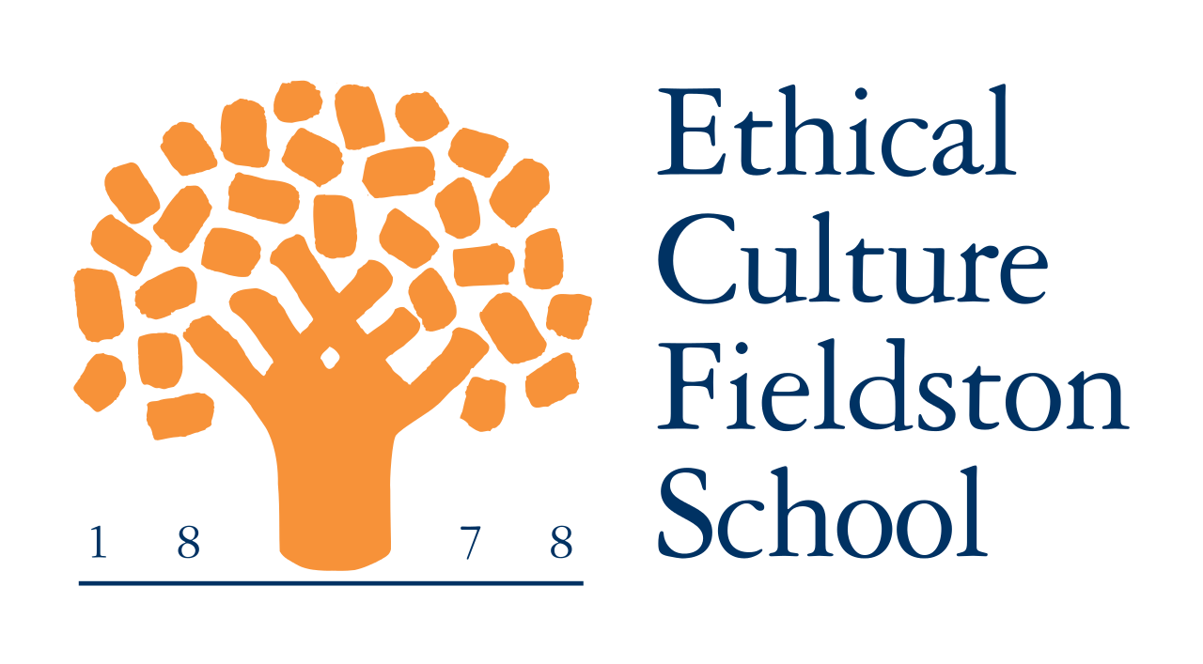
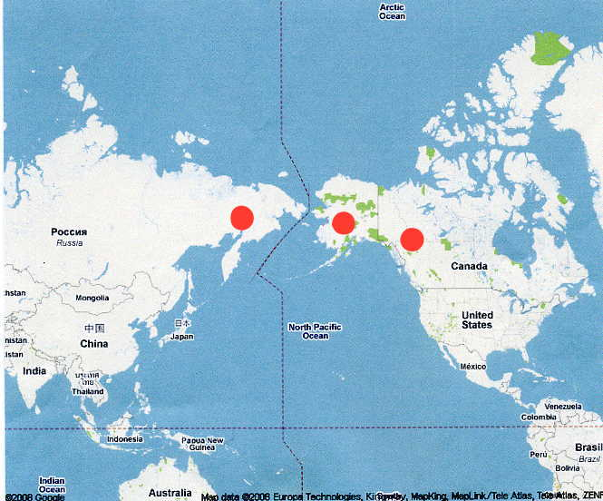
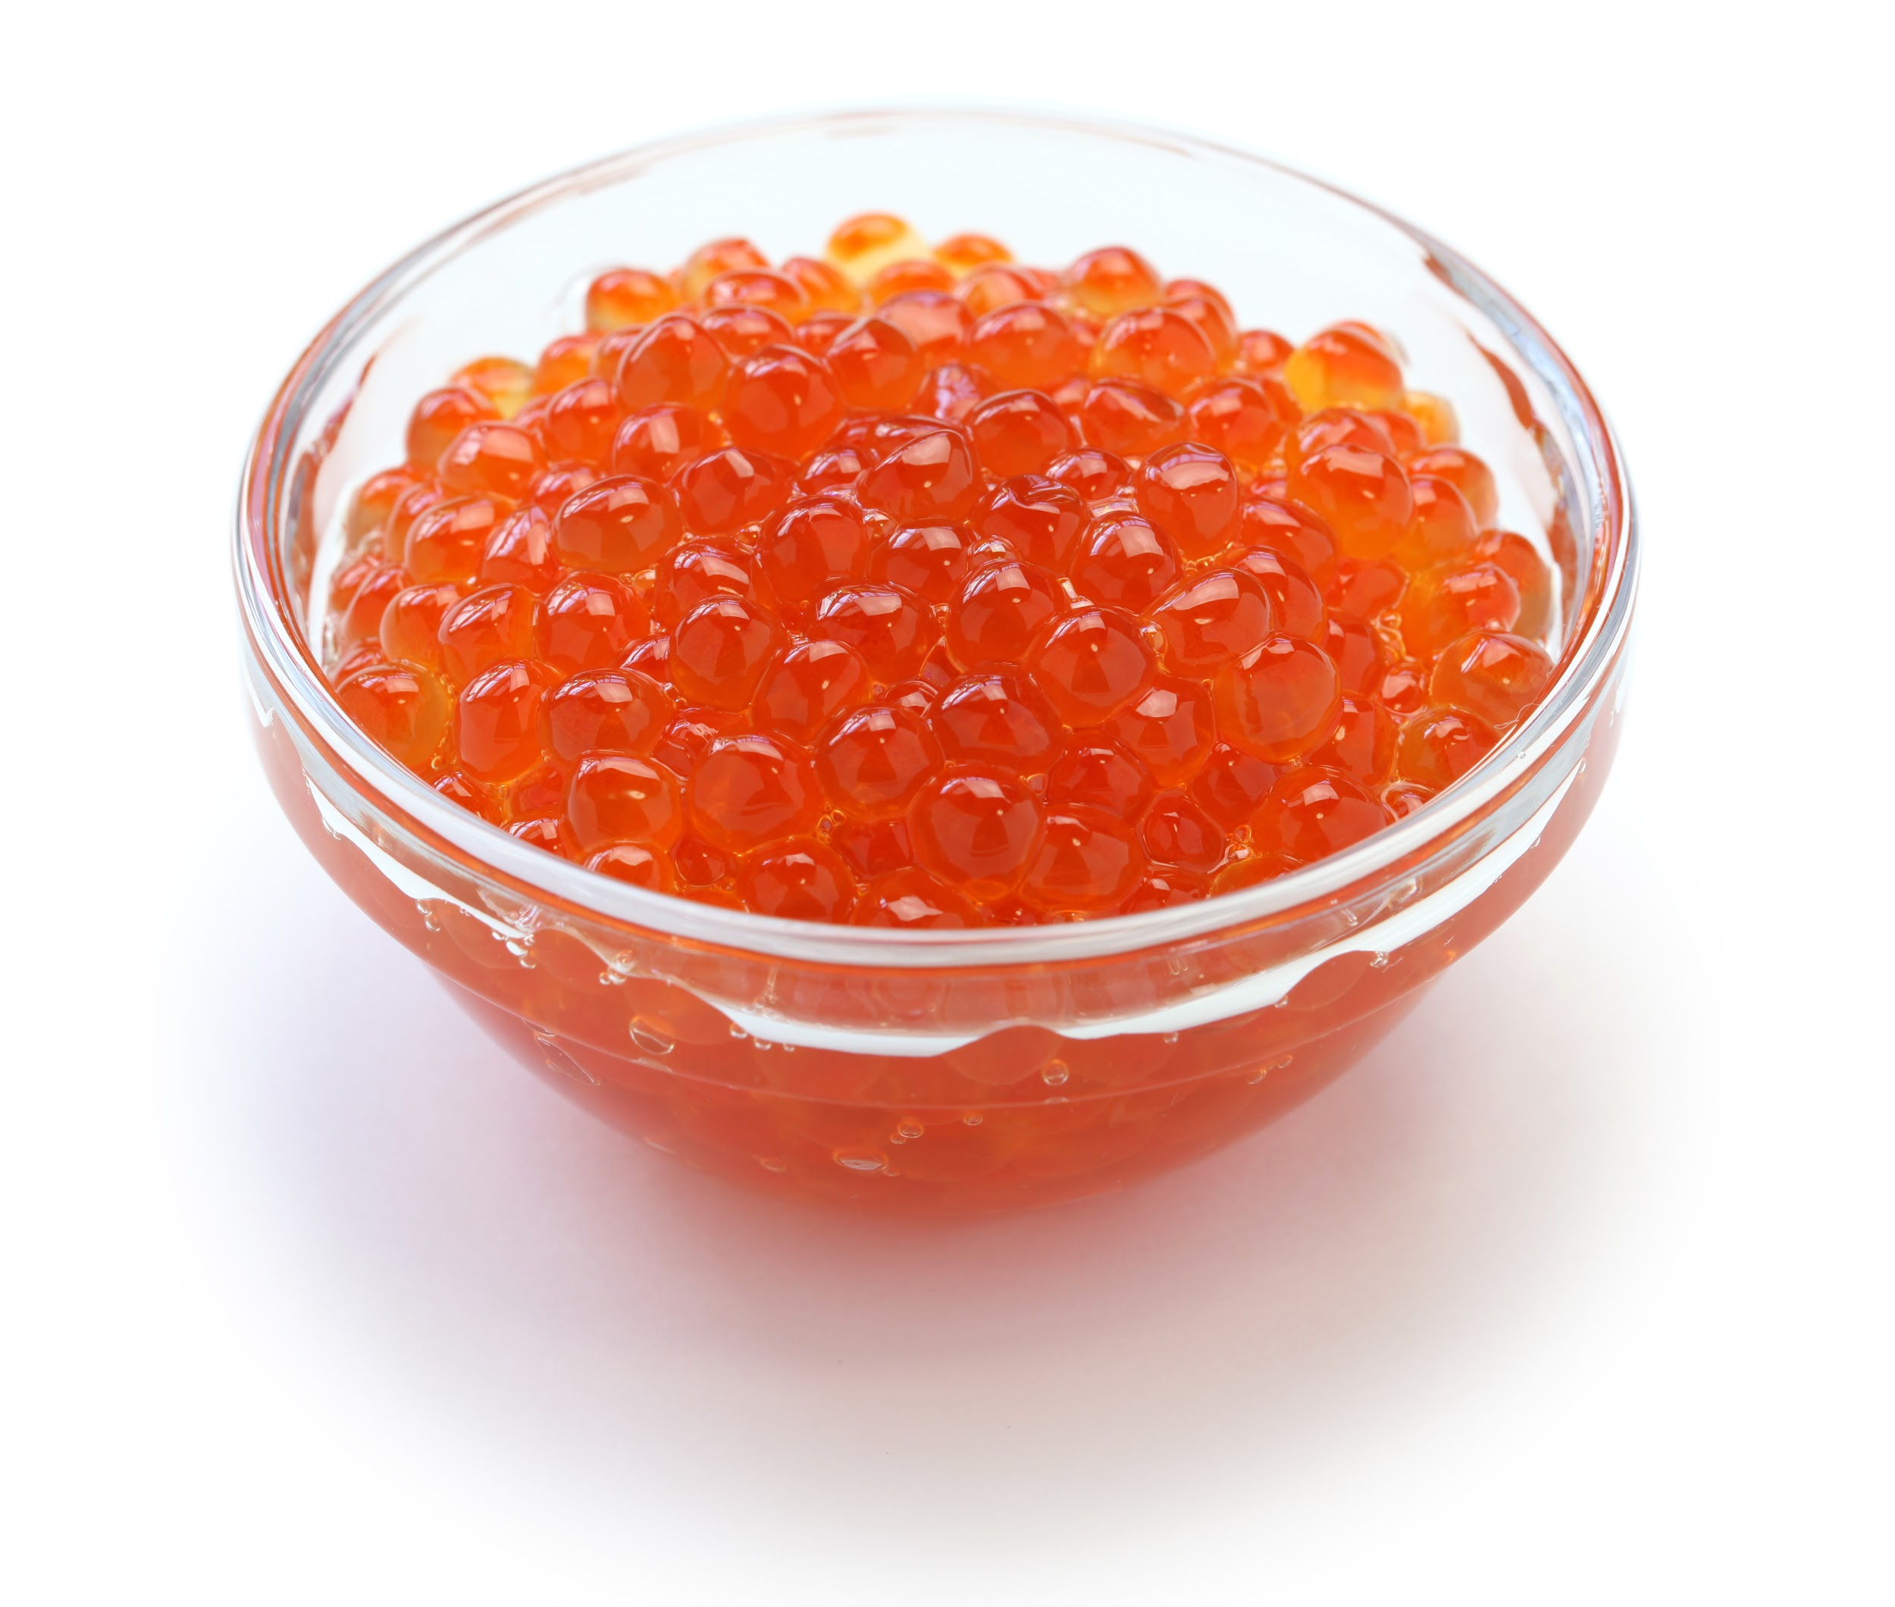
Red Caviar: The Variation in Salmon Species Collected from Different Geographical
Authors: Addison Bent¹, Sophie Geskin¹, and Evan Lipton¹
¹Fieldston School
Abstract
Salmon caviar is one of the most harvested types of roe due to high demand. We wondered which species of salmon would be found from varying locations. The main objective of the research was to determine a trend and match different species of caviar to their designated location. In the experiment, red caviar was purchased from companies that harvested their roe in Alaskan, Canadian or Russian waters. Due to the high fat content in the caviar, the extraction process was altered when the pellet did not form when running the centrifuge. After numerous tries, the experiment continued without the clear formation of a pellet. The results from the lab came back positive for Coho Salmon for one set of samples, which were collected in Canadian waters. Due to the lack of results, we can only infer that during the midwinter, Coho Salmon is the most prevalent in the Canadian Pacific.
Introduction
Caviar is rated one of the most expensive types of food in the world. The rarity and demand of caviar causes it to be a sought after specialty food, causing fishing businesses to look abroad for the fish eggs. Salmon caviar is one of the most common types, and is often used for sushi and other specialty dishes. Research has found that Atlantic salmon spend most of their time feeding and maturing in the Atlantic Ocean. Salmon caviar is also harvested from the North Pacific, most commonly Alaska and Japan.
Species found in the Pacific include King, Coho, Sockeye, Chum, and Pink. The salmon found in the Atlantic is called Atlantic salmon. Caviar is often not labeled with the species, only being referred to as salmon caviar or salmon roe. It would be interesting to investigate which species of salmon are found at different locations. Although we are not directly investigating it, another variable would be the time of year. Species of salmon go upriver to spawn during different times of year, so our project investigates the salmon populations during mid-winter, around when we received the caviar. This could change which types of salmon are found in certain locations. Through our DNA testing we should be able to find out what types of salmon are found in Alaska, Canada, Russia and Japan.
Materials & Methods
When looking for samples, the location in which they were collected was an integral part of the decision. There were two samples each from Alaska, Canada and Russia, and one from an unknown location. The samples were purchased online in January. Once we received the caviar we started the extraction process. We ground up one egg per sample and added a lysis solution. After using a microcentrifuge to separate the DNA from excess material, we saw that the DNA had not formed a pellet. Due to this, we had to diverge from the standard procedure. We put the lysis and caviar mixture into the microcentrifuge again, trying to get a pellet to form. We tried without success several times, using several different approaches, and eventually decided to start the extraction process again. Instead of using the entire egg, we attempted to extract only the oily orange substance and recommence the extraction. Again, no pellet formed, but we decided to continue even without a pellet. When the procedure said to take out the pellet, we extracted the fluid at the bottom of the container. After the initial complications, the procedure went without further deviations.
Results
Only two samples came back with positive DNA results. Both of these came from the salmon samples that were sourced from Canada, and both were sequenced as Oncorhynchus kisutch (Coho Salmon). The DNA sequences from the Canadian Salmon caviar samples both had 7 mismatch pairs. The first sample had an Aln. Length of 705 and a Bit Score of 1234. The second sample had Aln. Length of 705 and a Bit Score of 1227. These numbers show the strong results of the experiment.
Discussion
It can be concluded that the results support the labeling on the samples, based on the two results actually achieved. However, this may not ring true for all of the other samples, since none of the other results were conclusive. Using these data, we can infer that during the winter, the salmon in Canada is going to most likely be Coho. Unfortunately, nothing can be said of the other samples. The reason for the Canadian salmon DNA having the only positive samples is unknown. We hope to look further into this phenomenon.
As shown by the results, only the DNA of two samples was capable of being sequenced. One reason for the lack of results may have been due to the large amount of fat in caviar. When following the PCR procedure, the fat blocked the supernatant, and made it difficult to pipette the fluid when necessary. Additionally, the nucleus within an egg is small in comparison to its yolk, which created yet another obstacle.
Acknowledgements
We would like to thank the Harlem DNA Lab for completing the sequencing process for us, Fieldston for providing the lab we worked in, the Cold Spring Harbor Laboratory for many of the materials, and Mr. Waldman for guiding us through the process. Photos taken from: http://www.podor.hu/files/3814/5146/2446/bigstock-red-caviar-salmon-roe-isolate-51870439.jpg
http://dnasubway.iplantcollaborative.org/project/phylogenetics/console.html?pid=75754
References
Martha Taylor, Eric Simon, Jan Reece, Jean Dickey Campbell Biology: Concepts & Connections Seventh Edition
Tania Aspasia Johnson, M.Sc.; and Arati Iyengar,Ph.D. Phylogenetic Evidence for a Case of Misleading Rather than Mislabeling in Caviar in the United Kingdom. Journal of Forensic Sciences. Volueme 60, January 2015

