Slide 1
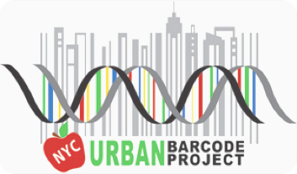

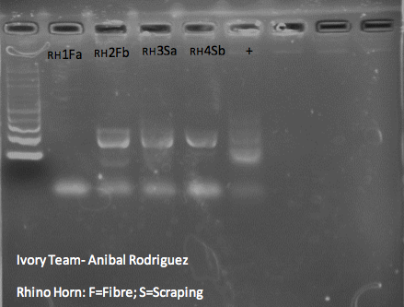
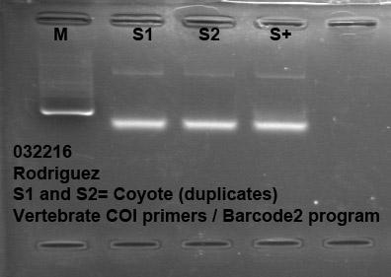
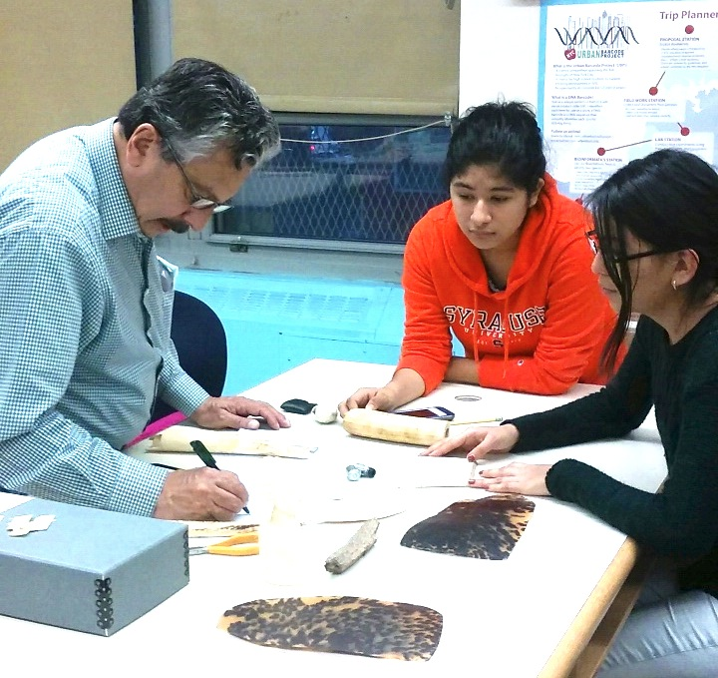
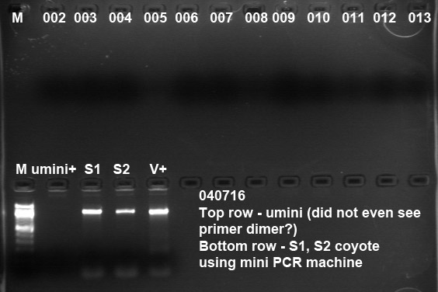
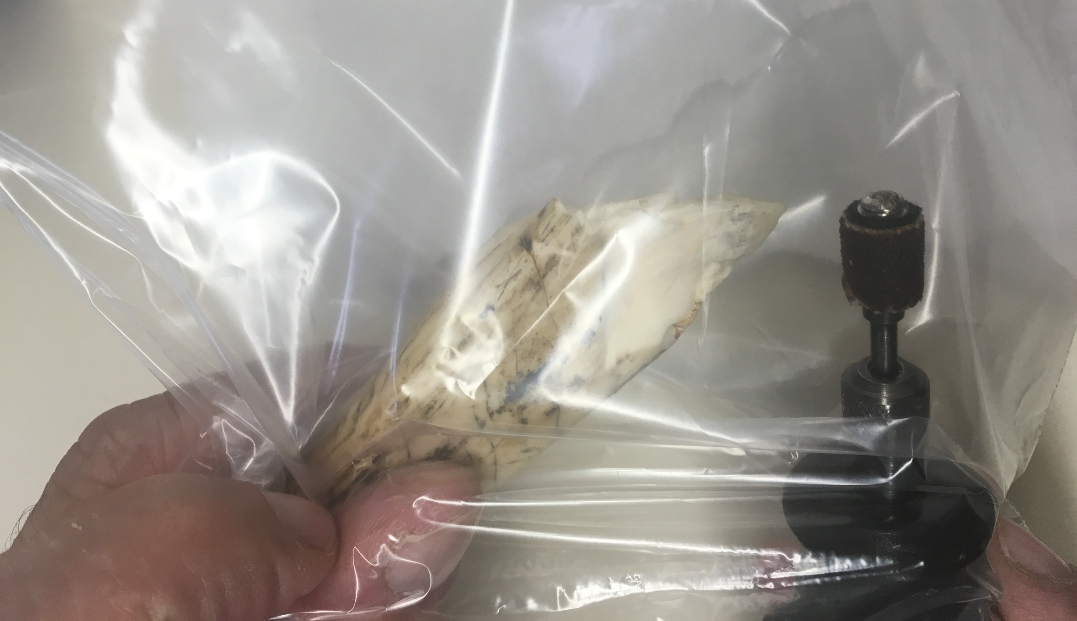
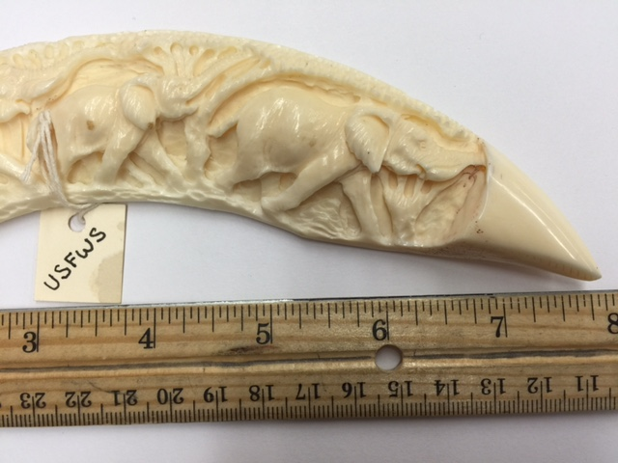
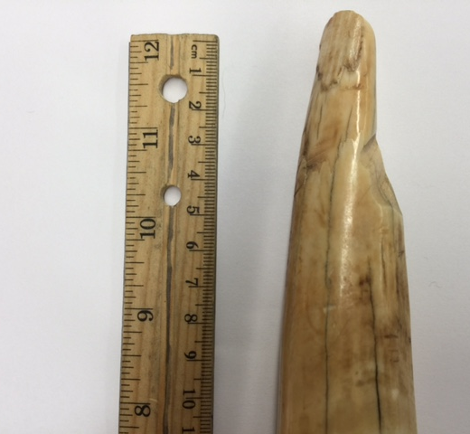
Using DNA Barcode to Identify Endangered Species
Lorena Flores¹, Lizbeth Ortigoza², Anibal Rodriguez ³
Manhattan Center for Science and Mathematics¹, Hostos Lincoln Academy of Science², American Museum of Natural History³
Abstract
The wholesale killing of endangered species, in particular the elephant and rhino is an issue that must be addressed. The use of DNA Barcode will allow us to individually identify each species. The samples took on two forms: raw unworked and worked samples (artifacts). The aim is to extract DNA from target samples using barcoding techniques in order to ascertain the most efficient procedure for identifying ivory species. A total of 4 raw unworked samples were sequenced. A total of 13 samples were pulverized using a high speed grinding tool. The pulverized samples were segregated, photographed and numbered. The samples were then processed in a lysis solution, processed further and PCR’d with last stage sequencing. After processing the samples, our results revealed both negative and positive results. The negative results concluded are due to the poor quality of DNA from the area harvested. Positive results are due to the harvesting of DNA loci, which is situated in the pulp cavity of the ivory tusk.
Introduction
Today, a variety of animal species are endangered and face the possibility of extinction. In 1973, 1.3 million elephants roamed in Africa. Today it is certified by WWF that the elephant population has declined drastically to 400,000, thus creating a sense of urgency to research species identification. While the numbers vary for other species, the problem of threat of extinction is shared by ivory bearing animals, valuable horn, and other commodities. The purpose of research is to determine which are the most target species and those in immediate target of extinction given the different populations. DNA Barcode allows us to track the illegal trade and poaching of critically endangered animal species, especially those. It is important to identify which animals are being targeted in order to manage and conserve these species.
In our research, we want to be able to reach out to the authorities who are in charge of protecting these animals. The techniques used in the project to identify the species will also benefit those who are investigating on poaching. Individually identifying the species can require more than one technique to be able to attain the proper identification. Our results will be able to demonstrate how different techniques are used for the identification of the specimen and how to improve for further analysis.
Materials & Methods
13 different worked (artifacts) and unworked ivory specimens were collected from the American Museum of Natural History. Most of the artifacts sold globally are made of ivory, so with the samples collected we will be able to find out if any are actually ivory and if it belongs to any threatened or endangered species. Each specimen was pulverized using a high speed drilling tool. 2 coyote samples and 2 rhino horn samples were also worked with. One specimen taken was fresh meat and the other was a hair fiber from the coyote. The hair fiber was plucked out and inserted into lysis solution, as well as the meat specimen. In order to ensure the breakdown of DNA contained, each sample was incubated in lysis solution that was stored at room temperature for a prolonged time. Next, the DNA Barcode Protocol was followed for each. For the 13 ivory specimens we extracted DNA using a Qiagen kit, adding At Buffer 1 and Proteinase K to the protocol. The extra use of these buffers is to ensure no contamination and the removal of anything that might degrade the specimen’s DNA.
Results
Out of the 13 ivory specimens, only 003, 007, 0010, 0012 and 0013 appeared to provide strong DNA amplification according to the gel electrophoresis:
the two coyote and two rhino horn samples.
All positive samples were analyzed using DNA Subway. However, only the coyote and rhino samples were an exact match. The ivory samples produced too short and low quality sequences, so they didn’t match any that were on DNA Subway.
Discussion
Out of 17 samples sequenced only 9 were positive. The only samples that matched to the sequences on DNA Subway were the two coyote (Canis latrans) and the two rhino horn samples. According to DNA Subway, the coyote genus and species is Canis latrans, which is found in North America and the rhino sample is Ceratotherium simum, also known as the white rhino. If further species information was given, the rhino could either be a Northern or Southern White Rhino. The Southern White Rhino has 17,460 left in the wild as of 2007, while Northern White Rhino is rarer and only 5 left in captivity. The positive and negative results are able to provide us with information about what went wrong and how to fix it for further research. A reason why we might have not obtained DNA could be because we drilled too far away from the pulp cavity, which is where the highest concentration of DNA is located. Another reason might’ve been the protocol; the primers used may have been the wrong ones needed to obtain the DNA. For further research, we would drill the ivory near the center where the pulp cavity is found. Different types of procedures and primers will also be worked with in order to determine which is the best at indicating the correct sample species. Overall, our research was able to provide us with information on how to obtain better ivory results.
References
Alphonse R. Nougoue
DNA Barcoding as a Tool for the Identification of Illegally Traded Wildlife Products
Kenine Comstock et al, Amplify my DNA ivory, 2003.
Acknowledgements
We want to thank for their guidance, time and leadership Christine Marizzi, Ph.d, and Melissa Lee, cshl, Harlem DNA Lab.

