Slide 1
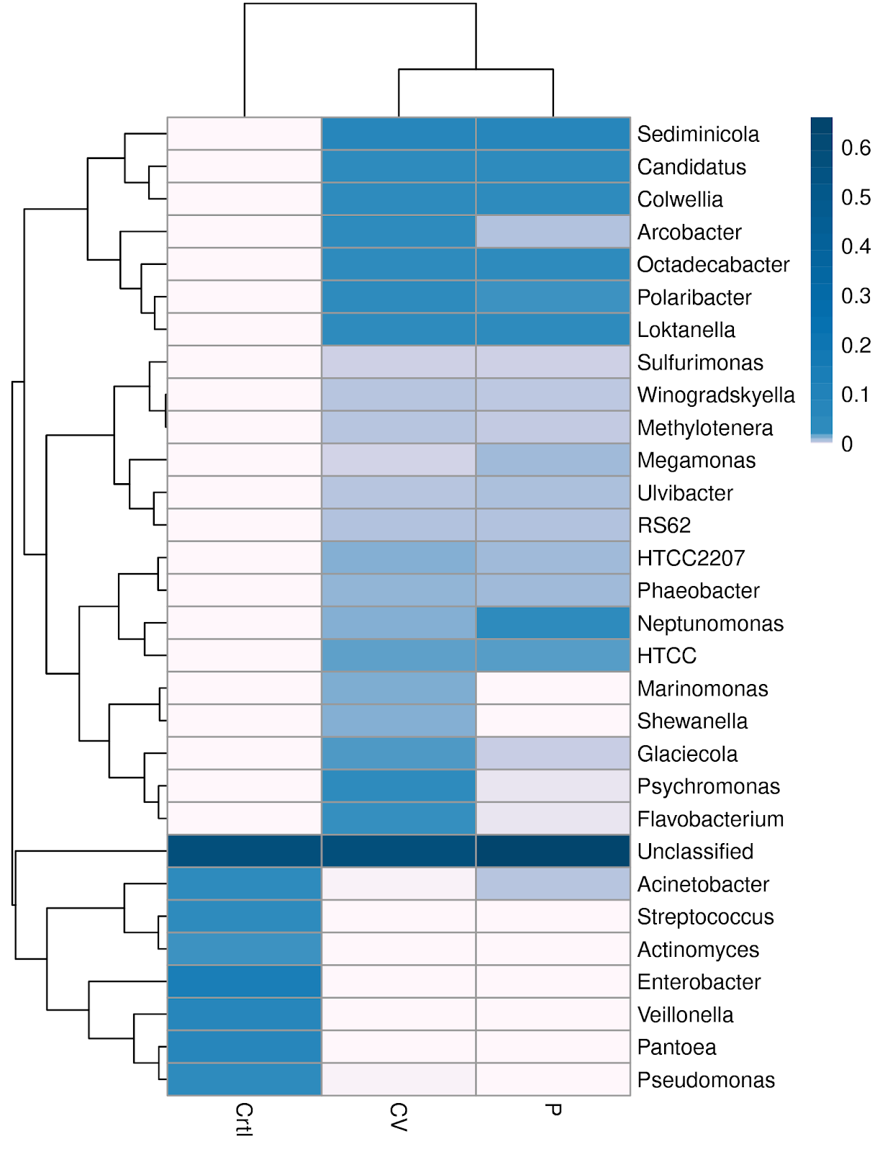
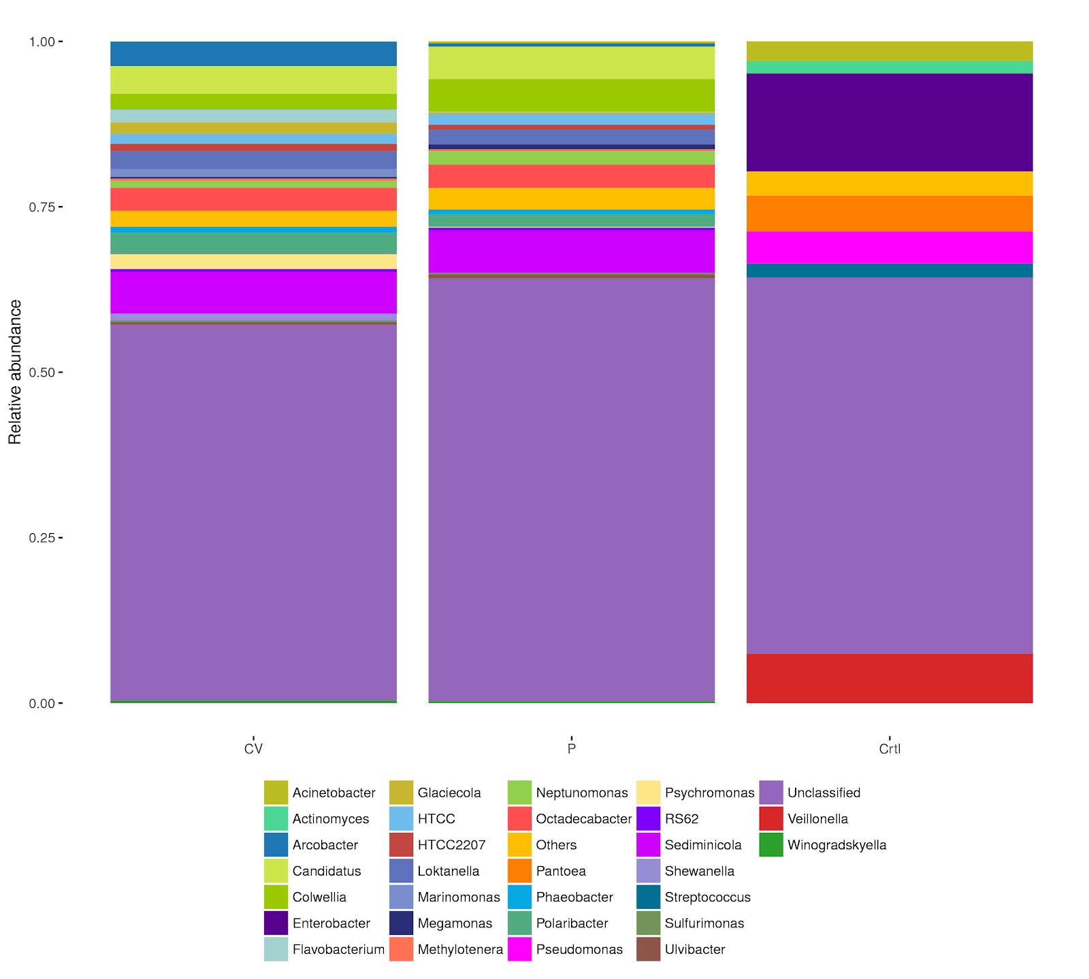
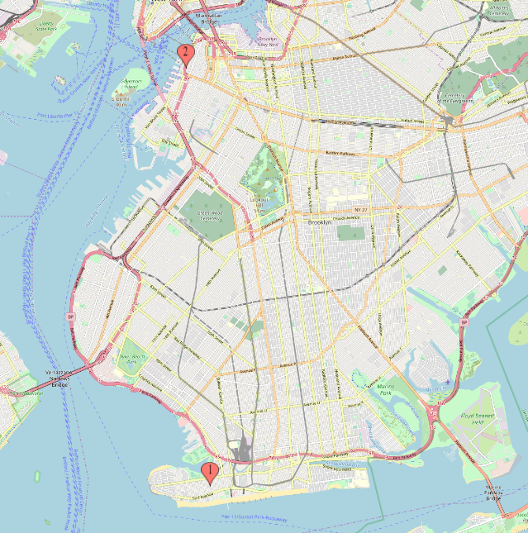
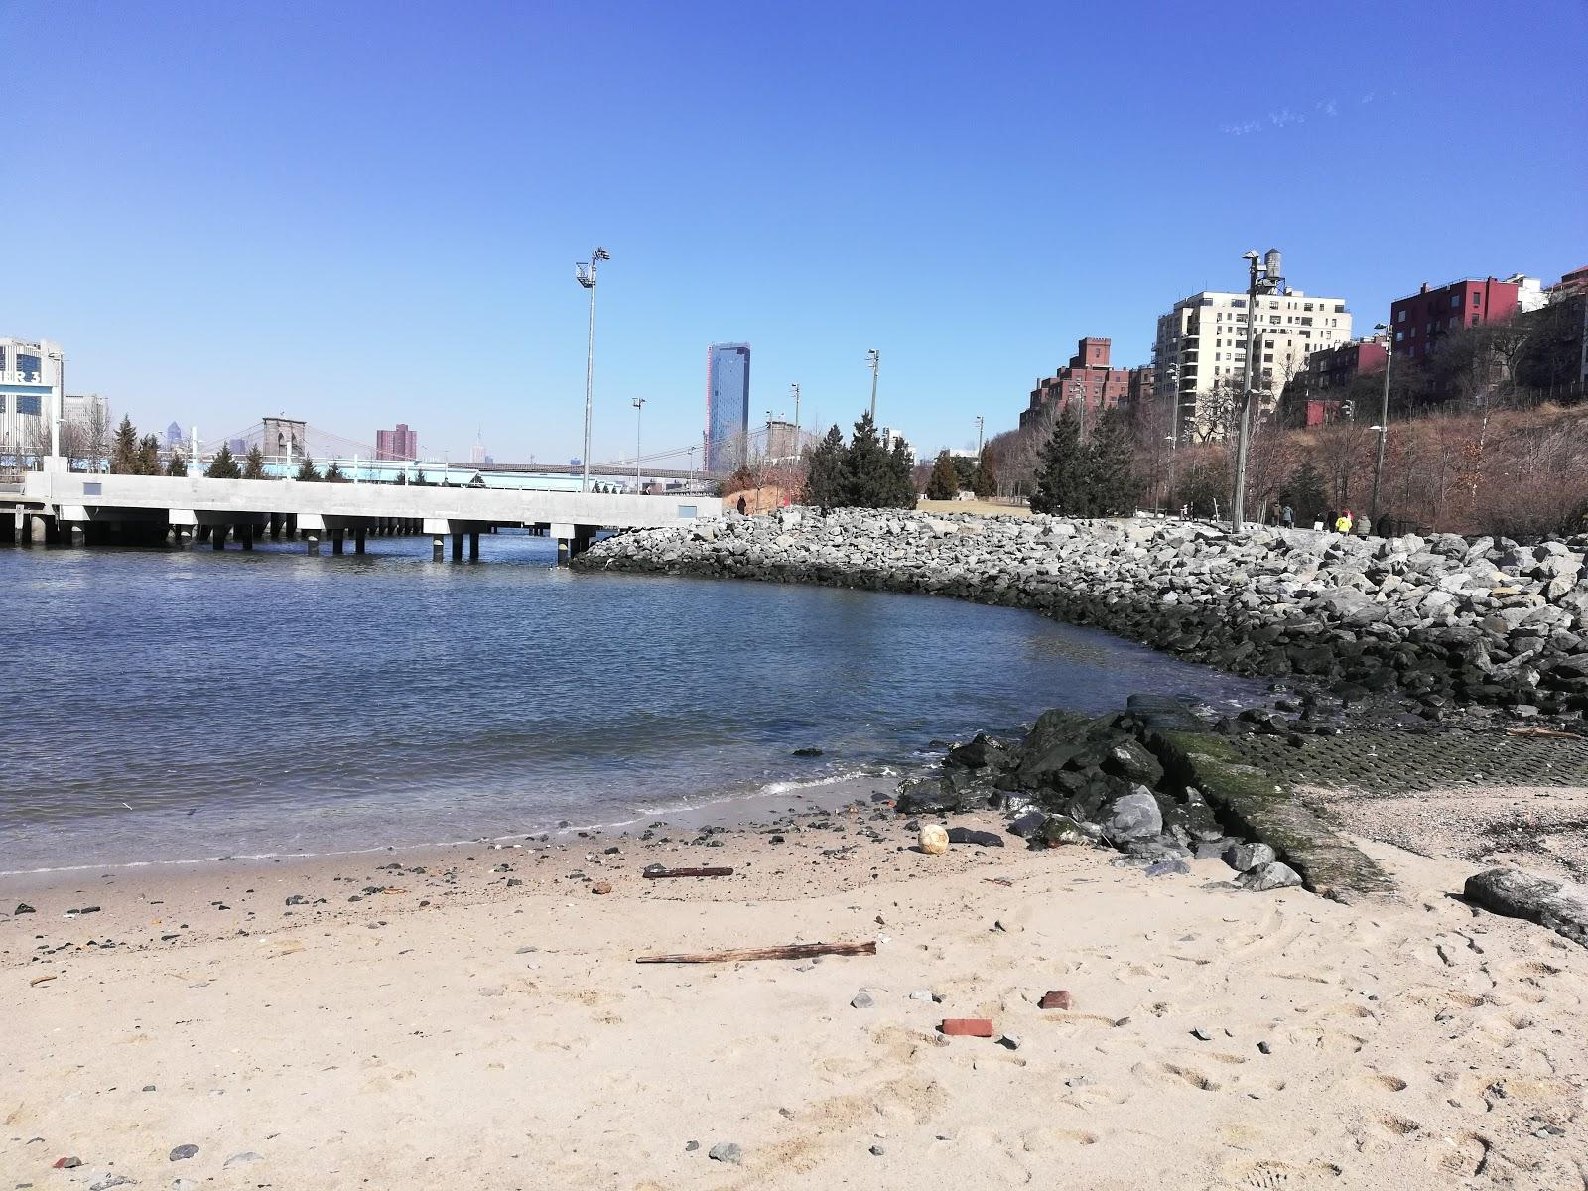
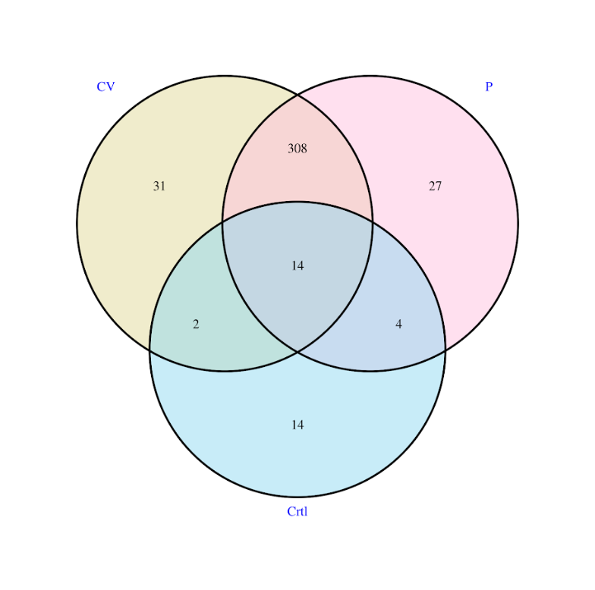
Assessing Microbial Biodiversity in New York Harbor
Funded by:
Naema Begum¹, Sophia Wen¹, Victoria E. Ruiz²
¹ High School for Health Professions and Human Services; ² St. Francis College
Abstract
New York Harbor is one of the largest natural harbors in the world, yet it does not have many studies published regarding its microbiome. Microbial biodiversity can help determine the health of biosystem and any potential pathogenic threats. This study will test for the biodiversity of microbes around New York Harbor, specifically from Coney Island Creek (40.5798° N, 73.9899° W) and Pier 4 (40.6966° N, 73.9993° W). It was hypothesized that the microbial diversity would be highest in Coney Island Creek due to the previously found illegal dumping of waste. Samples were collected from each location, filtered, and then DNA was extracted. The DNA was then sent out to sequencing. Results show that Coney Island Creek did have more biodiversity than Pier 4. It was determined that both locations had healthy levels of bacteria with no potential pathogens, making it safe for anthropogenic activities.
Results
From the data sequenced, it was found that Coney Island Creek had greater biodiversity than that of Pier 4. (Figure 3 and 4) Genera that was found in high abundance both in Calvert Vaux and Pier 4 were Sediminicola, Candidatus, Colwella, Octadecabacter, Polaribacter, and Loktanella. Other genera found excessively in Coney Island Creek were Marinomonas, Shewanella, Glaciecola, Psychromonas, and Flavobacterium. Arcobacter and Flavobacterium though not common, can sometimes be pathogenic. Flavobacterium can cause diseases in Freshwater Fish and Arcobacter can contribute to enteric diseases.
Introduction
Water is essential to the human body, acting as both a solvent and messenger, and regulates the planet’s climate and providing a home for many marine animals, plants, and microorganisms. Microbial presence contributes to the biodiversity of an aquatic ecosystem. It was found the greater the diversity, the greater the material welfare, security of communities, resilience of local economies, relations among groups in communities, and human health (Cresswell & Murphy 2016). The presence of microbes in water, however, can also negatively affect the sanitary state of water bodies (Jung et al.,2014). Microbial contamination levels are correlated with the risk of enteric diseases. Due to the effect microbes can have, aquatic microbial levels must be monitored. Many factors contribute to the level of aquatic microorganisms: anthropogenic activities, industrial waste, runoff, sewer system discharge, precipitation, and the presence of sediments. (Tornevi, Bergstedt, & Forsberg, 2014). Despite being one of the largest natural harbors in the world, New York Harbor does not have many studies published regarding its microbiome. This study tested for the biodiversity of microbes around New York Harbor, specifically from Coney Island Creek and Pier 4. Pier 4 is a collection site that has high human activity being open as a beach and open in the summer for public kayaking. Coney Island Creek was a site for illegal dumping, where raw, untreated sewage was dispelled into the water. As a result of this, it was expected for Coney Island Creek to have the highest microbial diversity. This study is crucial to understand the current conditions of the New York Harbor Biome and to ensure its health.
Figure 4: Relative Abundance of Genera
Materials & Methods
Sample Collection: Each collection day, one liter water samples were collected from Coney Island Creek (40.5798° N, 73.9899° W) and Pier 4 (40.6966° N, 73.9993° W), (Figure 1). The samples were collected four times, each Saturday, from February 9th to March 2nd from each location. Samples were collected following the Humans Water Quality Testing Protocol.
DNA Extraction and sequencing: DNA was filtered and extracted through PowerWater® Sterivex DNA Isolation Kit. The quality of the extraction was checked and the samples were then stored at -20 degrees Celsius. After DNA extractions for all dates were complete, the samples were sent out for sequencing and analysis.
Figure 3: Absolute Abundance Heatmap of Genera
Discussion
The most abundant genera found at Coney Island Creek were Seminicola, Candidatus, and Octadectabacter. At Pier 4, the most relatively abundant species were Sedimincola, Candidatus, and Colwellia. As predicted, Coney Island Creek had genera that were found specific to or found in greater concentrations compared to Pier 4. Coney Island Creek had four more OTUs specific to its location. It was found that Coney Island Creek does have a greater biodiversity than that of Pier 4 proving the hypothesis correct. It was also found that harmful genus of bacteria such as Campylobacter and Enterococcus was not present in high concentrations, demonstrating that the water does not pose a threat to living organisms that come in contact with it.
Figure 1: Collection Sites
Figure 2: Pier 4 Site
Results
Acknowledgements
We would like to thank St. Francis College for providing resources and a facility. We would also like to thank the The Pinkerton Foundation, Science Sandbox, and the Cold Spring Harbor Laboratory. We would also like to thank Alison Cucco, Christine Marizzi, and Melissa Lee for managing the UBRP.
The OTU group Venn diagram shows operational taxonomic units (OTUs) that are unique and shared between water from Coney Island Creek (CV) and East River (Pier 4) Overall Coney Island Creek had 31 unique taxonomic units and Pier 4 only 27 unique taxonomic units. Coney Island Creek had 5,175 sequences of Arcobacter whereas Pier 4 only had 647 sequences.
References
Cresswell ID, Murphy H (2016). Biodiversity: Importance of biodiversity. In: Australia state of the environment 2016, Australian Government Department of the Environment and Energy, Canberra, https://soe.environment.gov.au/theme/biodiversity/topic/2016/importance-biodiversity, DOI 10.4226/94/58b65ac828812
Ortega, Cristina & Solo-Gabriele, Helena & Abdelzaher, Amir & Wright, Mary & Deng, Yang & Stark, Lillian. (2009). Correlations between Microbial Indicators, Pathogens, and Environmental Factors in a Subtropical Estuary. Marine pollution bulletin. 58. 1374-81. 10.1016/j.marpolbul.2009.04.015.
Tornevi, Andreas & Bergstedt, Olof & Forsberg, Bertil. (2014). Precipitation Effects on Microbial Pollution in a River: Lag Structures and Seasonal Effect Modification. PloS one. 9. e98546. 10.1371/journal.pone.0098546.
Zagare, L. (2018, January 23). Beach Haven Apartments Fined $400,000 For Dumping Raw Sewage Into Coney Island Creek. BKLYNER.
2016 Citizens Water Quality Testing Program Sampling DOs and DON’Ts [Word Document]. Retrieved from http://www.nycwatertrail.org/CWQT_2016.html
Figure 3: OTU Group Venn Diagram

