Slide 1
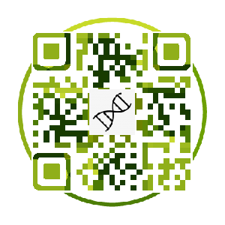
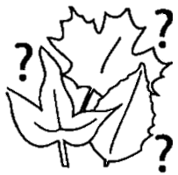
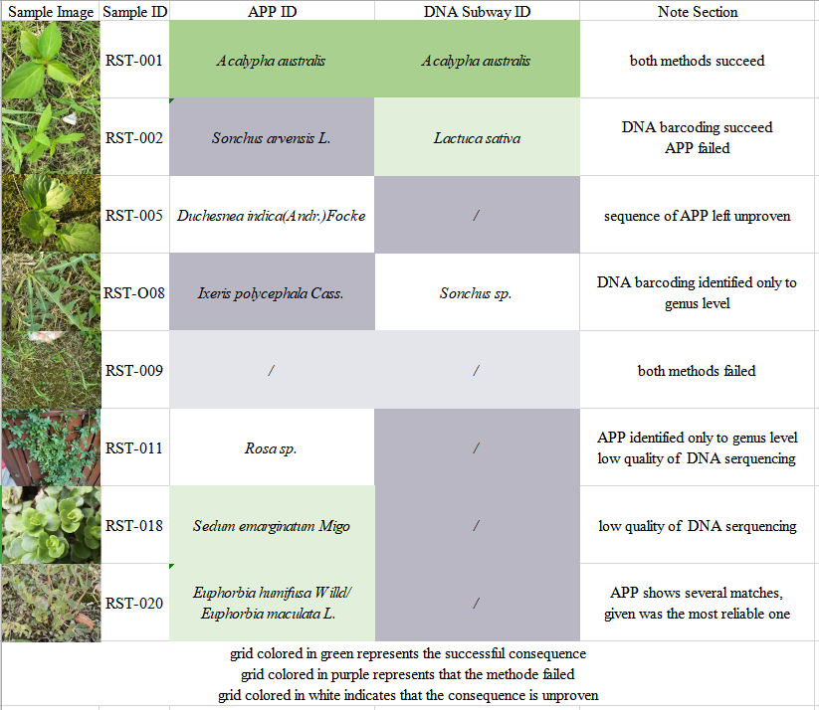
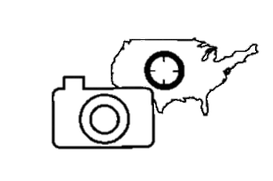
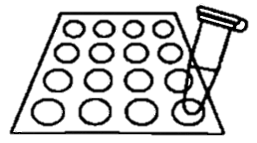
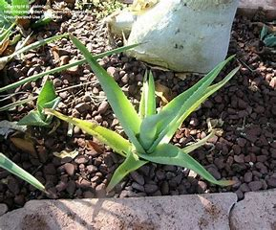
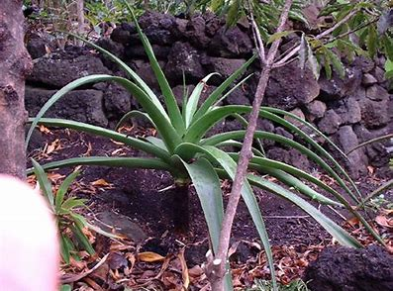
DNA BARCODING
PLANT SPECIES IDENTIFYING APP
—— —— comparison of accuracy between the two
emerging species identification tools
By group1 Gin, Sally, Susan, Rebecca
Mentor: Dr Pepenella
Introduction:
Identification applications are real-time and more portable identification tools than DNA Barcoding, and they are applied
widely in our daily life. DNA barcoding use sections of rbcL genes extracted from chloroplasts to distinguish species , while apps use taxonomy as their principle and AI technology as a tool. We formed a hypothesis that the APPs are more focused on better catering domestic plants, making them not adequate for cases especially scientific species identification while DNA barcoding will be more accurate but also more expensive. We chose the identification app with best comments in the app store
Purpose:
To assess the possibility of using apps in species identification field.
To guide consumers in choices of app downloading
Scan the QR code to learn more about our project !!!!
Discussion：
What’s good about the app:
The app could help obtain a somewhat reliable result in situations when DNA barcoding tends to gain unideal results like low quality DNA isolations , highly conserved rbcL gene regions and extremely closely related species , due to its access towards additional appearance references.
The app offers an immediate and free result with just a photo needs to be taken, which greatly solved two main problems of DNA barcoding, extremely high price（mainly for DNA sequencing） and time-consuming process（nearly two days needed）.
Limitations:
The accuracy of the app is limited (around 36.% rate being completely correct), so as its specificity as most samples the App could only correctly identify the species specific to its genus level. Therefore there’s still a long time needed for the app to even partially take the place of specialized taxonomists.
The accuracy of the app is greatly affected by the photographing conditions including light intensity, shooting angle and the similarity between plants.
Plus:
Though the app is widely popular among users in daily identification, it still has some limitations in scientific identification, especially species that look alike with each other.
In our point of view, to provide the general public a low-cost, mobile kit for species identification, DNA barcoding and AI plant identification should go hand- in-hand. Further development is required: lowering the cost and improving the specificity for DNA barcoding and increasing the accuracy and consistency for AI plant identification.
Result：
Out of the 20 samples, 11 got their DNA sequences being identified. DNA barcoding and apps reached consensus over 4 of them; for 4 other cases, DNA barcoding succeeded in identifying the species while the APP’s results proved to be wrong;
Materials and methods:
We collected 20 plant samples using random selection and stored them in sterile containers and suitable environment
At the same time, the plants were preliminarily identified by the plant-identifying APP called ‘shiwu’
Afterwards, the plants were taken photos and documented using our cell phones, ruler, grid paper and microscopes
Genetic analysis – DNA isolation from lamina （leaves）
Method: Silica isolation
A standard charge-binding method for DNA isolation
Acknowledgment：
The authors would like to appreciate Cold Spring Harbor DNA Learning Center for supporting the members throughout the project and Dr. Pepenella for her mentorship and support.
Reference:
Field-based Species Identification of Closely-related Plants
Using Real-time Nanopore Sequencing.21 Aug. 2017.
Giblin, David. "Is Field-based Plant ID Using DNA Barcoding Coming to a Smarphone Near You? https://www.burkemuseum.org/news/field-based-plant-id-using-dna-barcoding-coming-smarphone-near-you, 22 Apr. 2019, Dafenghao,wemedia.ifeng.com/73670192/wemedia.shtml. Accessed 31 July 2019.
PCR（in thermal cycler）:
Two species with similar appearance
PCR: A process of DNA amplification through temperature changes
Sample
（No.015）
Agar sugar gel electrophoresis:
Result by App
Result by
DNA
sequencing
To check the quality of DNA isolation
This indicates that the app using “appearance” as its way of identifying species still has some problem tell apart between species that look alike, showing a little disparity in accuracy with the result provided by DNA sequencing.

