Slide 1
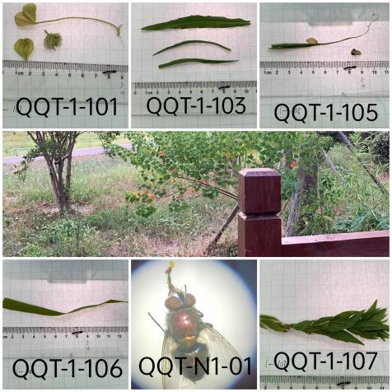
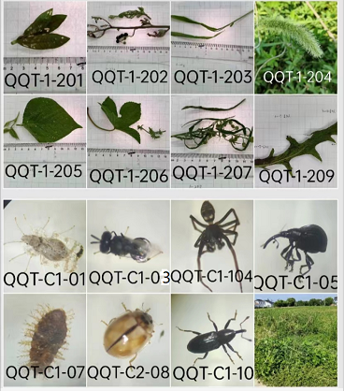
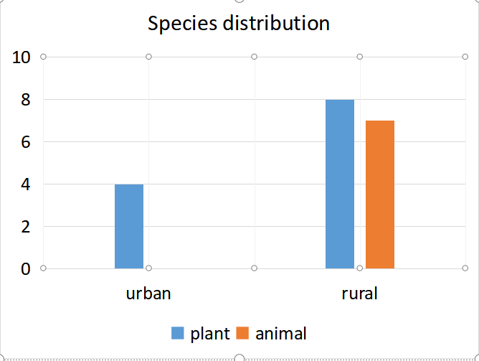
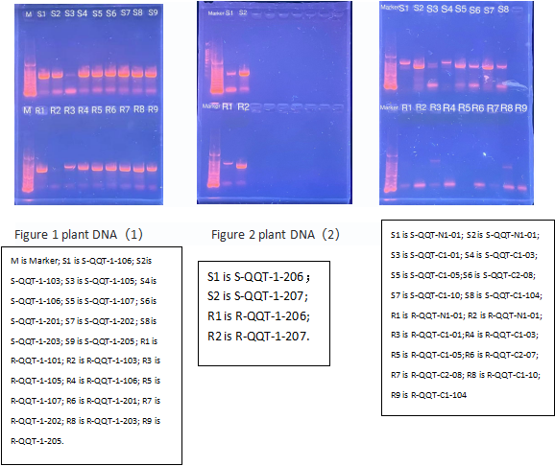
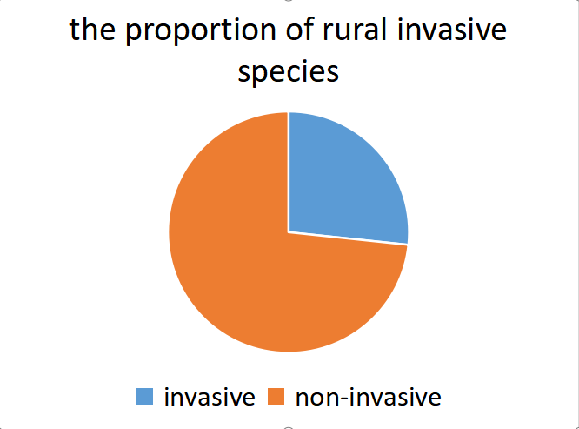
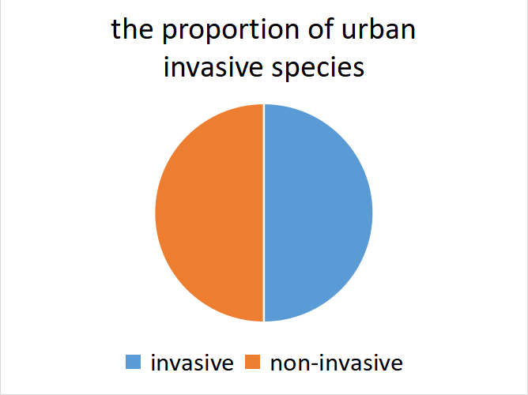
DNA Barcoding--Biodiversity difference between
urban green space and rural green space
Authors:¹Xuxinran Xiong, ²Yue Zhang, ³Shunbing Yang
Mentor:Xinyue Wang Zhiyuan Liu
¹Taicang Senior High School of Jiangsu Province,²the High School Affiliated to Soochow University ,
³Shandong Province Yantai development zone Senior middle school
Abstract
DNA barcoding is widely used to identify species. In this research, we took several samples from the developed area and the countryside and used DNA barcoding technology to identify them, attempting to gain an insight into the ecosystems of the city and countryside and find the differences between them. We used both Silica and Rapid methods to extract DNA, sequenced them with the help of AZENTA, and used to research the relationship between the sample organisms and other creatures, then we would know what the sample exactly is, or at least what it is similar to. We found that the biodiversity is more abundant in the countryside, and there are some invasive species in both the city and the countryside. We proposed several ways to control the invasive species, including chemical methods and biological methods.
Samples which are identified without sequencing: Developed area: Bermuda grass, Digitaria sanguinalis Scop. ,Metaplexis japonica Countryside: green bristlegrass There are also samples we failed to sequence which we identified by observing and searching: C1-01 is Platanus occidentalis L, invasive species C1-104 is some kind of spider C1-10 is Echinocnemus squameus Billberg
Fig4: species distribution
Discussion
1.The insects are not collected totally, which has an impact on the biodiversity analysis of the results.
2.Since only one quadrat can be selected, the selection of the quadrat is subjective, and more plant species were included within 1 square meter. The advantage is its high research value, and the disadvantage is that its biodiversity may be higher than the average of the surrounding area. Moreover,the grassland in urban or rural areas cannot be widely investigated, and the number of quadrats is too small, resulting in large data conditionality.
3.The DNA purity and sequencing sensitivity may not be high enough due to limited laboratory technology. When comparing the sequencing results with the genes in NCBI and DNA Subway, there may be multiple results, and we still need to search the morphological characteristics on the website and compare them with the photos of the samples taken to determine the specific species.
4.The Silica method extracted better than Rapid, and plant DNA extracted better than animal DNA. We guess that it is easier for plants’ DNA to be extracted, and that animals’ DNA may be more difficult to enter the supernatant and be adsorbed by the filter paper.
5.it is not difficult to find that the diversity of animals and plants in the rural green space is much greater than that in the urban regions. So we can know that due to strong artificial intervention (such as regular spraying of pesticides), the biodiversity of urban green space is relatively single. In the villages with weak intervention, biodiversity is more abundant.
6.In the rural quadrat, a large number of Corythucha ciliate occur on the leaves of Erigeron canadensis, forming a predation relationship, and both of these organisms are alien invasive species from North America. Another invasive alien species, Alternanthera philoxeroides, was also affected by the insects, but it still grew well. Native species such as Setaria viridis, Vigna angularis and Humulus scandens are relatively healthy. Chenopodium glaucum leaves dry curl, large wormhole area. This may indicate that insects can be used to control the growth of invasive plants.
7.In the rural quadrats, there are liana, Gramineae, Chenopodiaceae, and Asteraceae, but there is no lower vegetation, probably because of blocking light and the inhibitory effect of invasive species.
8.Through literature review, it is known that both alien invasive plant species and local plant species have value in traditional Chinese medicine and economy, which can be used for reference by farmers to treat diseases with herbal medicine, obtain economic value with local species, to promote rural development and to improve farmers' quality of life.
References
1. Nicolas Hubert, Xuzheng Wang, Yan Huang, Yanjun Shen. DNA barcoding the ichthyofauna of the Yangtze River: Insights from the molecular inventory of a mega-diverse temperate fauna[J]. Chinese Academy of Sciences, 2019, 00:1–14
Acknowledgements
Thanks for Cold Spring Harbor Asia. Thanks to Genewiz for their collaboration. Great appreciation to Ms. Wang Xinyue，and Ms. Liu Zhiyuan for guidance. The experiments were performed under the instruction of teachers at CSHDNALC.The sequencing was done by AZENTA.Moreover, we are grateful to our parents for funding the project.Thanks for our committed group members.
Introduction
In recent years, with the implementation of the national policy of environmental protection, environmental monitoring have been paid more and more attention, and biodiversity has become one of people’s focuses. The ecological environment in urban areas is seriously affected by human beings. Haze, automobile exhaust pollution, pollinator reduction and other factors lead to the reduction of biodiversity in wild grassland, while excessive pesticide use often occurs in rural areas, resulting in soil and water pollution problems and affecting plant growth.
According to the 2019 Bulletin on the State of China's Ecology and Environment released by the Ministry of Ecology and Environment, more than 660 alien invasive species have been discovered in China. They are difficult to intervene with, spreading like fire, harming local species, disrupting the ecological balance and further reducing biodiversity, which is alarming. Due to the dense hydrographic net, fertile soil, suitable climate and lax supervision, the invasion of alien species in Suzhou area is serious with a wide distribution range, large number and high risk, which need to be investigated.
DNA barcoding is a popular technique in the world in recent years, which can be used for rapid and accurate identification of species by using short standard DNA fragments. Under the conditions of lack of experience, samples have been processed or morphology is difficult to distinguish, traditional taxonomic methods are limited, and recognition software is not accurate. However, DNA barcoding technology can break through these limitations. This technology has also been applied to biodiversity analysis and become a powerful tool to identify species accurately and rapidly¹.
In conclusion, DNA barcoding technology was used as a tool for species identification.
Fig1:urben samples
Fig2:countryside samples
Fig5: the proportion of invasive species
Fig3:gal electrophoresis
Results
Materials & Methods
1. sample collection
A 1m×1m quadrat was taken from both urban and rural areas of Suzhou city to investigate the biodiversity, and a large proportion of invasive species were found.
2.DNA extraction
We extracted DNA from 20 samples collected by silica and rapid, and PCR amplified rbcL fragments from 12 plant samples and CO1 fragments from 8 animal samples
3.PCR amplification, product purification and sequencing
24 PCR reagents with rbcL as primers and 16 PCR reagents with CO1 as primers were respectively configured. Put them into the instrument for PCR cycle.
rbcl PCR reaction cycle setting:
Initial step: 94℃ 1 minute；35 cycles of the following profile: Denaturing step:94℃ 15 seconds；Annealing step: 54℃ 15 seconds；Extending step: 72℃ 30 seconds，One final step to preserve the sample: 4℃ ad infinitum.
CO1 PCR reaction cycle setting:
Initial step: 94℃ 1 minute；35 cycles of the following profile:Denaturing step:95℃ 30 seconds；Annealing step: 50℃ 30 seconds； Extending step: 72℃ 15 second；One final step to preserve the sample: 4℃ ad infinitum.
4. gel electrophroesis to detect to PCR products
After 2% agarose gel electrophoresis, the amplified products were detected by UV Gel imager. After purification, PCR products were sent to bio company for bidirectional sequencing.
5.DNA sequence alignment and species identification
After checking and splicing the determined gene fragment sequences, blast alignment is carried out in the DNA subway website, and the similarity of the extracted gene fragments is compared to confirm which species the sequence to be tested belongs to.
We took 8 plant samples and 7 animal samples from the rural quadrat and 4 plant samples from the urban quadrat. DNA of 6 rural plants, 5 urban plants, 8 rural animals and 1 urban animals have been extracted. The samples we identified by sequencing or other methods are as follows.
Table 1: the result of sequencing
number | source | BLAST result | Invasive species
QQT-1-101 | developed | white clover （Trifolium repens L.）
QQT-1-103 | developed | Diamond leaf aster（Aster subulatus Michx.） | √
QQT-1-105 | developed | Reed(Phragmites australis(Cav.)Trin.ex Steud)
QQT-1-106 | developed | Reed(Phragmites australis(Cav.)Trin.ex Steud)
QQT-1-107 | developed | Diamond leaf aster(Aster subulatus Michx.) | √
QQT-N1-01 | developed | Lucilia sericata
QQT-1-201 | countryside | Alternanthera philoxeroides (Mart.) Griseb | √
QQT-1-202 | countryside | Grey green resveratrol（Chenopodium glaucum Linn）
QQT-1-203 | countryside | Digitaria sanguinalis
QQT-1-205 | countryside | Vigna angularis (Willd.) Ohwi et Ohashi
QQT-1-206 | countryside | scandent hop(Humulus scandens)
QQT-1-207 | countryside | Horseweed (Conyza canadensis) | √
QQT-1-209 | countryside | Indian lettuce herb(Lagedium sibiricum)
QQT-C1-01 | countryside | - | √
QQT-C1-03 | countryside | Perilampus tristis Mayr
QQT-C1-104 | countryside | -
QQT-C1-05 | countryside | -
QQT-C1-07 | countryside | -
QQT-C2-08 | countryside | Turtle grain ladybug(Propylaea japonica)
QQT-C1-10 | countryside | -
“-”means we failed to identify the sample with its DNA

