Slide 1
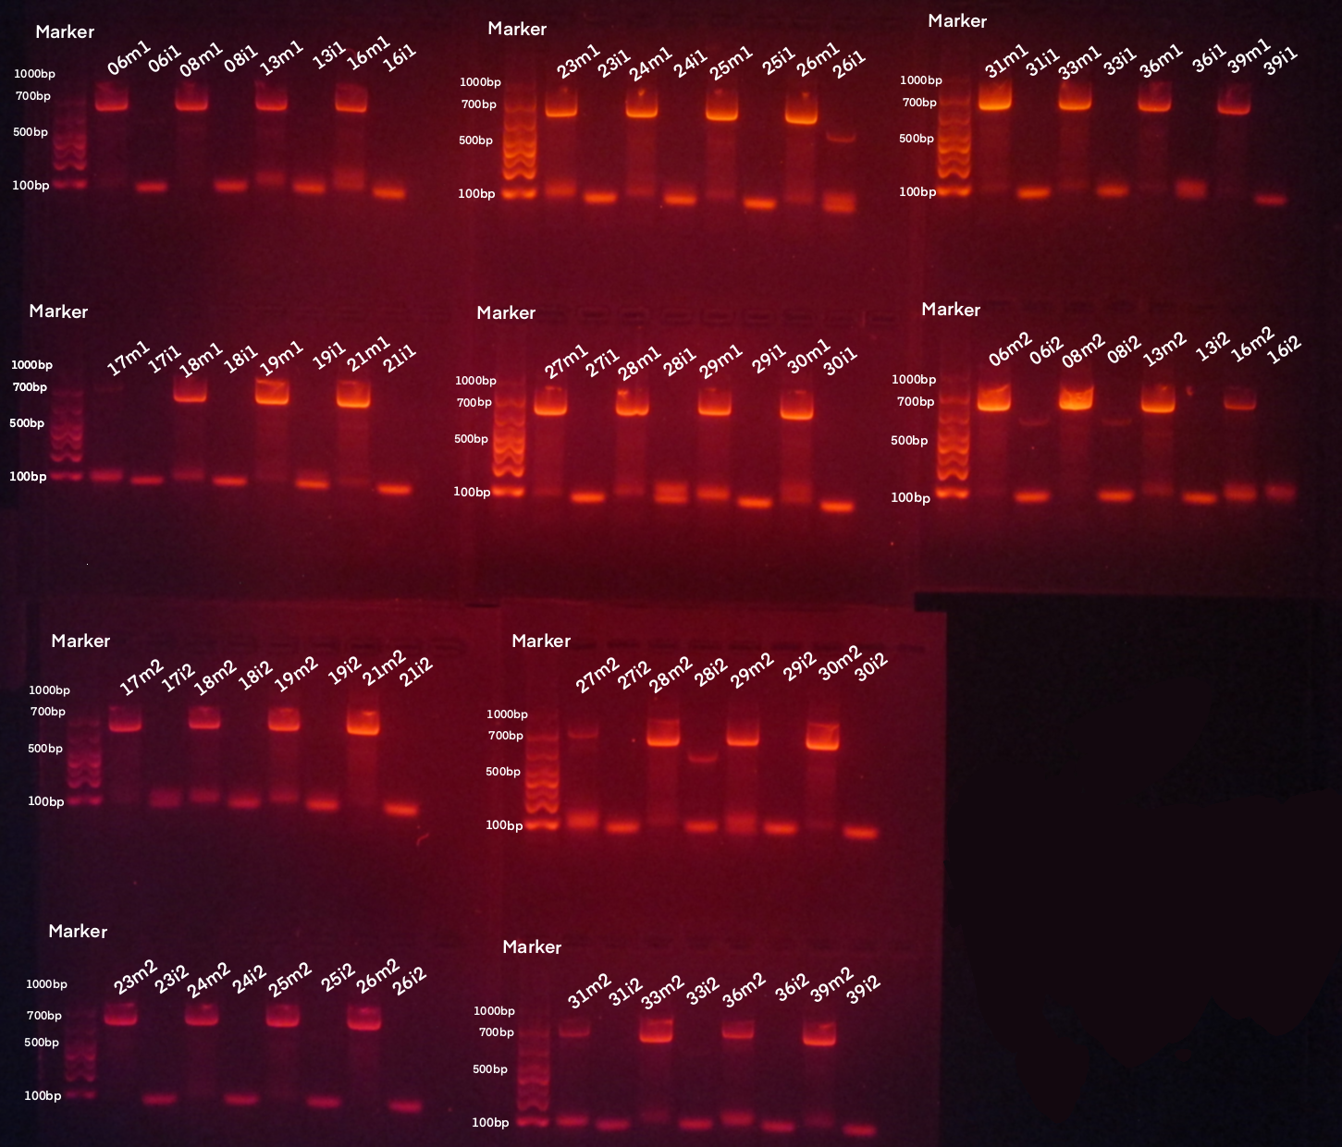
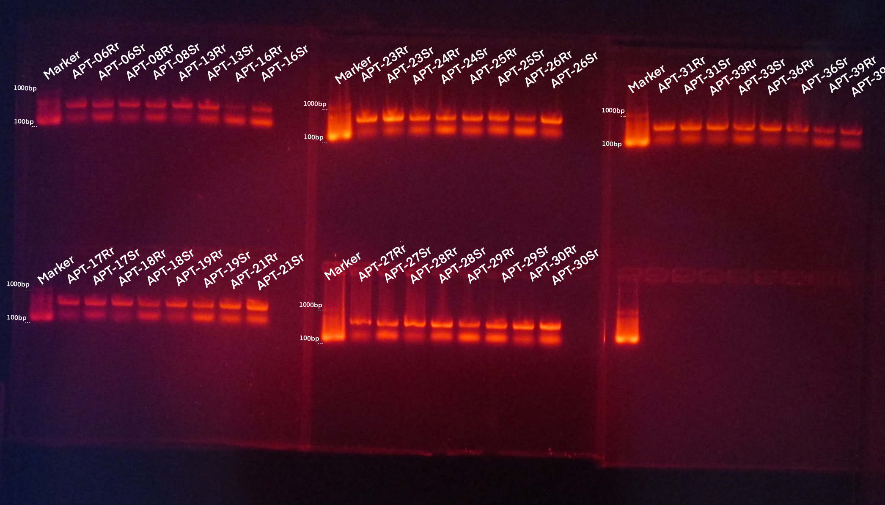
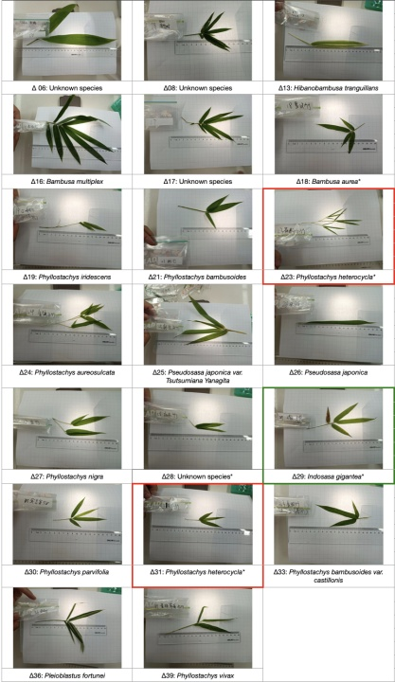
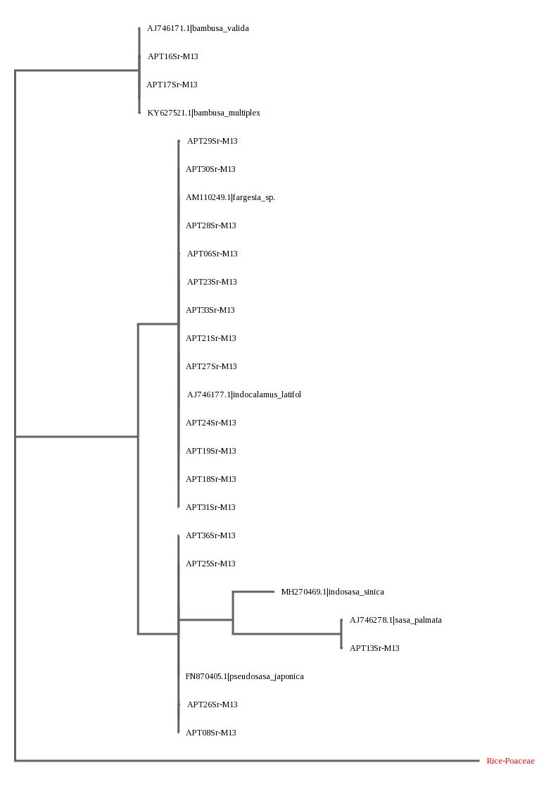
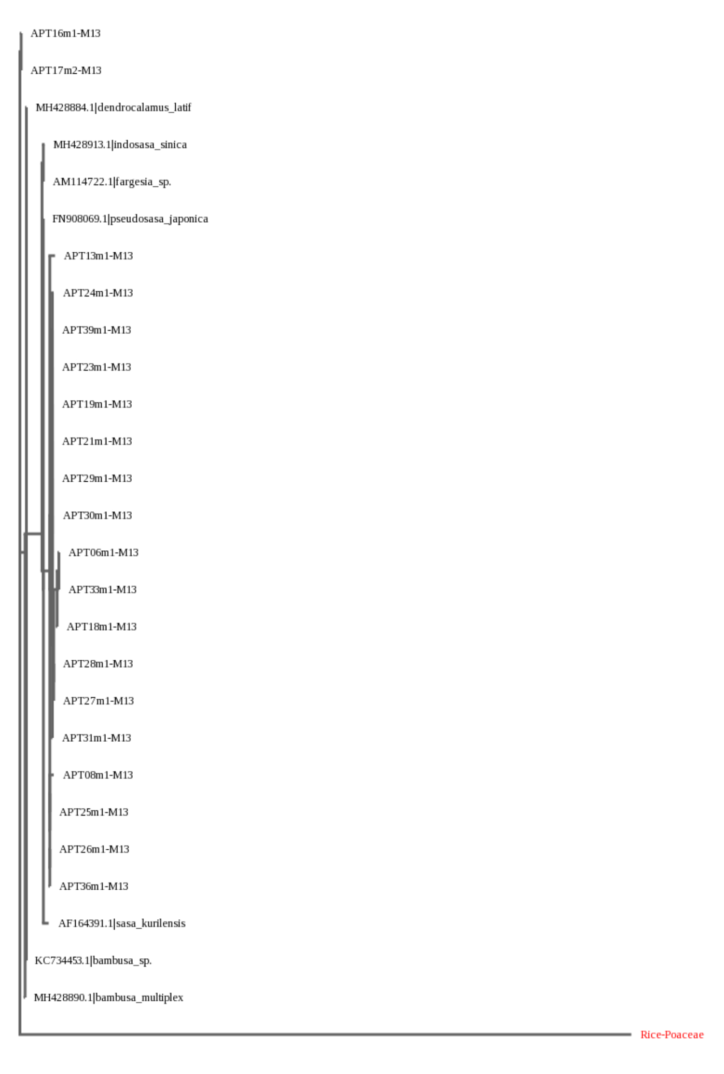
The Phylogenetic Analysis for Bambusoideae Species Based on DNA Barcoding.
Authors: Zhimeng Bao, Zhongyu Lu, Letong Xu, Wenxin Zhang.[ Each author contributed equally. The authors‘ names are listed in alphabetical order by family name.]
Mentors(s): Xinyue Wang, Zhiyuan Zhang
Cold Spring Harbor Asia DNA Learning Center
Abstract
The harsh climate and other human factors have put Bambusoideae species into a dangerous situation, emphasizing the importance and the urgency of improving the database and its classification. Our research aims to find the phylogenetic relationships between bamboos to provide evidence for related preserving measures from the molecular aspect. Partial fragments of the isolated DNA from 20 Bambusoideae species will be amplified by PCR (polymerase chain reaction) using 3 primers (rbcL, matK, ITS2) and sent to Azenta, China for sequencing. The best PCR results have been acquired using the rbcL primer, showing that the Bambusoideae species in the Surging Waves Pavilion can be separated into 2 groups and 3 subgroups.
Discussion
The clear, bright bands from the regions of rbcL and matK suggested that the PCR system is working, while the failure of ITS2 primer is probably because by the nonexistence of regions for ITS2 primer to combine, which suggests that ITS2 may not be suitable enough to be the primer when amplifing Bambusoideae species.
Comparing the ML tree generated by rbcL and matK group, it comes that rbcL can recognize Bambusoideae species more specifically. Therefore, we consider that rbcL is the best primer to amplify Bambusoideae species among the 3 common primers.
Following phylogenetic relationship researches are based on the rbcL-ML Tree.
The rbcL ML Tree has separated 20 samples in to 3 subgroups. The first is closely related to the Bambusa genus, the second being related to multiple genuses such as fargesia and indoclamaus, and the third being related many sasa-relevant species. Meanwhile, the traditional taxonomy has suggested that the samples should be classified into 8 genuses. The great differences between two classification method suggest the limitation and the imperfection of traditional taxonomy. It also provides a new perspective to sort Bambusoideae species from molecular degree.
Primers used have shown a low rate of mutation across different Bambusoideae Species. It leaves the identification of species within each of the large sub-classes in the ML tree difficult as there are almost no difference in the target DNA. In future studies, other synthesized primers could be used to create better results for identifying and finding out the phylogenetic relationships between different Bambusoideae Species.
* The results on this gel are for rbcL
* The results on this gel are for matK and ITS2.
Figure 1a, 1b Electrophoresis Gel Comparison of PCR products of the rbcL, matK and ITS2 primer from the 20 samples using different DNA extraction methods. The target DNA was separated on 2.0% agarose gels.
Introduction
The various applications and the profound meaning of Bambusoideae have made it an essential and inseparable part of Chinese traditional culture. However, according to Nature in 2004, nearly half of the Bambusoideae subfamily species are facing the danger of extinction. Although the situation has improved in recent years, further protection is still necessary. The lack of genetic information record and the uncertainty of current genera classification methods has confused the researchers, thus hindering the protection of Bambusoideae species.
To better evaluate and protect the Bambusoideae species, we need to improve the database and classification methods for Bambusoideae species to ascertain whether the Bambusoideae species have been provided with the most appropriate survival conditions.
Phylogenetic relationship between different species represents how “close” two species are in evolution or how similar the genetics of these species are. It is crucial evidence to suggest how the classification would have been established.
We hope to identify the phylogenetic relationships between Bambusoideae species with DNA barcoding technology in our research.
The Surging Waves Pavilion (Also known as The Cang Lang Ting), famous for its diverse Bambusoideae species, is ideal for sampling. It provides samples of species from different branches of evolution.
While the traditional taxonomy has struggled to distinguish Bambusoideae species accurately due to the similarity between different Bambusoideae species, DNA barcoding, which identifies different species based on the specific DNA sequence, holds its strength for being effective, explicit, and convenient. We have therefore favored DNA barcoding in our project.
“Bamboo under extinction threat” Helen R. Pilcher
References
Hebert P, Cywinska A, Ball S, deWaard J. 2003. Biological identifications through DNA barcodes. Proceedings of the Royal Society of London. Series B: Biological Sciences 270:313-321. [accessed 2022 Aug 15]
Sawarkar A, Shrimankar D, Kumar M, Kumar P, Kumar S, Singh L. 2021. Traditional System Versus DNA Barcoding in Identification of Bamboo Species: A Systematic Review. Molecular Biotechnology 63:651-675. [accessed 2022 Aug 15]
Shen Y, Hubert N, Huang Y, Wang X, Gan X, Peng Z, He S. 2019. DNA barcoding the ichthyofauna of the Yangtze River: Insights from the molecular inventory of a mega‐diverse temperate fauna. Molecular Ecology Resources 19:1278-1291. [accessed 2022 Aug 16]
Sinha A, Kumari K, Singh S. 2012. DNA Barcoding for species identification in Bamboos. ENVIS Forestry Bulletin 12:73-77. [accessed 2022 Aug 16]
Acknowledgements
At the end of the poster, we would like to thank our mentors, Dr. Liu and Dr. Wang for providing guidance and support for our research. Their rigorous attitude towards scentific research has motivated us on our scientific.
Furthermore, the meticulous care from our tutor has encouraged us immensely.
Lastly, we would like to thank the institution, DNA Coldspring Harbor Asia Learning Center for granting us access to the equipment needed in our research.
Figure 3 Sample pictures
Figure 2a The comparison of ML tree from rbcL group
Figure 2a The comparison of ML tree from matK group
Materials & Methods
20 samples from 8 genera have been collected from The Surging Waves Pavilion, Suzhou. DNA was extracted from them using both rapid and silica methods. To ensure accuracy, three different primers (rbcL, matK and ITS2) were used when amplifying DNA fragments. These have also been our 3 experimental groups. The products of PCR were tested using gel electrophoresis with 130 volts for 30 minutes on a 2% agarose gel. Successful products of PCR are selected and sent to Azenta, China, for purification and sequencing.
Results
The gel electrophoresis results have shown clear, bright bands of amplified DNA on the gel. The PCR products generated by silica methods generally created brighter bands. However, there are apparent lagging tails in figure 1, and bands occurred in unintended regions.
Both the rbcL and the matK primer successfully amplified all of our samples, but 20 samples with ITS2 primers only created 4 dim bands near targeted positions
The sequencing report from Azenta, China, suggested that all sequences amplified using rbcL have a variety of abnormal phenomena, including non-specific peaks, attenuation and no signal. None of the matK samples reported such problems. ITS2 samples are too short in length for analysis.
MUSCLE results for rbcL samples showed that the alignment after trimming had very few mismatches on the same positions. The rest have no mismatches. The ML tree for rbcL regions grouped the 20 samples into 3 major categories.
MUSCLE results for matK samples showed that some alignments after trimming had identical mismatches. The ML tree almost grouped all of our samples into the same branch.

