Slide 1
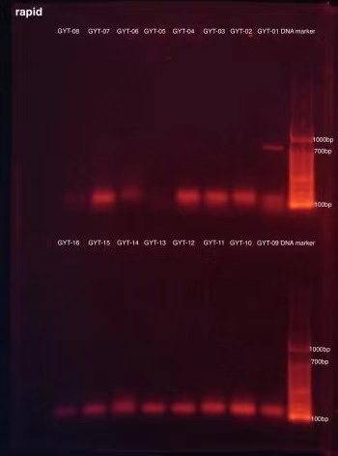
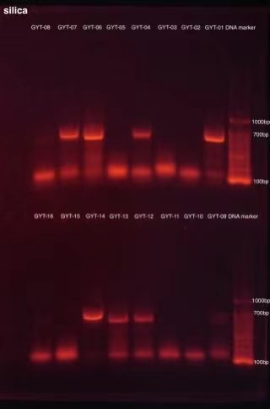
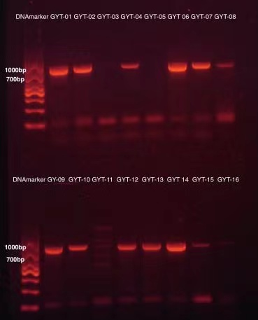
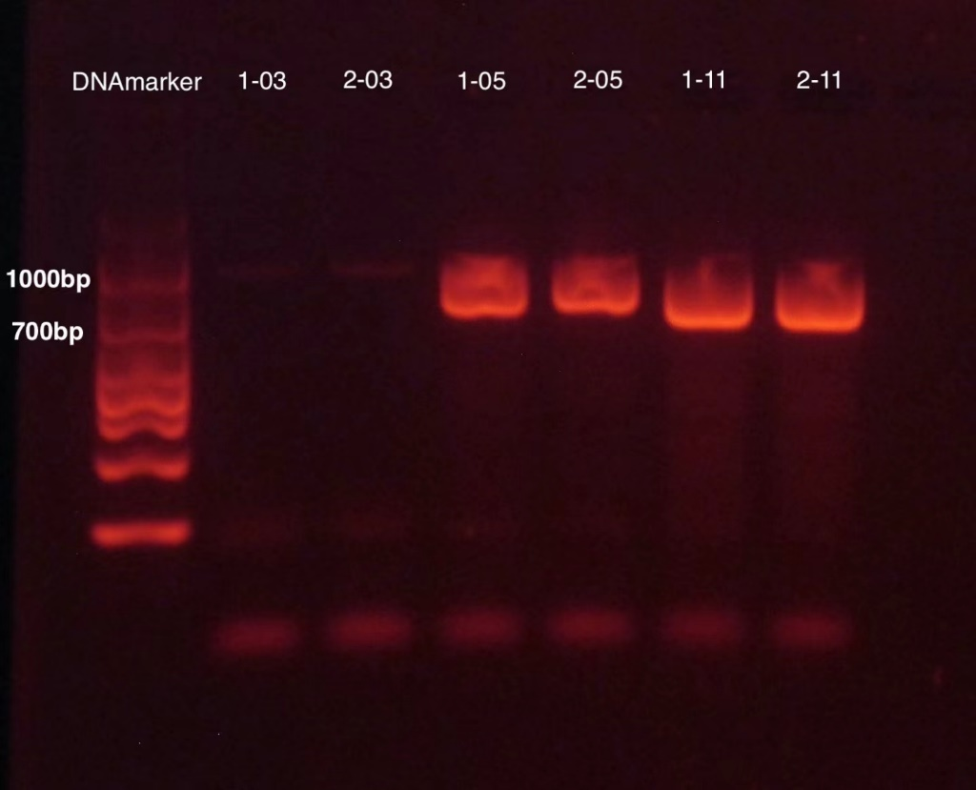
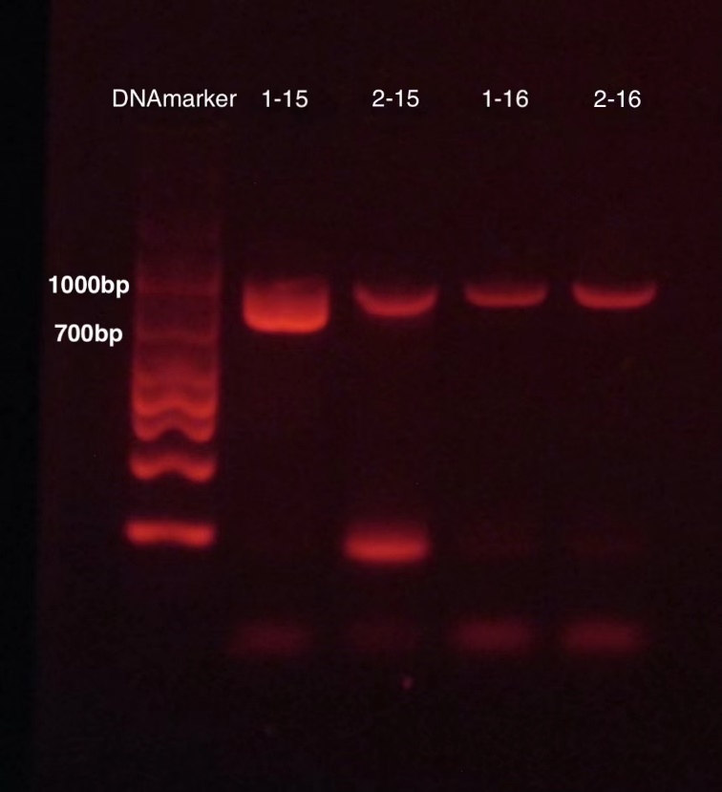
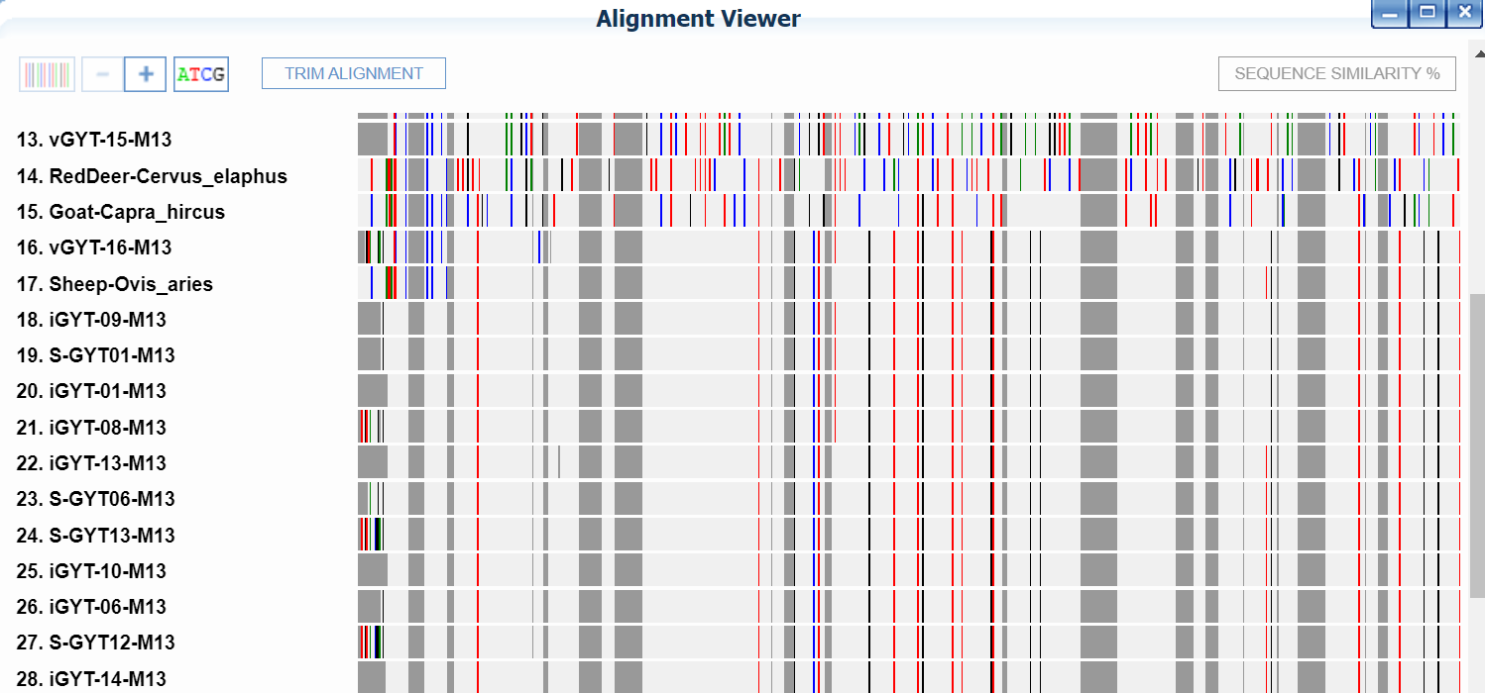
DNA Barcodes of Meat Collected in Different Barbecue Restaurants in Suzhou and Changzhou
Authors: Tony Gan¹, Susan Chen², Sophia Kim³, QiuQiu⁴
¹Wycombe Abby School ²Nanjing Normal University Suzhou Experimental School ³Dulwich School Suzhou ⁴Cheltenham Ladies’ College
Mentor: Xingyue Wang, Zhiyuan Liu
Cold Spring Harbor Asia DNA Learning Center
Abstract
With the increase of young people eating street food such as barbecues, more and more concerns have risen about how safe and genuine street food really is. In this experiment, we will be testing different kinds of meat from a variety of different barbecue restaurants in Suzhou and Changzhou. We hypothesize that most barbecue restaurants are selling meat with correct labeling. Our objective is to use DNA Barcoding to test the sequence of the target meat and make sure that the meat we eat is real lamb or beef. The key in extracting DNA is the Silica method, which involves using silica to absorb DNA, which then amplifies the target DNA sequence using PCR.
Discussion
From the results obtained, we’ve concluded that all sampled meats were labeled correctly. This implies that the specific meats in the barbecue restaurant are safe to eat. This investigation is significant as people’s concerns on the safety of the food they eat have risen rapidly in the past few years. This is partly because the economy is developing swiftly and people are striving to have better health and living standards, and also partly due to some restaurants selling fake meat that contain toxic chemicals. The good news is, the study has worked as originally hypothesized. However, we did not test a lot of stores, so we can’t speak for all barbecue shops, but we can assume from our results that most big branded shops should have reliable real meat.
Throughout the process, we experienced multiple difficulties in the DNA extraction of pork. At first, there was too much fat in the pork slice we took and it prevented us from taking a clear supernatant, so we had to repeat the experiment. After the gel electrophoresis results came out, none of the pork samples showed up and some of the strips were thinner and dimmer than others which could have been an anomaly. One of the lambs had a very dim DNA where others were clear which was an unexpected result. However, we soon figured out that the reason could be due to the small sample size and the lack of DNA.
In conclusion, most barbecue shops have real meat and it is safe for eating. For future studies, more varieties of animal meat could be used from a wider range of barbecue shops in order to have more reliable data about shops in general. We can also compare different aspects of shops, for example, big branded barbecue shops vs small barbecue shops, expensive vs cheep meat, and popular vs unpopular shops, and see which one is safer to go to. We can also test to see if there are other better DNA extraction methods that can be used for extracting meat to get more reliable data.
References
王维婷, 柳尧波, 杜鹏飞, 胡鹏, 汝医, 曹洪防, & 王守经. (2019). COI 序列应用于羊肉掺伪非定向筛查技术的研究. 现代食品科技, 35(2), 216-222.
贾慧建, 王天添, 赵远, 宋顺佳, 邵学超, 艾金霞, & 孙丽媛. 肉制品中狗, 狐, 貂源性成分 DNA 检测试剂盒的制备. 肉类研究, 35(8), 48-53.
谭利伟, & 王应宽. (2016). 发达国家畜禽产品质量安全可追溯系统的发展与启示. 肉类研究, 30(12), 54-63.
Acknowledgements
We would like to thank DNALC-Asia Learning Center, our tutors Xinyue Wang and Dr. Zhiyuan Liu, people who provided us with materials and equipment, parents who financially supported us, and finally everyone who spent time reading our project.
Figure 1. Rapid method in extracting DNA
Figure 2. Silica method in extracting DNA
The targeting DNA should be between 1000 to 700 bp, the ones at the end, are too small, which can’t be the target DNA. They are primer dimmer that is useless to sequencing. So we could conclude that rapid method only worked for the first sample. This means the DNA of animals are hard to extract with this method. There are more samples worked with silica methods, so we should use this method when we are repeating the experiment.
Figure 3. Redo of all the samples with CO1 primers
The Brightness of the strip reflects the quality of the DNA. Brighter it is, DNA has better quality. From this, we could see that GYT-01,02,06,07,09,10,12,13,14 is in good quality. Strips of GYT-04,08,15 are dimmer, but also showed up clearly. We could send these to gene company for sequencing. But for GYT-03,05,16, there are no strips at all, which means the target DNA is not amplified. We are unable to sequence those samples.
Introduction
Adulterated food have raised many problems in the past, especially in the processed food and meat sector. A common myth about barbecue shops is that they sell mice or shark meat and label it as lamb or pork on the menu in order to get more profit, which is a major concern that people have when deciding whether to get barbecue or not. We decided to have a look at the meat industry and see if the meat used in barbecue shops are real pork and lamb. This investigation is not only essential to us, but also to the people that had purchased these brand meat and future customers. We hope that this can help to solve the problems and concerns of adulterating food, as adulterating could damage buyers’ health and the reputation of the meat sector.
Figure 4. The collection of samples
Figure 5. Repeated PCR results with primer for vertebrates
We repeated every one of the samples twice to minimize the probability of manual mistakes. 1-03 and 2-03 are chicken, it did not show up in any tests, or any methods of DNA extraction. This could be because it had too many salts that cannot be washed off. It could also be the problem of primers. Since the rest had all shown up, clearly the target DNA had been extracted and could be send to sequencing.
Figure 6. The blast results chart, shows our lamb samples are lamb
As we can see from this figure that the DNA barcoding for sample 18 to 28 are similar to that of sheep-Ovis_Aries, which can prove that they are all real lamb.
Materials & Methods
Our samples are half made meat from barbecue shops and supermarkets. We washed the samples with distilled water. Next we cut a small piece of the sample and placed it into a tube. Then we added lysis, ground it up, and added in a paper disc for rapid DNA extraction. After soaking it for a while, we washed the paper disc with wash buffer and air dried it. The disk was then transferred into a tube of 30μL TE for storage. Meanwhile, we took the remaining lysis solution and we put it in a water bath and centrifuged it. Next, we took out 150μL supernatant and added 3μL silica to it. Finally, we repeatedly washed, mixed, and centrifuged it multiple times until we got the DNA we needed. In order to amplify our target DNA sequence (CO1), we used PCR with the primers named LCO1490 and HC02198. We then sent the sample to be sequenced. Once the results came back, we analyzed them using a software called DNA Subway.
Table 1. The blast results and identification of safety
Results
After we do gel electrophoresis, we found out
that it is very difficult to extract DNA After
carrying out gel electrophoresis, we found out
that it is very difficult to extract DNA from
pork (as shown in Figure3). There are several
reasons to this, and one is that pork contains
large amounts of fat tissue, which could interfere
with the process of amplifying PCR. Another reason might be that we used a primer that was not suitable for pork DNA. Making mistakes in the method could also be a reason, but it’s highly unlikely since we redid the experiment several times. We repeated the PCR for pork samples with a different primer, and all pork showed up, so we concluded that the problem with our first experiment was that we used the wrong primer. The chicken sample did not show up on the gel in both our experiments. However, we only have one sample of chicken, so we do not have enough evidence to state a conclusion. After sequencing, we have some good news.
All the samples are proved to be labeled correctly and there is no sign of fraud. All our samples are safe to eat.
Sequence Labelled Result 1 Result 2 Result 3 Judgement iGYT-01 lamb Ovis aries Ovis aries Ovis aries true
iGYT-02 beef Bos taurus Bos taurus Bos taurus true
iGYT-04 beef Bos taurus Bos taurus Bos taurus true
iGYT-06 lamb Ovis aries Ovis aries Ovis aries true
iGYT-07 beef Bos taurus Bos taurus Bos taurus true
iGTY-08 lamb Ovis aries Ovis aries Ovis aries true
iGYT-09 lamb Ovis aries Ovis aries Ovis aries true
iGYT-10 lamb Ovis aries Ovis aries Ovis aries true
iGYT-12 beef Bos taurus Bos taurus Bos taurus true
iGYT-13 lamb Ovis aries Ovis aries Ovis aries true
iGYT-14 lamb Ovis aries Ovis aries Ovis aries true
vGYT-05 pork Sus scrofa Sus scrofa Sus scrofa true
vGYT-11 pork Sus scrofa Sus scrofa Sus scrofa true
vGYT-15 pork Sus scrofa Sus scrofa Sus scrofa true
vGYT-16 lamb Ovis aries Ovis aries Ovis aries true

