Slide 1
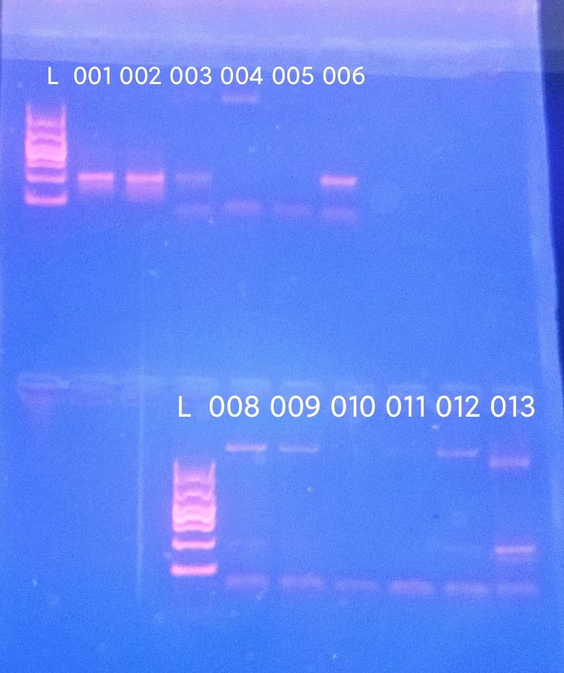
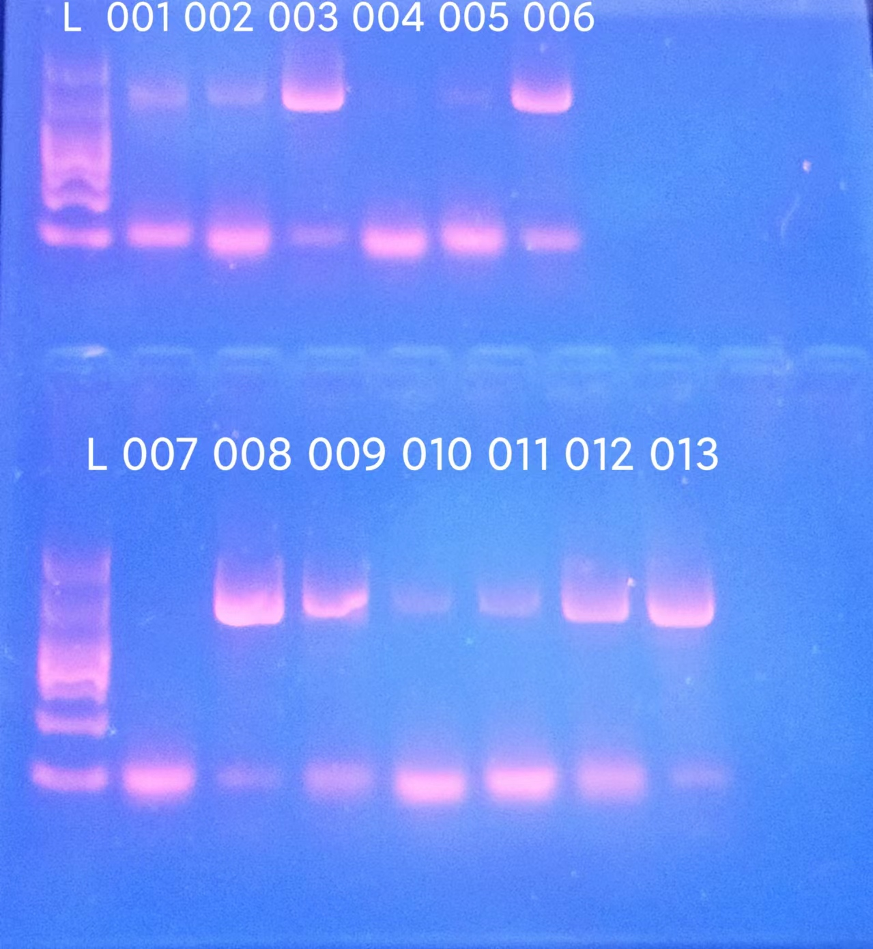
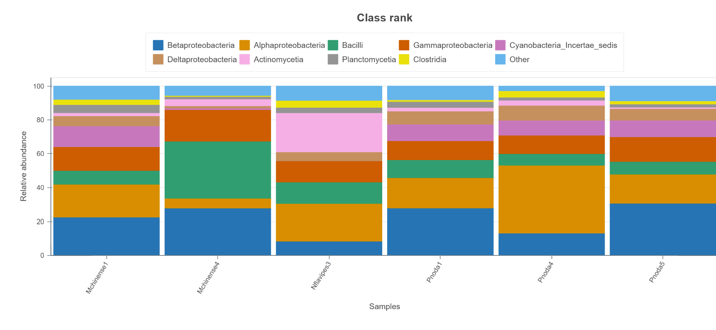
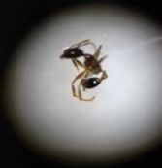
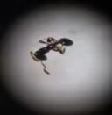
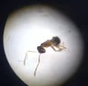
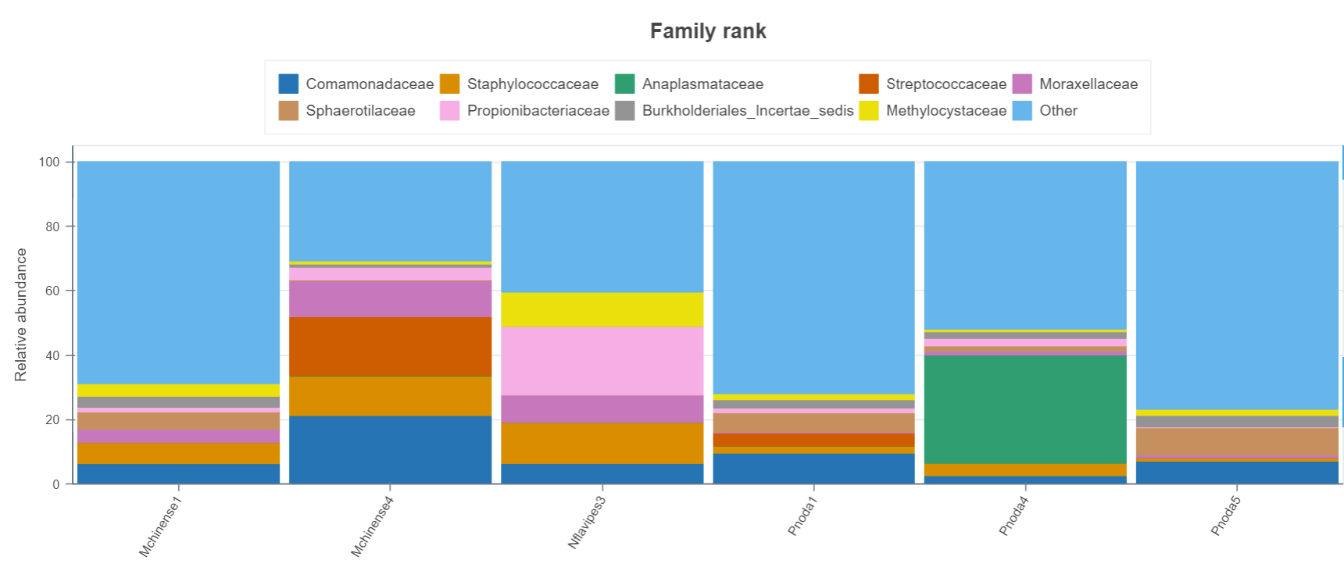
Using 16S metabarcoding with Oxford Nanopore Technologies to identify ant mandibular microbiomes and examine the link to ant diet
Authors: Tony Wang, Ryan Pu, Linda Yang
Tutor : Jeffry Petracca, XinYue Wang
Cold Spring Harbor Asia DNA Learning Center
Results
Discussion
According to the DNA subway graph, there are three species of ants which are the pheidole noda, the monomorium chinense, and the nylanderia flavipes available in our research. On the bacterial analysis, there are segmented bar graphs showing the bacteria components of the three ant species.
from the figure 1, we can know the distinction of the nylanderia flavipes from other kinds of ants that there is great amount of actinomycetia in the samples. By comparing the diets of these ants’ diets, a differentiation of the diet of the nylanderia flavipes that they favor the dead animals can be known. So according to the information on the internet that this kind bacteria are harmless soil microorganism which also serves as an antibiotic producers. Meanwhile, this kind of bacteria is also commonly find in some dead animals which can be the food of nylanderia flavipes. So this can the explanation why there are lots of this kind of bacteria in this kind of ant. However, this situation of eating dead animals for survival not only exists among, but also among Pheidole. But according to the chart, bacteria actinomycetia doesn’t exists as much in Pheidole. We expect that the nylanderia has a greater favor in carrion.
Moraxellacease commonly occur in commensals of mammals and in soil or water. From the figure 2, we can notice that this kind of bacteria doesn’t occur in Pheidole while it exists in other two kind of ants. So we presume that the ants that prefer eating plants nectars live long in plants and do not spend a lot of time finding carrion in the soil. This can prove that Pheidole don’t have a favor in carrion compared to the nylanderia.
Drawing lessons from the above, there are several aspects of this project that we could improve. First of all, the data set is not enough for us to conclude a specific result. We should collect more ant heads next time since the DNA amount on one head is extremely low. Secondly, due to the time length and our ability, we are not able to exclude all other variables such as diet variating according to the age and gender of ants within a specific ant colony. We are also not sure if the ants have eaten food and got its bacterial DNA on its head. Next time, we could probably place the ants in a container and give food to them and get all other variable constant.
References
“Barcode Project Sample Database.” Sampledb.dnalc.org, sampledb.dnalc.org/barcoding/
.“Fast Track to Gene Annotation and Genome Analysis - DNA Subway.” Dnasubway.cyverse.org, dnasubway.cyverse.org/
.Lucas, Jane M, et al. “The Microbiome of the Ant‐Built Home: The Microbial Communities of a Tropical Arboreal Ant and Its Nest.” Ecosphere, vol. 8, no. 2, 1 Feb. 2017, https://doi.org/10.1002/ecs2.1639. Accessed 22 Aug. 2023.
Acknowledgements
Our team successfully completed our research and finally had our project presented with the help of everyone who supported our team. First of all, our team give sincere thanks and appreciation for our tutor Jeff, whose encouragement and patience to listen to our questions have accomplished our team so much. It is a pleasure to study under his guidance. We are also extremely grateful to our classmates who have kindly provided our team assistance and companionship in the course of preparing this project.
Abstract
Ants (Formicidae) have evolved and diverged into 12,000 different species since they first appeared around the Jurassic period. Over time their preferences for food have also varied. While many ants have a varied diet, some feed on particular animals or plants. It is known that diet is closely linked to an organism’s microbiome. This is likely the case for ants, as well. In our study, we are going to examine the microbial diversity on the mandibles of different species of ants. We intend to examine the relationship between microbiome diversity and ant species’ recorded diet. We are going to use silica DNA extraction and analysis of the CO1 gene code region to confirm the species of ant. Then, the Qiagen Powersoil Pro kit will be used to extract bacterial DNA from the ants’ mandibular region. Oxford Nanopore Technologies will be used to sequence bacterial 16S libraries.
SWT CO1 gel images for ant DNA (left) and bacteria DNA (right)
Gel electrophoresis data
Introduction
Different species of ants have different diets. From this observation, the diet can correlate with the microbiomes of the ants’ mouth parts and head. We want to find out the relationship between the diet of different species and the microbiomes from their mouth parts and head. We want to expand the understanding of how the microbiomes vary between species. The is a wider view than that of varying diet, gender and ages in a single species colony.
We used the ant heads because there may have microbiome that may facilitate nutrient acquisition or promote health. We want to explore the difference in ant diet between three species to examine patterns between microbiomes and diets.
Ant species were confirmed by CO1 DNA barcoding. Microbiomes were assessed using the 16S barcoding kit from Oxford Nanopore technology.
The research question can help find the regulation between the diet and the microbiomes of different species of ant, maybe we can apply the regulation to different animals and develop the certain microbiomes by giving the certain diet.
figure1
Pheidole noda
Monomorium chinense
Nylanderia flavipes
figure2
Materials & Methods
Processing samples: collecting three species of Formicidae and separating body and head
Ant body DNA extraction: use silica isolation method to extract DNA of Formicidae from body
Amplification of DNA and test the amplification: PCR & gel electrophoresis
Ant CO1 DNA Sequencing: Sent to Azenta Life Sciences
Analysis of CO1 barcodes: DNA subway
Ant head Bacterial DNA extraction: using QIAGEN DNeasy Powersoil Pro Kit.
Amplification of DNA and test the amplification:
PCR (using specific barcodes from the Nanopore 16S Barcoding Kit) and gel electrophoresis
Bacterial DNA Sequencing: 1 DNA Library preparation
2 Flongle flow cell priming
3 Flow cell loading
Analyzing data: Using the website Minknow
Chart1: Bacterial distribution results showing the lack of moraxellaceae in P. noda.
Chart2: Bacterial distribution results showing the abundance of actinomycetia in N. flavipes.

