Slide 1
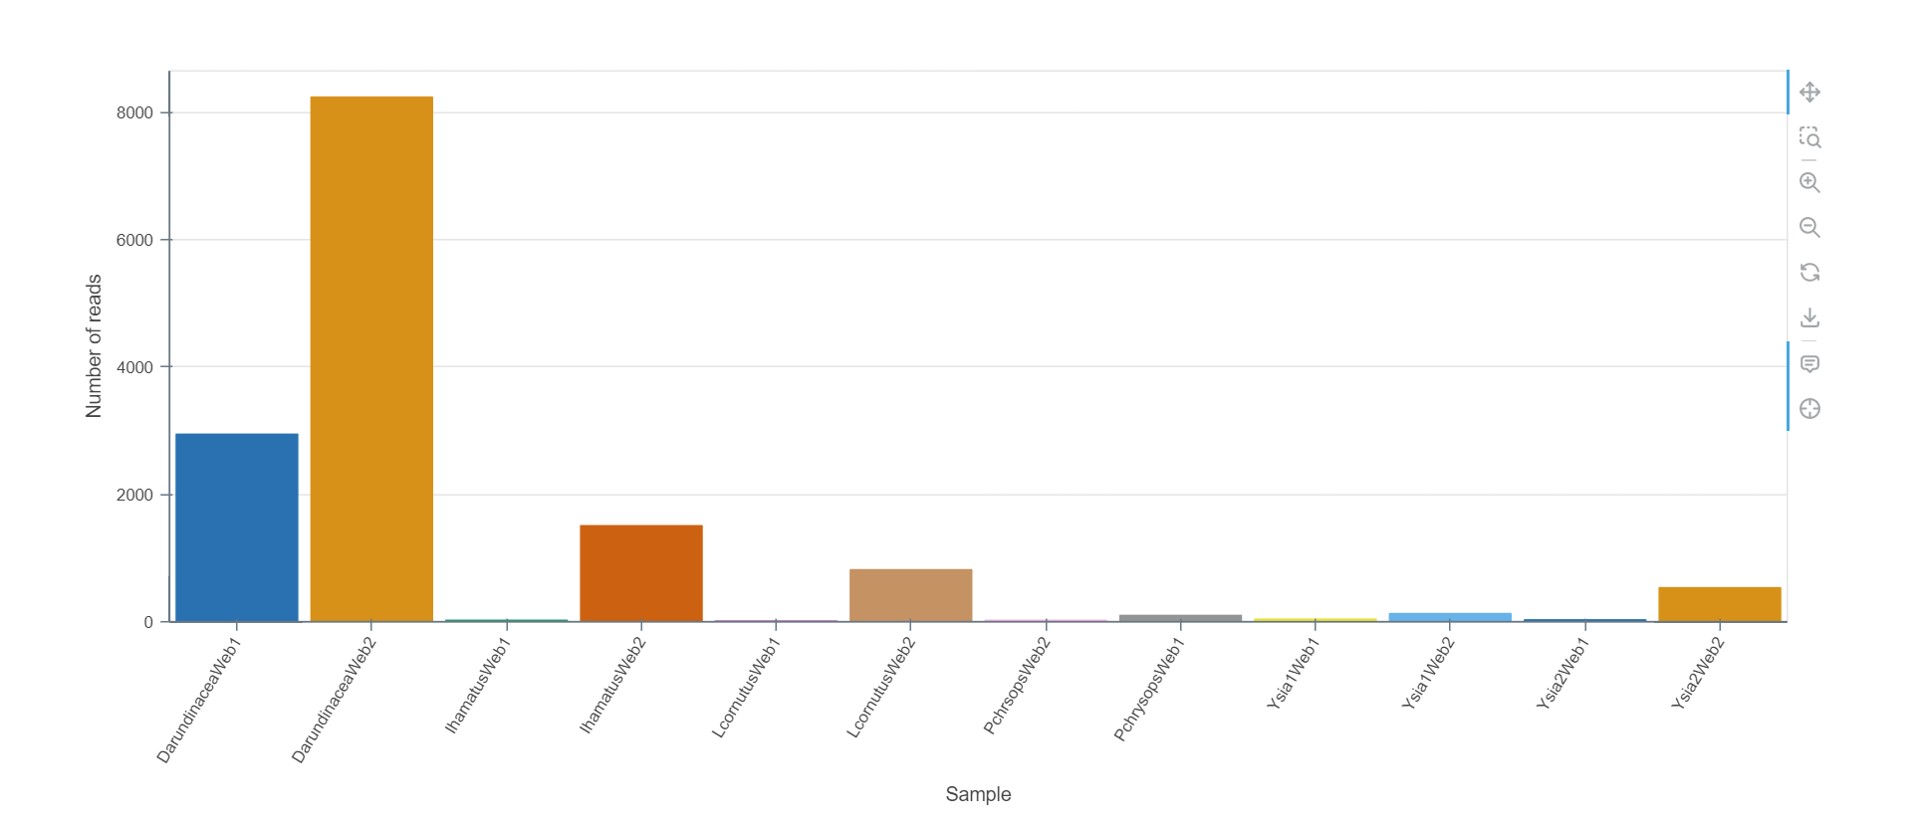
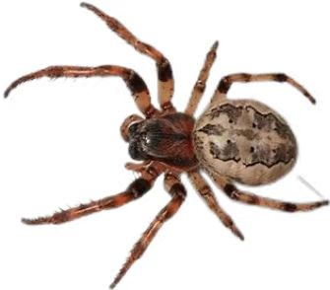
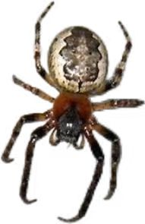
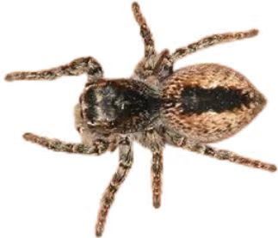
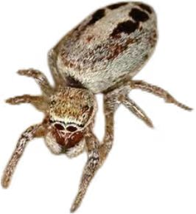
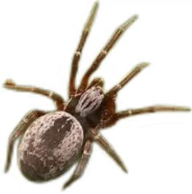
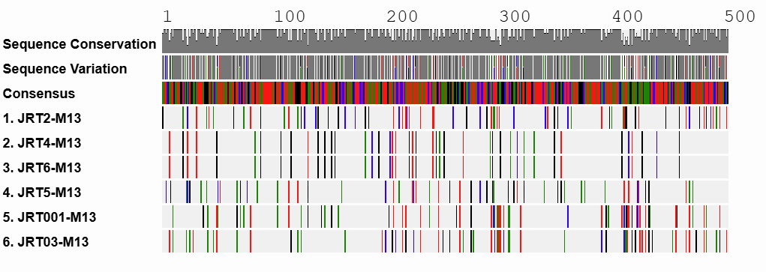
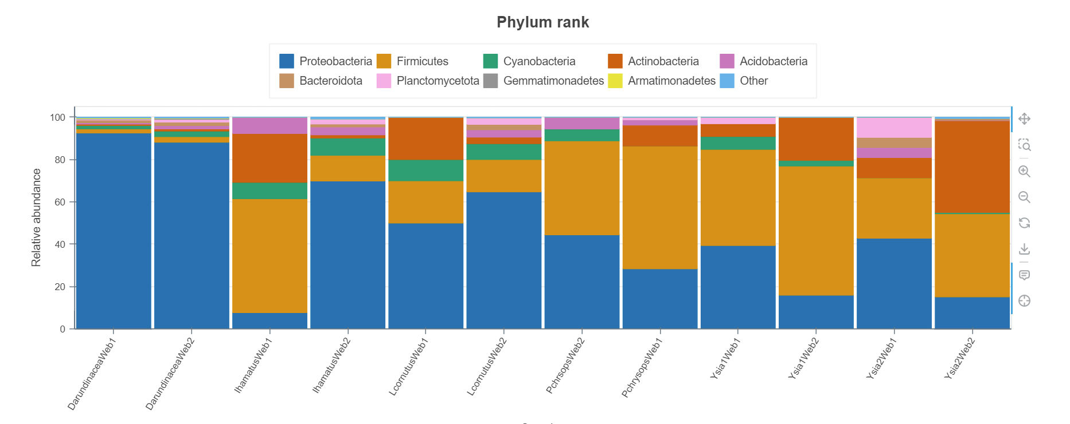
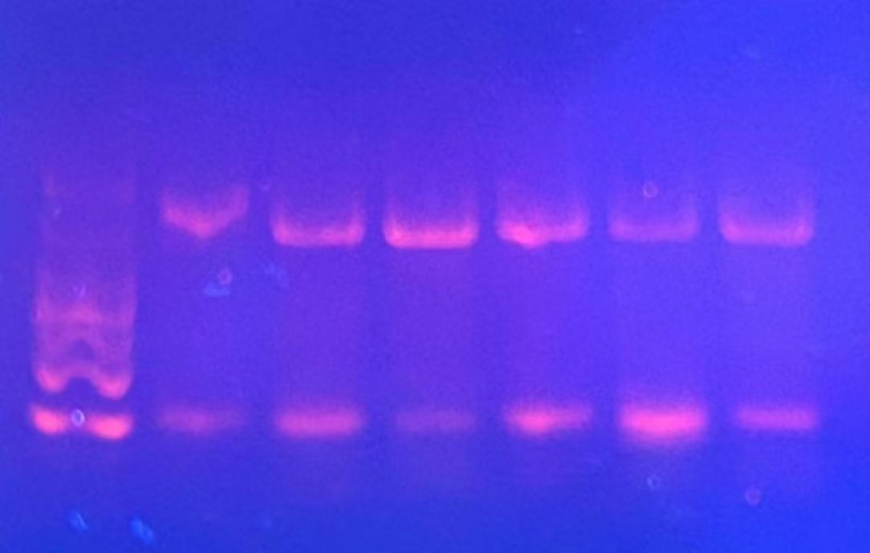
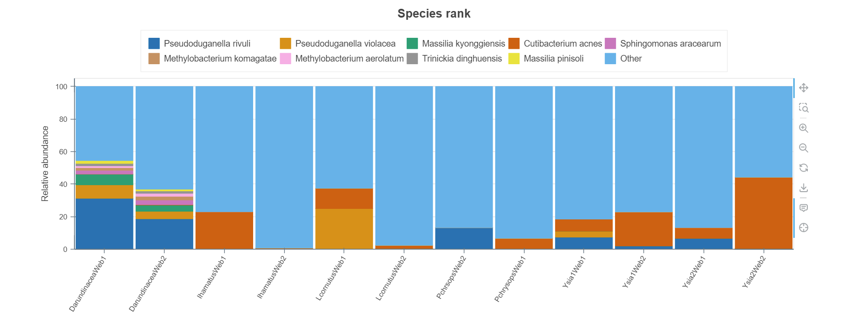
Using DNA barcoding to explore the evolutionary differences in spider web microbiomes
Authors: Muyao Wang, Jiahao Yan & Linhao Tao
Mentor: Jeffry Petracca
Cold Spring Harbor Asia DNA Learning Center
Results:
Abstract:
Spider silk is a promising material in many fields attributable to its incredible ductility and strength. Nevertheless, the knowledge about the bacteria communities in spider webs is lacking. In this study, we researched three kinds of different spider species and their webs to explore the microbiome in the spider silk in order to better understand the differences in microbial communities across different species of spiders’ webs. Spider species and web microbiome species diversity was determined by DNA barcoding, a process that can identify a species using sequence information from a specific region of the DNA. We used the Qiagen Powersoil Pro kit to extract the DNA from web samples and the silica DNA isolation method to extract the DNA from spider samples. The cytochrome oxidase 1 (CO1) marker was used for spider identification and 16S was used for bacterial species identification. The results could suggest how differences in web microbiomes have shaped spider evolution.
Figure 1: The PHYLIP ML of the spider samples
Discussion:
1. Sample collection limitations:
The spider silk sample is small and some of them could not yield enough bacterial DNA. In future, we should use more silk to generate microbial DNA libraries. We used a tube to collect the samples, it’s difficult to put the webs in and hard to get all of them out. I suggest that to use a plastic bag to collect the webs since it’s much easier to obtain the enough samples and get them out.
2.The relationship between our result and the human development:
the spider silk can be an excellent material in many fields due to its great mechanical properties. We already know that the bacteria inhabiting spider webs can enhance the silk extensibility [1]. Our research can be a preparation of the further research on this relationship since different bacteria may have the different effect on the spider silks.
3. Further research:
In the future, we can test more species of spider silks and obtain much more sample than this time. We can also test the viscosity of different kinds of silks and compare the difference on their microbiomes. By this way, we may figure out the relationship between the bacteria inhabiting the spider silks and the spider silks’ viscosity.
Figure 4: The number of 16S reads from the spider silk sample
Introduction:
Our project focused on discussing differences in microbiome diversity in the silks produced by different varieties of spiders. This research can help us better understand the evolutionary relationships of spiders and prepare for the further research of bacteria and the spider webs. We know that the bacteria inhabiting spider webs can enhance host silk extensibility, we think it’s interesting and it may have the effect on the spiders’ evolution. The bacteria may play a vital role in the evolutionary differences in spiders.
We used CO1 DNA barcoding to identify the spider species. DNA barcoding is a tool that uses a short genetic marker in an organism’s DNA to identify the species. We also used the 16S barcoding to identify bacterial diversity in our silk samples.
Figure 2： The alignment viewer of the spider samples
L
JRT
001-M13
JRT
003-M13
JRT
006-M13
JRT
002-M13
JRT
004-M13
JRT
005-M13
Figure 5: The Phylum differential Abundance plot of the microbiome in spider silk sample
References:
[1] Maryia Tsiareshyna , Te‑Hsin Wang , Ying‑Sheng Lin , Dakota Piorkowski , Sammi Yen‑Ting Huang , Yi‑Lun Huang , Wei‑Ting Chao, Yuan Jay Chang , Chen‑Pan Liao , Pi‑Han Wang & I‑Min Tso. Bacteria inhabiting spider webs enhance host silk extensibility[J]. scientific reports, 2024(14):1-11
[2]Blast: https://dnasubway.cyverse.org/
Method:
1. Specimen collection: spiders were collected at night since most of them are nocturnal animals.
2. DNA extraction: We used the Qiagen Powersoil Pro Kit to extract the DNA from web samples and the silica DNA isolation method to extract the DNA from spider samples.
3. PCR: We used 2 primer sets with M13F and M13R tails CO1 for spider identification and 16S for bacterial species identification.
4. PCR testing: We use the gel electrophoresis to test the quality of PCR.
5. 16S NG Sequencing: on a flongle Flowcell using MinION MK1B
6. Species Identification: We identify the species and analyze the data with DNA subway.
Figure 3: Images of gel electrophoresis of the CO1 spider samples
Figure 6: The species differential Abundance plot the microbiome in spider silk sample
The spider samples’ CO1 PCR amplicons are all successful as indicated by the result of gel electrophoresis (Figure 3). BLAST identifications confirm the species of all samples:
JRT001-M13: Icius hamatus
JRT002-M13: Dictyna arundinacea
JRT003-M13: Philaeus chrysops
JRT004-M13: Yaginumia sia
JRT005-M13: Larinioides cornutus
JRT006-M13: Yaginumia sia
We use the PHYLIP ML to see their relationship in the taxonomy using DNA Subway. The result shows that JRT004-M13 and JRT006-M13 are the same species, and they are relative to JRT005-M13. In fact, all of these three spiders are collected on the web behind a wall in the same location. According to this, we can concluded that these three spiders evolved the similar habit that to make their webs in the dark and breezeless places. And about JRT001-M13 and JRT003-M13, they are the jumping spiders in Salticidae family. We know that this kind of spider never make the webs although they have the silks in their body. At last, here is JRT002-M13 . We found it and its web on a tree, so it’s a arboreal spider from another family. To sum up, the six samples are separated into three different families. And it seems that each family’s spiders have their own special spider silk form and living habit.
Our spider silk sample 16S PCRs were not as successful, possibly due to the small sample quantity of silk from which we isolated bacterial DNA. The number of reads are also low for some of them, but there is still some useful data here. The sample of Dictyna arundinacea’s silk is the most successful one since we get the entire web on the tree which brought us enough DNA in here. Let’s see the Phylum rank first. We can find that the Proteobacteria has the dominated status in most of the samples, especially in the samples that we are succeed in PCR. Next, we can go to see the Species rank, its much more specific than the Phylum rank since we can exactly see which species is inhabiting there. From the Figure 5, we can clearly see that the Pseudoduganella rivuli is the most abundant species in the web (We just pay attention to the most successful sample here to make sure the result is more precise.)
What’s more, we find a phenomenon in these figures that the higher the number of the reads, the larger proportion of the Proteobacteria is showed. According to this, we have a theory that the Proteobacteria in the dominated status is the most precise pattern. But there is still a exception: The Ysia2Web2 sample. This sample has comparative high number of reads in these samples, but it shows the very less Proteobacteria and the largest proportion of Actinobacteria. There is two possibilities: The first explanation is that this kind of spider has its own very special silk microbiome. The second explanation is that the number of reads is not enough to show the proper pattern. This question still need the further research.
Acknowledgements:
Here, we would like to thank the teachers who taught us during the 14 days. Then, we want to thank our parents for giving us the chance to reach out the DNA Barcoding. Moreover, we would like to thank Cold Spring Harbor Asia DNA Learning Center and Oxford Nanopore for providing us with up-to-date facilities and equipment. Finally, it is also very important to thank ourselves for our efforts to complete our project.

