Slide 1
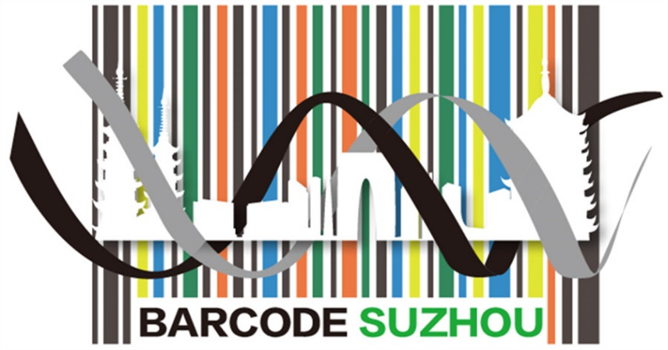





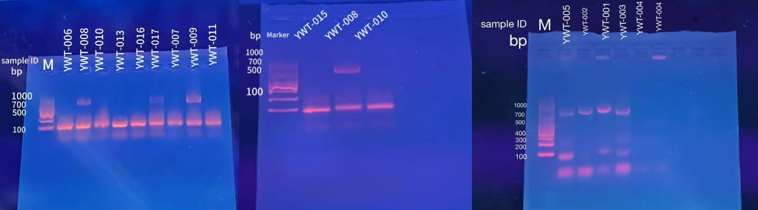
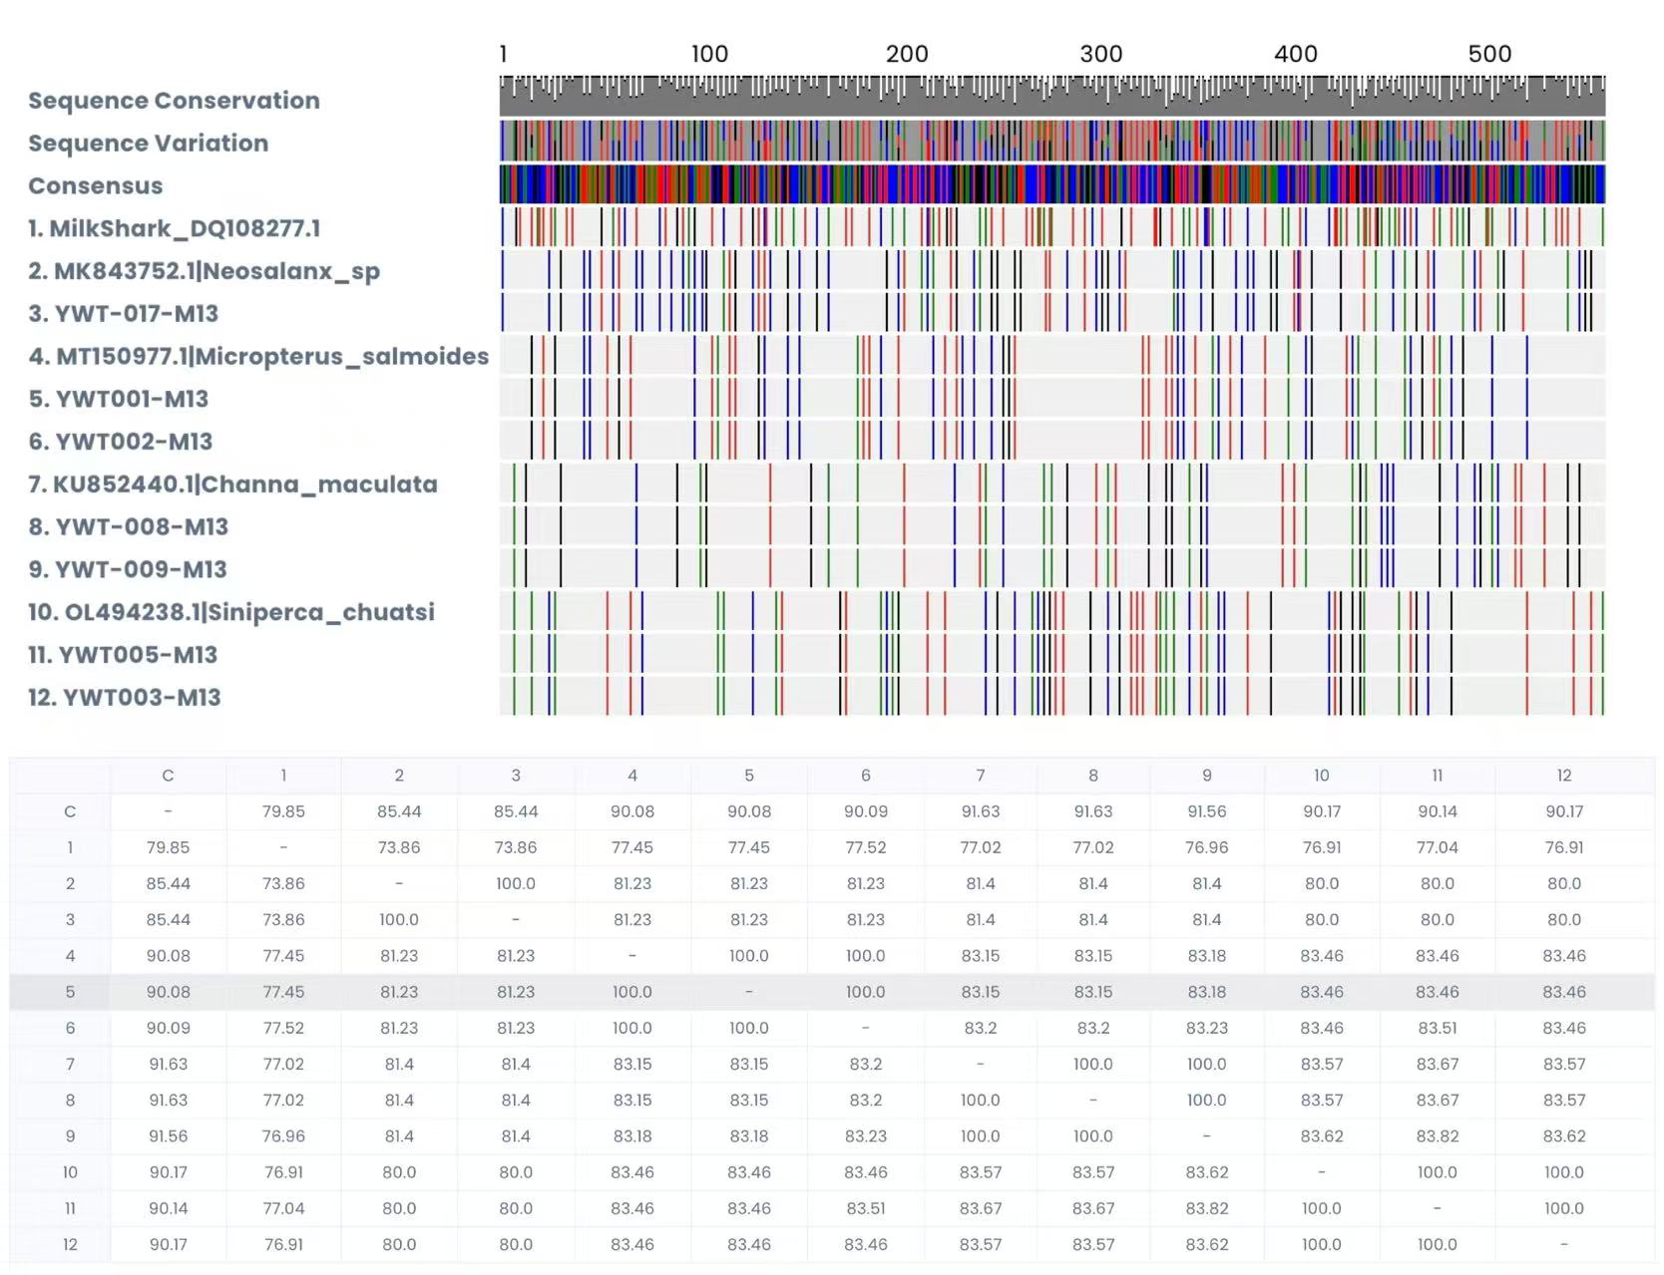
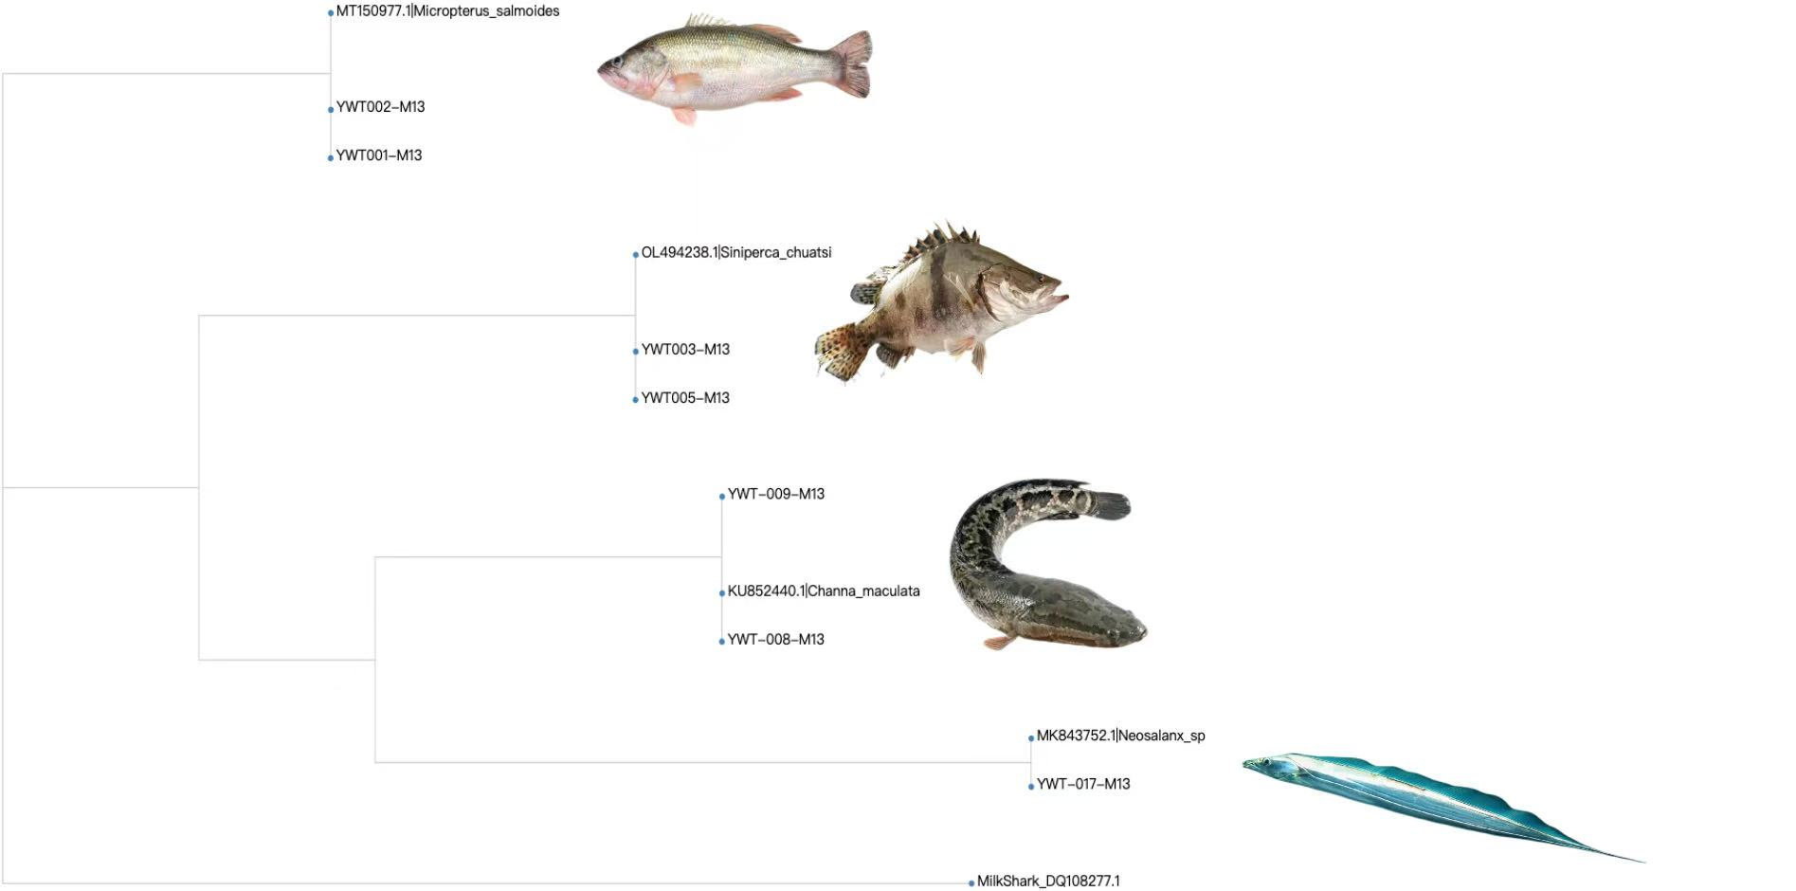
Identification of Fish Species Using DNA Barcoding in Suzhou Aquatic Markets
TEAM MEMBERS: SHUYAN JIN, XIAOXIAN ZENG, YUHAN DING, YUHAN ZENG
MENTORS: CRISTINA FERNANDEZ, XINYUE WANG
Abstract
DNA barcoding is a molecular technique used to identify species by analyzing a standardized region DNA. This method has been adopted for detecting species substitution and mislabeling in the food industry, where visual identification can be unreliable due to cryptic species. Our project aims to examine the degree to which DNA barcoding assess the authenticity of certain fish species collected in local aquatic markets in Suzhou. We collected samples of fish labeled as specific species from a range of aquatic markets. Given the variable quality and potential degradation of DNA in processed fish, we chose the silica DNA isolation method and then amplified the COI gene using primer cocktail, followed by Sanger sequencing and BLAST search. Four out of eight species have been successfully sequenced due to challenges during sample collection and DNA isolation. The findings evidenced that DNA barcoding could effectively identify fish species to a degree and thus identifying some fish frauds; however, the efficiency of DNA barcoding relies heavily on sample quality and extraction. The present study can benefit relative applications of DNA barcoding in ecology and taxonomy, highlighting the necessity of further improvements in sample collection and extraction methods.
Discussion
Eight samples were isolated and underwent PCR amplification. Four out of eight samples could show expected results during gel electrophoresis, and these four samples were sequenced and identified successfully. The scientific names given after sequencing matched to part of the names that were labeled on fish when bought since we found that there were multiple species under one common name used in markets. The results showed that DNA barcoding can help us distinguish fish species to a certain extent and accurately define their actual classification or essential characteristics. Nevertheless, whether the PCR products can be clearly shown in gel electrophoresis and whether our sequences can match with DNA sequences in the DNA subway database depend on the quality of the sample, primer suitability, and selection of region for barcoding (e.g. COI, mtDNA, ITS).
Our unusual finding highlights that the "common names" we use in our daily life can refer to different species of fish belonging to distinct families. For example, while we refer to Sea bass as "LuYu," this name encompasses multiple species. Although Japanese sea bass (Lateolabrax japonicus), perch (Perca fluviatilis), and large-mouthed black sea bass (Micropterus salmoides) are commonly known as "perch” or “ sea bass” in daily life, but their genetic differences are significant. Specifically, the Lateolabrax japonicus belongs to the Lateolabracidae family, whereas the Micropterus salmoides is part of the Centrarchidae family.
To further verify, we found the Lateolabrax japonicus’s GenBank Accession number in the National Center for Biotechnology Information(NCBI). We input this GenBank Accession number in DNA Subways and consulted the Sequencing similarity Table. Sequence similarity analysis shows that the similarity between Japanese sea bass and perch is only about 50%, and the similarity with large-mouthed black sea bass is 60%, and the similarity between perch and large-mouthed black sea bass is only 51.41%, which is far lower than the typical similarity threshold of the same species (usually >90%). These results confirm that the common name "perch" or “sea bass” actually cover many species with relatively distant genetic relationship and belong to different families or orders.
We faced multiple difficulties that could lead to four samples not successfully being amplified for the sequencing. During our sample collection, we could only buy the fish stored in cryopreservation. The owner of the aquatic market wasn’t willing to share fins, and it was beyond our resources to buy a whole fish. Therefore, some DNA isolation failed as the DNA’s quality decreased when it was repeatedly frozen and melted. This recurring process results in ice crystal formation, which destroys cell structure, degrading DNA. Long-term cryopreservation also slow enzymatic activity or oxidation reactions, which may damage DNA. Moreover, fish tissues contain inhibitors such as polysaccharides, fats, and hemoglobin. Such residual PCR inhibitors would lead to electrophoresis results that display only shadows and no clear bands. In future fish sample collection, it is recommended to give priority to the following sample types, such as the base of fish fins that have not been repeatedly frozen and thawed (rich in mitochondrial DNA), which probably has more undegraded DNA.
Selection of COI gene could also lead to our failure of four samples. The COI sequences of some deep-sea fish vary, and the universal primers (cocktail C._FishF1t1 and C._FishR1t1) we chose might not match with certain species. In future experiment regarding fish DNA barcoding, COI can be replaced with other mitochondrial gene primers, for instance, 16S rRNA (applicable to fish).
The results from Suzhou aquatic markets not only help identify fish fraud in aquatic markets but also play a critical role in bridging scientific discovery and practical applications. For instance, identifying species commonly sold in Suzhou could contribute to regional biodiversity records, thus revealing cryptic species or misidentified taxa that were previously overlooked. Plus, mistakes of our experiment highlight the importance of improving the DNA barcoding method in the future.
Fig.1 Gel electrophoresis results. Three(YWT-008, YWT-009, YWT-017) out of nine samples were at expected bp.
Fig.2 Gel electrophoresis results. YWT-008 was double tested. One(YWT-008) out of three samples was at expected bp.
Fig.3 Gel electrophoresis results. YWT-004 was tested twice in this gel. Four(YWT-001, YWT-002, YWT-003, YWT-005) out of six samples were at expected bp.
Introduction
Fish species vary greatly in shapes, sizes, and colors, so traditional morphological way of identifying fish species may be inaccurate due to high diversity and existence of cryptic species (Victor et al., 2009). In aquatic markets, despite ongoing effort for food traceability, some sellers frequently use substitutes for certain fish and mislabel their products(Blanco-Fernandez 2021). Such fraud could cause serious issues in aquatic products consumption, leading to health risks and ethical concerns. DNA barcoding techniques for fish identification have proven especially useful in addressing these problems, especially in identifying closely related species, including those from processed materials. The application of DNA barcoding is essential for enhancing product authenticity and sustainability within aquatic markets. Studies by Formosa et al. (2010) and Filonzi et al. (2023) have stated DNA barcoding as an effective tool for fish species identification. Furthermore, other works (Willette al., 2017; de Carvalho et al., 2020)) have applied it to monitor fish fraud in different places worldwide. Notably, Zhao et al.(2024) and Yan et al.(2016) successfully used DNA barcoding methods to reveal fish fraud in Chinese markets.
However, a geological gap in monitoring fish fraud in Chinese inland cities, such as Suzhou. Our project aims to address this gap by assessing the authenticity of certain fish species collected in Suzhou aquatic markets using DNA barcoding techniques. This method relies on a standardized, highly variably region of the genome. For animals, 5′ region of the mitochondrial cytochrome oxidase subunit I (COI) gene is the most commonly used regions. Studies shows that COI genes can be especially effective in discriminating fish species (Ward et al., 2005; Hubert et al., 2008; Valdez-Moreno et al., 2009). Thus, we collected samples of fish labeled as specific species (e.g. mandarin fish) from a range of aquatic markets, isolated fish DNA, and chose COI gene for sequencing.
Fig.4 Similarity of Barcoding Sequences Based on MUSCLE Alignment
Materials & Methods
The materials collected is all from Suzhou aquatic markets. The bass (YWT-001, YWT-002) and mandarin fish (YWT-003, YWT-004, YWT-005) were fresh when collected, while capelin (YWT-006, YWT-007), snakehead (YWT-008, YWT-009), hairtail (YWT-010, YWT-011), basa fish (YWT-013), salmon (YWT-014, YWT-015), whitebait (YWT-017) were frozen in fridge. We used silica DNA isolation method(Formosa, 2010), which can be used for plants, fungal, and animal samples. The main reagent of this method is silica resin, which can bind to the nucleic acids. After we isolated the DNA, we amplified DNA obtained using universal primer cocktail C._FishF1t1 and C._FishR1t1 (Willette et al., 2017; Zhang, J., & Hanner, R., 2012) to undergo PCR. After PCR, we analyzed PCR products by gel electrophoresis. Effective result is between 650bp and 1000bp. Then we chose reliable DNA samples to go through Sanger sequencing and analyzed the results on DNA SUBWAY. On this website, BLAST algorithm matched our sequences to the DNA sequences stored in its database. The species from which the sequences were derived were identified by their scientific names. Next, Maximum Likelihood(ML) tree which can determine the phylogenetic placement of species based on DNA barcoding data was built.
References
Blanco-Fernandez, C., Ardura, A., Masiá, P., Rodriguez, N., Voces, L., Fernandez-Raigoso, M., Roca, A., Machado-Schiaffino, G., Dopico, E., & Garcia-Vazquez, E. (2021). Fraud in highly appreciated fish detected from DNA in Europe may undermine the Development Goal of sustainable fishing in Africa. Scientific reports, 11(1), 11423. https://doi.org/10.1038/s41598-021-91020-w
de Carvalho, S. C., Sampaio, I., & Santos, S. (2020). DNA barcoding reveals mislabeling and commercial fraud in the marketing of fillets of the genus Brachyplatystoma Bleeker, 1862, the Amazonian freshwater catfishes economically important in Brazil. Heliyon, 6(9), e04888. https://doi.org/10.1016/j.heliyon.2020.e04888
Filonzi, L., Ardenghi, A., Rontani, P. M., Voccia, A., Ferrari, C., Papa, R., Bellin, N., & Nonnis Marzano, F. (2023). Molecular Barcoding: A Tool to Guarantee Correct Seafood Labelling and Quality and Preserve the Conservation of Endangered Species. Foods, 12(12), 2420. https://doi.org/10.3390/foods12122420
Formosa, R., Ravi, H., Happe, S., Huffman, D., Novoradovskaya, N., Kincaid, R., & Garrett, S. (2010). DNA-based Fish Species Identification Protocol. Journal of Visualized Experiments : JoVE, 38. https://doi.org/10.3791/1871
Hubert et al. (2008).Hubert N, Hanner R, Holm E, Mandrak NE, Taylor E, Burridge M, Watkinson D, Dumont P, Curry A, Bentzen P, Zhang J, April J, Bernatchez L. Identifying Canadian freshwater fishes through DNA barcodes. PLOS ONE. 2008;3:e2490. doi: 10.1371/journal.pone.0002490.
Valdez-Moreno et al. (2009).Valdez-Moreno M, Ivanova NV, Elías-Gutiérrez M, Contreras-Balderas S, Hebert PND. Probing diversity in freshwater fishes from Mexico and Guatemala with DNA barcodes. Journal of Fish Biology. 2009;74:377–402. doi: 10.1111/j.1095-8649.2008.02077.x.
Victor BC, Hanner R, Shivji M, Hyde J, Caldow C (2009) Identification of the larval and juvenile stages of the Cubera snapper, Lutjanus cyanopterus, using DNA barcoding. Zootaxa 2215: 24–36.
Ward et al. (2005).Ward RD, Zemlak TS, Innes BH, Last PR, Hebert PD. DNA barcoding Australia’s fish species. Philosophical Transactions of the Royal Society of London B: Biological Sciences. 2005;360:1847–1857. doi: 10.1098/rstb.2005.1716.
Willette, D. A., Simmonds, S. E., Cheng, S. H., Esteves, S., Kane, T. L., Nuetzel, H., Pilaud, N., Rachmawati, R., & Barber, P. H. (2017). Using DNA barcoding to track seafood mislabeling in Los Angeles restaurants. Conservation Biology, 31(5), 1076–1085. https://doi.org/10.1111/cobi.12888
Yan, S., Lai, G., Li, L., Xiao, H., Zhao, M., & Wang, M. (2016). DNA barcoding reveals mislabeling of imported fish products in Nansha new port of Guangzhou, Guangdong province, China. Food chemistry, 202, 116–119. https://doi.org/10.1016/j.foodchem.2016.01.133
Zhang, J., & Hanner, R. (2012). Molecular Approach to the Identification of Fish in the South China Sea. PLoS ONE, 7(2), e30621. https://doi.org/10.1371/journal.pone.0030621
Zhao, S., Zhang, H., Zhao, Z., Zhang, Y., Yu, J., Tang, Y., & Zhou, C. (2024). Integrated DNA barcoding methods to identify species in the processed fish products from Chinese market. Food research international (Ottawa, Ont.), 182, 114140. https://doi.org/10.1016/j.foodres.2024.11414
Fig.5 Phylogenetic Tree(Maximum Likelihood Tree)
Results
In DNA isolation part, we obtained eight types of fish (samples collected in 15 tubes), and they all underwent PCR. After PCR we ran the gel electrophoresis and gained three images of the gel, as shown in Fig.1, 2, and 3. In Fig.1, four PCR products (YWT-005, YWT-002, YWT-001, YWT-003) have successfully shown the target DNA between 700bp and 1000bp. Row containing YWT-004 didn't dispaly a band of target DNA, and there was a little residue at the end of this row. In Fig.2, only YWT-008 showed the target DNA at ~600bp. Other two products(YWT-010, YWT-015) showed no DNA bands on the image but a little residue. Last, In Fig.3, YWT-008 again showed target DNA at expected bp, and YWT-009 and YWT-017 also displayed the DNA successfully. However, other products(YWT-006, YWT-010, YWT-013, YWT-016, YWT-007, YWT-011) didn’t demonstrate the availible DNA.
Based on the results of electrophoresis, we selected YWT-001, YWT-002, YWT-003, YWT-005, YWT-008, YWT-009, YWT-017 to process the DNA sequencing. When we put these sequencing into DNA SUBWAY, the consequence of BLAST of all the species matches the database correctly.
In additon, DNA barcoding graph (Fig.4) and ML (maximam likelihood) tree graph (Fig.5) also demonstrates the relationship between the samples we collect and the consequence of BLAST.
Acknowledgements
We are grateful to our mentors, Cristina Fernandez and Xinyue Wang of Cold Spring Harbor Asia DNA Learning Center, for their invaluable guidance and support throughout our experiment. We would also like to express our thanks to all our group members for their collaboration and assistance during the entire process..

