Slide 1
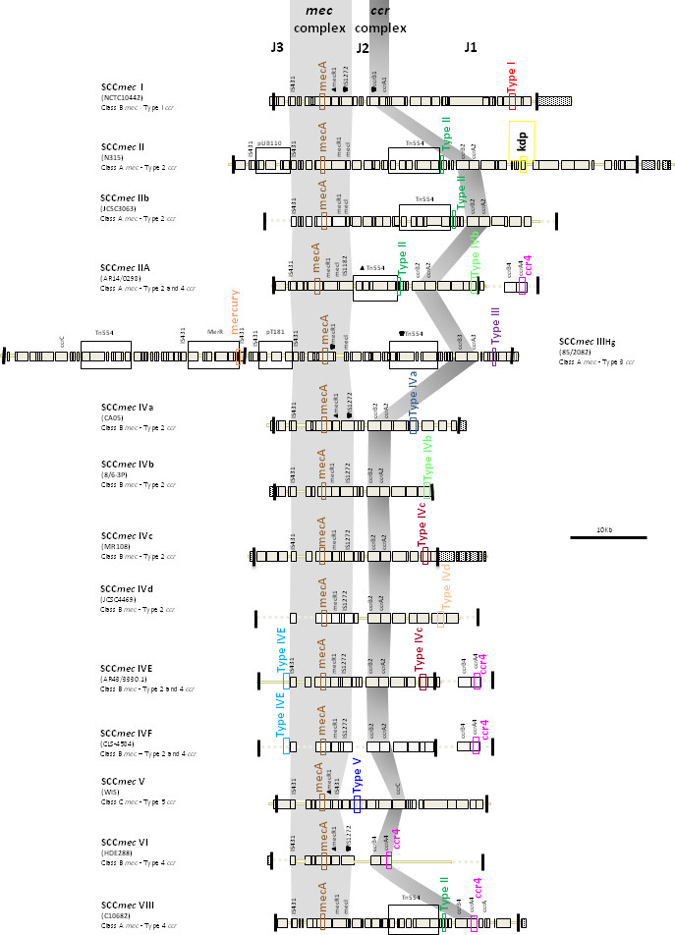
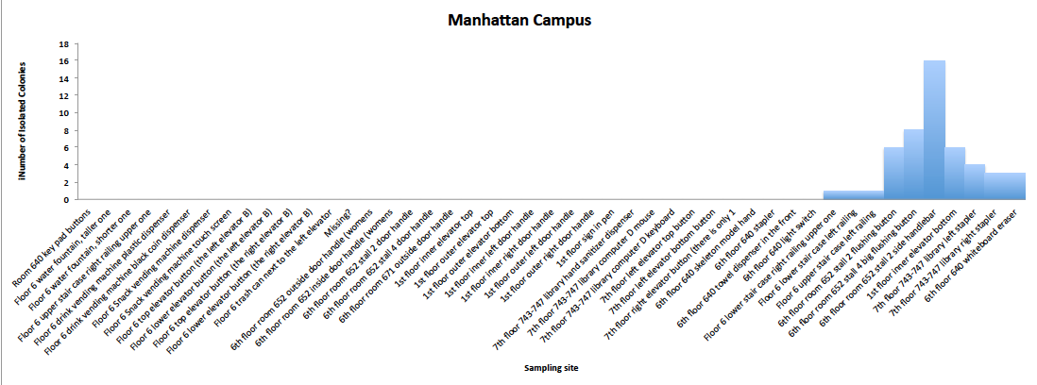
What’s On That Railing?
Microbes on High-Contact Surfaces of an Urban University Authors: Joanna Tan,¹ Siyue Zhu² Mentor: Dr. Davida Smyth³
¹Hunter College High School; ² Manhattan Center for Science and Mathematics; ³Mercy College.
Funded by:
Abstract
Materials and Methods
Discussion
The purpose of our research is to identify if surfaces around our college harbor antibiotic resistant Staphylococci. If the bacteria contain the gene mecA, they can resist methicillin. It’s very dangerous if a patient is infected with antibiotic resistant Staphylococci, because there are few drugs that can be used to treat the infection. These bacteria can be acquired from the environment. We targeted 47 different high-contact surfaces across two floors of our campus. Of the DNA isolated so far, thirteen isolates of Staphylococcus haemolyticus were identified and one isolate of Staphylococcus aureus, our target bacteria, was discovered. These results indicate that high-contact surfaces may be reservoirs for bacteria and mediate bacterial transmission to human hands.
Isolation of the bacteria.
We collected samples by targeting a variety of surfaces most likely to come into contact with human hands, such as elevator buttons, bathroom stall handles, door knobs, and water fountain valves.
To select for MRSA, we used HardyCHROM MRSA contact plates which allows for growth of species resistant to Methicillin (Hardy Diagnostics, 2016).
Each plate was pressed against a surface for 10 seconds. In total, we sampled 47 sites on two floors of the building on a single day during the semester (Table 1). After collection, the samples were incubated at 37C for 48 hours.
Of the 47 plates, 10 were positive for growth. Each colony that grew on the 10 plates was then transferred and cultured on mannitol salt agar plates with 7% NaCl in order to select for Staphylococci.
Next, these colonies were streaked on tryptic soy agar (TSA) to isolate single colonies from which DNA was isolated and frozen stocks were made and stored at -80C.
DNA Isolation, PCR and Sequencing.
DNA was isolated with the UltraClean DNA Isolation kit as described by the manufacturer.
We amplified two target sequences through polymerase chain reaction (PCR) of the isolated DNA: the tuf (elongation factor tu) gene and the mecA gene (Heikens et al, 2005; Robinson &, Enright, 2003).
PCR products were run on a gel to confirm amplification alongside a ladder. Presence of the tuf gene indicates that the sample is a bacterium (all Staphylococci are expected to have a tuf gene) and presence of the mecA shows that it encodes resistance to methicillin.
PCR products were cleaned up using the Qiagen PCR clean-up kit. PCR products were then sent to be sequenced after adding a primer to Macrogen.
Finally, we interpreted the sequencing results using Basic Local Alignment Search Tool (BLAST).
DNA Marker
To date DNA of 23 different colonies was sequenced, with Staphylococcus haemolyticus identified 13 times out of 24 samples, followed by Bacillus licheniformis identified 3 times, Staphylococcus cohnii identified 2 times, Staphylococcus capitis identified 1 time and Staphylococcus aureus identified 1 time (excluding the control). Many S. haemolyticus were isolated from the library stapler, which shows that such bacteria are commonly found on everyday objects that are not regularly cleaned.
Previous research on the diversity of bacterial communities on public surfaces has been conducted by other scientists including our PI, Prof Smyth. Her lab has found Staphylococcus epidermidis to be the most common resistant staphylococci present in a college campus setting by culturing. Her lab identified a similar distribution of Staphylococcal species in multiple buildings. DNA sequencing revealed that the identity and proportions of microorganisms changed when students moved into occupied buildings. Streptococcus, not Staphylococcus, was the most significant human associated species.
In a study from another research group, the authors investigated the bacterial populations on four surfaces (elevator buttons, bank machine buttons, restroom surfaces, employee clock-in system) of a large Brazilian public teaching hospital through parallel sequencing of the 16S rRNA genes and found that Firmicutes, Actinobacteria, and Proteobacteria were most prevalent. They also discovered potentially pathogenic bacteria such as Salmonella enterica, Klebsiella pneumoniae, and Staphylococcus aureus (Pereira da Fonseca et al., 2016). Another research study specifically investigated the prevalence of bacteria on elevator buttons and determined that they were sites of high bacterial colonization, but most were non-pathogenic (Kandel et al., 2014).
Compared to other studies, we found a much higher proportion of S. haemolyticus and no Staphylococcus epidermidis, which may suggest that S. haemolyticus is the most common resistant staphylococci due to its high resistance. Some potential sources of error are: failing to plate the bacteria by not full covering the surface, contamination of DNA samples during isolation, and mistakes in amplifying the DNA. As indicated by our results, some examples of fomites that may host antibiotic resistant bacteria include: railings, toilet flushing buttons, elevator buttons, and staircase railings. We suggest regular cleaning of all high contact surfaces in order to limit bacterial propagation and transmission.
Future experiments could include investigation into microbes that possess resistance to cleaning agents. Bacteria which are both antibiotic resistant and unaffected by cleaning agents could pose a threat for infection.
This first gel shows 5 ul of our extracted DNA. The first lane is a DNA marker and each of the 8 lanes contains an individual DNA sample.
This second gel shows PCR products for four of the above samples. Each pair of products is tuf and mecA amplified respectively.
Introduction
Antibiotics are commonly used to prevent and treat bacterial infections in farm animals and human patients. The use of antibiotics kills the majority of the bacteria sensitive to the antibiotics, present within a system, thus selecting for organisms that possess resistance (i.e. have little to no response) to these substances. The organisms that survive then propagate and pass on their antibiotic resistance genes to the next generation. Antibiotic resistance can arise in individual bacteria through several mechanisms: bacterial transformation, conjugation, and mutation. Study of antibiotic sensitive species, such as Methicillin-sensitive Staphylococcus aureus (Gram-positive virulent bacteria), shows that they lack a segment of foreign DNA called the mec element compared to their Methicillin-resistant counterparts (Stapleton & Taylor, 2002). The presence of the mecA gene in the mec element encodes the 76 KDa penicillin-binding protein, enabling antibiotic resistance. Antibiotic resistance is often acquired through horizontal gene transfer from species with a high rate of possessing the mec gene, such as Staphylococcus cohnii or Staphylococcus sciuri (Chambers & DeLeo, 2009).
Methicillin-resistant Staphylococcus aureus (MRSA) are of particular concern because they are virulent and possess resistance to a growing number of antibiotics; they are currently listed under “Serious Threats” by the Centers of Disease Control and Prevention (CDC) and are one of the most common causes of nosocomial infections in the United States (2018). Staphylococci are very common in communal settings and can be easily transmitted in locations with many high-contact surfaces such as gyms, daycare centers, schools, military barracks and hospitals (CDC, 2016).
The objective of our project was to sample and identify the strains of bacteria in an urban college campus setting. Our sampling and isolation technique was designed to find antibiotic resistant Staphylococci, especially S. aureus. The prevalence of these species was unknown, so we targeted sites most likely to come in contact with human hands.
Colony # | Site | Consensus | mecA
ATCC 43300 0 1 | N/A Control sample | Staphylococcus aureus | Pos
4 | Floor 6 lower staircase upper right railing | Staphylococcus cohnii | Pos
5 | Floor 6 lower staircase left railing | likely Bacillus licheniformis | Neg
7 | Floor 6 upper staircase left railing | likely Staphylococcus aureus | Pos
21.1 | Floor 6 Rm. 652 stall 2 flushing button | Staphylococcus haemolyticus | Pos
21.2 | Floor 6 Rm. 652 stall 2 flushing button | Staphylococcus haemolyticus | Pos
21.3 | Floor 6 Rm. 652 stall 2 flushing button | cannot be determined | Neg
21.4 | Floor 6 Rm. 652 stall 2 flushing button | possibly Staphylococcus haemolyticus | Neg
21.5 | Floor 6 Rm. 652 stall 2 flushing button | cannot be determined | Neg
21.6 | Floor 6 Rm. 652 stall 2 flushing button | cannot be determined | Neg
27.1 | Floor 1 inner elevator bottom button | possibly Bacillus licheniformis | Neg
27.2 | Floor 1 inner elevator bottom button | Staphylococcus haemolyticus | Neg
27.3 | Floor 1 inner elevator bottom button | Staphylococcus cohnii | Neg
27.4 | Floor 1 inner elevator bottom button | Bacillus licheniformis | Neg
27.5 | Floor 1 inner elevator bottom button | likely Staphylococcus haemolyticus | Neg
27.6 | Floor 1 inner elevator bottom button | Staphylococcus haemolyticus | Neg
37.1 | Floor 7 Rm. 743-747 library right stapler | Staphylococcus haemolyticus | Neg
37.2 | Floor 7 Rm. 743-747 library right stapler | Staphylococcus haemolyticus | Pos
37.3 | Floor 7 Rm. 743-747 library right stapler | Staphylococcus haemolyticus | Neg
36.1 | Floor 7 Rm. 743-747 library left stapler | Staphylococcus haemolyticus | Pos
36.2 | Floor 7 Rm. 743-747 library left stapler | Staphylococcus haemolyticus | Pos
36.3 | Floor 7 Rm. 743-747 library left stapler | Staphylococcus haemolyticus | Pos
36.4 | Floor 7 Rm. 743-747 library left stapler | Staphylococcus haemolyticus | Pos
44.1 | Floor 6 Rm. 640 whiteboard eraser | possibly Staphylococcus capitis | Neg
References
Centers for Disease Control and Prevention. (2018, February 27). Biggest threats. Retrieved May 7, 2018, from https://www.cdc.gov/drugresistance/biggest_threats.html
Centers for Disease Control and Prevention. (2018, March 5). About antimicrobial resistance. Retrieved May 8, 2018, from https://www.cdc.gov/drugresistance/about.html
Chambers, H. F., & DeLeo, F. R. (2009). Waves of Resistance: Staphylococcus aureus in the Antibiotic Era. Nature Reviews. Microbiology, 7(9), 629–641. http://doi.org/10.1038/nrmicro2200
Hardy Diagnostics. (2016). HardyCHROM™ MRSA, Contact Plate: Instructions for Use. Santa Maria, CA: Hardy Diagnostics.
Kandel, C. E., Simor, A. E., & Redelmeier, D. A. (2014). Elevator buttons as unrecognized sources of bacterial colonization in hospitals. Open Medicine, 8(3), e81–e86.
McClure-Warnier, J.A., Conly, J.M., & Zhang, K. (2013). Multiplex PCR assay for typing of Staphylococcal cassette chromosome mec types I to V in Methicillin-resistant Staphylococcus aureus. Journal of Visualized Experiments, (79). https://doi.org/10.3791/50779
MO BIO Laboratories. (2016). UltraClean Microbial DNA Isolation Kit. Carlsbad, CA: MO BIO Laboratories.
Pereira da Fonseca, T.A., Pessôa, R., Felix, A.C., & Sanabani, S.S. (2016). Diversity of bacterial communities on four frequently used surfaces in a large Brazilian teaching hospital. International Journal of Environmental Research and Public Health, 13(152). https://doi.org/10.3390/ijerph13020152
Roberts, M.C., Soge, O.O., No, D., Helgeson, S.E., & Meschke, J.S. (2011). Characterization of Methicillin-resistant Staphylococcus aureus isolated from public surfaces on a university campus, student homes and local community. Journal of Applied Microbiology, 110, 1531-1537. https://doi.org/10.1111/j.1365-2672.2011.05017.x
Stapleton, P. D., & Taylor, P. W. (2002). Methicillin resistance in Staphylococcus aureus: mechanisms and modulation. Science Progress, 85(Pt 1), 57–72.
This figure is taken from McClure-Warnier, et al., 2013. It shows the diversity of SCCmec elements of which several are shown.
While the elements differ from each other, two areas are shared, the mec complex and the ccr complex (in grey).
To determine if our isolated colonies were potentially resistant, we used PCR targeting the mecA gene.
Results
10 were positive for growth. Site 4, 5 and 7 had a single colony, sites 37 and 44 had three colonies, site 36 had four colonies, site 21 and 26 had six colonies, site 23 had 8 and site 24 had sixteen.
Out of the 24 samples sequenced, S. haemolyticus was identified 13 times, B. licheniformis was identified 3 times, S. cohnii was identified 2 times, S. capitis was identified one time and S. aureus was identified one time (excluding the control).
Acknowledgments
Urban Barcode Research Program funded by the Pinkerton Foundation. Prof. Davida Smyth is funded through a Mercy College Faculty Development Grant.

