Slide 1


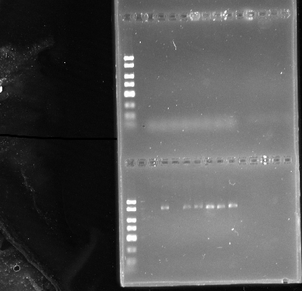

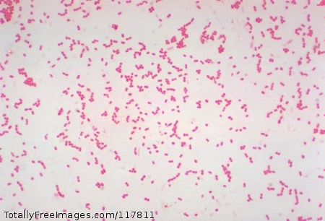
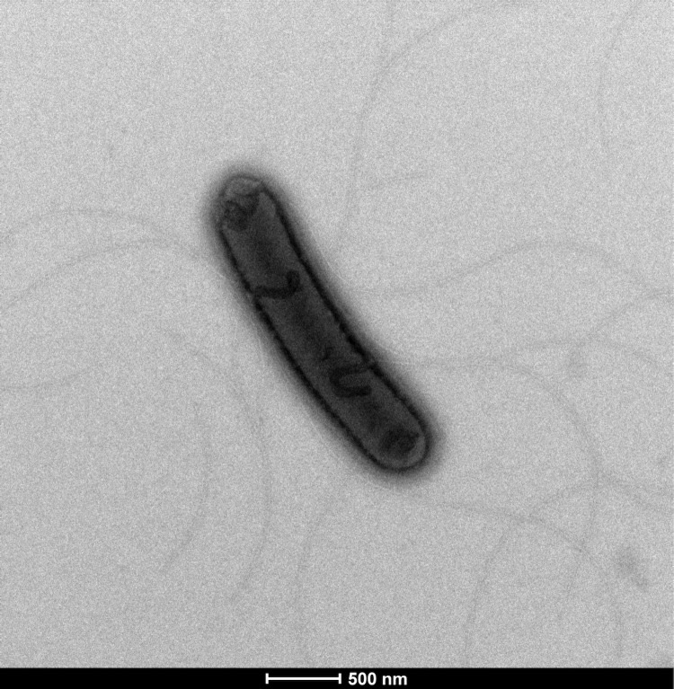
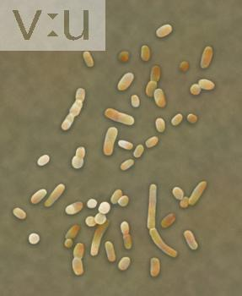
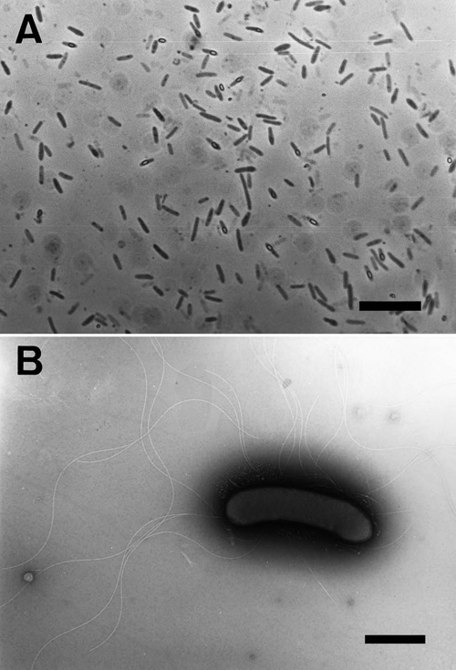
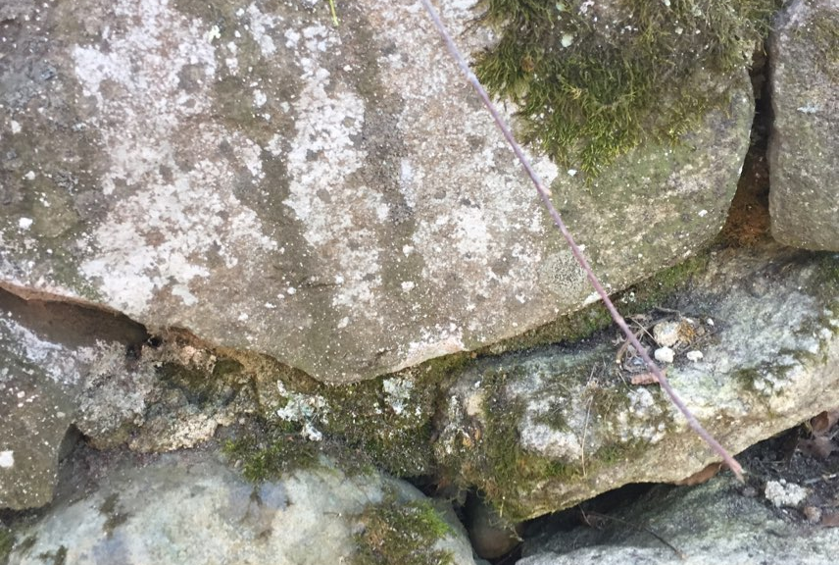
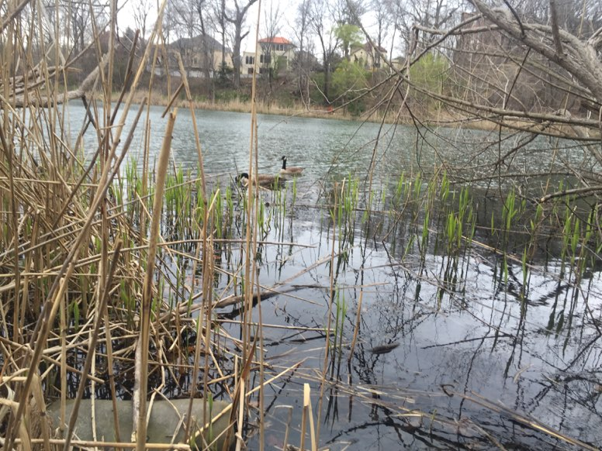
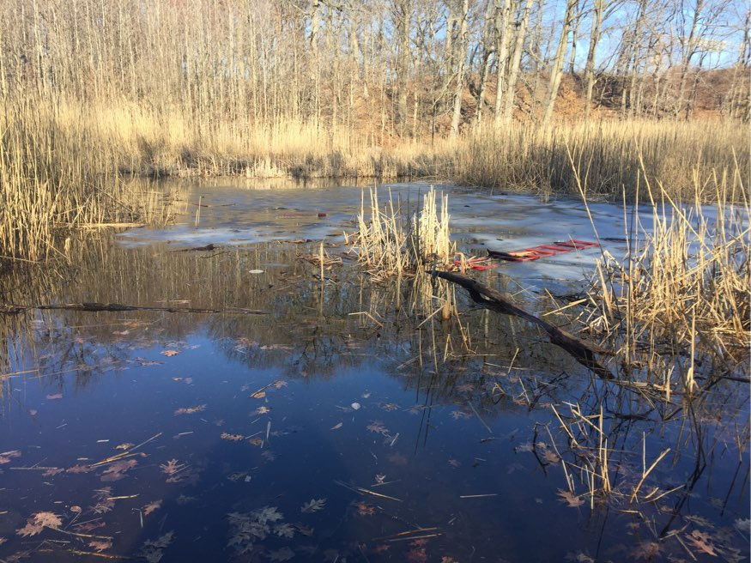
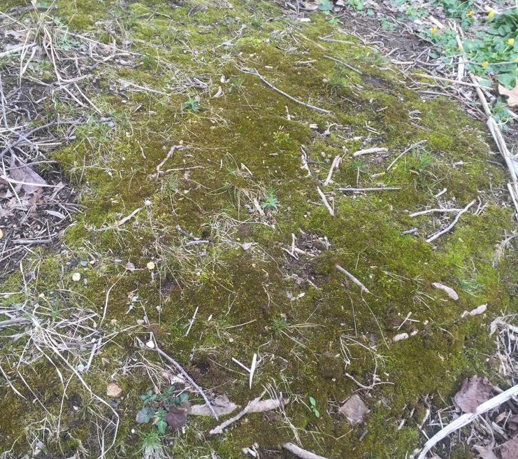
DNA Barcoding of Algae and Bacteria from acqutic environments
Authors: Geidily Beaton¹, Kathleen Guerrero¹
Mentor: Dr. Mangala Tawde²
Benjamin N. Cardozo High School¹, Queensborough Community College, CUNY²
Abstract
Results
Materials and Methods
Algae and Bacteria are the key players in Nature’s ecosystem. We decided to identify some of the algae growing in our neighborhoods. We were also curious about the bacteria that are associated with these algae. Our main question was what made our water green? To test for the answer we DNA barcoded algae and bacteria from aquatic environments in Queens, New York. We used standard DNA extraction methods. Our results were inconclusive since the amplification of algae DNA did not work. Even though we unable to amplify the algae DNA, we did find many different types of bacteria which are associated with algae in these aquatic environments.
PCR Amplification of 16s rRNA of Bacterial Isolates
When the weather was moist and rainy we decided to begin collecting samples from various aquatic environments. Algae-like specimens were collected from moist areas and water environments around our neighborhoods. We collected about 8-10 samples using gloves to peel off algae-like samples from rocks under lakes and surrounding the lake and conserving them in plastic tubes, each labeled with location and sample number.
We then attempted to identify and categorize the collected Algae specimens by DNA barcoding. Genomic DNA was extracted from each of these samples using standard DNA extraction/ purification methods, purified, and amplified by Polymerase Chain Reaction (PCR) using universal primers for 16s ribosomal DNA for both algae and bacteria. The PCR products were analyzed by gel electrophoresis. The amplified DNA were sent for sequencing. The Basic Local Alignment Search tool (BLAST) from DNA Subway website from CSHL website or the NCBI website was used to analyze the DNA sequences resulting from sequencing. Bioinformatics programs were then used to identify the different species of Algae in different environments based on the BLAST results analysis.
DAY 2
Genomic DNA amplified for 16s rRNA by PCR using primers for algae and bacteria (rbcL) primers. PCR products analyzed on 1% Agarose gel electrophoresis.
Top panel: Lanes 1-8, PCR reactions that did not work with new taf algae primers
Bottom panel: Lanes 1-8, PCR with bacteria (rbcL) primers
Lane 1: KG-1 Lane 5: KG-5
Lane 2: KG-2 Lane 6: KG-6
Lane 3: KG-3 Lane 7: KG-7
Lane 4: KG-4 Lane 8: KG-8
DAY 2
Introduction
Algae are a key component of many ecosystems. They are mainly found in aquatic environments such as ponds, lakes, rivers, swimming pools or even water puddles. Algae constitute a polyphyletic group since they do not include a common ancestor. There are many different types of Algae which differ in color, shape, and size and energy source used. Green Algae have primary chloroplasts derived from endosymbiotic cyanobacteria. Brown Algae have secondary chloroplasts derived from endosymbiotic red Algae. Most Algae are phototrophic, they consume energy from the sun but other groups that are mixotrophic, they derive their energy from both photosynthesis and uptake of organic carbon either by osmotrophic, mycotrophic or photography. (phototropic) mechanisms. Overall, Algae are the ultimate source of both cellular carbon and chemical energy for other organisms, so they are often called primary producers. The products from these processes are the two major source of oxygen in flowing surface waters. They are important in the food chain and provide habitat to other organisms. In addition, Algae assimilate large amounts of nutrients and trace metals during the growing season which makes them an important indicator organism.
However Algae are little overlooked when it comes to identifying different species. Since they serve an important role in our ecosystem but are underrepresented, we decided to identify these species and their association with bacteria. Algae and bacteria, together, influence ecosystems from deep seas to lichens and represent all modes of interactions. These interactions are pervasive and define the primary productivity in most ecosystems.
For our project, we collected Algae samples from different water bodies in Queens, New York. The goal of this project was to identify the different species of Algae found in various water bodies through DNA barcoding and explore their association with bacterial species. We hypothesized that each environment would differ in its Algae and bacteria groups. We also compared and contrasted the various types of Algae we found depending on the environment from where the Algae were extracted.
Identification of Bacterial Isolates
KG-2 Bacillus sp.
K-4 Achromobacter xylosoxidans
KG-5 Hydrogenophaga sp.
KG-5 Achromobacter piechaudii
KG-6 Uncultured Xylella
KG-7 Halobacillus sp.
KG-8 Ornithinibacillus scapharcae
Achromobacter xylosoxidans
Bacillus sp.
https://en.wikipedia.org/wiki/Bacillus
http://cid.oxfordjournals.org/content/31/5/1183/F1.expansion.html
Results and Discussion
Achromobacter piechaudii
When we amplified the genomic DNA with algae primers by PCR, the primers did not work and we failed to get any product even after trying two different PCR conditions. In the same PCR reaction and amplification run however the bacterial primers worked and we did get PCR products that we could analyze on a 1% agarose DNA gel. These PCR products were then sent for sequencing and we obtained sequencing data for bacterial species. Since the algae primers were new and their PCR conditions were not optimized. So we were not able to get results which led us to focus on bacteria. In the future we will continue to try to amplify algae DNA with another set of primers and PCR conditions.
Ornithinibacillus scapharcae
Haloballicus sp.
http://standardsingenomics.org/content/9/3/1352/sigs.5611012-f3.jpg
https://microbewiki.kenyon.edu/images/0/0c/320223.jpg
http://femsle.oxfordjournals.org/content/205/2/291
Water samples from Our Urban Neighborhoods
Conclusion
It was disappointing that we could not identify the algae-like specimens that we had collected from various accusative environments. But since we could identify at least the bacterial species associated with these algae specimen, we are happy to conclude that DNA barcoding is a great method to identify various known or unknown species in urban neighborhoods.
Geidily
References
Acknowledgement
Kathleen
Aschenbrenner IA, Cernava T, Berg G, Grube M. “Understanding Microbial Multi-Species Symbioses.” Front Microbiol. 2016 Feb 18;7:180
Schwenk D, Nohynek L, Rischer H. “Algae-bacteria association inferred by 16S rDNA similarity in established microalgae cultures.” Microbiologyopen. 2014 Jun;3(3):356-68.
http://oai.dtic.mil/oai/oai?verb=getRecord&metadataPrefix=html&identifier=ADA06760
http://www.scienceclarified.com/A-Al/Algae.html
Urban Barcode Research Program Funded by the Pinkerton Foundation http://www.thepinkertonfoundation.org
Biology Department of Queensborough CC, CUNY

