Slide 1
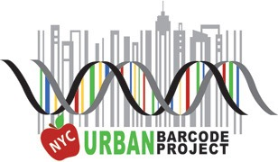
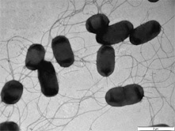
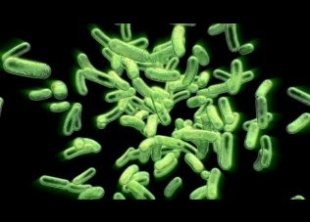
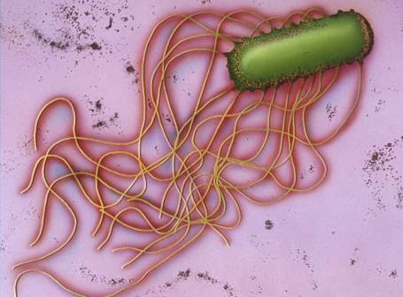
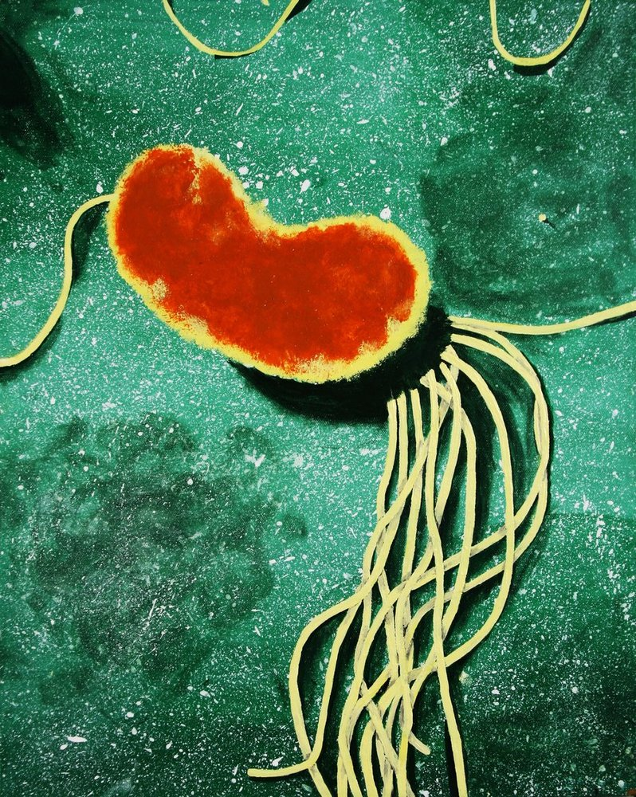
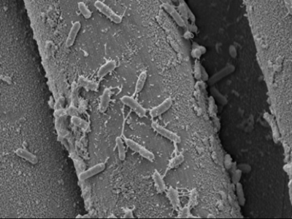
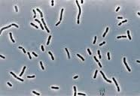
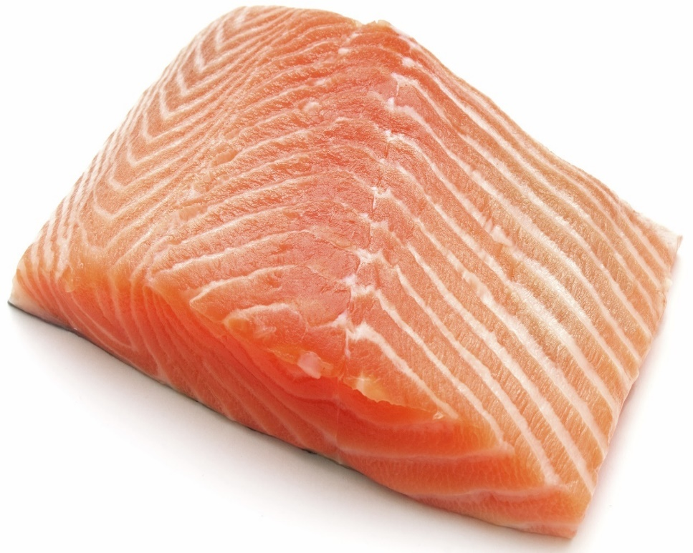
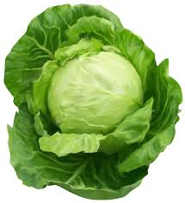
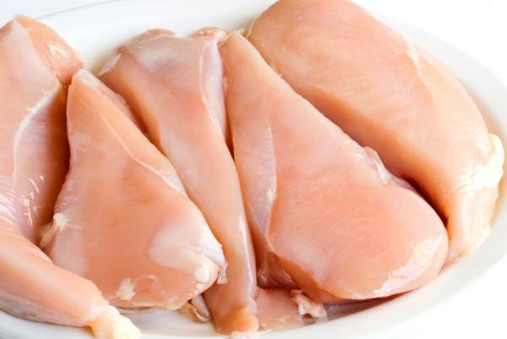
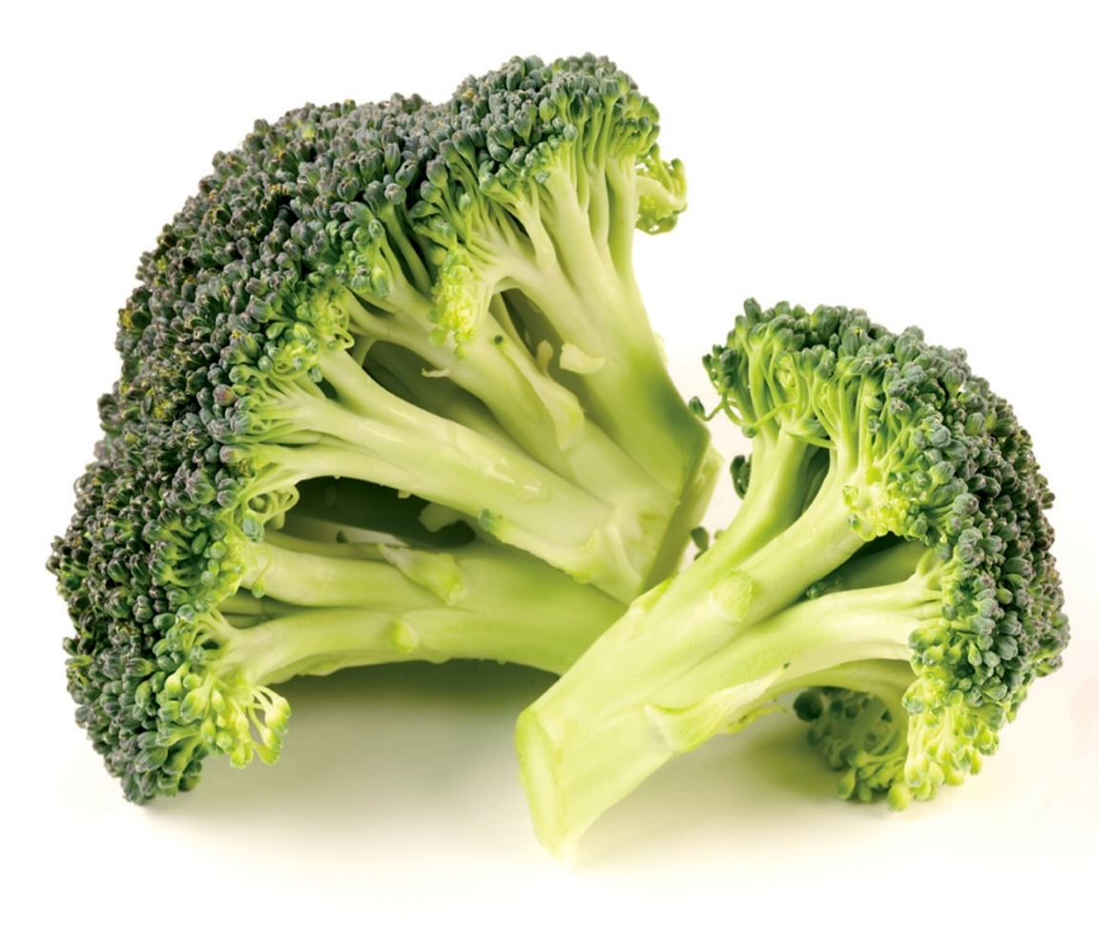
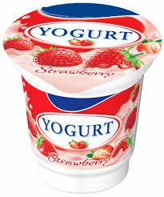
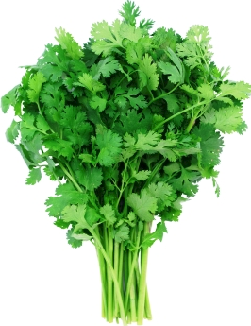
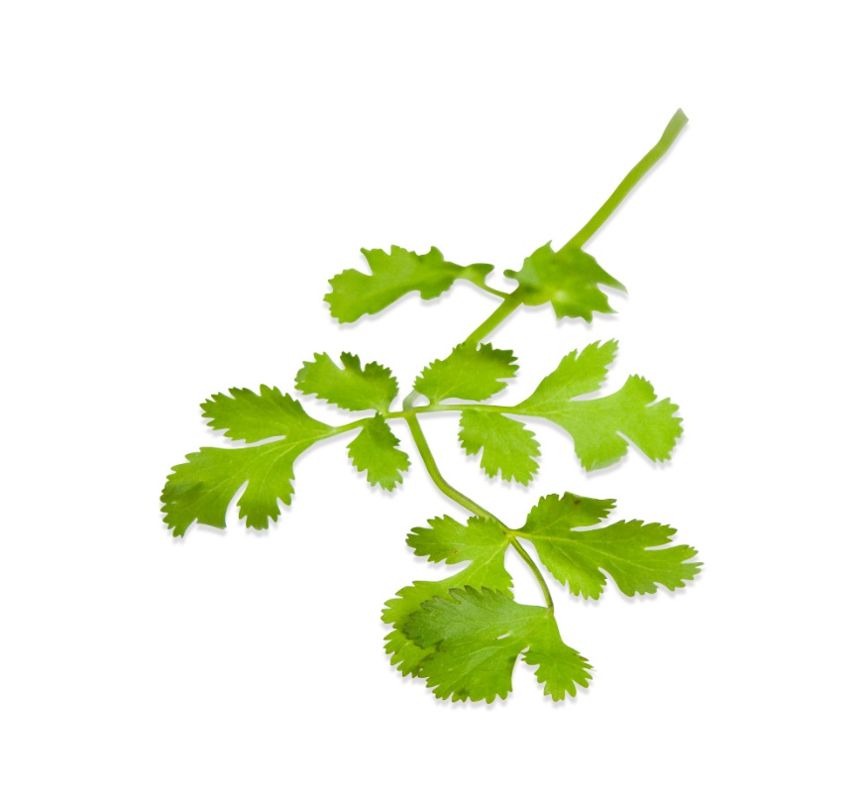
Are our foods safe? Antibiotic resistance in food bacteria
Authors: Chidiya Ama¹, Stephanie Pinto²
Mentor: Dr. Mangala Tawde³
Preparatory Academy for Writers¹, Forest Hills High School ², Queensborough Community College, CUNY³
Abstract
Results
Materials and Methods
Our main goal of our project was to identify bacteria in various foods and determine if they are resistant to any known antibiotics. We DNA barcoded foods such as meat, dairy and berries from supermarkets in Queens. We hypothesized that foods such as dairies and meat will get more easily contaminated with more bacteria compared to other foods which will assist us in being able to identify a greater number of bacteria. Our result determined that the meats did, in fact, have a greater number of bacteria than most foods but the dairies didn’t have as much growth. We isolated specific bacteria, grew them as pure cultures and tested them against different antibiotics and determine if the bacteria were sensitive or resistant.
PCR Amplification of 16s rRNA of Bacterial Isolates
We collected samples from various supermarkets around New York City. Vegetables, fruits, meats and dairy specimens were collected from different environments around our neighborhoods. We collected about 8-10 food samples and conserved them in the refrigerator. Various types of food samples such as fish, chicken, vegetables and yogurt were collected from various sources such as grocery stores, local farms or farm stands. These foods were swabbed and the swabs were streaked on nutrient agar media to grow and isolate bacteria.
We then extracted the bacterial DNA using standard DNA extraction/ purification methods, and purified. The 16s rRNA gene sequences were amplified by Polymerase Chain Reaction (PCR). The PCR products were then analyzed by gel electrophoresis and the amplified product was sent for sequencing. The (BLAST) Basic Local Alignment Search tool was used to analyze DNA sequences that were identified. Bioinformatics programs such as “DNA Subway” of CSHL DNA Learning center were then used to identify the different species of bacteria in different foods based on the BLAST results analysis.
DAY 2
Genomic DNA was extracted from various bacterial isolates that were isolated from various foods and grown on standard bacterial growth media. DNA was amplified for 16s rRNA gene by PCR using bacterial (rbcL) primers. PCR products were then analyzed on 1% Agarose gel electrophoresis and sequenced.
Top panel: Samples 1-8 Bottom panel: Samples 9-16
Lane 1: Lane 5: Lane 1: Lane 5:
Lane 2: Lane 6: Lane 2: Lane 6:
Lane 3: Lane 7: Lane 3: Lane 7:
Lane 4: Lane 8: Lane 4: Lane 8:
DAY 2
Introduction
Antibiotic resistance is a serious concern in the fields of medicine and biological sciences. It is the ability of a microbe to resist the ability of an antimicrobial drug to kill the microbe or prevent its growth. The resistance to antibiotics occurs when bacteria mutate in some way that enables them to reduce or negate effectiveness of antimicrobial drugs that are designed to kill them to cure or prevent infections. Due to the increase in antibiotic resistance, treating infectious diseases has become a losing battle for medical practitioners. A drug that would have easily cured a simple disease or cold is now ineffective, leaving the patients prone to getting more ill, and eventually, death. A recent example is incidence of MRSA where cases of Methicillin-Resistant bacterium Staphylococcus aureus caused. This crisis has been attributed to the abuse and overuse of antibiotics, as well as a lack of new drug progress by the pharmaceutical industry due to reduced economic encouragement and challenging regulatory requirements. In our day-to-day life, we consume various types of foods which have higher chances of getting contaminated with bacteria that could potentially be antibiotic resistant. Therefore, in order for us to have a better understanding of the bacteria that could contaminate our foods, we have chosen to study the correlation of antibiotic resistance in bacteria isolated from the common foods we consume. After some research literature review, we feel encouraged to pursue the research of identifying different bacteria in common foods to determine if they are resistant to certain antibiotics. Sometimes, we eat in a carefree manner without knowing what types of bacteria inhabit inside our food. We may unwittingly be consuming antibiotic resilient bacteria and wouldn’t realize it until we become ill and our usual medications are no longer effective.
Identification of Bacterial Isolates
Conclusion
Although we initially ran 16 samples through PCR we were only able to amplify the DNA of 12 samples. After being given the sequence data we used DNA Subway program to identify what bacteria species each sample could be. On our MSA and EMB plates we were able to look at the selective growth media of our samples of bacteria. On the MSA plate a lot of samples were salt tolerant sample and some samples that were also able to ferment mannitol to make acid. One the EMB plates we were able to see gram negative bacteria grow and also founds strands on E.coli in some samples. Our results from the Kirby-Baur assay were really astonishing. We were able to conclude that the 6 samples of bacteria we choose to place the antibiotics on were resistant to multiple commonly used antibiotics.
Exiguobacterium sp.
Brochothrix thermosphacta
Proteus mirabilis
Pseudomonas fluorescens
Bacillus aerophilus
Exiguobacterium sibiricum
Food samples from Our Urban Neighborhoods
Discussion
Chidiya
Ama
After overlooking our discoveries of how resilient these bacteria are to such important antibiotics we took a step back to think about how much of these bacteria we intake when we eat common foods. We never really take a moment to try and find out how our food is being preserved and produced, especially meats. These animals raised in cramped conditions that promote sickness to spread to the animals. In response to this, farmers give these animals foods full of antibiotics to fight off illnesses and keep them alive. When we consume the meat, we consume loads of same antibiotics. The constant consumption of these antibiotics will soon render them useless when used to fight off bacterial diseases. We really need to become weary of what we put into our system because there may be a chance we are unintentionally allowing the bacteria in our body and environment to become antibiotic resistant.
References
Stephanie
Pinto
The Antibacterial and Anticancer Activity of Marine ... (n.d.). Retrieved November 7, 2016, from https://www.researchgate.net/profile/Phi_Tien/publication/273063693_The_Antibacterial_and_Anticancer_Activity_of_Marine_Actinomycete_Strain_HP411_Isolated_in_the_Northern_Coast_of_Vietnam/links/54f691510cf21d8b8a5cd2ee.pdf?disableCoverPage=true
Antibiotic Resistance Profile of Bacterial Isolates from ... (n.d.). Retrieved November 7, 2016, from https://www.researchgate.net/profile/Hiroshi_Tsunoda2/publication/242553736_Network_Application_Identification_Based_on_Communication_Characteristics_of_Application_Messages/links/00b7d52aa60984611b000000.pdf
Acknowledgements
Urban Barcode Research Program Funded by the Pinkerton Foundation http://www.thepinkertonfoundation.org
Biology Department of Queensborough CC, CUNY

