Slide 1
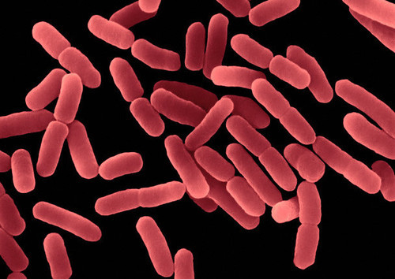
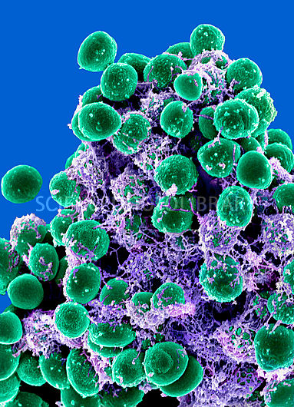
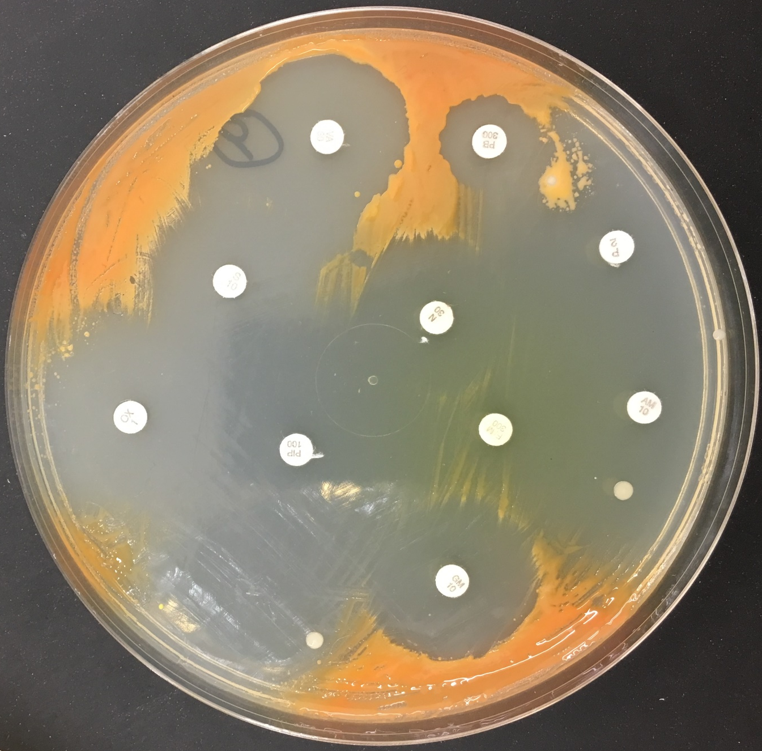
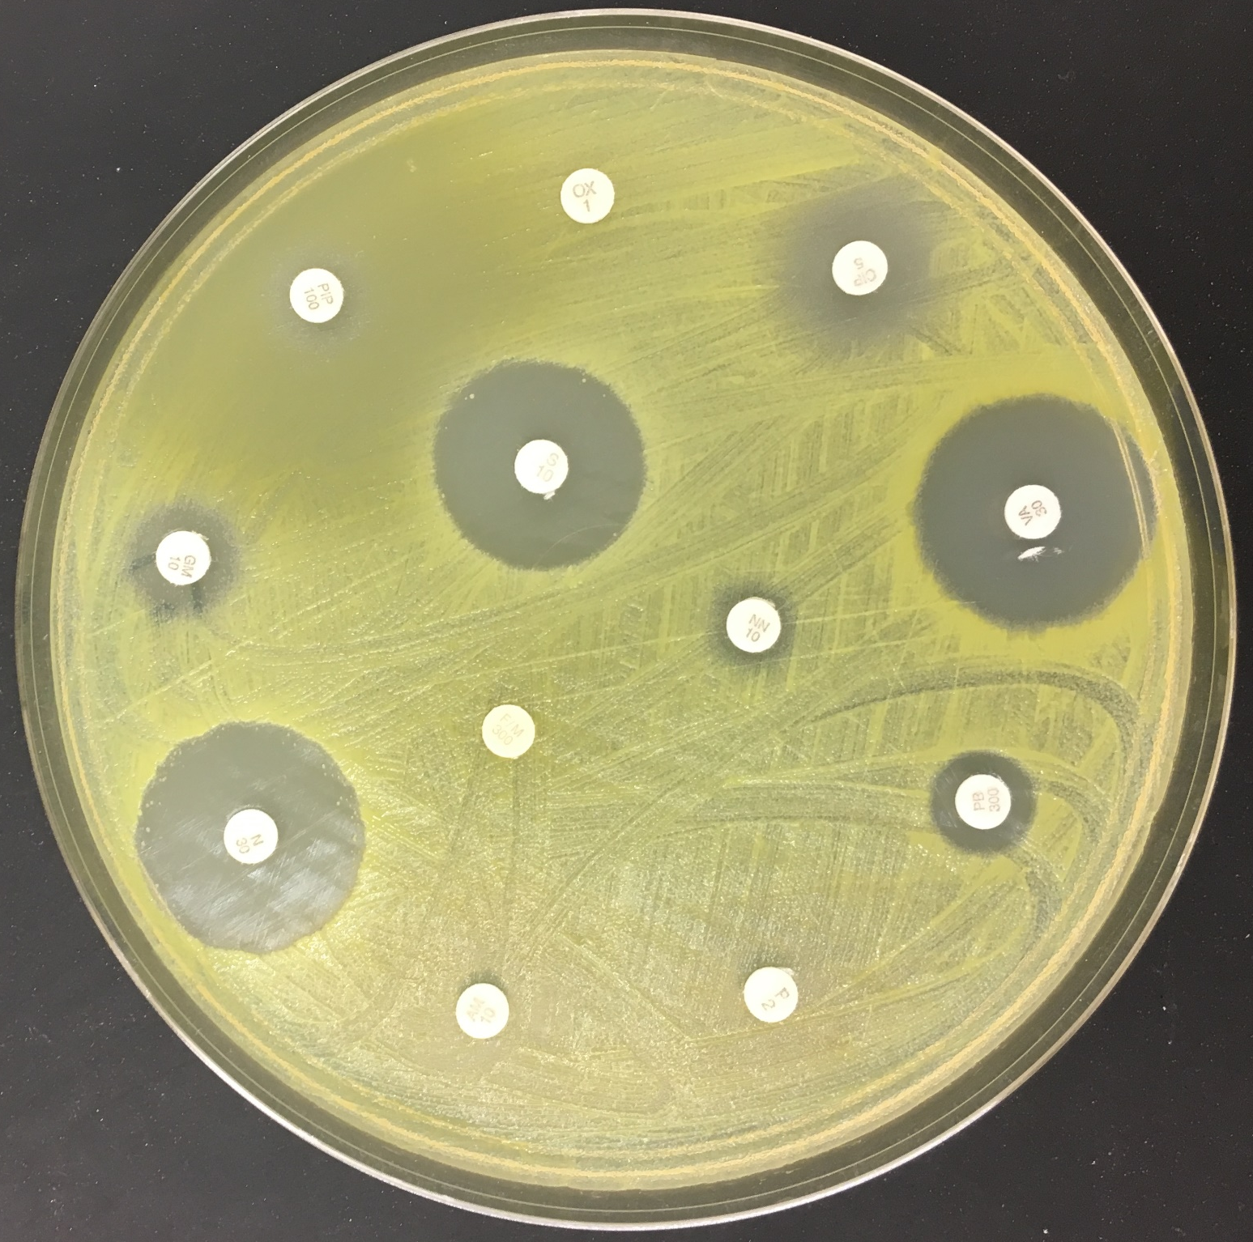
Microbial Diversity in Urban Environments: Concern for Antibiotic Resistance
Authors: Henry Lee¹, Rooshi Parikh²
Mentor: Dr. Mangala Tawde³
Regis High School¹, Benjamin N. Cardozo High School², Queensborough Community College, CUNY³
Abstract
Materials & Methods
Results
We are almost oblivious to the novel world of microorganisms in our daily lives, but they exist and come into contact with us all the time. While some bacteria are harmless, and even beneficial, other bacteria can cause infections. A common treatment to bacterial infections is antibiotics and the success of an antibiotic depends on the resistance of the bacteria to the antibiotic. We conducted an experiment to identify the types of bacteria that can be found on surfaces that come into contact with a vast number of people on a daily basis and how this can affect the antibiotic resistance/ susceptibility of these bacteria. By using common laboratory procedures to extract, amplify and barcode DNA, we identified 12 samples of bacteria. We also used to the Kirby-Bauer assay to test for their antibiotic resistance /susceptibility. The results obtained showed that surfaces with presumably greater contact with people had a greater diversity of bacteria and at the overall level, the bacteria of the sample population were mostly susceptible to the commonly used antibiotics which is a good news!
A total of 8 surfaces from public locations were swabbed for bacteria. Locations were chosen on the presumption of a great flow of people and excessive contact with the surfaces. The swabs were streaked on bacterial nutrient media to isolate and grow the bacteria. From there, 20 colonies were picked and grown as pure cultures in nutrient broth. The bacterial DNA was extracted and purified using the basic DNA extraction and purification procedures. The 16s rRNA gene was amplified using Polymerase Chain Reaction (PCR). Resulting PCR products were separated and analyzed using gel electrophoresis and sent out to be sequenced. The sequence data was analyzed using the bioinformatics program “DNA Subway” provided by the DNA Learning Center of the Cold Spring Harbor Laboratory. The 12 gene sequences were put into the National Center for Biotechnology Information (NCBI) website where its Basic Local Alignment Search Tool (BLAST) was used to identify the species of the DNA sequences found. A test of antibiotic resistance /susceptibility called Kirby-Baur test was conducted for 10 random samples out of the original 20 samples. Antibiotic discs were placed in each agar medium containing one of the 10 bacterial isolates and incubated at 37C for 3 days. The 12 different antibiotics used to test the resistance included some commonly used antibiotics such as Penicillin, Cipro, Ampicillin, gentamicin, Streptomycin etc.
The 12 swabbed samples obtained showed much diversity of microbial population among the different locations as well as within the same location. As for the 10 random bacteria isolates we picked to perform the Kirby-Bauer assay, the results were intriguing. About 28% of the 10 bacteria were resistant whereas about 68% of the bacterial isolates were susceptible to the 12 commonly used antibiotics. Some bacteria tested intermediately resistant or susceptible to the antibiotics tested but overall most were sensitive.
Bacillus subtilis
Staphylococcus epidermidis
Sample | NBCI BLAST Result
Fast food restaurant 1 door handle (colony 1) | Kocuria rhizophila strain TA68 16S ribosomal DNA gene, partial sequence
Bus handle (colony 1) | Erwinia tasmaniensis strain Et1/99 16S ribosomal RNA, partial sequence
Bus handle(colony 2) | Kluyvera intermedia strain JCM1238 16S ribosomal RNA gene, partial sequence
Bus handle(colony 3) | Erwinia tasmaniensis strain Et1/99 16S ribosomal RNA, partial sequence
Library computer mouse (colony 1) | Staphylococcus caprae strain DSM 20608 16S ribosomal RNA gene, partial sequence
Library computer mouse (colony 2) | Staphylococcus caprae strain DSM 20608 16S ribosomal RNA gene, partial sequence
Library keyboard (colony 1) | Staphylococcus epidermidis strain Fussel 16S ribosomal RNA gene, partial sequence
Library keyboard (colony 2) | Bacillus circulans strain NBRC 13626 16S ribosomal RNA gene, partial sequence
Fast food restaurant 2 door handle (colony 1) | Bacillus subtilis strain IAM 12118 16S ribosomal RNA, complete sequence
Fast food restaurant 2 door handle (colony 2) | Staphylococcus haemolyticus strain JCM 2416 16S ribosomal RNA gene, partial sequence
Fast food restaurant 2 door handle (colony 3) | Staphylococcus epidermidis strain NBRC 100911 16S ribosomal RNA gene, partial sequence
Fast food restaurant 3 table top (colony 1) | Bacillus cereus strain ATCC 14579 16S ribosomal RNA (rrnA), partial sequence
Discussion
Our results are very interesting. As hypothesized the locations with a presumably greater influx of people showed greater diversity of microorganisms. This indicates the vast number of bacterial species we come into contact with every day without knowing it. The test for antibiotic resistance/ susceptibility showed that most bacterial species were susceptible rather than resistant countering our hypothesis. This is a positive outcome providing some relief, that these bacteria can be successfully treated with common antibiotics if need be. The chosen locations included fast food restaurants and public transportation which are inevitably used by a large number of people and although our intuition said that this would mean that the bacteria would me more antibiotic resistant, the results showed the contrary. Some antibiotics seem to be incredibly stronger than others, but overall the bacteria are more susceptible to the antibiotics. Our results may have been more interesting if all the bacteria existing at these locations were barcoded and identified- i.e. if we could study the microbiome by using next generation sequencing. And testing antibiotic resistance of each individual microbial species would be great. These ideas would lead to new and exciting data which could begin to connect our world to the microbial world.
Introduction
Antibiotic resistant bacteria have and still do pose a problem to human health. Without the availability of antibiotics before the 1930s (Guilfoile and others 2007) bacterial infections were a serious medical case that could lead to death. Since then, however, discoveries of many types of antibiotics have emerged and some bacterial infections can be easily cured. The overuse of antibiotics, on the other hand, has caused some bacteria to become resistant and new antibiotics have had to be developed. The antibiotic resistance is polygenic trait controlled by various genes which can be transferred between bacteria and cause an antibiotic resistant population to grow (Blair and others 2016). The decline in biodiversity of microbes may be leading to the increase in allergies and a decrease in immunity against some microbes (Reese and others 2015). We expose ourselves to an unfathomable number of bacteria every day without our knowledge and sometimes certain types of bacteria can turn out to harmful to us. It has been seen that Streptococcus pneumoniae had increased resistance to the revolutionary drug penicillin shortly after twenty years from its discovery. The mutations in these microorganisms may occur in a relatively short amount of time and can spread quickly as well (Furuya and Loxy 2006). Local environments presumably play a major role in determining the most frequent bacteria type you may encounter on a daily basis. To begin to understand some of the possible relations between the environment of the types of bacteria present along with their antibiotic resistance, we will conduct an experiment using DNA barcoding to barcode the bacteria found at several public locations in New York City.
The purpose of this project is to identify the types of bacteria found in the various different locations and test for their antibiotic resistance. We hypothesize that the bacteria found in the areas with a larger flow of people such as fast food restaurant or public transportation will be more antibiotic resistant and have greater biodiversity. This will help us determine and understand any correlation between environment and the biodiversity of bacteria as well as their antibiotic resistance.
Figure 1 Some of the bacterial isolates, such as this one, was found to be susceptible to most, if not all, of the tested antibiotics.
References
Blair JM, Webber MA, Baylay AJ, Ogbolu DO, Piddock LJ. 2014. Molecular mechanisms of antibiotic resistance. Nature Reviews Microbiology 13: 42. Available: https://www.nature.com/articles/nrmicro3380. Accessed 2017 Nov 14.
Guilfoile P, Alcamo IE, Heymann DL. 2007, Antibiotic-Resistant Bacteria. New York: Chelsea House. 128 p.
Furuya EY, Loxy FD. 2006, Antimicrobial-resistant bacteria in the community setting. Nature Reviews Microbiology [internet]; 4: 36. Available: https://www.nature.com/articles/nrmicro1325. Accessed 2017 Nov 16.
Reese AT, Savage A, Youngsteadt E, McGuire KL, Koling A, Watkins O, Frank SD, Dunn RR. 2015. Urban stress is associated with variation in microbial species composition–but not richness–in Manhattan. The Isme Journal [internet]; 10: 751. Available: https://www.nature.com/articles/ismej2015152. Accessed 2017 Nov 16.
Figure 2 Some samples, such as this one, recorded to be resistant to most of the tested antibiotics
Acknowledgements
We would like to thank The Pinkerton Foundation, Science Sandbox, Cold Spring Harbor Laboratory and the Queensborough CC Microbiology Department for support on this project. We also would like to thank Dr. Mangala Tawde for sharing her knowledge, ideas with us and continuous support and guidance in completing the project.

