Slide 1
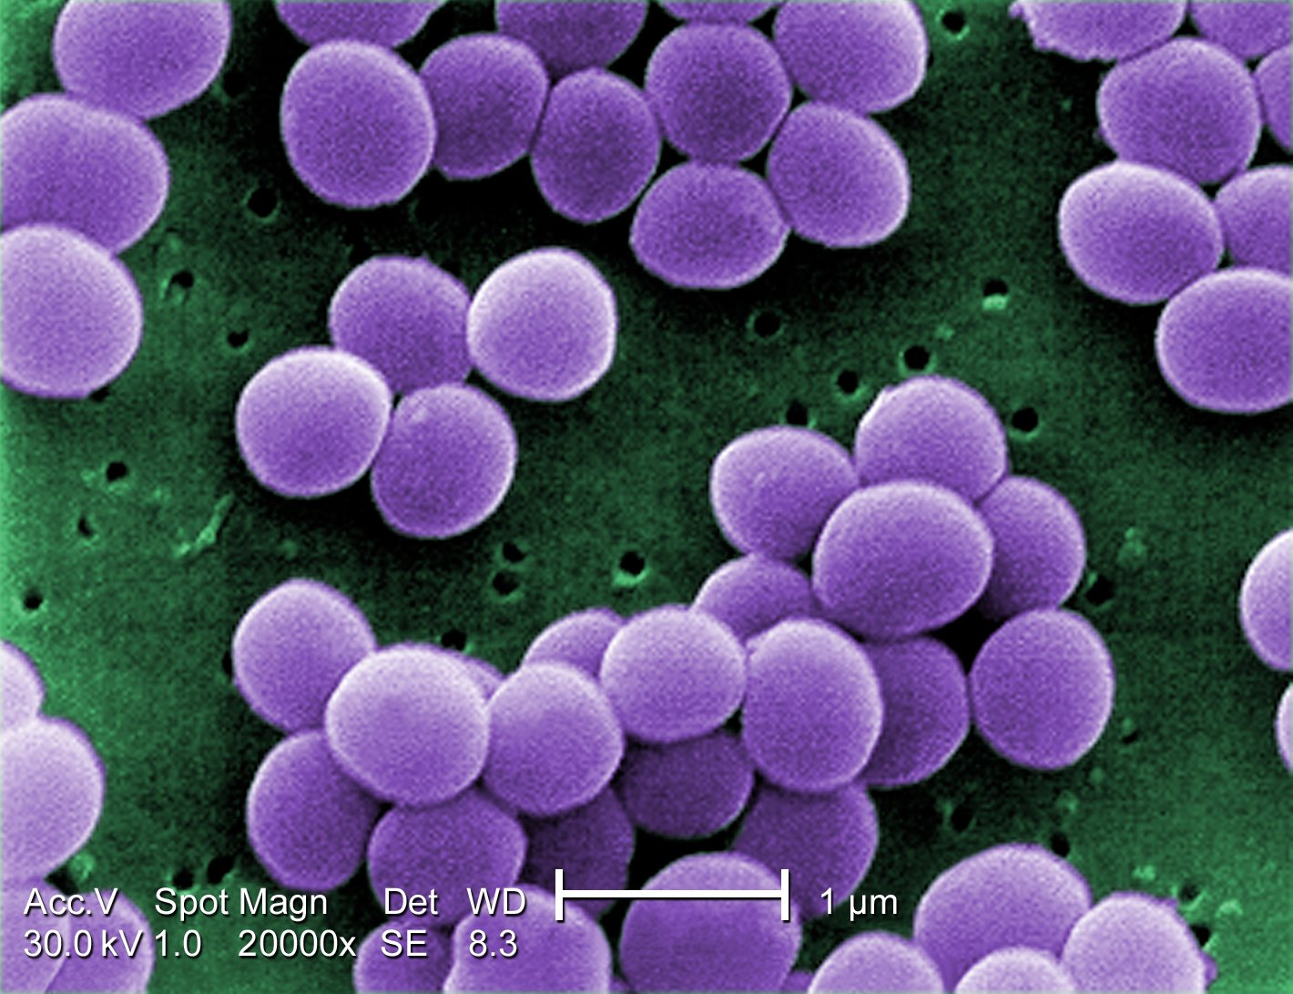
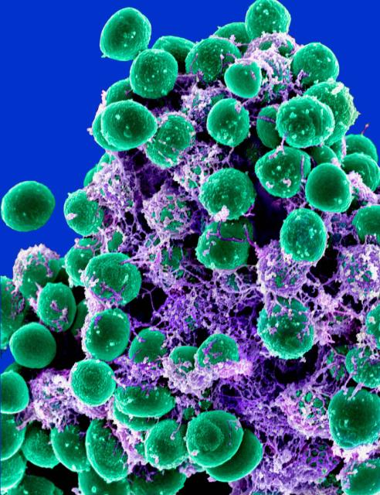
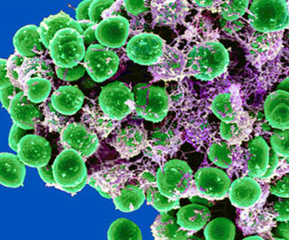
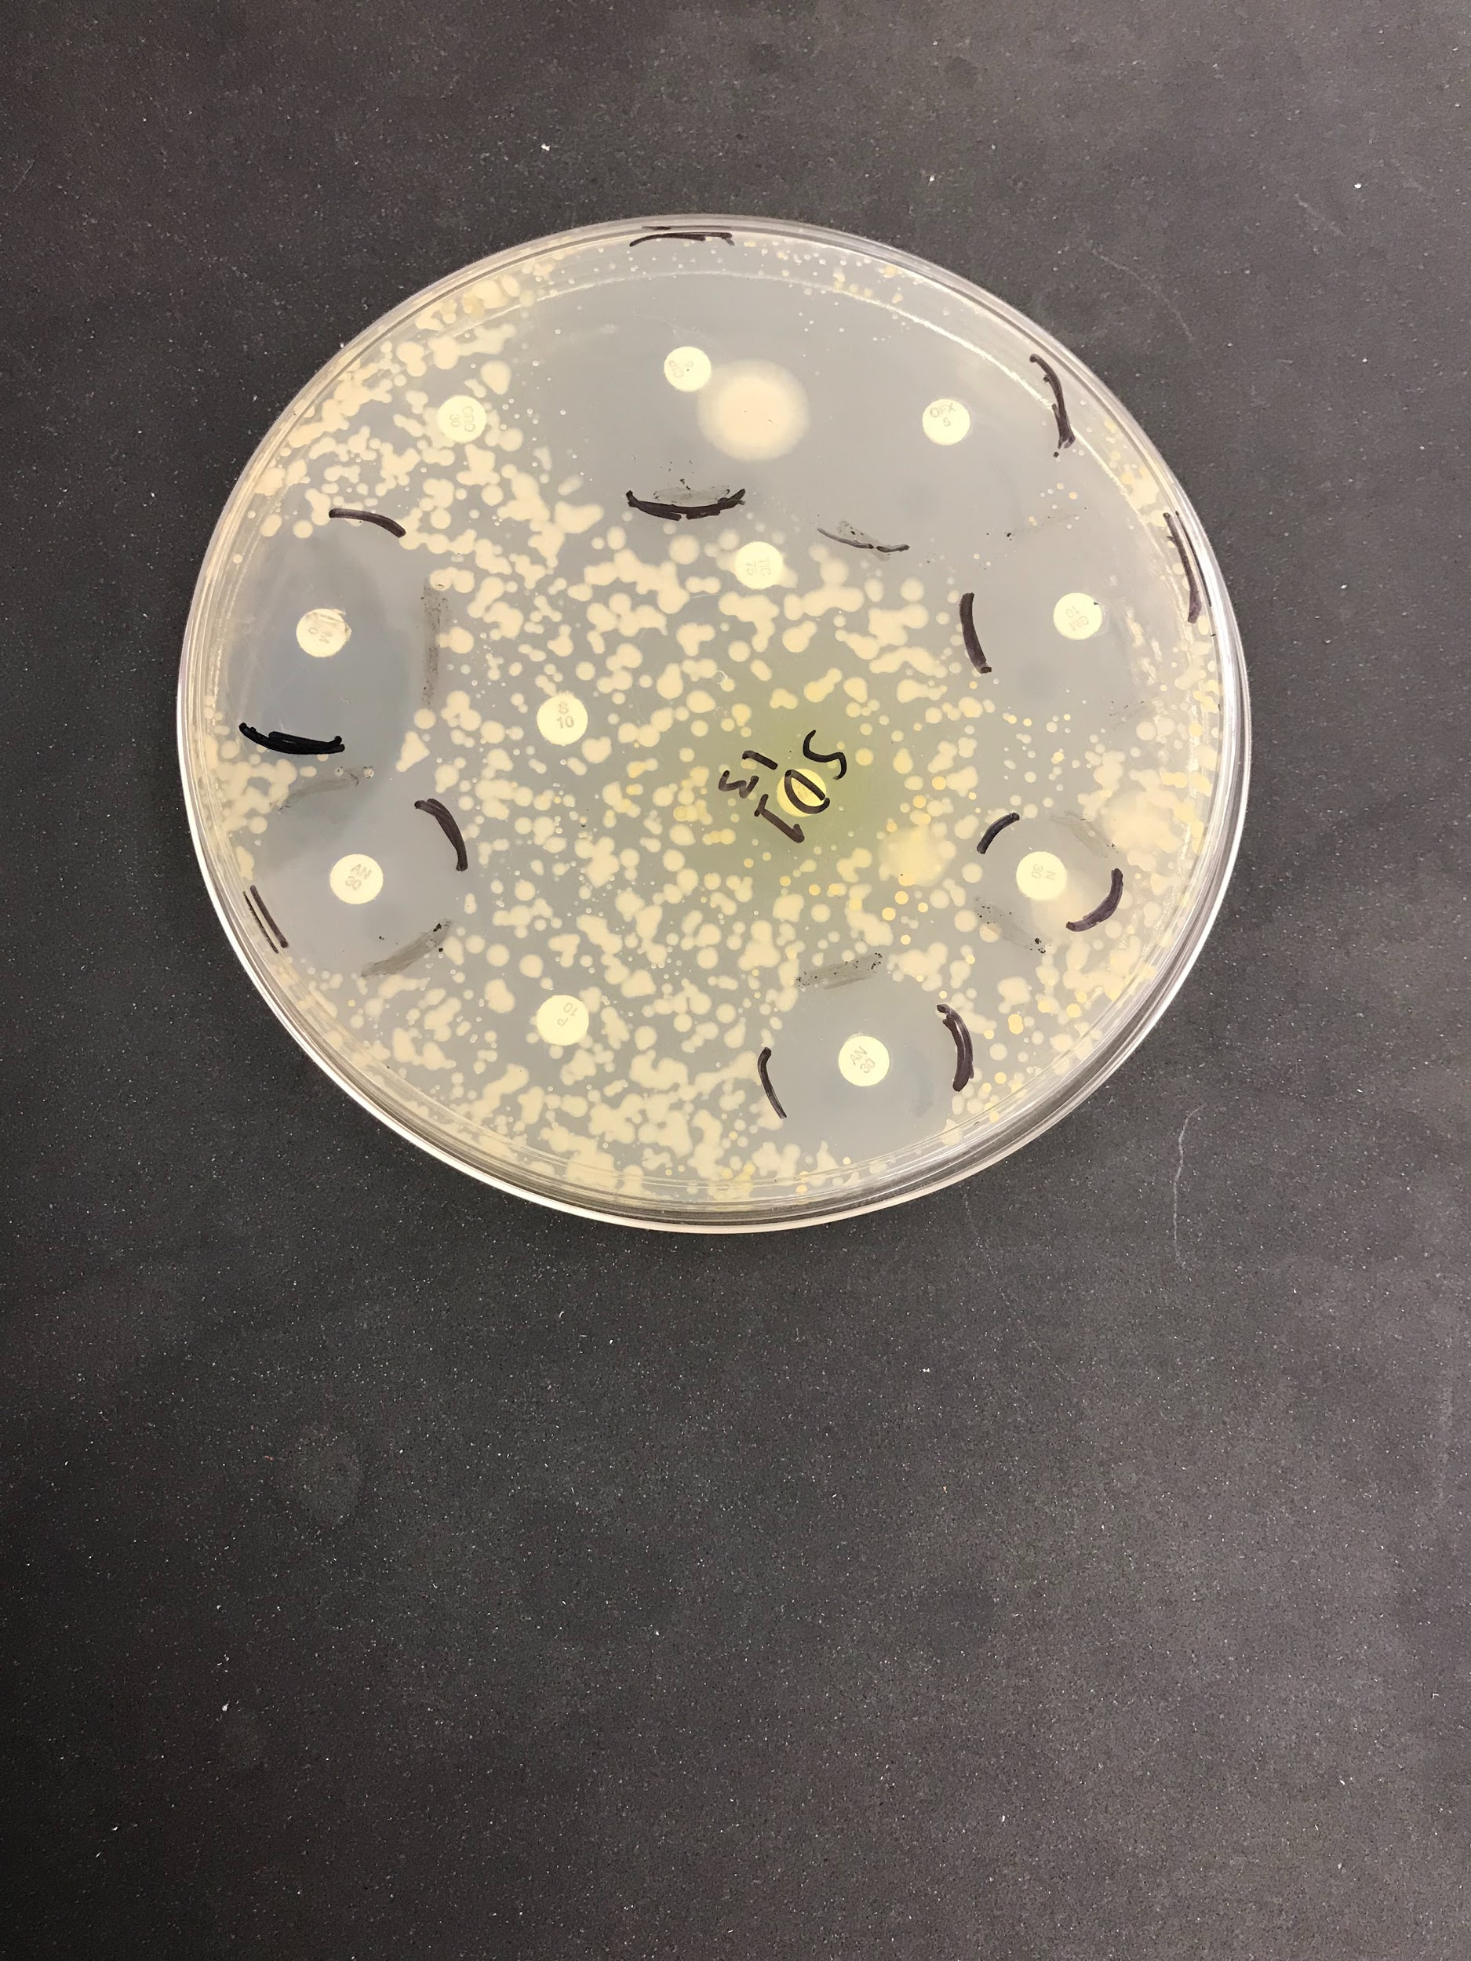
Microbial Diversity in School Environments:
Urbanization and Antibiotic Resistance
Funded by:
Jerry Qiu¹, Chelsea Zhang², Dr. Mangala Tawde³
Cardozo High School¹, Stuyvesant High School², Queensborough Community College³
Abstract
Is microbial biodiversity between schools similar? Does urbanization and overcrowding affect the antibiotic sensitivity in the bacterial populations at these locations? These are critical questions now as antibiotic abuse and antibiotic-resistant bacteria continue to grow simultaneously. In order to understand the factors that affect the relationship between school areas and the types of potentially antibiotic-resistant bacteria in them, we collected bacteria samples from two schools to sequence, identify, and test for antibiotic resistance. The Kirby-Bauer test was used to test for antibiotic resistance after the bacteria samples were grown and the bacterial DNA was isolated and sequenced for identification purposes. Our results found three bacterial species: S. epidermidis, S. aureus, and S. haemolyticus. Our Kirby-Bauer test results showed that two bacteria samples both isolated from student desks were resistant to a number of antibiotics such as penicillin. It is unsurprising that our results yielded common bacteria found on the skin although this may indicate increasing prevalence in public, leading to growing resistance. It is also unsurprising to find bacteria resistant to widely used antibiotics although resistance to newer antibiotics is concerning. Further investigation should be done on the growing prevalence of different types of bacteria in schools and their increasingly rapid resistance to new antibiotics.
Materials & Methods
We swabbed following surfaces from Benjamin N. Cardozo High School and Stuyvesant High School using sterile swabs dipped into a saline solution
Classroom: desks, windows, computers
Cafeteria: tables, vending machines
Hallways: staircase railings, walls, water fountains
In total, two samples from each of the eight different test surfaces were collected of the three locations. Each sample was labeled and recorded.
Swabs were streaked onto nutrient agar dishes and incubated at 37 C to allow them to grow and populate into colonies. Each bacterial colony from the agar dish is picked out and grown in nutrient broth overnight.
The bacterial DNA is extracted using standard DNA extraction methods, amplified for 16s RNA gene by PCR (Polymerase Chain reaction), analyzed by gel electrophoresis, sequenced and then bacterial species were identified with BLAST (Basic Local Alignment Search Tool).
The bacteria were also streaked on the Mueller-Hinton agar plates in a uniform lawn and a set of antibiotics impregnated on disks at certain concentrations were stamped on the bacterial lawn. These plates were incubated at 37℃ overnight and then analyzed for susceptibility.
Discussion
It is not surprising that the bacterial species we identified in our school setting were S. epidermidis, S. aureus, and S. haemolyticus given that they are extremely common and usually found on the skin. S. aureus is the most dangerous of all the staphylococcal bacteria. While it usually does not cause harm to healthy skin, it can often cause pneumonia, bone infections, heart valve infections, or other potentially serious infections if it enters the bloodstream or internal tissues. Its increasing difficulty to treat as it grows more resistant to antibiotics and its high prevalence, especially among healthcare workers, is especially concerning. The similar high frequency of S. epidermidis has also made it increasingly difficult to treat, presenting a serious burden for the public health system too. While previously seen as an innocuous microorganism, it is now a leading cause of nosocomial/ hospital-acquired, infections. S. haemolyticus is commonly found in hospitals too and is increasingly resistant to antibiotics. The possibility of increasing prevalence for all three bacteria species outside of hospitals should be further investigated, as a cause of even greater antibiotic resistance.
However, the Kirby-Bauer test results analysis indicated that an isolate SD1 isolated from a student desk at Stuyvesant High School was resistant to penicillin, streptomycin, ceftriaxone, nitrofurantoin, and ticarcillin (Table 1). Another isolate SD2- isolated from same school was resistant to penicillin and ticarcillin (Table 2). Both isolates were found to be resistant to penicillin, not very surprising, given the widespread use of Penicillin in foods and treatments and as a result decreasing its efficacy. However, it is concerning that the bacteria could also be resistant to newer antibiotics such as nitrofurantoin. This could indicate that newer antibiotics are being overprescribed already and losing their effectiveness more rapidly. Another high possibility is that the bacteria are mutating and evolving faster to be resistant to multiple drugs.
Introduction
Antibiotics are one of the most vital drugs in our world today, that are used to fight specific bacterial infections (WHO, 2018). However, with the overuse and misuse of antibiotics, bacteria have evolved to become resistant to the point where antibiotics designed to prevent or kill them have no effect, making these bacteria antibiotic resistant (CDC, 2018). In further detail, bacteria become antibiotic resistant through a form of natural selection, where the bacteria that have either genetically mutated or attained resistance through other bacteria survive through the use of an antibiotic and then goes on to repopulate, becoming a stronger strain of the original bacteria (APUA). Antibiotic-resistant bacteria have grown in numbers in most recent times and has become a global problem with diseases such as tuberculosis, food poisoning, and pneumonia (just to name a few) becoming more challenging to treat as the potency of antibiotics lessen over time (CDC, 2018). This is a huge challenge for many scientists who now are trying to test for many pathogens and their resistance to certain drugs (Hudzicki, 2009). As the study for antibiotic-resistant bacteria has improved and expanded, common methods for testing resistant bacteria have been created such as the Kirby-Bauer method which is what we will be using for our experiment (Hudzicki, 2009). In our experiment, we are trying to determine if there are any possibly antibiotic-resistant bacteria in various school environments. We also plan to determine if there is any relationship between bacteria isolated from surfaces in crowded locations or highly used surfaces such as school desks, computers, boards etc. and possible antibiotic resistance exists. The bacteria obtained will be classified through DNA sequencing and the resistance of the bacteria will be determined through the Kirby-Bauer method.
Results
Ultimately, four bacterial DNA samples were successfully sequenced and identified. We found Staphylococcus aureus, Staphylococcus epidermidis, and Staphylococcus haemolyticus
We were also only able to perform the Kirby-Bauer test for antibiotic resistance on two bacteria culture samples. We found that the isolated bacteria found in those cultures had some antibiotic resistance. The results of the Kirby-Bauer tests on the two cultures are summarized in the tables below:
References
About Antimicrobial Resistance | Antibiotic/Antimicrobial Resistance | CDC. Centers for Disease Control and Prevention.
Antibiotic resistance. World Health Organization. 2018 Feb 5.
Barros EM, Ceotto H, Bastos MCF, Dos Santos KRN, Giambiagi-Demarval M. Staphylococcus haemolyticus as an important hospital pathogen and carrier of methicillin resistance genes. Journal of Clinical Microbiology.
Bush LM. Staphylococcus aureus Infections. Merck Manuals Consumer Version.
General Background: About Antibiotic Resistance. Alliance for the Prudent Use of Antibiotics.
Hudzicki J. KIRBY-BAUER DISK DIFFUSION SUSCEPTIBILITY TEST PROTOCOL. American Society for Microbiology; 2009.
Otto M. Staphylococcus epidermidis--the 'accidental' pathogen. Nature reviews. Microbiology.
Reynolds J. 9: Kirby-Bauer (Antibiotic Sensitivity). Biology LibreTexts.
Sofy AR, Sharaf AE-MMA, Karim AGA, Hmed AA, Moharam KM. Prevalence of the Harmful Gram-Negative Bacteria in Ready-to-Eat Foods in Egypt. Food and Public Health.
Taylor TA, Unakal CG. Staphylococcus Aureus. Staphylococcus Aureus.
Zone of Inhibition Test for Antimicrobial Activity.
Antibiotic | Disk Potency Abbreviation | Zone of Inhibition (mm) | Resistant (R)/ Intermediate (I)/ Susceptible (S)
Imipenem | IPM-10 | 32 | S
Penicillin | P-10 | 0 | R
Gentamicin | GM-10 | 30 | S
Streptomycin | S-10 | 0 | R
Amikacin | AN-30 | 26 | S
Ceftriaxone | CRO-30 | 0 | R
Ciprofloxacin | CIP-5 | 40 | S
Ofloxacin | OFX-5 | 40 | S
Neomycin | N-30 | 16 | I
Nitrofurantoin | FM-300 | 0 | R
Ticarcillin | TIC-75 | 0 | R
Antibiotic | Disk Potency Abbreviation | Zone of Inhibition (mm) | Resistant (R)/ Intermediate (I)/ Susceptible (S)
Imipenem | IPM-10 | 30 | S
Penicillin | P-10 | 0 | R
Gentamicin | GM-10 | 20 | S
Streptomycin | S-10 | 14 | I
Amikacin | AN-30 | 18 | S
Ceftriaxone | CRO-30 | 20 | I
Ciprofloxacin | CIP-5 | 30 | S
Ofloxacin | OFX-5 | 30 | S
Neomycin | N-30 | 20 | S
Nitrofurantoin | FM-300 | 18 | S
Ticarcillin | TIC-75 | 0 | R
Table 1. Kirby-Bauer test results for the first bacterial sample isolated from a student desk at Stuyvesant High School
Table 2. Kirby-Bauer test results for the second bacterial sample isolated from a student desk at Stuyvesant High School
Acknowledgements
Our team would like to appreciate and thank The Pinkerton Foundation, Science Sandbox, Cold Spring Harbor Laboratory and the Queensborough Community College Microbiology Department for support on this project. We are extremely grateful to Dr. Mangala Tawde, our mentor from QCC, for her continuous support, knowledge of the field and guiding us throughout the project.
Figure 4. First bacteria culture isolated from a student desk at Stuyvesant High School, showing the results of a Kirby-Bauer test.
Figure 5. First bacteria culture isolated from a student desk at Stuyvesant High School, showing the results of a Kirby-Bauer test
Staphylococcus aureus
Staphylococcus epidermidis
Staphylococcus haemolyticus

