Slide 1
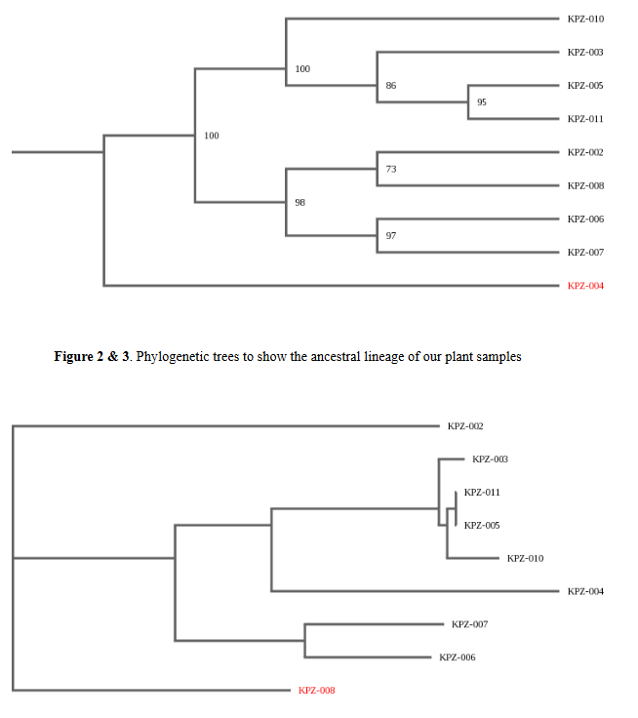
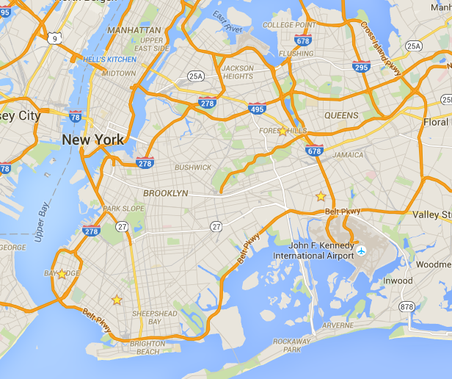
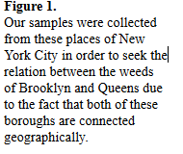
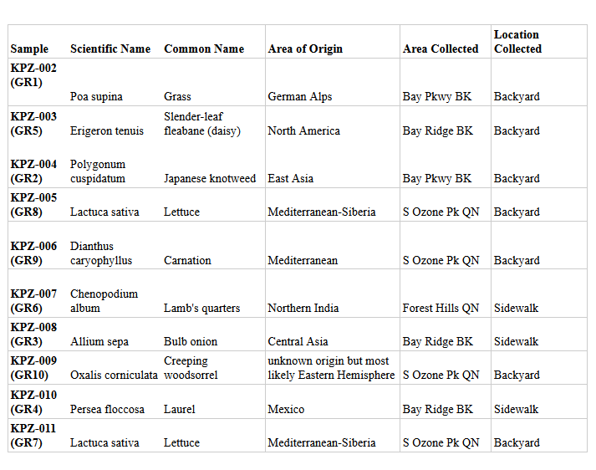
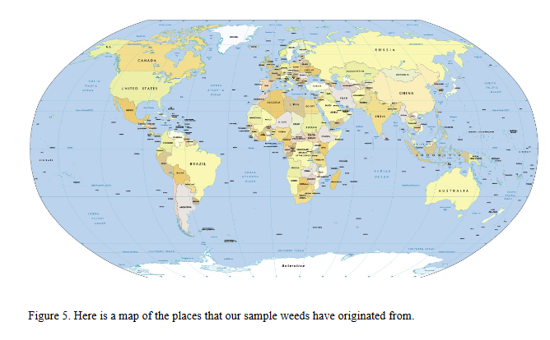
Biodiversity of Weeds
Tiffany Lam, Lily Li, Stephane Sartzetakis, and Britney Singh.
Mentor: Dr. Stephanie Tzall
Brooklyn Technical High School
Abstract
The objective of our project is to compare and contrast the weeds grown in backyards to the weeds that are grown in the sidewalks in order to identify the diversity of weeds throughout Brooklyn and Queens. Biodiversity contributes to ecological factors such as the circulation of seeds and the regulation of water and climate. We isolated and extracted DNA from our samples of weeds and then we utilized polymerase chain reaction to amplify the DNA. Our results suggested that our samples from both the backyard and the sidewalk have similar attributes such as being edible and having weed-like attributes: hard to maintain, unintentionally planted, and competitive. In addition, our results showed that our samples originated from various regions of the world which emphasizes that even though Queens and Brooklyn share a land mass, they do not share the same biodiversity of plants. Brooklyn and Queens are sustainable areas for the growth of the biodiversity of weeds.
Introduction
Biodiversity is defined by the New York State Department of Environmental Conservation as the “total variety of life on Earth... or in a given area” (New York State Department of Environmental Conservation, 2015). Biodiversity is a necessity because it provides many biological services and economic values. Environmental impacts include: protecting areas from detrimental weather conditions, helping maintain a healthy balance of gases in the atmosphere which reduces the risk of global climate change, promoting the recycling of nutrients, pollinating food plants, acting as a natural filter to remove waste, and indicating dangerous changes in the environment (Green-Schools Ireland, 2015). The economic factors have many beneficial effects such as: providing a food source and natural medicines, having commercial value, holding cultural importance, and improving the aesthetic of an area (Green-Schools Ireland, 2015). Overall, the species of our planet are very interdependent and function at their best when all present; therefore, biodiversity is something that must be conserved for the well being of an array of species.
A weed is most commonly considered a plant that is out of place and not intentionally planted or a plant that is growing where it is not wanted. Weeds are popularly seen as an inconvenience. They can be fierce competition for natural resources which hinders crop growth and development; they can also host pathogens that may attack crops (Ligenfelter, 2015). Many people take measures to get rid of weeds by: utilizing pesticides, controlling seed dispersal, containing existing infestations, minimizing soil disturbances, controlling infestations early, and establishing competitive vegetation (Bokan, 2009). However, they can have their benefits. Weeds can protect the soil from erosion, provide a habitat for insects and animals, and recycle soluble nutrients back into our soils (Ligenfelter, 2015).
In urban areas like Brooklyn and Queens, there can be many apparent threats to biodiversity. This includes many human activities. As an illustration, habitat destruction is a major issue for biodiversity. Since Brooklyn and Queens are part of a metropolis, most of its areas have turned into pavements and buildings that are causing a decrease in the areas in which are good for various types of plants to thrive. Additionally, the spread of invasive species can hinder biodiversity; urban species are susceptible to a wide variety of these foreign organisms because they are so diverse due to the many different ethnic people bringing in plants and animals. Through this experiment, we will discover how the biodiversity of various parts of Brooklyn and Queens has fared under such stressors. Additionally, we want to see how the weeds from backyards compare to the weeds between the cracks on city sidewalks.
Materials & Methods
In order to solve the question concerning the biodiversity of weeds, we followed the basic procedures indicated in the Urban Barcode instructions. We extracted DNA from the weeds we collected in Brooklyn-Queens regions of New York City. Our initial steps in isolating the DNA was centrifugation, electrophoresis using the E-gel iBase Power System, and PCR of the DNA. Samples were then prepared for Genewiz submission.
We collected our ten samples from plants that were unintentionally planted in various regions of Brooklyn and Queens.
We extracted and isolated the DNA from the weed plants that we collected by following the instructions of DNA Barcoding 10: Isolating DNA
After we thoroughly removed the debris from the DNA and we extracted it from the cell, we used the PCR to amplify the DNA.
To confirm the presence of DNA, we used gel electrophoresis from the E-gel iBase Power System
We sent our DNA samples to Genewiz for sequencing
Lastly, we used DNA subway, to determine the ancestral lineage of our samples using phylogenetic trees
We collected our 10 samples from the following regions:
Bay Ridge, Brooklyn
Bay Parkway, Brooklyn
South Ozone Park, Queens
Forest Hills, Queen
Results
Out of the ten samples that we collected, we were able to identify a fair variety of weeds which broadly defined the biodiversity with the help of DNA Subway. For sample KPZ-002, it was identified as Poa supina (also known as grass). It originated from the German Alps. Sample KPZ-003 was identified as Erigeron tenuis, which is also known as the slender-leaf daisy which originated from North America. Sample KPZ-004 was identified as Polygonum cuspidatum, or the Japanese Knotweed that originated from East Asia. Both KPZ-005 and KPZ-011 were identified as Lactuca sativa or lettuce. Sample KPZ-006 was identified as Dianthus caryophyllus which is also known as carnations. KPZ-007 was listed as Chenopodium album or in other words, Lamb’s quarter. Sample KPZ-008 was identified as a commonly eaten staple today, the Allium sepa or the bulb onion. Sample KPZ-009 was identified as the Oxalis corniculata which had an unknown origin. Sample KPZ-010 was identified as Persea floccosa which originated from Mexico. There was also a relatively defined pattern in the places that these weeds originated which ranges from the entire Eurasian continent and North America itself.
Tables & Figures
Discussion
We supported our hypothesis that we will discover a variety of weeds in the backyards and sidewalks in Brooklyn and Queens. All of our samples that we collected were of mostly of different identity and origin such as Grass, Daisy, Japanese Knotweed, Lettuce, Carnation, Lamb’s Quarter, Bulb Onion, Creeping Woodsorrel, and Laurel. This also supported our hypothesis that the weeds from the cracks of the sidewalks are different from the weeds of various backyards.
Even though we have a general list of the biodiversity of weeds in Brooklyn and Queens, it was not enough to map out the entire biodiversity of weeds in Brooklyn and Queens. Future studies may include expanding the collections of garden weed samples. In addition, we can expand the location of sampling from Brooklyn and Queens to all of New York City in order to gain more variety of weeds. It is interesting to note that one of our samples that we collected from the sidewalk in Bay Ridge, called the Persea Floccosa (Laurel), was listed as vulnerable in the red list category (González-Espinosa). This can contribute to future studies related to endangered weed species.
The identification of garden weeds can contribute to databases on weeds or research in fields such as medicine. For example, when Lemon Balm were given to patients, they had an increase in calmness and could do the most difficult timed memory task more quickly (Davies & Johnston, 2003, para. 5). In addition, research shows that the sap from Milkweed can cure skin cancer. An Australian study examined 36 patients with 48 non-melanoma lesions between them. The patients were treated once a day for three consecutive days by an oncologist, who used a cotton bud to apply enough sap to cover the surface of each individual lesion. After a month, 41 of the 48 cancers had gone (Hope, 2011, para. 6-9).
References
Bokan, S. (2009. June). The Impact of Weeds. Retrieved from
http://www.colostate.edu/Dept/CoopExt/Adams/sa/pdf/June2009-WeedImpact.pdf
Davies, C., & Johnston, P. (2003, Mar 14). “Garden weed that can be a calming influence.” The Daily Telegraph. Retrieved from http://search.proquest.com/docview/317711693?accountid=51599
González-Espinosa, M. (1998). “Persea floccosa.” The IUCN Red List of Threatened Species1998: e.T30753A9576464. Retrieved from http://dx.doi.org/10.2305/IUCN.UK.1998.RLTS.T30753A9576464.en.
Green-Schools Ireland. (2015). Why is Biodiversity Important? Retrieved from http://www.greenschoolsireland.org/biodiversity/why-is-biodiversity-important.364.html
Hope, J. (2011, Jan 26). “Garden weed may help to cure skin cancer, say doctors eire region]”. DailyMail. Retrieved from
http://search.proquest.com/docview/847263290?accountid=51599
Ligenfelter, D. (2015). Introduction to Weeds: What are weeds and why do we care? Retrieved from http://extension.psu.edu/pests/ipm/schools-childcare/schools/educators/curriculum/weeds/introweeds
New York State Department of Environmental Conservation. (2015). Biodiversity & Species Conservation: Sustaining New York's Animals, Plants and Ecosystems. Retrieved from
http://www.dec.ny.gov/animals/279.htmll
Acknowledgements
We thank Dr. Risa Parlo and Dr. Stephanie Tzall for helping us along the way of this project. We thank Brooklyn Technical High School for providing a well-equipped lab for us to proceed with our experiments for this project. We also thank Cold Spring Harbor Laboratory’s DNA Learning Center and DNA Subway for assisting us on DNA sequencing.
Figure 4. A table listing all of the samples with their scientific names

