Slide 1
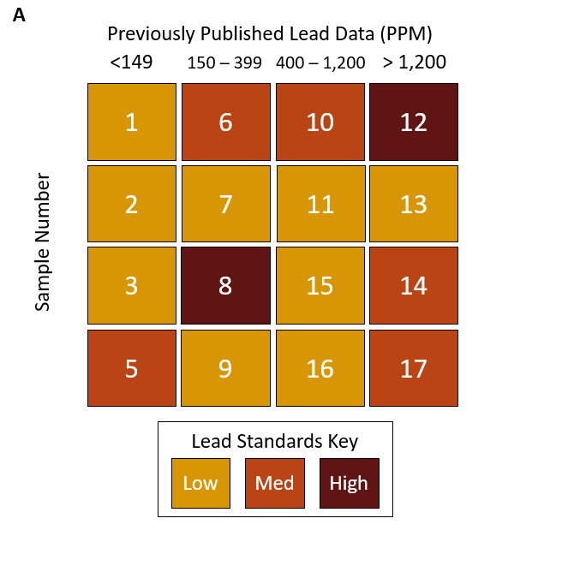
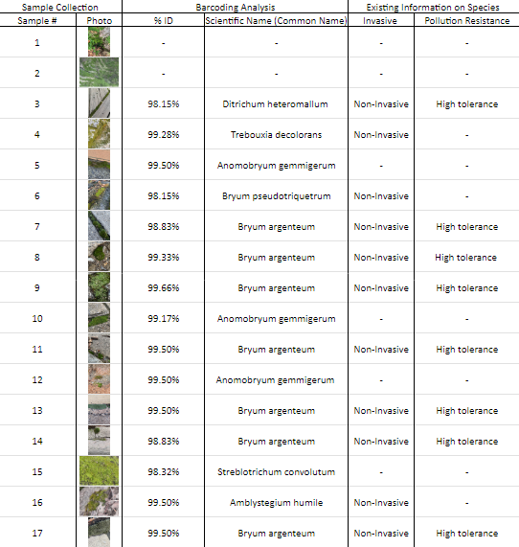
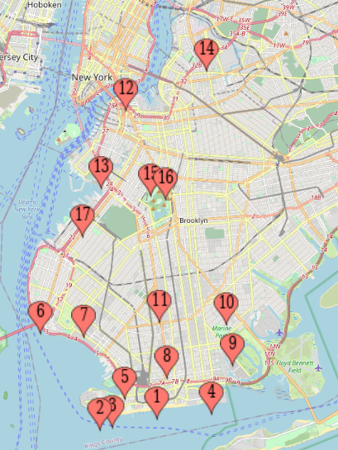
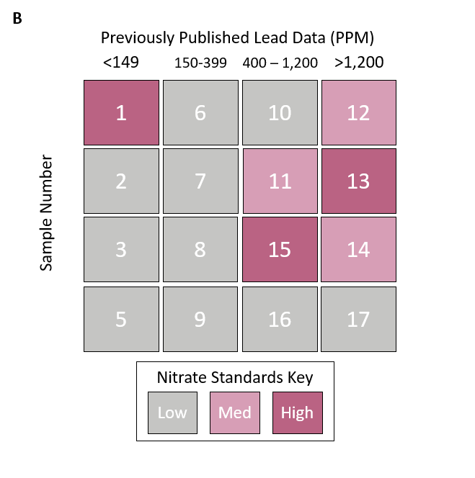
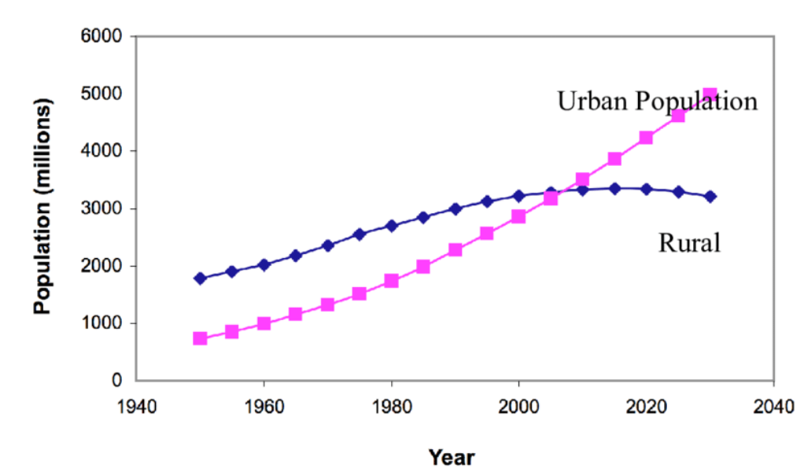
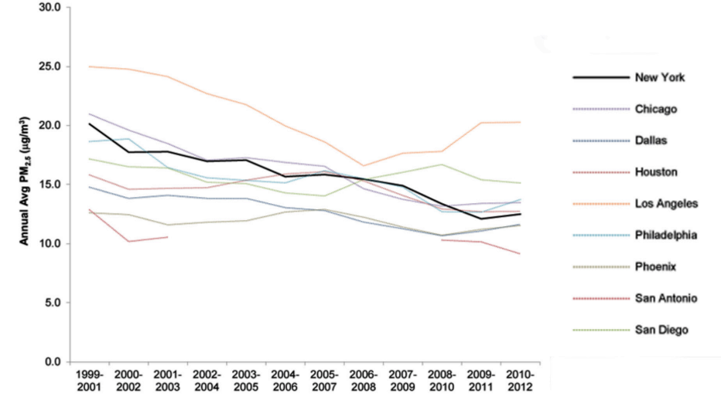
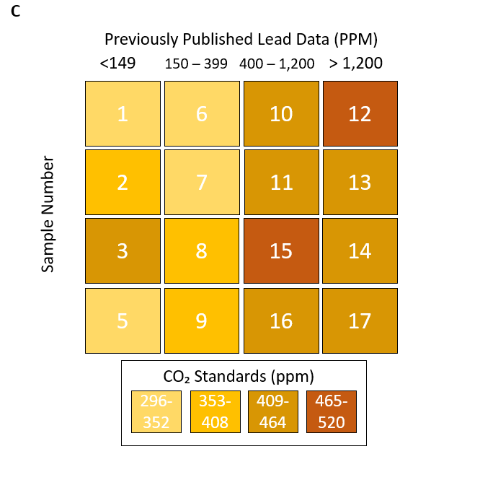
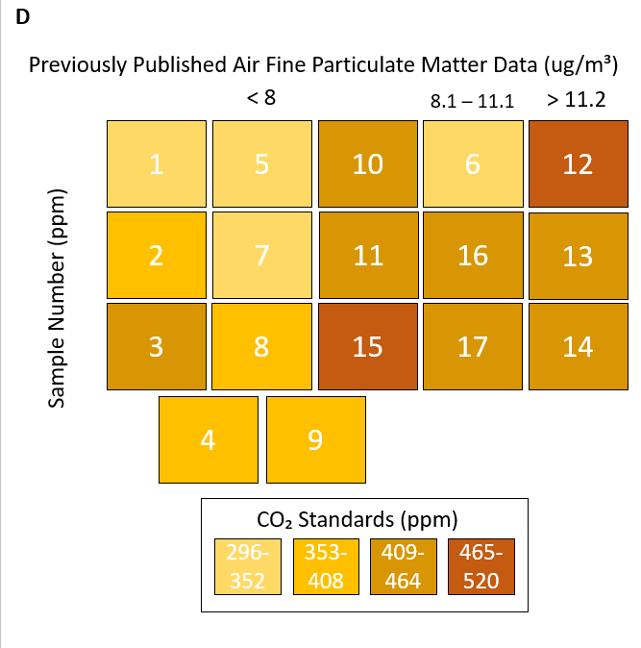
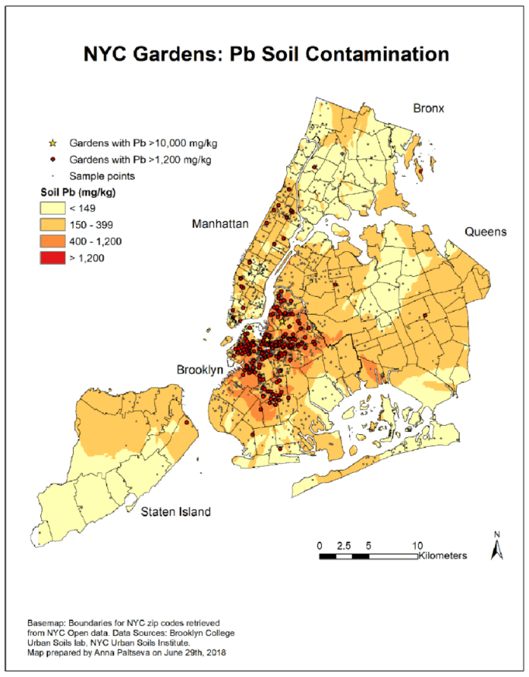
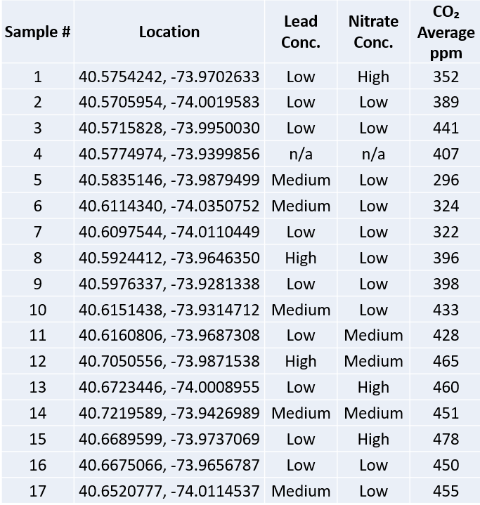
DNA barcoding Moss and Performing Soil and Air Analyses to
Identify Unique Species for Bioremediation of Pollutants in Brooklyn, NY
Robert Antonyan*, Xuanjie Chen*, Michael A. Estrella‡
Brooklyn Technical High School, Brooklyn, NY
*students, ‡mentors
Abstract
Results
Materials and Methods
Air and soil pollution, such as CO₂ and heavy metals, pose threats to ecosystems and public health. Biomagnification of these pollutants is of particular concern to human health. Previous research has shown specific moss species can remediate these pollutants. Moss is resilient and widespread in NYC, we hypothesize that they can be used to reduce pollutants and prevent biomagnification. Using prior mappings of NYC pollution, we will collect samples of moss, the surrounding soil and measure air CO₂ levels at specific locations in Brooklyn. Species of moss will be identified through DNA barcoding and soil and air CO₂ levels will be measured. From this data, correlations between species and pollution levels will be investigated with the goal of identifying moss species that are adept at helping lower NYC’s pollution levels. The data could contribute to solutions using bioremediation through urban planning and sampling the biodiversity of moss in Brooklyn.
DNA Barcoding Results
DNA Barcoding Procedure
Collected samples of plant species and soil from locations based on previously published data on pollution levels.
Performed PCR to amplify DNA samples with RbcL primers.
Performed gel electrophoresis to confirm the presence of DNA amplicon
Sent PCR product for sequencing.
Performed NCBI Nucleotide BLAST on the sequencing results to identify the species collected.
All samples were identified except samples 1 and 2. Sample 1 had too much noise, sample 2 had a failed gel.
7 different species were identified.
Invasiveness
5 of the identified species were found to be non-invasive, one being an algae. No sufficient previously published data was found to determine the invasiveness of the other three species.
Pollution Resistance
2 of the identified species were found to have high pollution tolerance.
Introduction
More than half the world’s population lives in urban areas, and this is projected to continue increasing.
This number was already 4.46 billion people in 2021, according to the United Nations.
New York City is one of the most populated urban areas in the United States and the in world.
Figure 7. Relative location of sample collection.
Soil Analyses Procedure​
Performed soil testing using Heavy Metal Water Test Kit made by TESPERT on all samples except for sample 4.
For each sample, used a 50 ml graduated cylinder and added up to 10 ml of soil. Then, added a volume of water, over 90 degrees Celsius, which was 10 times the volume of soil. Next, after 5 minutes, agitated the mix and dipped the testing strip for two seconds.
Figure 1. Projection of Urban and Rural Population of the World. Source: United Nations
Conclusions
We expected that our relative soil lead concentration would align with that of the previously published data, based on sample location. However, we found this correlation to be extremely weak. We hypothesized that our collected carbon dioxide levels would align with both the previously collected lead data and airborne fine particulate matter data based on location. Our data supported this as the air carbon dioxide levels had a strong positive correlation with the previously published lead data. However, the correlation with the fine particulate matter data was weaker.
We found that several of our identified species are known to be highly tolerant to pollution. Since we found different samples of the same species in different locations with pollution levels ranging from low to high, it indicates that the species is robust and could potentially be used as a bioindicator.
Limitations: We had a small sample size, of 17, so the results may not be representative of the population. Additionally, we were limited by our access to test for a variety of heavy metal content accurately as aqua regia is costly and dangerous.
Future Directions: We found that there is not as much documented data on mosses as we expected. This data will contribute to the identification of moss species in New York and the East Coast. The species we identified can be used in further research to consolidate if they can be used in the bioremediation of urban areas. We plan to expand our research to work with a greater sample size, which we expect to make trends more prevalent. Additionally, more samples would mean better documentation of the species in New York City.
Figure 2. Air Pollution in New York City.
Source: DRAGOS NESS / SHUTTERSTOCK
Figure 3. Trends in 3-year average PM₂.₅ concentrations in New York City relative to other large U.S. cities. Source: New York City Department of Health
In urban areas, pollution is caused mainly by industrial processes and transportation.
Over time, there have been downward trends in overall air pollution seen in some urban areas, while fluctuations in others.
One consequence of high pollution levels such as air CO₂ and heavy metals is biological exposure.
Adverse effects on humans include damage to cells, fatality, and toxicity.
Table 1. Results from DNA barcoding of plant samples. The samples collected were identified, with sample number, photo, percent identity, scientific name, and known information (invasiveness and tolerance to pollution).
E
Acknowledgments
Soil Analyses Results
Lead
There is an extremely weak correlation between our collected lead
data and previously published lead data based on location.
Nitrate
There is a strong correlation between our collected nitrate levels and
previously published lead data based on location.
Carbon Dioxide
There is a strong correlation between our collected carbon dioxide
levels and previously published lead data based on location. There is
a correlation between our collected carbon dioxide levels and
previously published fine particulate matter data, but this is weaker
than the correlation with previously published lead data.
We would like to thank the Urban Barcode Project, Brooklyn Technical High School, and our mentor, Dr. Estrella for their support.
Figure 4. A map of airborne fine particulate matter in New York City from 2017. Source: New York City Department of Health and Mental Hygiene
Figure 5. A map of Pb soil contamination in NYC community gardens from 2018. Source: Anna Paltseva, Geospatial analysis and assessment of garden soil contamination in New York City.
References
Moss can be found on any continent, and many species have a cosmopolitan distribution.
Moss can survive in extreme conditions and are bioindicators of pollution levels.
Based on prior research, it has been found that specific moss species can cling to arsenic and lead in water, making it potable.
We want to investigate if there are any unique moss species in our environment that can decontaminate NYC’s urban ecosystems, helping control pollution levels and their adverse health effects.
Liang, L., Gong, P. Urban and air pollution: a multi-city study of long-term effects of urban landscape patterns on air quality trends. Sci Rep 10, 18618 (2020). doi: 10.1038/s41598-020-74524-9
Youjun Qin, Eugene Kim, Philip K. Hopke, The concentrations and sources of PM2.5 in metropolitan New York City, doi: 10.1016/j.atmosenv.2006.02.025
Zhao, H., Wu, Y., Lan, X. et al. Comprehensive assessment of harmful heavy metals in contaminated soil in order to score pollution level. Sci Rep 12, 3552 (2022). doi: 10.1038/s41598-022-07602-9
Itouga, M., Hayatsu, M., Sato, M., Tsuboi, Y., Kato, Y., Toyooka, K., Suzuki, S., Nakatsuka, S., Kawakami, S., Kikuchi, J., &amp; Sakakibara, H. (n.d.). Protonema of the Moss Funaria Hygrometrica can function as a lead (PB) adsorbent. doi: 10.1371/journal.pone.0189726
Arifin Sandhi, Tommy Landberg, Maria Greger, Phytofiltration of arsenic by aquatic moss (Warnstorfia fluitans) doi: 10.1016/j.envpol.2017.11.038
Figure 6: A-C. Collected relative lead levels in soil, nitrate levels in soil, and air carbon dioxide levels, respectively. Organized in columns based on the location of previously published lead data from Figure 5. D. Air carbon dioxide levels are organized by published air fine particulate matter data from Figure 4. Carbon dioxide standards were determined by sample standard deviations and the mean of experimentally determined data. E. scatterplot of collected carbon dioxide and collected relative lead concentration.
Table 2. Sample number and information such as location, relative lead and nitrate concentration, and average carbon dioxide concentration in ppm.

