Slide 1



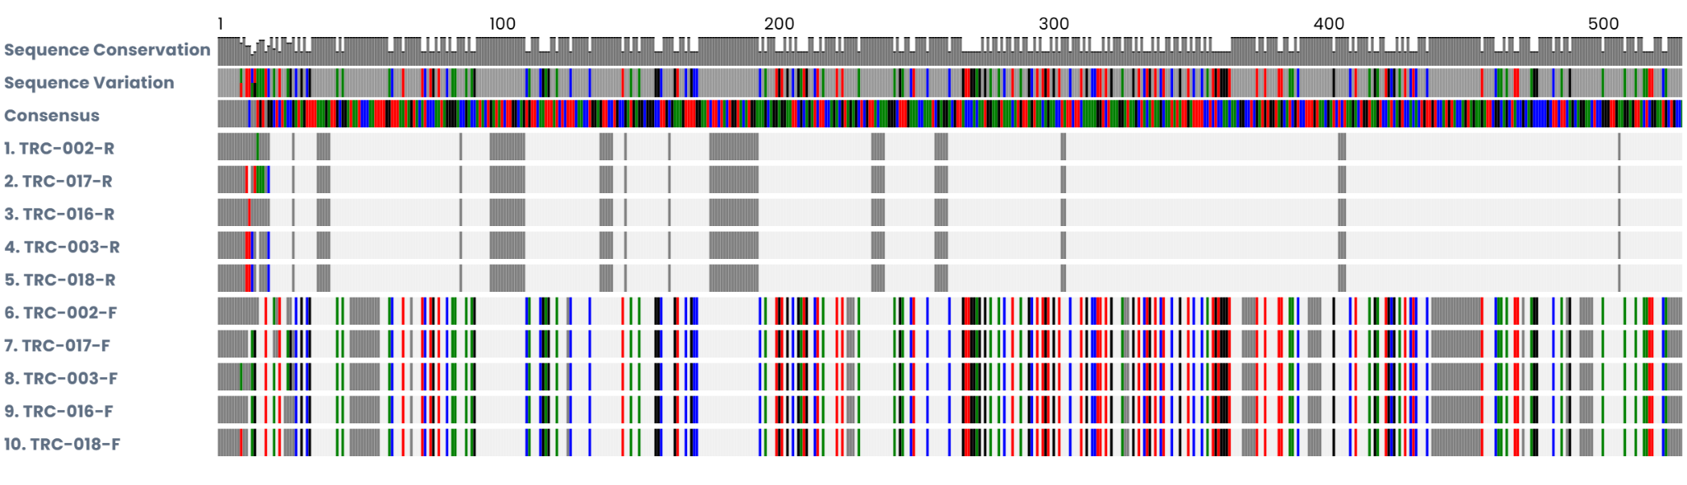
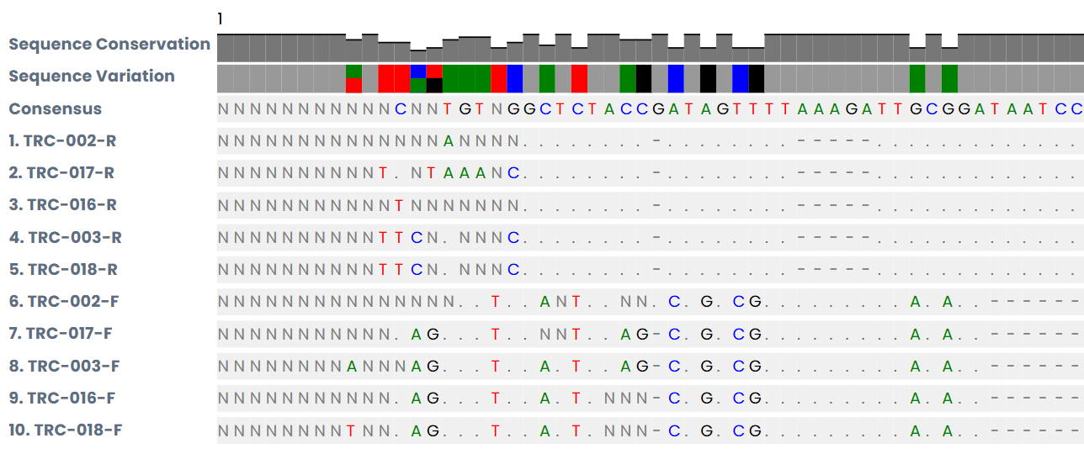
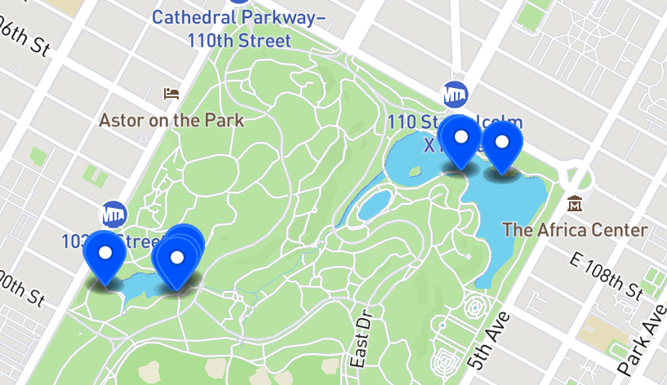
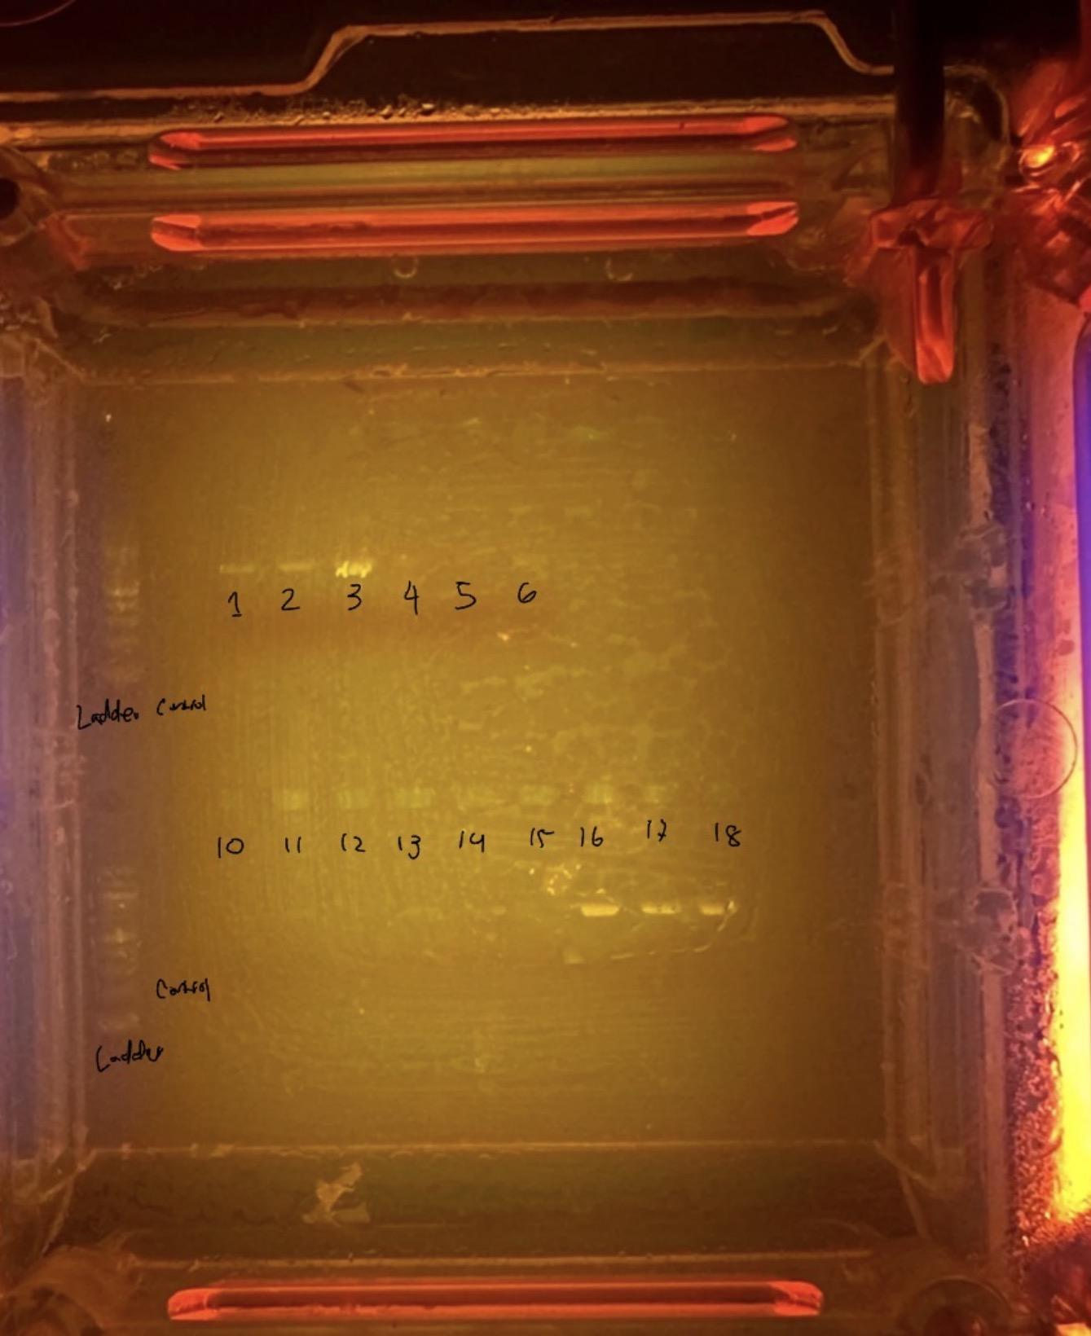
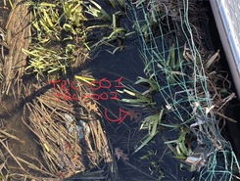
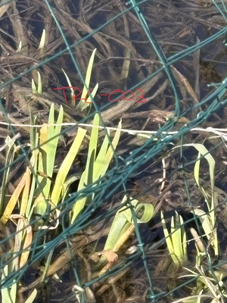
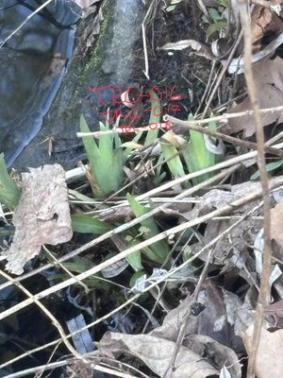
Comparing Biodiversity of Non-polluted and polluted areas of NYC
Millie Lin, Rufah Ava, Lauren J. Scanlon
Forest Hills High school
Introduction
NYC has 13,000+ native plant species that supports ecosystems. Man Made pollutants in parks disrupt these natural habitats. Studying biodiversity helps show how pollution affects ecosystem health. Pollution damages plant tissues and slows growth.
Understanding the loss of freshwater plant biodiversity is important because wetlands play a critical role in supporting the fragile ecosystems of New York city.
We hypothesized that biodiversity would be lower in polluted areas because toxins and excess nutrients directly harm plants, damaging tissues and hindering growth. Additionally, polluted conditions also disrupt soil and water chemistry, favoring a small number of tolerant, fast-growing species (often invasive. In this study, using Silica DNA barcoding comparing the biodiversity of each environment may prove that pollution is leading to overall species loss and ecosystem imbalance.
MUSCLE Multiple Sequence Alignment
Table of BLAST Results
Results
With analysis we determined samples were from the Iridaceae family According to the table of Blast Results, the average alignment length for all the samples from both polluted and non polluted sites were very similar. Showing low biodiversity overall.
As shown in the results of MUSCLE multiple sequence alignment (figure 1), TRC-002 and TRC-003 (polluted area samples) alignments are very similar to TRC-016, TRC-017 and TRC-018 since they are the same species. the first row of sequence for all the samples as shown in the Figure, , TRC-002 and TRC-003, has slightly different band alignment from the samples TRC-016, TRC-017 and TRC-018
TRC# | Forward or Reverse | Average E-value | Average Alignment Length
TRC-002 | Forward | 0.0 | 566.06
TRC-002 | Reverse | 0.0 | 557
TRC-003 | Forward | 0.0 | 568.74
TRC-003 | Reverse | 0.0 | 558.76
TRC-016 | Forward | 0.0 | 568.42
TRC-016 | Reverse | 0.0 | 557.92
TRC-017 | Forward | 0.0 | 568.54
TRC-017 | Reverse | 0.0 | 566.72
TRC-018 | Forward | 0.0 | 568.42
TRC-018 | Reverse | 0.0 | 558.76
Discussion
The sequenced DNA bands appeared similar in position, alignment and length. There were no large genetic differences detected between these samples.
This study was limited by the unequal sample size between locations. American Waterweed was not represented in Harlem Meer.
Both sites had a pH (6) despite clear differences in water quality, showing that pH alone isn’t a reliable indicator of pollution or biodiversity loss. Other environmental factors likely play a larger role in shaping ecosystem health.
Although the hypothesis predicted lower biodiversity in polluted environments, the sequencing did not provide strong genetic evidence to support this. Improved PCR conditions, larger sample sizes, and more precise sample collection are needed to gain clearer data and a more accurate understanding of how pollution affects freshwater plant diversity.
Methods
Step 1: Sample Collection
2 sites were chosen based on how the area was treated by people around the park. The Loch was selected as non polluted site while Harlem Meer was selected as the polluted site. Samples of Yellow flag iris, American waterweed and pond moss was collected. It was planned to collect 18 samples but in total 15 samples were collected, 6 from polluted site and 9 from non polluted.
Step 2: Silica DNA isolation
We took the procedure of Silica DNA isolation. It relies on the principle that DNA can bind to silica surfaces under specific conditions. The process we conducted involves the following steps: Cell Lysis ,Binding, Washing, and Elution.
Step 3: Pcr amplification
PCR makes millions to billions of copies of a specific DNA segment, amplifying tiny amounts of genetic material which makes results easier to read and increases accuracy. Since our study was plant based we used a Plant primer:rcbL to ensure correct amplification process. PCR includes 3 steps: Denaturation,Annealing, and Extension.
Step 4: Running gel electrophoresis
And Preparing the Gel, loading & Running the Gel for gel electrophoresis which separates DNA, RNA, and proteins by size and charge. It helps us to analyze samples.
Step 5: Sequencing
We sent in viable samples in for sequencing for visualization of data. Samples sent: TRC-002, TRC-003, TRC-015, TRC-017, TRC-018
Sample sites and Location
Gel electrophoresis results
References
Addgene. (n.d.). Agarose gel electrophoresis. https://www.addgene.org/protocols/gel-electrophoresis/
Bartee, L., Shriner, W., & Creech, C. (n.d.). DNA isolation, gel electrophoresis, and PCR. In Principles of biology. Open Oregon Educational Resources. https://openoregon.pressbooks.pub/mhccmajorsbio/chapter/dna-isolation-gel-electrophoresis-and-pcr/
Biology Insights. (2025, April 29). Gel electrophoresis: A step-by-step guide for DNA analysis. https://biologyinsights.com/gel-electrophoresis-a-step-by-step-guide-for-dna-analysis/
DNA Learning Center. (n.d.). DNA barcoding 101. Cold Spring Harbor Laboratory. https://dnabarcoding101.org/lab/
Gallego, A. (n.d.). Guide to plant DNA extraction. GoldBio. https://www.goldbio.com/blogs/articles/guide-to-plant-dna-extraction
OPS Diagnostics. (n.d.). CTAB protocol for isolating DNA from plant tissues. https://opsdiagnostics.com/notes/protocols/ctab_protocol_for_plants.htm
What Factors Have Led to the Increase in Invasive Species? (2026, January 4).Biology in Sights.
Retrieved May 12, 2026, from https://biologyinsights.com/
what-factors-have-led-to-the-increase-in-invasive-species/
Successfully sequenced samples
Fig. 1
Fig. 2
Fig. 3
TRC-003
TRC-016
TRC-017
TRC-018
TRC-001
TRC-002
TRC-003
Fig 1. TRC-002
Fig 2. TRC-003
Fig 3. TRC-016, TRC-017 TRC-018

