Slide 1
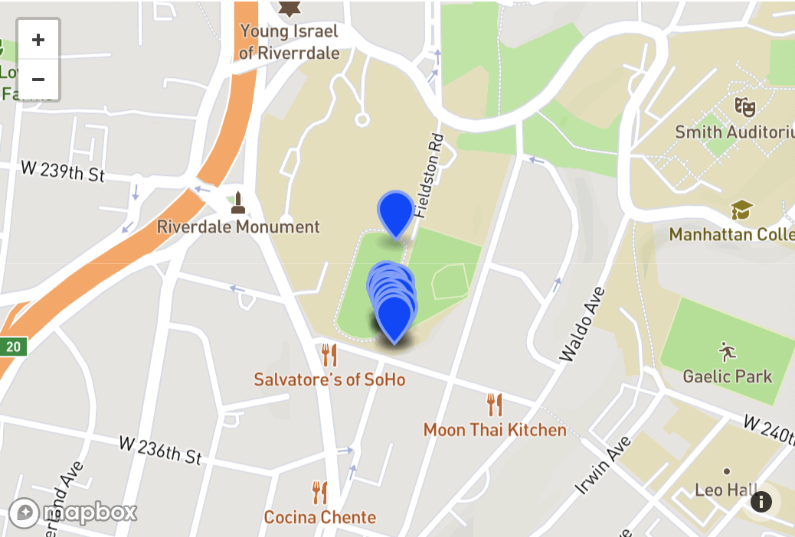
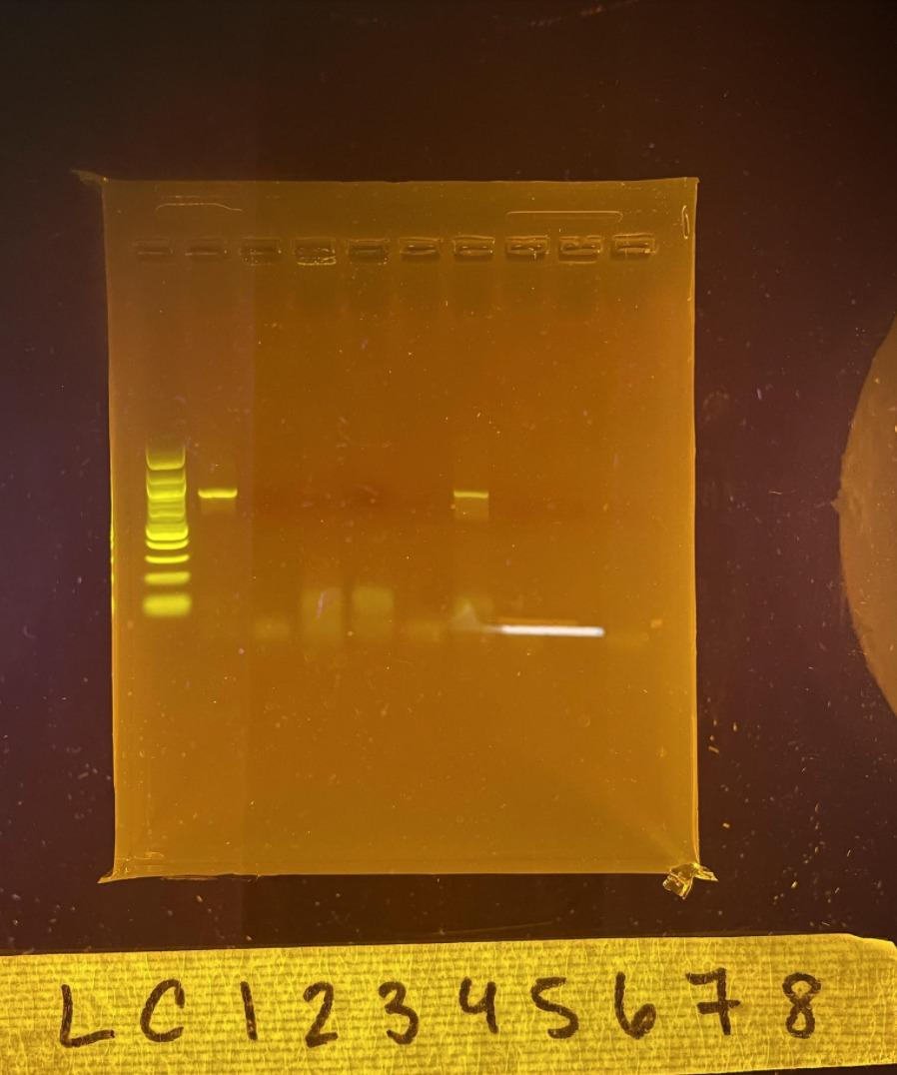
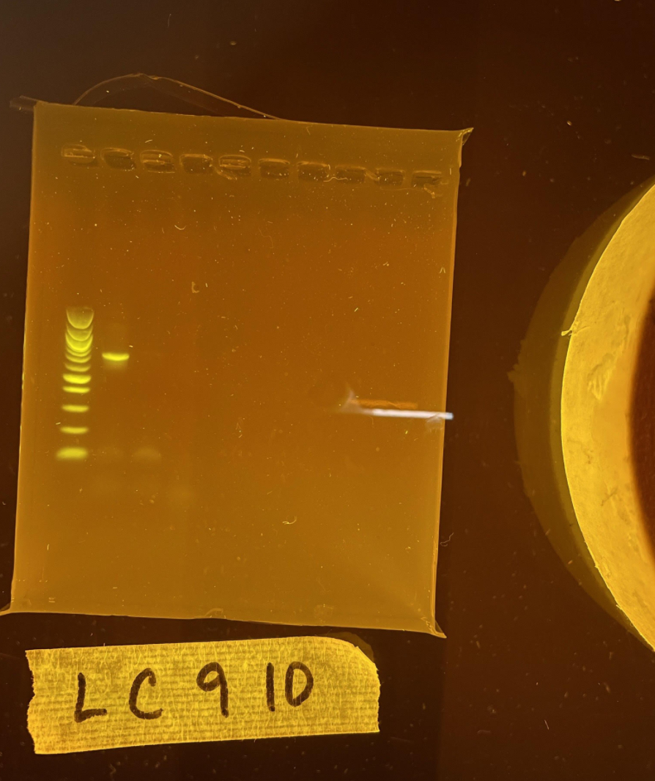
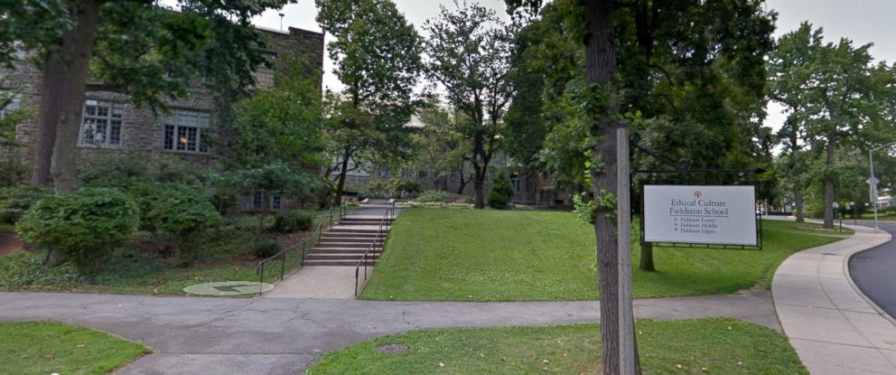
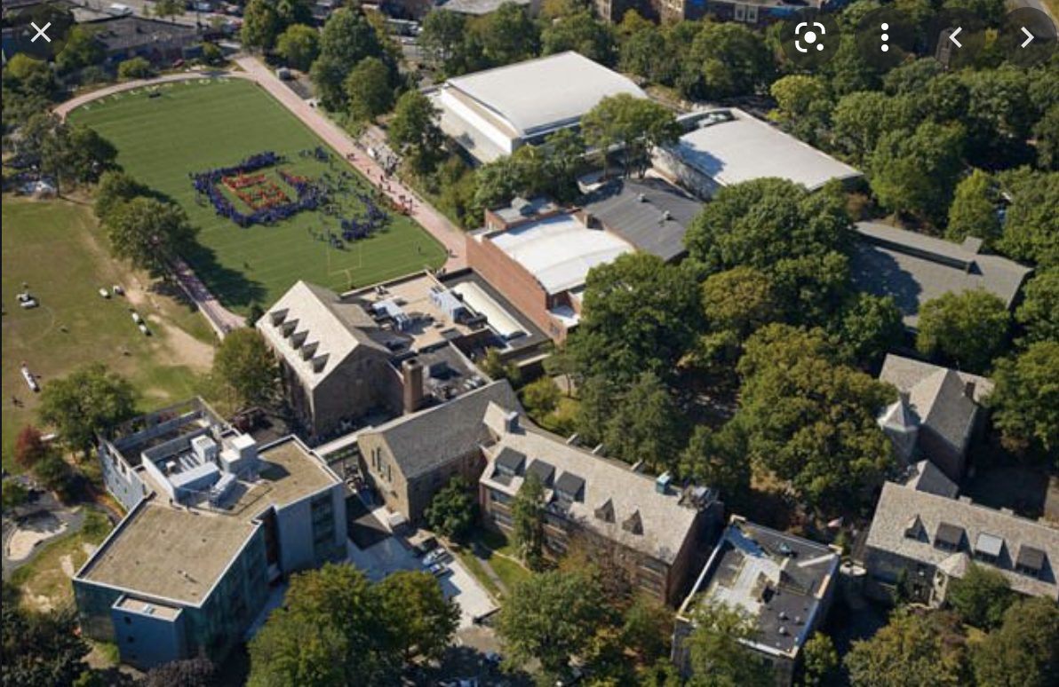
`
Lumbricidae on the Fieldston Campus
Ella Caplan (she/her) and Rex Hechter (he/him)
Funded by the
Thompson Family Foundation
¹Ethical Culture Fieldston School
Abstract
Results
Discussion
Abstract
Our goal was to extract DNA samples from worms collected from two contrasting worm habitats: the pile of fresh leaves versus the degraded leaf pile near man-made planks of wood on the Ethical Culture Fieldston School campus. The purpose was to determine the diversity of various worm species in two different habitats on the school grounds. We should also be able to determine whether or not there are any invasive species. The DNA of at least 12 samples was collected, and the DNA sequence will be determined.
The purpose of this experiment was to determine the different types of species of Lumbricidae on the Fieldston Campus, from two different locations, using the Chelex method. Our goal was, after extracting the DNA through PCR and gel electrophoresis, to analyze the varying species of worms that inhabited each location. We would then be able to identify the biodiversity of the two areas in the lower field of the Fieldston Campus which were close by to each other. We would also be able to understand the contrasting species of worms that existed on campus.
However, due to experimental error this was not achieved. Only one sample was acquired during gel electrophoresis, which did not allow for any comparisons to be made between the samples from the two locations. During the first process of amplifying DNA, no samples appeared after gel electrophoresis. After repeating the Chelex protocol, PCR, and gel, we were only able to obtain one sample. We propose that the experiment error in this case was the Chelex protocol. It seems that on larger species such as Lumbricidae. This method is not effective, possibly because the DNA is harder to extract. We suggest that using the Silica protocol on worms in the future would obtain more favorable results.
In the future, we also suggest that the grinding time used before adding the specimen to the PCR should be increased. This would possibly allow for more DNA to be extracted from the specimen. We also suggest an increase in sample size by at least triple. That way, if the Chelex procedure is still being used, there is a higher chance that a comparison between results would be able to occur.
"Compost Food Scraps." Grow NYC. Accessed November 27, 2020. https://www.grownyc.org/compost.
DNA Learning Center Barcoding 101. (2020). Dnabarcoding101.org. https://dnabarcoding101.org/lab/protocol-2.html#alternatee
Encyclopedia Britannica, ed. "Oligochaete." Britannica Student. Last modified February 18, 2020.
https://www.britannica.com/animal/oligochaete.
"Fieldston, Bronx." Wikipedia. Last modified May 4, 2020. https://en.wikipedia.org/wiki/Fieldston,_Bronx.
Lwanga, Esperanza Huerta, Hennie Gertsen, and Harm Gooren. "Microplastics in the Terrestrial Ecosystem: Implications for Lumbricus terrestris (Oligochaeta, Lumbricidae)." Last modified March 1, 2016. https://pubs.acs.org/doi/10.1021/acs.est.5b05478.
New Hampshire PBS. "Annelida - Segmented Worms." Wildlife Journal Junior. Last modified 2020. Accessed November 27, 2020. https://nhpbs.org/wild/annelida.asp#:~:text=Burrowing%20annelids%2C%20like%20the%20earthworm,in%20the%20material%20they%20ingest.
Ramel, Gordon. "Oligochaeta." Earth Life. Accessed November 27, 2020. https://www.earthlife.net/inverts/oligochaeta.html.
Reish, Donald J. "Annelid." Britannica Student. Last modified June 1, 2020. https://www.britannica.com/animal/annelid/additional-info#content-2.
Science Direct. Last modified September 29, 2017. Accessed November 27, 2020. https://www.sciencedirect.com/science/article/pii/B9780128115190000017.
"Using DNA Barcodes to Identify and Classify Living Things." In Using DNA Barcodes to Identify and Classify Living Things. Cold Spring Harbor Laboratory DNA Learning Center, 2014. Last modified 2014. Accessed November 27, 2020. https://dnabarcoding101.org/files/using-dna-barcodes.pdf.
Thank you to Howard Waldman and Dr. Anne Kloimwieder for helping us collect samples in the Fieldston Campus. We would also like to thank our Science Research class for their support.
Figure 1: Sample Locations in
The Fieldston Campus
Figure 1. Sample Locations on the Fieldston Campus. Map of the Fieldston campus indicated the locations of each of the collected samples. The pins represent the location of the samples on the lower field. The samples closest to the lower half represent the compost specimens collected, whereas the upper represents the worms from the dry area.
Introduction
Figure 2. Gel Electrophoresis Results.
Annelids are found in habitats all around the world
freshwaters
oceanic waters
soil
A subclass of the annelids called the oligochaetes
3,250 different species.
The most common oligochaete is the earthworm (Lumbricus terrestris)
Roles of turning over and aerating the soil in their ecological niches
Oligochaetes are found in a range of lengths
Fraction of an inch-->ten feet
Lumbricidae play an essential role in aiding all types of organic matter to decompose
Eat dead plants and animals--otherwise referred to as compost. In the process of consuming these non-living foods, they take in a range of soil and tiny pebbles
They ingest nutrients from microorganisms in the mechanism of their digestion.
Earth’s most important soil organisms
Vital to their ecosystems
improve nutrient and water mobility among soil stratum
Ethical Culture Fieldston School is located in the Bronx, New York.
Results of all the gel electrophoresis tests, with the ladder and sample numbers labeled in the bottom. Samples 1-8 are represented in the first image, and samples 9-10 are in the second.
References
Materials
and Methods
21 worm samples were collected
Found in areas around the Ethical Culture Fieldston School campus
Chelex protocol was used to extract DNA from the slugs
DNA from the samples was isolated and amplified using PCR
PCR products were analyzed using gel electrophoresis and 1 sample were sequenced
Acknowledgements
Notes:
OK good design--you will put in your own info. But realize you won’t have a tree because you only have one sample.

