Slide 1


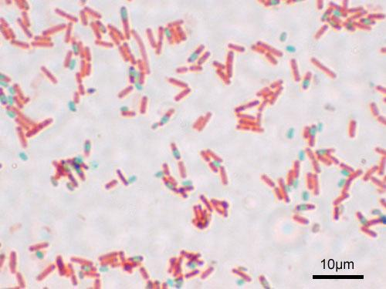
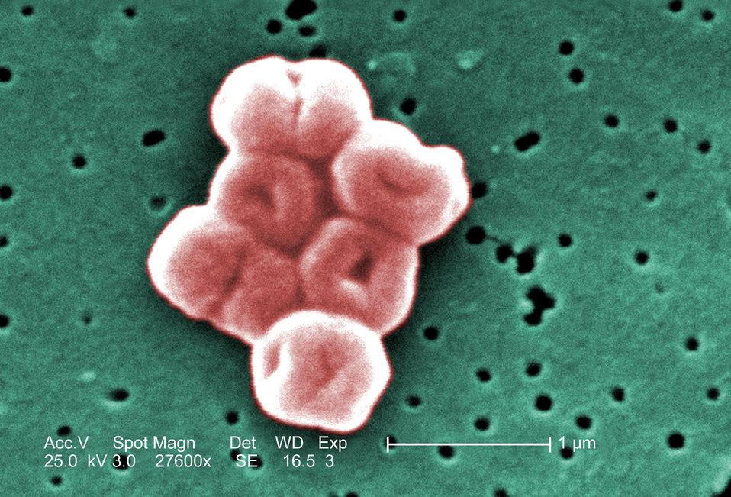
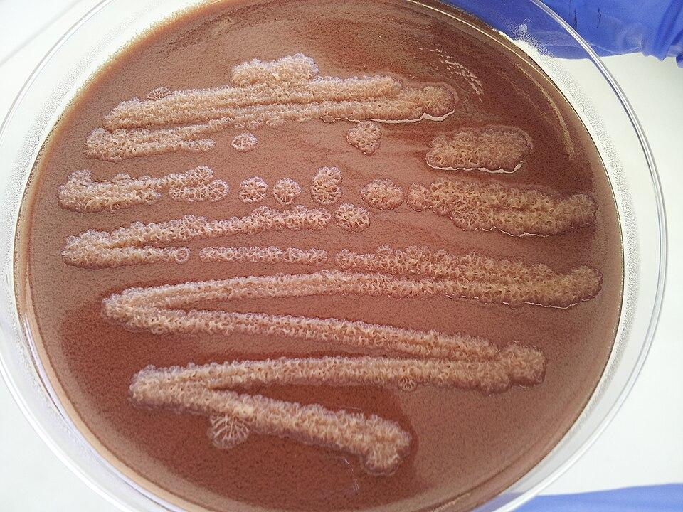
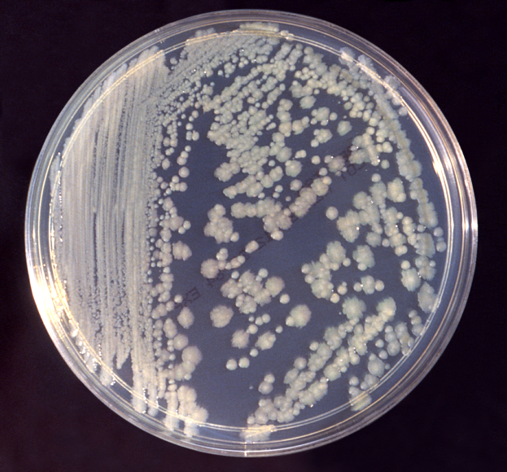
Bacteria found in plant-based Diets
Jaylynn Castro, Sharissa Marsh, Cassidy Marcus, Amanda Hiciano, & Dr. Marianne Williams (mento
Funded by the
Thompson Family Foundation
Saint Raymond Academy for Girls
Abstract
In this research we closely observed the mediterranean and other plant-based diets, isolated the DNA found on the bacteria of the plants, and used DNA barcoding the classify and identified the bacterial species. We concluded that plant-based diets consist of either harmless or potential pathogens.
Introduction
Vegetables are good for you, there is no doubt about that. Since childhood, we are taught to incorporate a decent amount of vegetables into our diet. They strengthen our immune system, aid in reducing inflammation, and overall improving the gut microbiome. When we look at people who heavily incorporate vegetables into their diets, such as those on the mediterranean diet, they have excellent gult health and a reduced risks of developing diseases such as arthritis, IBD, and cancer. Now, the question isn’t whether or not vegetables are good for us, but rather, why are they good for us? We took it upon ourselves to observe several vegetables on a genetic level and conclude if there was a specific common factor as to what makes them so beneficial to human health.
Materials & Methods
The teacher will go to Guintas Meat Farms in Bohemia, NY to purchase a variety of
vegetables (cabbage, broccoli, cauliflower, Brussels sprouts, kale, carrots, romaine lettuce, iceberg lettuce, cucumbers, string beans, tomatoes, spinach, onions, peas, zucchini, yellow squash) all on the same day. The vegetables will be stored at 4 degrees Celcius.
A small piece of each vegetable will be streaked onto a Tryptic Soy Agar plate to grow bacteria. The plate will be incubated at 37 degrees celcius for 48 hours. If necessary a second culture will be done if there appears to be multiple different kinds of colonies on the same plate.
A tryptic soy broth will be inoculated with a colony from each plate from each vegetable. The broths will be incubated at 37 degrees celcius for 48 hours.
The DNA from the broths will be isolated using the Chelex method.
  Open a tube of Chelex solution
  Add a specimen sample
  Boil water and fill mug
  Place tube through foi and secure lid
  Keep Chelex sample submerged in water
  Remove from water and let Chelex settle
  Transfer supernatant to clean tube
  Store in the refrigerator at 4°C
Once the DNA is successfully isolated it will be kept in a freezer at approximately zero degrees Celcius, before amplification is done in order to prevent/decrease DNA degradation.
The DNA products will be amplified using bacterial primers. The amplification products will be kept in a freezer until they are sent out for sequencing.
Amplification protocol:
  Obtain PCR tubes containing Ready-to-Go PCR beads containing dehydrated Taq polymerase, nucleotides, and buffer.for each bacterial sample. Using a micropipette transfer 23ul of bacterial primer to each tube.
  Using a micropipette transfer 2ul of DNA to each tube sample.
  Store sample on ice until ready to begin thermal cycling.
  The thermocycler will be programmed as follows for the bacterial primer set:
Initial step: 94 degrees celcius for 1 minute
35 cycles of the following:
Denaturing step: 94 degrees celcius for 15 seconds
Annealing step: 54 degrees celcius for 15 seconds
Extending step: 72 degrees celcius for 30 seconds
Final step: 4 degrees celcius ad finitum
The amplification products will be checked using gel electrophoresis to determine if the amplification was successful.
The amplification products will be sent out for sequencing.
Once the DNA sequences are obtained bioinformatics on the DNA subway platform will be done to both identify the bacterial species.
Results
We discovered that a majority of the bacteria found in plant based diets were either harmless or potential pathogens. This helps us get a better grasp on how plant-based diets are beneficial as the potential pathogens help stimulate the immune system by promoting the stimulation of antibodies.
Tables & Figures
Discussion
The goal of our project was to examine the health benefits plants in diets provide with the help of DNA barcoding. Our results concluded that the bacteria in these plants could range from harmless to potential pathogens. Our data depended on the accuracy of our DNA sequencing. Isolating and culturing the bacteria proved to be difficult, due to insufficient frequence resolution and the rapid bacterial growth contributing to background noise in and unclean DNA. In spite of this, our conclusions could inspire future discussions based on plant-human interactions especially in terms of nutrition and immune responses.
References
Ross et al., (2024). The Interplay between diet and the gut microbiome: implications for health and disease. Nature Reviews Microbiology Volume 22 pages 671-686.
Singh et al., (2017). Influence of diet on the gut microbiome and implications for human health. Journal of Translational Medicine. 15:73.
Acknowledgements
We would like to thank the Thompson family foundation for funding our research and Dr. Williams with helping us conduct our research.
Bacteria | Function
Bacillus(licheniformis) | Used as a probiotic, potential pathogen
Acinetobacter | Pathogen, can lead to infection(UTI, lung)
Pseudomonas(plecoglossicida, extremorientalis, synxatha, azotoformas, chlororaphis) | Potential pathogen, biocontrol
Enterobacter | Potential pathogen

