Slide 1
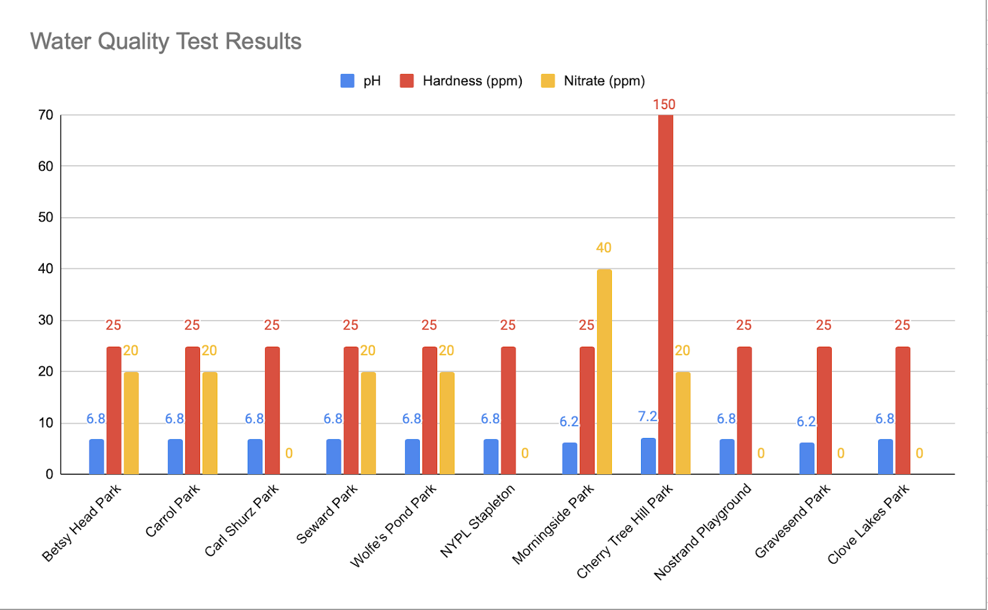
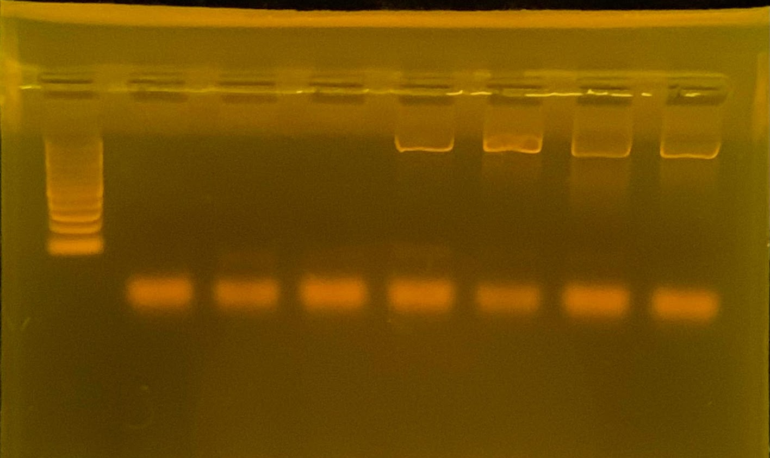
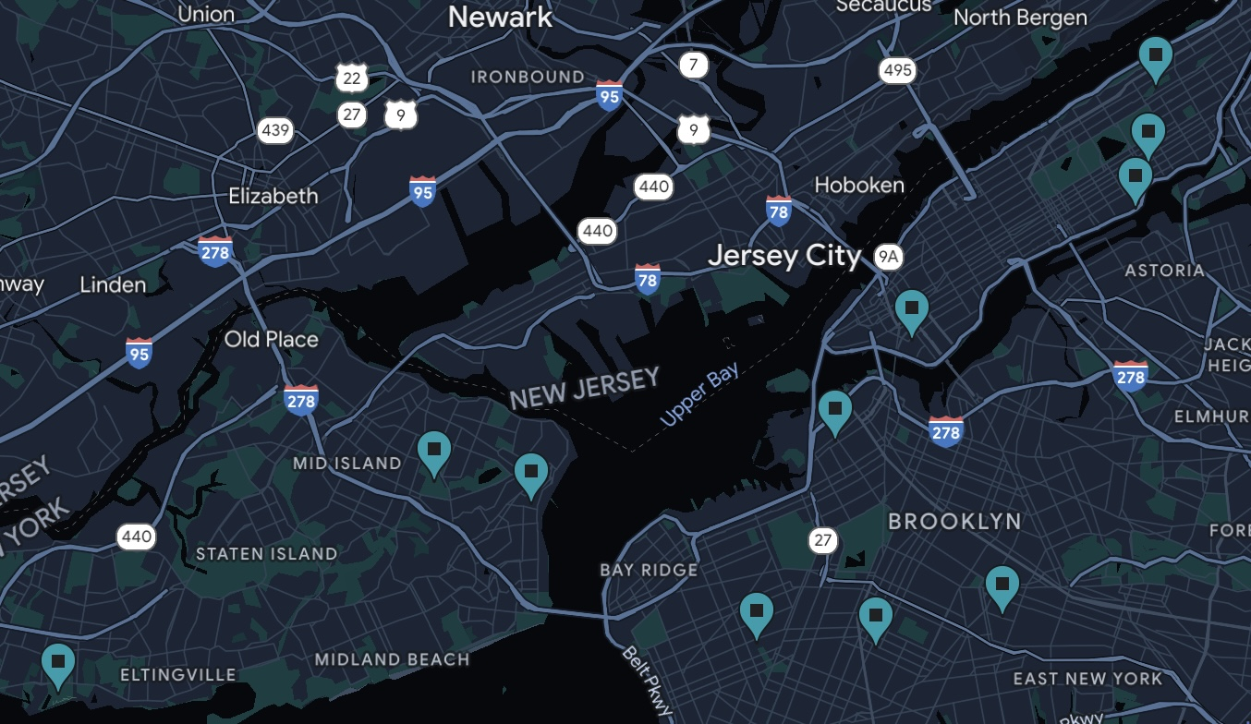
What Am I Drinking: Bacterial Metagenomics in the Water of Public Parks in New York City
Funded by:
Sofia Mykytenko¹, Omna Siddiqui² , Michael Friedman³
Staten Island Technical Highschool¹, Susan E. Wagner High School² , Pratt Institute³
Abstract
New York City is renowned for some of the best public drinking water in the country. This leads us to the question: what microbes are present in our water? Although water treatment and inspection are the same at the source, varying types of bacteria can be present in the pipes and storage tanks where water is stored before use by the general population. In our research, we sampled water from parks of diverse income levels around Brooklyn, Manhattan, and Staten Island to identify and analyze the diversity of microbes present. We planned to identify whether the socioeconomic status of the neighborhoods is associated with the microbial communities in the tap water. In our results, 9/13 of our samples provided bands on the gel but the concentration of DNA in our samples were too low, making them unable to be sequenced. We hoped to identify what the bacterial species correlate to, and how they may affect human health. We can, however, based on our PCR results and previous research, infer that bacterial communities are present in NYC tap water.
Results
Graph (right) demonstrating water quality test results. Cherry Tree Hill had the highest abnormality in hardness. Nitrate stayed relatively consistent at appropriately low levels. pH values stayed consistent, although both slightly lower and higher levels were recorded
Gel # | Well 1 | Well 2 | Well 3 | Well 4 | Well 5 | Well 6 | Well 7 | Well 8
 | Ladder strand | Sample A Null (no bands) | Sample B 1.56% µg/µl | Sample C 0.460% µg/µl | Sample D 1.68% µg/µl | Sample E 2.14% µg/µl | Sample F 0.856% µg/µl
 | Ladder strand | Sample G Null (no bands) | Sample H Null (no bands) | Sample I Null (no bands) | Sample J 1.59% µg/µl | Sample K 1.65% µg/µl | Sample L 3.36% µg/µl | Sample M 3.94% µg/µl
Introduction
The city primarily receives its water from reservoirs upstate that are a part of the Catskill/Delaware Watersheds area and the Croton Watershed area. (Karow, 2018.) However, the microbial communities of bacteria are subject to change due to the conditions of pipes, storage tanks, and reservoirs where water is being stored before it goes to the general population. (Winter, 2019.)
Positive correlations have been shown between exposure to variations in microbial communities and more adaptive immune responses. (Ishaq et al., 2019.)
A similar research study conducted in Milan, Italy was used to determine the biodiversity of water collected from drinking water treatment plants or DWTPs. Similarly, they amplified their DNA through qPCR amplification of 16S rRNA gene and identified a total of 46 bacterial phyla and 95 classes., the most abundant found phyla Proteobacteria (43%) and Pates Bacteria (41%) (Bruno, et al. 2018) Their research confirmed our expectations that different types of bacteria are present in water.
Another study conducted in the Požega‐Slavonia County in Croatia tested for diseases in children as a result of their drinking water supply. This study sampled the water supply of rural and urban neighborhoods and determined that children from rural areas had a reduction in the risk of asthma and rhinitis. In further quantitative analysis, it was determined that an increase in the bacterial load in drinking water during the first year of life, greatly decreased the risk of allergic diseases. (Mirjana Turkalj et al 2020.) From this study, we can understand that microbial diversity from the water of contrasting neighborhoods can have an impact on health of the community.
The table (left) shows the results of our gels after the third round of PCR. 9/13 samples received bands on the gel. We measured the concentrations of DNA found in all the samples with bands, to determine if they were viable for sequencing. The percentages indicate the amount of DNA recorded in each sample
Discussion
The concentration in our DNA samples were found to be less than expected in order to be sent for sequencing to GeneWiz (< 20% µg/µl). Because of this, we were not able to send our samples in for sequencing, and therefore conclude our study with what types of bacteria were present in our water.
In a revised study, we can plan to take more abundant samples of each park. This way, we can aim to have a larger quantity of DNA concentration present within the sample. During our project, we encountered the issue of not having enough PCR product to precipitate and amplify our DNA product. With a larger sample size, we could have further concentrated the amount of DNA for our PCR. A larger number of samples could also help us have more space for error. We found ourselves having to try different methods to produce bands on our gels, including using a different extraction kit, different primers, and having multiple control sets for the same PCR products.
Additionally, collecting the samples over a larger time frame, similar to the Milan study, can allow us to control for variables including weather, time of year, etc. Because our samples were collected during the winter season, many of the park bathrooms/water fountains were shut off due to inactivity. The time of year may also account for how often the water sources from the park are used. Usually during the summer, parks are used more often which might result in different types or quantities of bacteria we could test for. Sampling throughout the year can allow us to account for these confounding variables that may influence the bacteria present.
Materials & Methods
750-1000 ml tap water samples were collected from park bathroom sinks
Tested the water’s pH, hardness, and nitrate levels using EasyStrips™ 6-in-1 Aquarium Test Strips
Filtered the water to collect any debris and DNA onto a piece of filter paper
Used the DNeasy PowerSoil Pro Kit and procedure to isolate the DNA from the filters.
DNA analysis and PCR through PCR 16s RNA gene
3 different PCR methods; 3rd PCR (shown in the gels) include, Taq2 x MasterMix: 12.5 µl, Primer: 10.5 µl, DNA: 2 µl
Used Zymoclean Gel DNA Recovery Kit to attempt to purify and concentrate DNA further and determine the concentration of DNA.
References
Bruno, Antonia, et al. "Changes in the drinking water microbiome: effects of water treatments
along the flow of two drinking water treatment plants in a urbanized area, Milan (Italy)." Frontiers in microbiology 9 (2018): 2557
Mirjana Turkalj, et al. “Association of Bacterial Load in Drinking Water and Allergic Diseases in
Childhood.” ResearchGate, Wiley, Apr. 2020, www.researchgate.net/publication/340530112_Association_of_bacterial_load_in_drinking_water_and_allergic_diseases_in_childhood.
Karow, J. (2018, October 15). New York City Drinking Water Microbiome Study Reveals Variety
of Bacterial Species. Genomeweb.
https://www.genomeweb.com/sequencing/new-york-city-drinking-water-microbiome-study-reveals-variety-bacterial-species#.YbvYW_HMKEs
Winter, A. (2019). Drinking water quality and bacteria in water distribution systems (Part 1).
Wcs-Group.co.uk.https://www.wcs-group.co.uk/wcs-blog/drinking-water-quality-and-bacteria-in-water-distribution-systems-part-1
Ishaq, S. L., Rapp, M., Byerly, R., McClellan, L. S., O’Boyle, M. R., Nykanen, A, … & Tavalire,
H. F. (2019). Framing the discussion of microorganisms as a facet of social equity in
human health. PLOS Biology, 17(11), e3000536.
Furman Center, N. (2019). New York neighborhood data profiles. Retrieved December 16, 2021,
from https://furmancenter.org/neighborhoods
Acknowledgements:
We want to thank our mentor Michael Freidman for scientific guidance and assistance during our research. We would also like to thank Allison, Arden and City tech for supplies and lab access.
Map above indicates testing sites of parks located in varying income levels of three NYC boroughs: Manhattan, Brooklyn, and Staten Island
Income levels were determined using median household income data from Furman Center, N. (2019)

