Slide 1
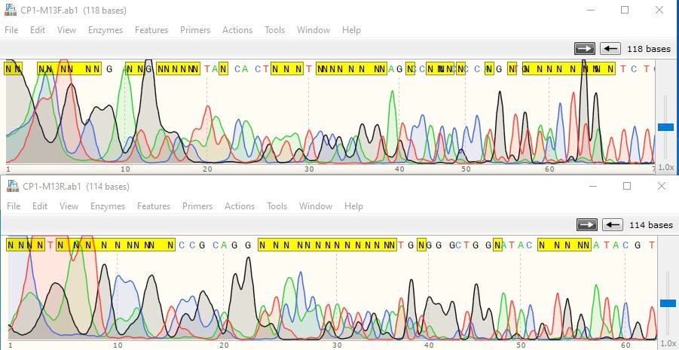
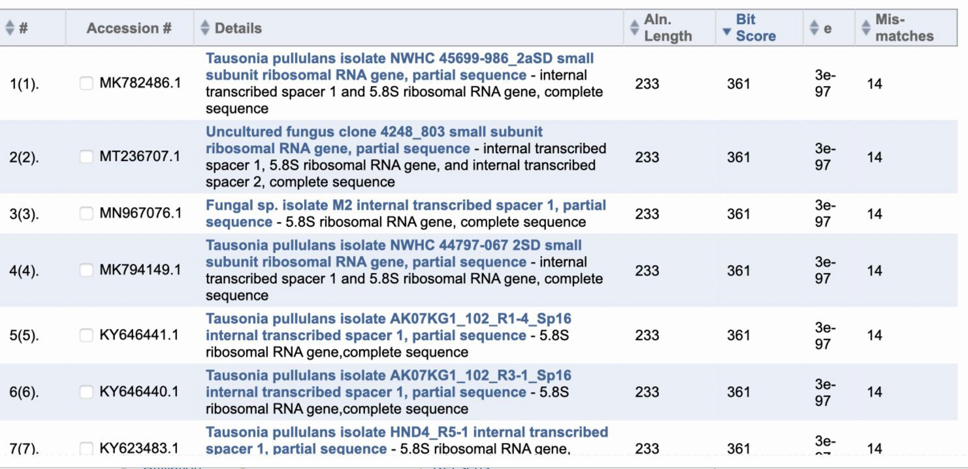
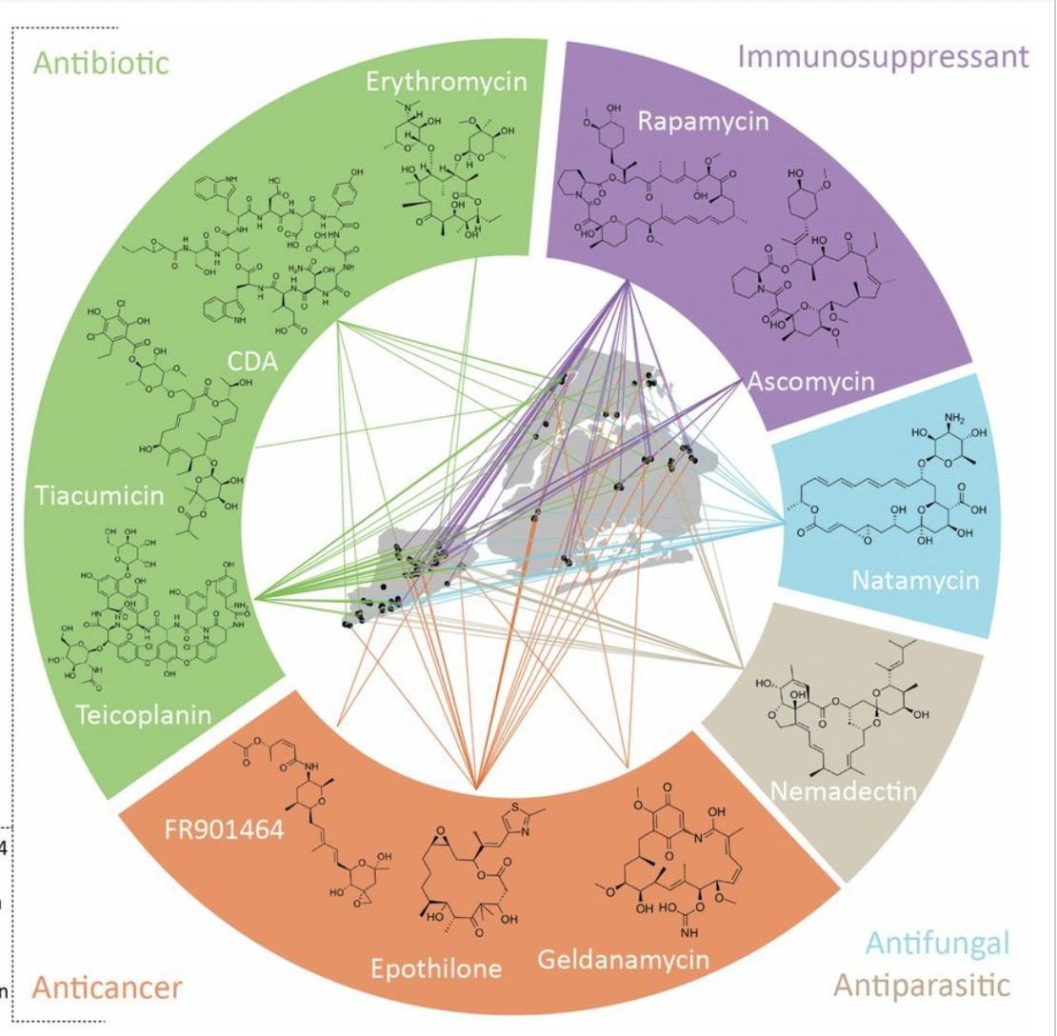
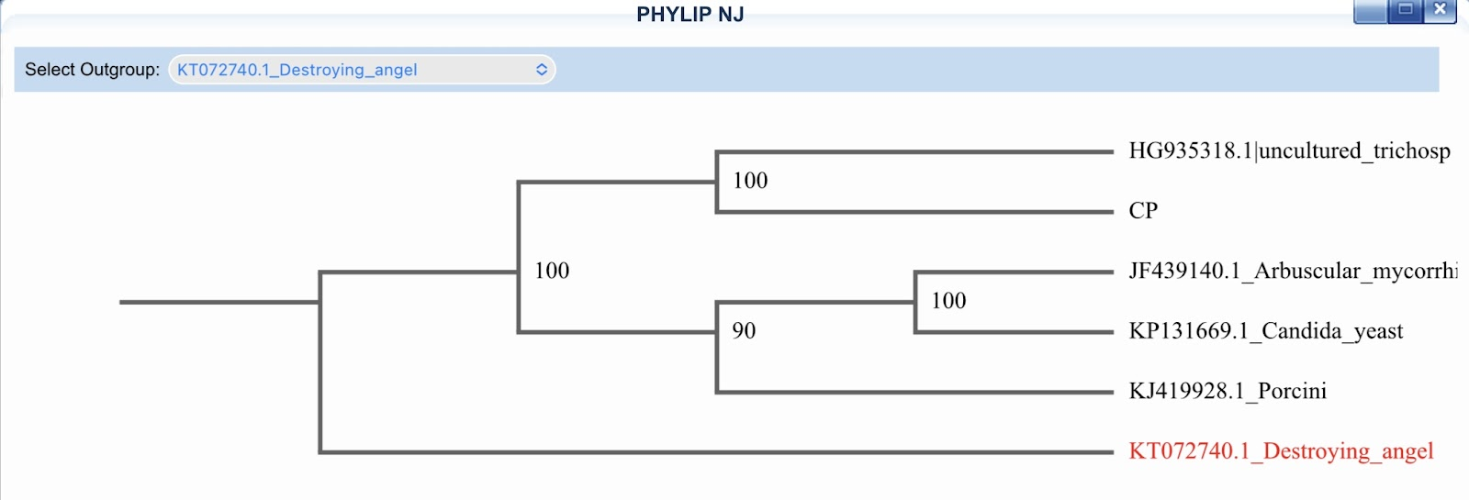
Soil biodiversity and its functioning impact both directly and indirectly to human wellbeing
Rain Ball¹ , Nora Hassan²
New Heights Academy¹ , New York University²
Abstract
To better understand soil biodiversity we aimed to conduct
DNA barcoding of soil to identify different species in the soil. We aimed to extract RNA from soil samples collected from various parks in NYC to identify the effects of different types of microplastics or microbes in our community as well as how stressful environments can cause changes in soil
Discussion
One example of microplastics on the soil is from a study done by Huang, et al (1), which states that Microplastics can have a very negative effect on agriculture. It is reported that “seeds exposed to microplastics for 8 h delayed germination,” which can be due to the microplastics blocking the pores in the seed capsule which can prevent the seed from getting water. Therefore, we aimed to determine whether microplastics have a positive or negative effect on the microorganisms as well as the soil. We found a large number of Tausonia pullulans organisms that were closely related to the DNA extracted from Central Park.
biodiversity.
Introduction
Microplastics in soil can affect the physical and chemical properties of the soil.There is a lot of biodiversity in soil but there is not a lot of DNA barcoding to identify the different species of bacteria and organisms in the soil. We aimed to identify the bio-organisms in the soil to see the effect that microplastics have on them. As more industrial waste is distributed into the environment, one particular area of concern is the rising levels of soil pollution.
Figure 2:Central park sequence data reflecting how there seems to be multiple species, there are overlapping reads. We should have expected to see one curve perbase read.
The health of soil and the microbes and plants that live in it is of important consequence to human health, as evidenced by Steffan et al. (2). However, with the advent of plastic mulch, or a layer of material applied to soil to conserve soil moisture and to reduce weed growth, the amount of plastics, or more specifically microplastics found in soil has grown exponentially. Thus, it is important for humanity to quantify the dangers of microplastic contamination within soil.
Interestingly in a study done by Charlop-Powers et al. revealed a class of antibiotics and enormous potential for discovery of new therapeutics (Figure 4). Which raises an interesting what impact, do these molecules have on a child who eats the dirt? Especially with the increasing data on long-term effects of early childhood exposures to toxins or medication use.
Materials & Methods
Figure 3: After performing DNA subway we found top 7 species that closely matched our DNA
DNALC-prepared extraction and PowerSoil DNA extraction kits were purchased
Soil samples from Central Park, Hillman Park, and Luther Gulick Park were collected in ziplock bags. Two samples were collected from each site. We believe having duplicates from each site will provide us with more information about the species.
Bioinformatics Analysis:
We performed BLAST to find DNA sequences in the ncbi database
Created a DNA subway-Blue line.
Figure 4: Discovery sites of antibiotic molecules found to date.
Future Directions
Unfortunately, after submitting our samples for sequencing we were not able to extract clean DNA samples (Figure 2). In the future we would recommend taking fresh samples of soil and using these samples soon after. However, we found a large number of Tausonia pullulans organisms that were closely related to the DNA extracted from Central Park. Further research will need to be conducted in order to examine the impact Tausonia pullulans has on the environment.
In the future I would also like to use animal DNA samples, it would be easier to extract DNA and get useful information out of the analysis.
DNA was extracted from our soil samples using DNALC-prepared extraction and PowerSoil DNA extraction kits.
We amplified the DNA barcode region by using primer sets ITS: (ITS1F / ITS4)
and ran a PCR reaction. These are fungi primer sets which will target the soil samples.
We analyzed the PCR products by creating an agarose gel and running a gel
electrophoresis using a small amount of pcr product.
We interpreted the gel by seeing which bands appear/amplify well.
We submitted the rest of the PCR product for sequencing.
Figure 1: Soil samples were collected from each of the parks marked on the NYC map
References
1)Huang D, Wang X, Yin L, Chen S, Tao J, Zhou W, Chen H, Zhang G, Xiao R. Research progress of microplastics in soil-plant system: Ecological effects and potential risks. Sci Total Environ. 2021 Nov 4:151487. doi: 10.1016/j.scitotenv.2021.151487. Epub ahead of print. PMID: 34742990
Steffan, J. J., Brevik, E. C., Burgess, L. C., & Cerdà, A. (2018). The effect of soil on human health: an overview. European journal of soil science, 69(1), 159–171. https://doi.org/10.1111/ejss.12451
Charlop-Powers, Zachary & Pregitzer, Clara & Lemetre, Christophe & Ternei, Melinda & Maniko, Jeffrey & Hover, Bradley & Calle, Paula & Mcguire, Krista & Garbarino, Jeanne & Forgione, Helen & Charlop-Powers, Sarah & Brady, Sean. (2016). Urban park soil microbiomes are a rich reservoir of natural product biosynthetic diversity. Proceedings of the National Academy of Sciences. 113.201615581. 10.1073/pnas.1615581113.
Figure 5: Phylogenetic tree

