Slide 1

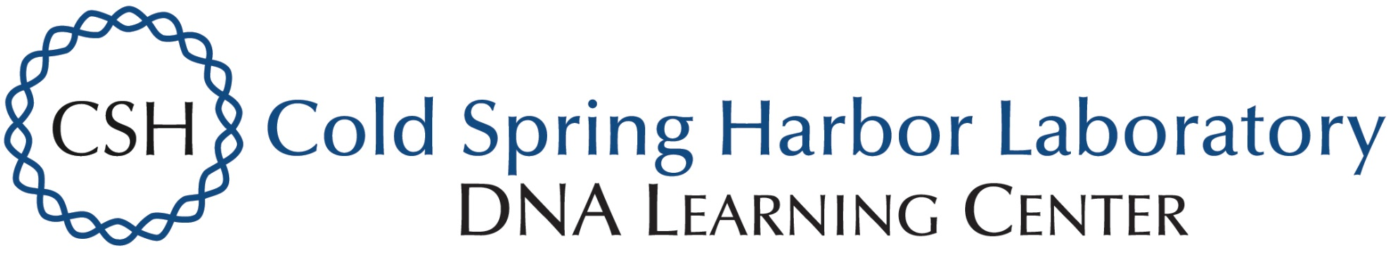
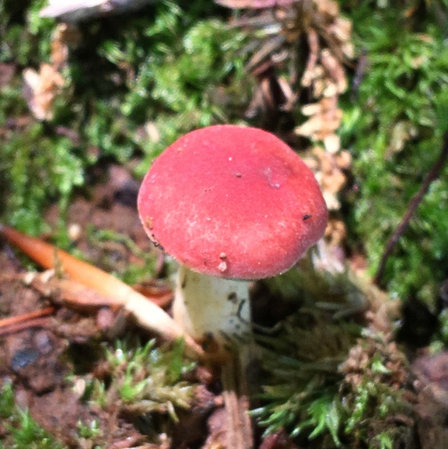
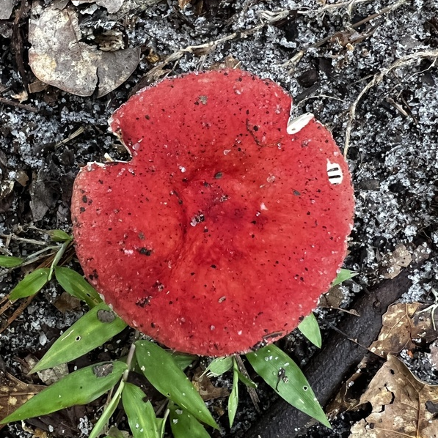
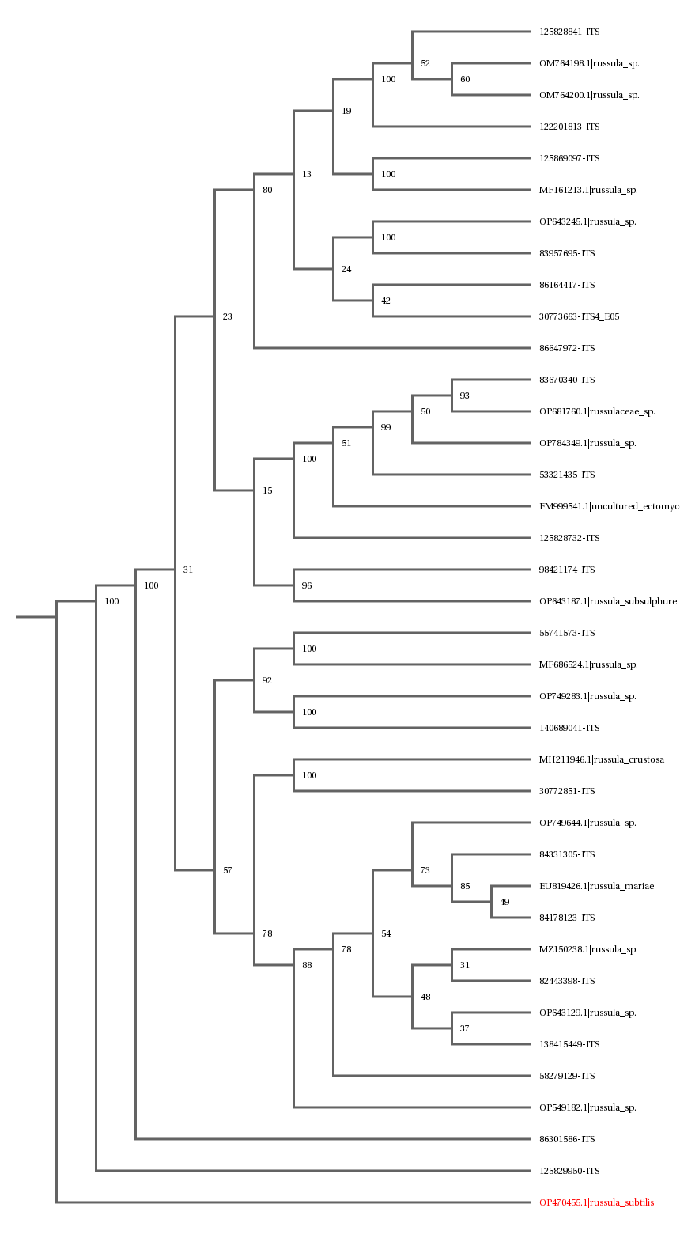
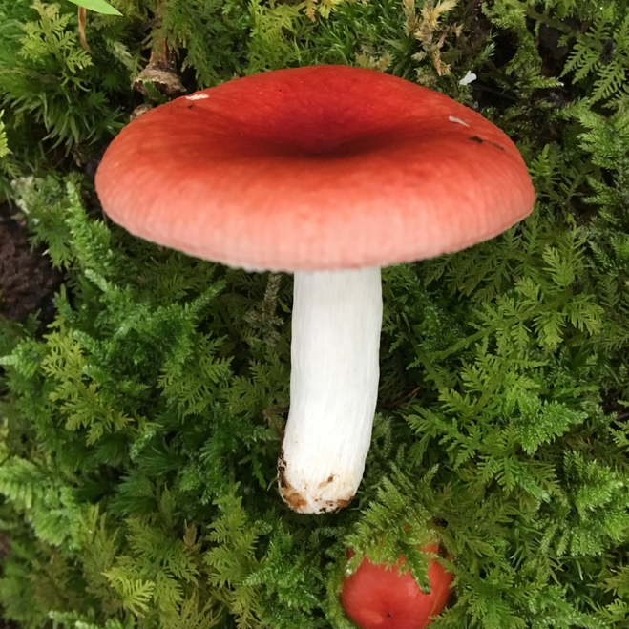
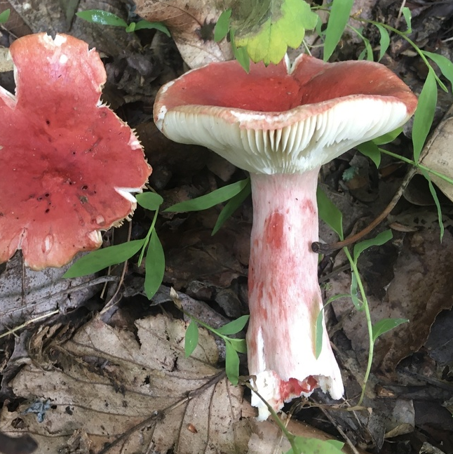
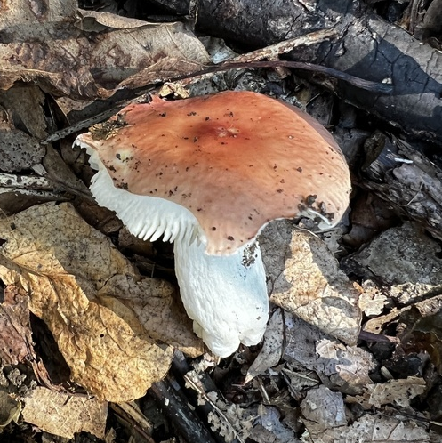
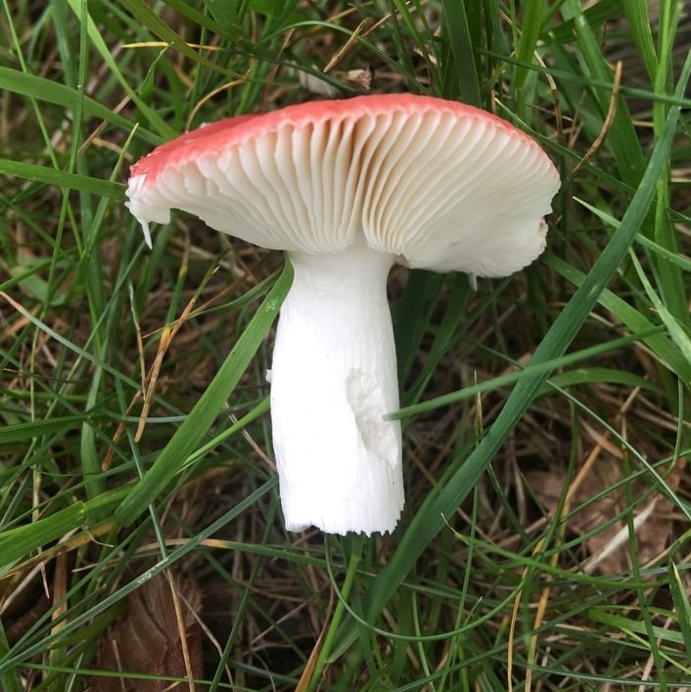
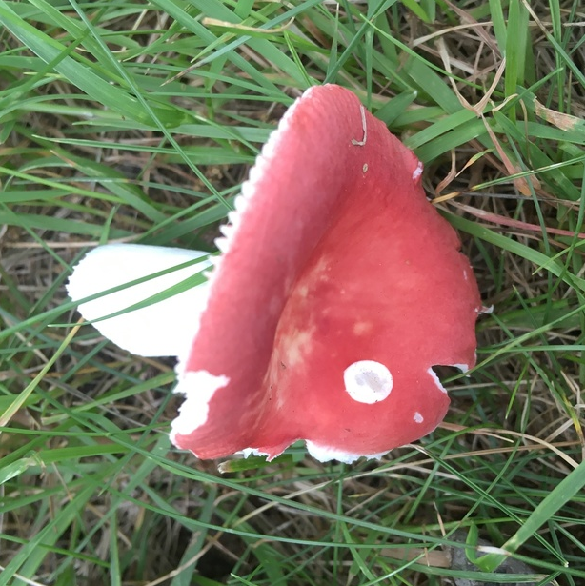
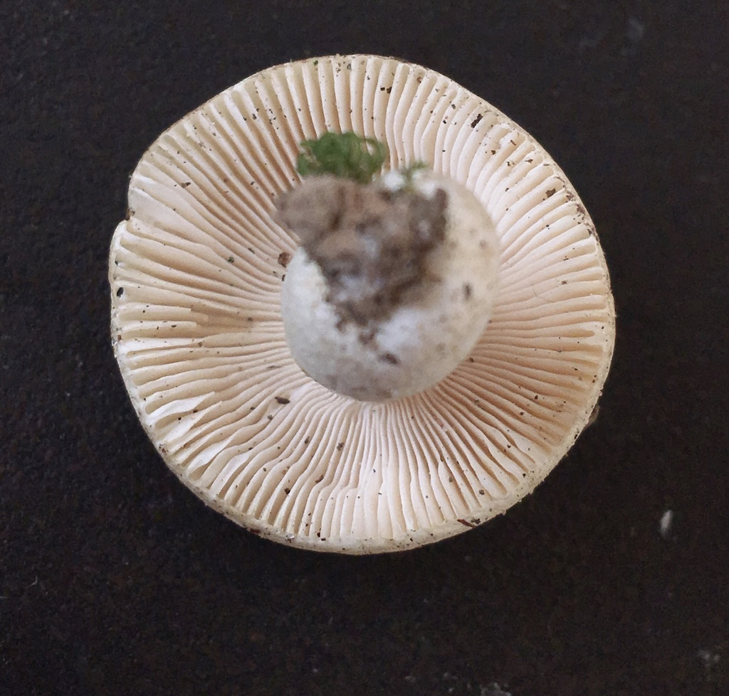
Identifying Russula in New York
Maxim Borisov, Zoë Feigelson, and Helen Mancini, Mentored by Dr. Ellen Jorgensen
Funded by the
Thompson Family Foundation
Urban Barcode Research Project, Biotech Without Borders
Abstract
The genus Russula is a family of commonly foraged mushrooms that contains a great deal of toxic Russula subspecies, so research into the identification of these mushrooms is crucial. However, only a few species can be visually identified while the rest remain a mystery. Thus, DNA Barcoding using the most experimentally successful Russula barcoding region, ITS, a necessary tool to analyze and speciate these mushrooms. Our research was aimed at assisting amateur and professional mycologists in confirming observed identities of species of Russula through DNA Barcoding. After being provided with dried mushroom samples and completing the fungal DNA barcoding protocol, we obtained the sequenced ITS region of our Russula samples and compared their species to the species identified by the forager community through each sample's corresponding iNaturalist number. Our DNA barcoding was around 75% successful, and our sequencing results yielded more specific speciation for the collected Russula samples.
Introduction
Mycology is an overlooked but crucial part of many ecosystems. Fungi cycles nutrients and drives soil health and carbon sequestration among other things.
The genus Russula is a particularly delicious family of ectomycorrhizal mushrooms (an organism with a preference for temperate and boreal forest trees) with several toxic subspecies, some of which are even fatal. This makes the accurate identification of these mushrooms key.
Russula can be characterized by their colorful caps, gills attached to the stem, and spore prints, but there is a remarkable genetic diversity within the family. Found on almost all continents, the whole Russulae genus contains around 750 subspecies. However, only about 20 to 30 species can be easily identified using morphological hints.
A study that included 433 sequences from 38 well-circumscribed Russula species found that the ITS barcoding region has the highest probability of successful identification for the broadest range of fungi
Using the iNaturalist site and samples generously given to us by the President of the New York Mycological Society, Sigrid Jakob, we chose 10 different mushroom samples to sequence that had been previously sequenced and 13 samples that had been tentatively identified (morphologically) by foragers but had not yet been sequenced.
By cross-referencing and building off pre-existing sequencing, we placed our identified species of Russula on a phylogenetic tree with other known species. By developing a detailed family tree of the Russula genus, we have started to notice patterns in the relationship between a mushroom’s morphology and its speciation. Our project aims to help amateur foragers identify their Russula species and contribute to a local network of genetic research on Mushrooms.
A phylogenetic tree of our samples as compared to BLAST results and each other
Materials & Methods
We used samples previously collected by experts in the mycological field. Ms. Jakob provided us with dried samples that have been documented on iNaturalist. Photos of the Russula, the date and time of their collection, and all other necessary information have been recorded and are available for reference. We followed Alan Rockefeller’s fungal DNA barcoding protocol. This protocol involves taking tissue from our Russula samples and adding X-amp, a premade solution that will minimize human error. The X-Amp DNA Reagent is designed for efficient release of DNA for direct use in PCR reactions without purification. The sample would then be put through a thermal cycler, and we would be left with pure fungal DNA. After the extraction was complete, we ran the DNA through a PCR with internal transcribed spacer (ITS) region primers. After the extraction and amplification were done, we ran a gel electrophoresis to make sure the PCR was successful. We would achieve this by using 1% agarose gel to visualize the 500 bp ITS region sequence.
Results
We were successfully able to identify many different Russula subspecies and create a phylogenetic tree (See Appendix A). These subspecies include Russula Velenovskyi, Russula Pulchra, Russula Mariae, Russula Rugulosa, Russula Subtilis, and more. This only goes to show how diverse the Russula genus is and how easily one of its subspecies can be mistaken for another.
Figures
Discussion
In our time at the lab, we barcoded and sequenced 23 different samples of Russula, sourced from different parts of New York State. When sequenced, only five of our samples returned entirely unintelligible sequences. This means that our DNA extractions, PCR reactions, and gel electrophoresis testing were ultimately successful in around 75% of cases. In our many trials performing these extractions, we learned how careful our lab technique had to be in order to avoid cross-contamination between samples. We were also testing a novel Fungal DNA Barcoding Protocol. This meant paying close attention to (and sometimes altering) the reaction times for various steps through trial-and-error. Our results yielded much more specific information as to the identity of each Russula sample. By putting these results into a phylogenetic tree, we could compare our samples to each other and track morphological trends (in cap color and gill shape). Although we have a fairly robust dataset on the identities of these Russula samples, it took much longer than we originally anticipated to fully barcode our samples, and we did not have time to complete the second phase of our proposed project. We hope to continue our research at Biotech Without Borders to complete the next phase of our proposed project.
References
1. Benefits of fungi for the environment and humans. UN Decade on Restoration. (n.d.). https://www.decadeonrestoration.org/stories/benefits-fungi-environment-and-humans
2. Cornell Mushroom blog. A deadly Russula :Cornell Mushroom Blog. (n.d.). https://blog.mycology.cornell.edu/2013/12/30/a-deadly-russula/
3. Jakob, S. (n.d.). Fungal DNA Barcoding Protocol. New York Mycological Society.
4. MushroomExpert.Com. (n.d.). The genus Russula (mushroomexpert.com). https://www.mushroomexpert.com/russula.html
5. Russulaceae Gallery. Russulaceae: Lactarius, Russula fungi picture gallery. (n.d.). https://www.first-nature.com/fungi/~russulaceae.php
Acknowledgements
We’d like to acknowledge Dr. Ellen Jorgensen and the rest of the Biotech Without Borders lab for welcoming us into their community, and Sigrid Jakob of the New York Mycological Society for her samples. We also want to thank Arden Feil and Dr. Mayle for their support throughout the program!

