Slide 1




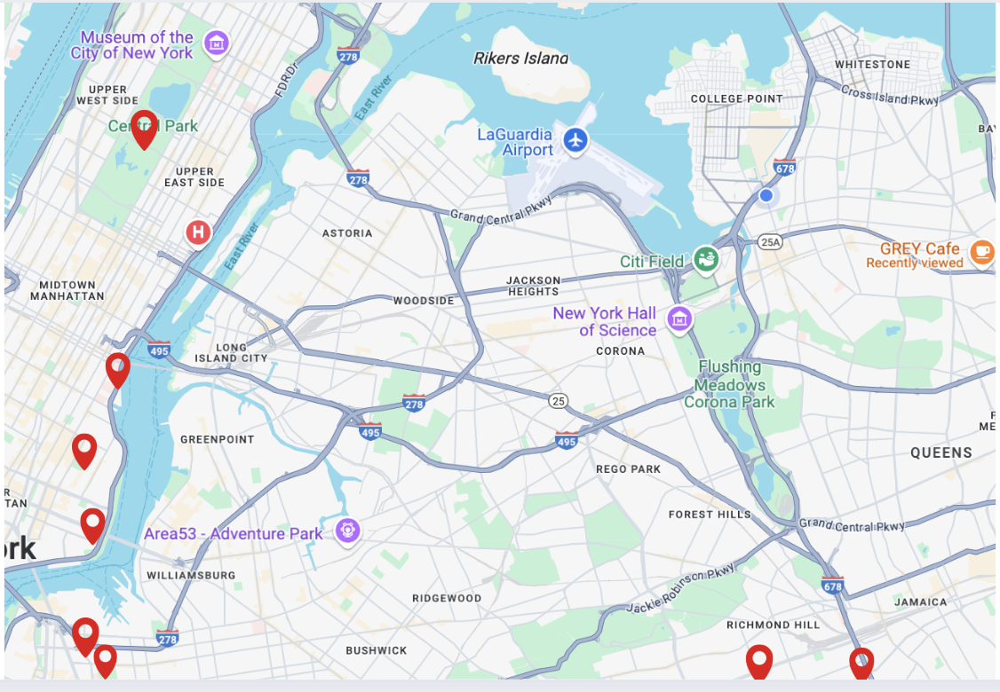
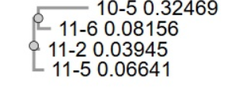
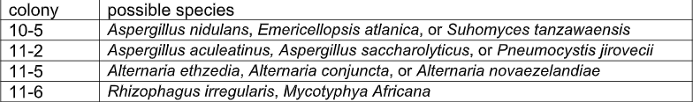
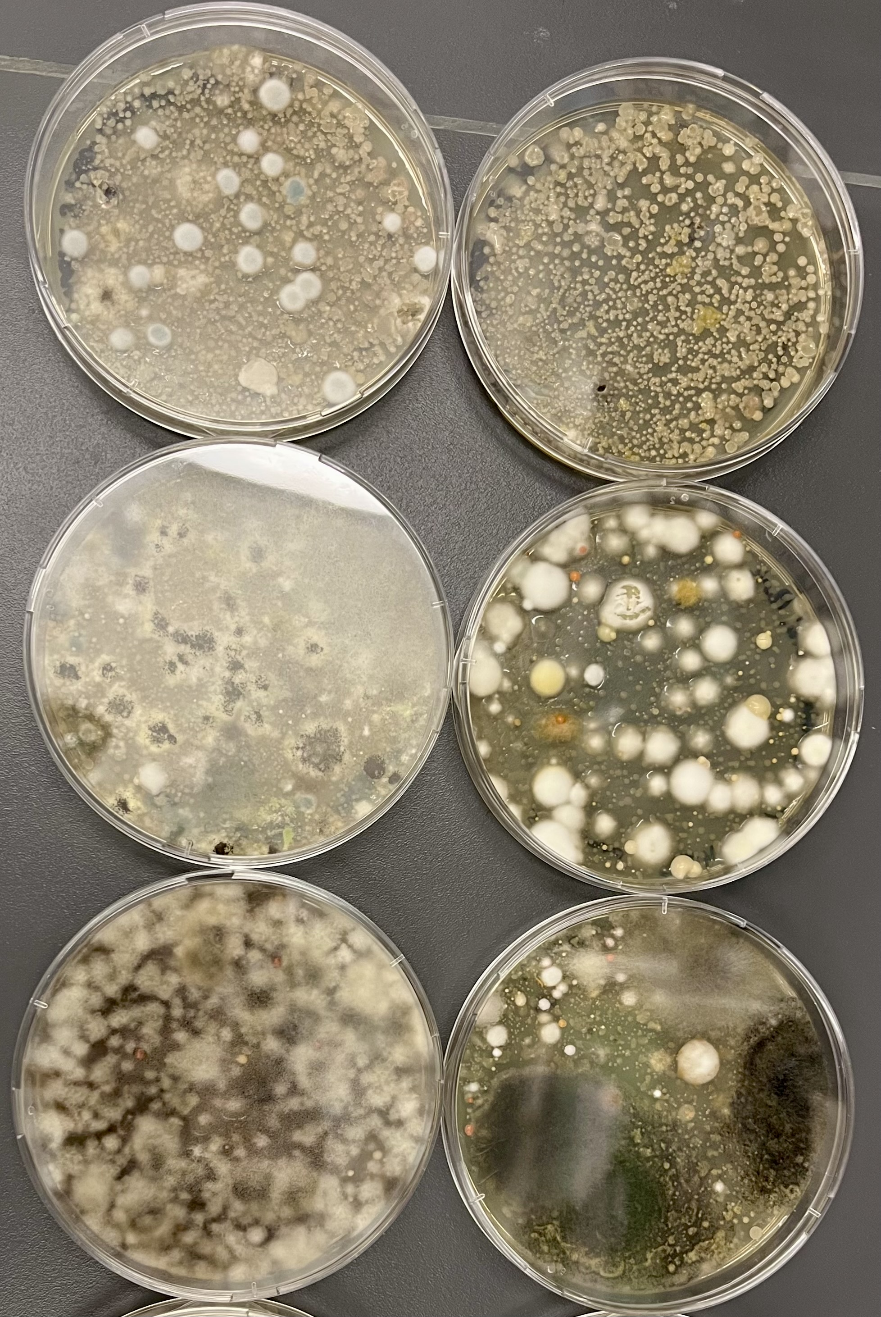
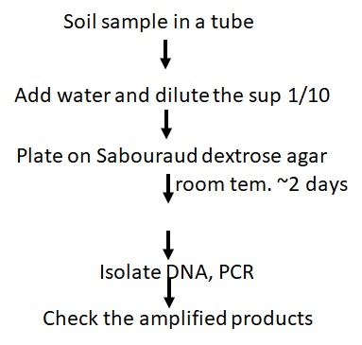
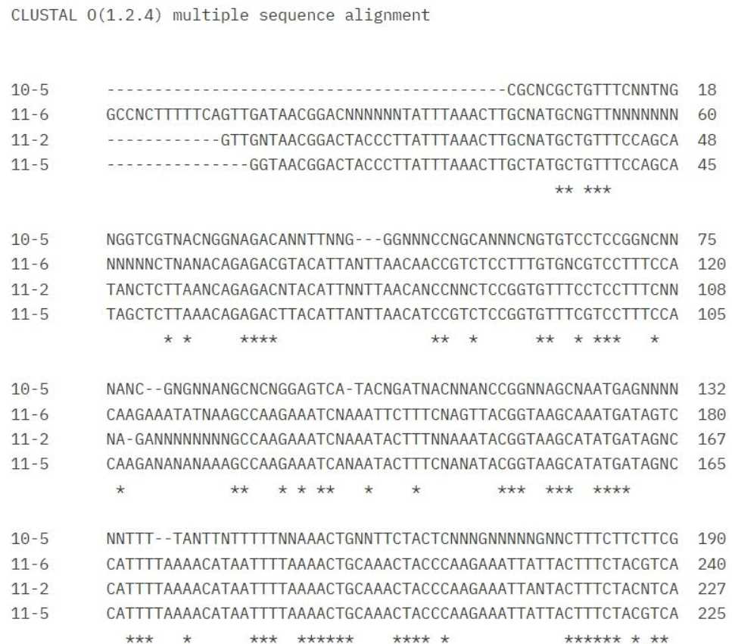
Effects of Pollution on Fungal Communities
1 Arianna Sukhdeo, 2 Tianxiao Liu, 3 Alexandra Snowden, 4 Katsuhiro Kita
1 NEST+m 2 Brooklyn Technical High School 3 Hunter College High School 4 St. Francis College
ABSTRACT
Fungal communities are vital for ecosystem health but remain underexplored in polluted environments.
This project investigates the impact of pollution on fungal biodiversity by comparing soils from areas of high and low pollution (e.g., highways versus nature reserves).
Soil samples will be collected and analyzed through DNA barcoding (ITS region sequencing) to identify fungal taxa.
The aim is to evaluate fungal diversity and community composition across pollution gradients.
It is hypothesized that high-pollution sites will exhibit reduced fungal diversity and altered community structures.
Statistical and graphical analyses will be employed to assess diversity indices and species distributions.
Bioindicator taxa may be identified to indicate pollution levels.
• Findings could inform environmental restoration efforts and underline the importance of protecting fungal biodiversity in polluted ecosystems.
Figure 4. The taxonomical relationship between four isolated fungi (created by Clustal Omega; left) and Table 1 (right) summarizing possible fungal species identified in this study.
SUMMARY
Among 60 isolated colonies, genomic DNA was successfully obtained from 37 samples
ITS region amplification was challenging, with only 7 samples producing visible bands after PCR
These 7 samples were subjected to Sanger DNA sequencing
2 sequences did not match fungal or yeast genomic DNA
4 sequences matched known fungal sequences
Figure 1. Sampling locations (red)
CONCLUSION
This study investigated the impact of pollution on fungal biodiversity by comparing soil samples from high- and low-pollution areas using DNA barcoding of the ITS region.
Fungi play essential roles in ecosystems such as nutrient cycling, organic matter decomposition, erosion prevention, and supporting plant growth through mycorrhizal relationships—yet they remain underrepresented in pollution studies.
Using culturing, DNA extraction, and ITS-region amplification, the project aimed to evaluate fungal diversity across pollution gradients.
Of 60 isolated colonies, genomic DNA was successfully extracted from 37 samples. However, ITS region amplification was difficult, with only 7 samples producing visible PCR bands.
These were sequenced via Sanger DNA sequencing; 4 matched known fungal sequences, while 2 did not align with fungal or yeast DNA.
These difficulties could be the results of cross-contamination, inadvertently growing bacteria rather than fungi or yeast, or other parts of our method didn’t work as intended.
INTRODUCTION
Fungi play critical roles in ecosystems, including nutrient cycling, organic matter decomposition, soil erosion prevention, and promoting plant growth through mycorrhizal relationships.
Despite their importance, fungi are often overlooked in environmental and pollution studies.
Pollution from human activities (e.g., industrial emissions, vehicle exhaust, waste runoff) introduces toxic substances like heavy metals into soil ecosystems.
These pollutants may negatively impact fungal biodiversity and the overall soil microbiome.
This project uses DNA barcoding to analyze fungal diversity and community composition in polluted versus unpolluted soils.
Fungi are sensitive to environmental changes, making them potential bioindicators of soil health.
Findings could contribute to conservation, restoration, and pollution mitigation strategies.
Although fungi are known to be important for soil health, few studies have explored how pollution specifically affects them—as this project intends to.
Figure 2. An example of typical plates.
MATERIALS AND METHODS
Each sample was placed in a 1.5-ml microcentrifuge tube with 500 μl of water
After vortexing and a quick spin, the supernatant was diluted (1:10) with water and plated on Sabouraud dextrose agar (4% dextrose, 1% peptone, 2% agar, pH ~5.6)
Fungal and yeast colonies were either directly used or cultured in Sabouraud dextrose medium (1 ml in microcentrifuge tubes) at 28°C for two days
Cells were resuspended in 100 μl of digestion buffer (1M sucrose, 50 mM EDTA, 2% mercaptoethanol) containing 2.5 μl (12.5U) Zymolyase and incubated at 37°C for 1 hour to digest cell walls
Genomic DNA was extracted using the DNeasy kit (Qiagen)
ITS1 and ITS4 primers, each tagged with an M13 sequence, were used to amplify the internal transcribed spacer (ITS) region
PCR conditions: initial denaturation at 94°C for 1 minute; 35 cycles of 94°C for 1 minute (denaturation), 55°C for 1 minute (annealing), and 72°C for 1 minute (extension)
Taq DNA polymerase (New England Biolabs) was used in all PCR reactions
PCR products were visualized using 2% agarose gel electrophoresis; expected amplicon size was 692 bp
REFERENCES
M. Tessler, F.J. David, S.W. Cunningham, E. Herstoff (2023) Microb. Ecol., 85, 1077-1086
H.M. Bik, et al. (2012) PLoS One, 7, e38550
C.J. Jackson, et al. (1999) J. Clin. Microbiol., 37, 931-936
F. Sievers and D.G. Higgins (2014) Methods Mol. Biol., 1079, 105-116
V. Baramidze, et al. (2025) J. Fungi, 11, 249
P. Loján, et al. (2017) J. Appl. Microbiol., 122, 429-440
B. Arunan, et al. (2024) J. Med. Virol., 96, e29601
ACKNOWLEDGEMENTS
We thank Drs. Allison Mayle, Ashley Paynter, Christina Newkirk and all the DNA Learning Center for their dedicated support throughout the program. We also acknowledge the Pinkerton Foundation for their support.
Figure 3. Four of read sequences aligned with
Clustal Omega.

