Slide 1
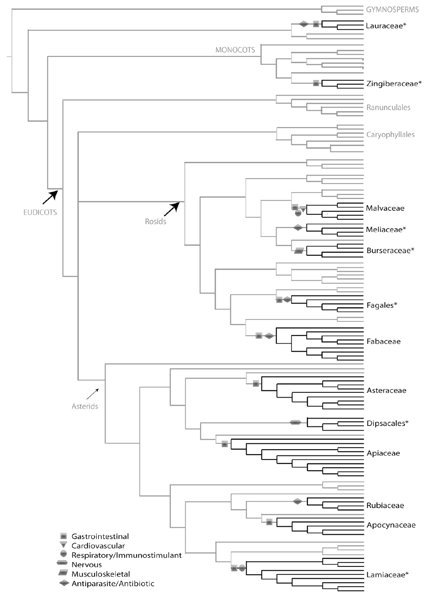
\
Predicting potential medicinal applications of barcoded plants using evolutionary pharmacology
Amy Lin¹, Neha Maskey¹, Jeanmaire Molina (mentor)²
¹Stuyvesant High School, ²Long Island University-Brooklyn
ABSTRACT
At least 25% of modern pharmaceuticals originated from plant natural products discovered through traditional medicine (ethnopharmacology). Pharmaceutical companies continue to pursue natural product research to uncover drug leads. Taxonomic identification of ethnomedically important plants precedes any type of research into their chemistry and pharmacology. DNA barcoding, a technique that utilizes a short DNA sequence from a genome to identify a species of a particular organism, can facilitate taxonomic identification. Once the identity of the plant is known, one can predict the specific medicinal application of the plant based on the phytochemical and pharmacological properties known from its close phylogenetic relatives. This concept of evolutionary pharmacology can expedite drug discovery, focusing efforts on a definite application in lieu of random bioassays and screens. As part of UBRP, we partnered with a natural products research company that seeks to identify new medicinal plants and compounds from remote unexplored environments. We DNA barcoded medicinal plant samples collected from these places and deduced medicinal applications using evolutionary pharmacology.
INTRODUCTION
At least 25% of our modern pharmaceuticals originated from plant natural products. At least 80% of plant-derived drugs were based on traditional medicine or have ethnomedical importance.
For example, the drug quinine, derived from Cinchona sp. was found to have antimalarial properties in the 1600s by Jesuits who have witnessed the plant’s use for fever by natives of the Andean jungle. Hydroxychloroquine, touted by Trump to be a “game changer” in the fight against Covid-19, is derived from quinine. Similarly, other modern drugs such as morphine, artemisinin, ephedrine, atropine, reserpine all have roots in traditional medicine.
Pharmaceutical companies continue to pursue natural product research to uncover drug leads. Taxonomic identification of ethnomedically important plants is paramount and precedes any type of research into their chemistry and pharmacology. DNA barcoding is a molecular tool that can facilitate taxonomic identification.
Once the identity of the plant is known, evolutionary pharmacology can be applied to predict the specific medicinal application of the plant sample based on the phytochemical and pharmacological properties known from its close phylogenetic relatives. This can expedite drug discovery, focusing efforts on a definite application in lieu of random bioassays and screens.
As part of UBRP, we partnered with a natural products research company that seeks to identify new medicinal plants and compounds from remote unexplored environments. We DNA barcoded medicinal plant samples and predicted their medicinal applications using evolutionary pharmacology.
RESULTS & DISCUSSION
The taxonomic ID based on the ITS2 barcodes are presented in Table 1. Though we are unable to reveal species identity, those with >96% pairwise identity (PWI) belong to the same species as the top species hit in Genbank, while those with >92% PWI is probably a different genus not yet in Genbank (Qin et al. 2017). The generic ID is enough to allow us to place the sample in the phylogeny published in Molina (2018, Fig. 1), where medicinal plant genera from various cultural groups (Ayurvedic/Indian, Latin/Caribbean, Islamic/Middle Eastern, African, Chinese, European, Native American) have been phylogenetically analyzed and their medicinal applications (cardiovascular, gastrointestinal, respiratory, muscle/skeletal, antiparasitic/antibiotic, nervous) have been mapped as traits on the phylogeny. The placement of the sample in a medicinally important clade may suggest potential medicinal applications that could be further investigated by the natural products research company we collaborated with.
We successfully barcoded 18 out of 23 plant samples we received. One sample (BBB) matched to a fungal taxon, perhaps mixed in with the plant sample, and was not analyzed further. Five samples had unreadable/noisy sequence chromatograms when inspected in Geneious, perhaps resulting from non-specific priming, and were excluded from Table 1.
Of the 18 samples, 4 samples belonged to families represented in Fig. 1. HHH and PPP, both identified to be Hydnophytum sp. belongs to Rubiaceae, whose members have been traditionally used as antiparasitic/antibiotic agents. QQQ was identified as Intsia sp. of Fabaceae, which has been used traditionally for its gastrointestinal and antibiotic properties. RRR turned out to be Tagetes sp. of Asteraceae, whose many species have been used culturally for gastrointestinal ailments.
There were other plants barcoded that do not belong to the medicinal families in Figure 1. However, they do possess medicinal qualities when searched for in the literature, but perhaps inherent to the individual species, and not generalizable at the family level. AAA and GGG of the genus Passiflora has been used for alleviating insomnia and has anti-anxiety and sleep-inducing properties (Guerrero et al., 2017). CCC is Terminalia sp., which has been found to possess antitumor, anti HIV-1, antifungal, antimicrobial, antimalarial, antioxidant, diarrhea and analgesic properties (Zhang et al. 2019). DDD belonged to genus Imperata, which has been used for its anti-anemia effects (Kone et al. 2012). EEE is Averrhoa sp., which has been used in Ayurvedic and Chinese medicine for its antioxidant and anti-inflammatory qualities but may be a danger to those with renal problems due to its high oxalic acid content (Muthu et al 2016). JJJ and LLL turned out to be Cissus sp. which has been shown to have bone-healing effects (Stohs and Ray 2013). KKK is a part of the Euphorbia genus, and these plants have diuretic, anti-hyperuricemia, anti-cancer, anti-platelet aggregation, hepatoprotective, and neuroprotective effects (Zhu et al., 2015). MMM belongs to the Tetracera genus that has been used for treatment of tuberculosis and respiratory infections (Fomogne-Fodjo et al., 2016). NNN represents Ipomoea and Convolvulaceae family that has plants with anti-fungal, anti-convulsant, anti-oxidant, sedative and wound healing properties (Fatima et al., 2014). There was no medinal information found for Lindernia (sample FFF). Sample III could represent a genus not yet in Genbank given the relatively low pairwise identity (80%), while sample OOO cannot bee identified to genus level as the top hit only provides the family identification.
The phylogeny allowed us to infer the potential medicinal applications of the 4 samples in this study. This can inform the natural products research company what pharmacological assays to prioritize in lieu of random bioassays and screens, thus expediting the drug discovery process.
This project allowed us to gain a better appreciation for plant biodiversity. Its preservation and sustainable use are key to finding new drugs that can help us treat novel diseases such as Covid-19.
A
B
C
MATERIALS & METHODS
We received a total of 23 plant samples, each with a unique accession number, from the natural products research company. These plants are often used by indigenous peoples in traditional medicine (Table 1)
Using the Qiagen DNeasy Plant Mini Kit, plant DNA was extracted from the samples. Primers for the nuclear internal transcribed spacer-2 (ITS2) were then used for PCR amplification following the same methodology in Molina et al. (2018). The PCR products were purified using Affymetrix ExoSAP-it and submitted to Genewiz Inc. (South Plainfield, NJ) for Sanger-based DNA sequencing.
Sequences were analyzed using the “blue line” workflow in DNAsubway (https://dnasubway.cyverse.org/). The same raw sequences were edited and assembled in Geneious 11.1.5 (Biomatters, New Zealand) and compared against the GenBank nucleotide database using Megablast https://blast.ncbi.nlm.nih.gov/Blast.cgi
Due to confidentiality agreements, we are unable to specify the name of the company, the species of the sample, as well as the provenance of the plant samples. However, the resulting generic identity is sufficient to place the sample in the phylogeny (Fig. 1) to deduce potential medicinal application for further testing.
Accession | Top species hits in Genbank | Pairwise identity with Genbank top hit | Family
AAA | Passiflora sp. | 96.2% | Passifloraceae
BBB | Lasiodiplodia theobromae | 99.1% | Botryosphaeriaceae (fungus)
CCC | Terminalia sp. | 100% | Combretaceae
DDD | Imperata sp. | 99.2% | Poaceae
EEE | Averrhoa sp. | 95.7% | Oxalidaceae
FFF | Lindernia sp. | 93.4% | Linderniaceae
GGG | Passiflora sp. | 97.7% | Passifloraceae
HHH | Hydnophytum sp. | 95.6% | Rubiaceae
III | Pitospathatha sp./Aridarum sp. | 80.8% | Araceae
JJJ | Cissus sp. | 92.9% | Vitaceae
KKK | Euphorbia sp. | 100% | Euphorbiaceae
LLL | Cissus sp. | 92.1% | Vitaceae
MMM | Tetracera sp. | 95.7% | Dilleniaceae
NNN | Ipomoea sp. | 97.7% | Convolvulaceae
OOO | Annonaceae sp. | 100% | Annonaceae
PPP | Hydnophytum sp. | 95.6% | Rubiaceae
QQQ | Intsia sp. | 97.2% | Fabaceae
RRR | Tagetes sp. | 100% | Asteraceae
REFERENCES
Achan et al. 2011. Malar. J. 10:144.
Baker et al. 2008. Nat. Prod. Rep. 24. 1225-1244.
Fabricant & Farnsworth 2001. Environ Health Perspect. 109: 69–75.
Fomogne-Fodjo et al. J. Ethnopharmacol. 195:238-245.
Fatima et al. 2014. J. Comp. Int. Med. 11:55-62.
Guerrero et al. 2017. Sleep Sci. 10:96-100.
Kress & Erickson. 2012. DNA Barcodes: Methods and Protocols. Humana Press, New York, NY.
Koné et al. 2011. Afr. J. Tradit. Complement. Altern. Med. 9:81-87.
Molina J. 2018. In: Ethnopharmacologic Search for Psychoactive Drugs, Vol. 2. Synergetic Press, NM, USA.
Molina et al. 2018. Open Life Sci. 13:48-55.
Muthu et al. 2016. Bioinformation 12: 420–424.
Saslis-Lagoudakis et al. 2012. Proc Natl Acad Sci USA. 109:15835–15840.
Qin et al. 2017. Sci Rep. 7: 17316.
Stohs & Ray. 2013. Phytother. Res. 27:1107-1114.
Zhang et al. 2019. Nat Prod Bioprospect. 9: 357–392.
Zhu et al. 2018. J. Ethnopharmacol. 227:41-55.
QQQ
RRR
HHH, PPP
ACKNOWLEDGMENTS
We would like to thank LIU-Brooklyn, the Pinkerton Foundation, Cold Spring Harbor Laboratory for sponsorship.
Fig. 1 of Molina (2018). Phylogeny of traditionally important medicinal plants used by various cultures. Branches in black (bold) represent genera of ethnopharmacologically important plant groups/clades with their corresponding taxon names (family/order). Symbols on nodes represent the primary therapeutic application of that clade. “*” indicates clades that are disproportionately important even after Correcting for generic diversity. © Synergetic Press, New Mexico, US. Samples from this study (red font) were superimposed next to their corresponding plant families.
Table 1. List of plant samples that were successfully DNA barcoded. Out of 23 samples, 18 had clean sequence chromatograms that were matched to species. Pairwise identities correspond to the top species hits using Genbank Megablast. Due to confidentiality agreements, we are unable to reveal species identity and accession numbers. Generic identity allowed us to place the sample in the phylogeny in Fig. 1 to deduce potential medicinal application. BBB matched a fungal species, perhaps mixed in with the plant sample, and was excluded from further analysis. Sample III showed two different top hits in DNAsubway and Megablast.

