Slide 1
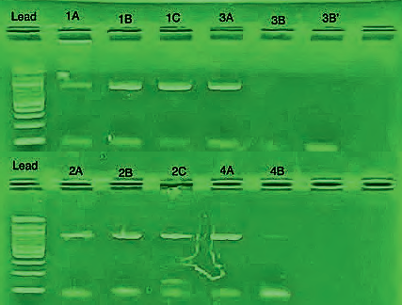
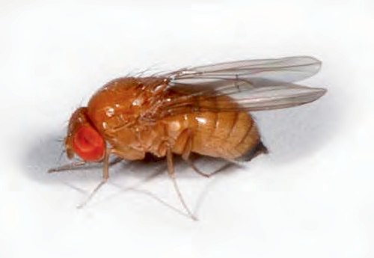
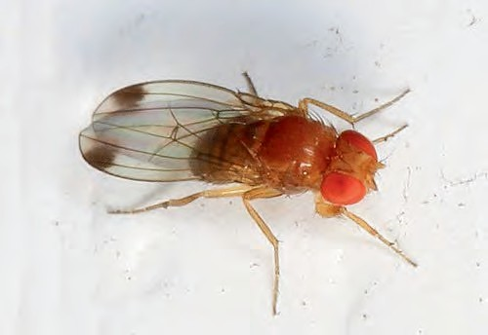
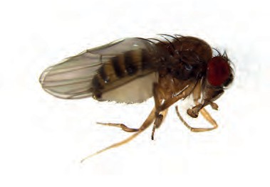
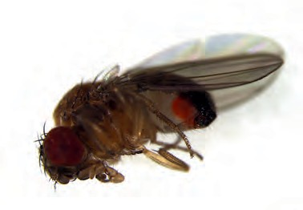
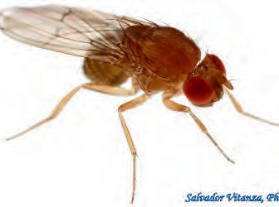
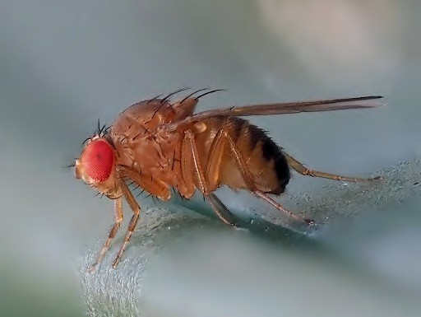
The Impact of the Luxury Effect on Drosophila Species Variation in NYC
Numa Barbato-Taormina¹, Lily Kaplan², Ollie Veyts³, and Sebastian Rojas Villa⁴
¹Millenium Brooklyn High School, ²Hunter College High School, ³Brooklyn Technical High School, ⁴Lehman College, CUNY
Abstract
Geophysical and biological factors are often studied with regards to the biodiversity of ecosystems. A more recent factor, human aspects—particularly socioeconomic processes
—such as wealth, have been observed to have a positive correlation with species biodiversity in a phenomenon termed ‘the luxury effect’. Evidence for the luxury effect typically focuses on taxonomic kingdoms and classes while families are overlooked. For the purpose of our research, we’ve assessed Drosophilidae in areas of high and low wealth, determined by median household income, to observe whether the luxury effect pattern holds true for families in NYC. With our results we were unable to conclude whether wealth impacted the number of species in areas of NYC of varying wealth.
However, our results do suggest that socioeconomic factors influence population variation. Understanding that wealth filters which species thrive in a given area reveals deeper patterns which are critical in making decisions that acknowledge wealth disparities.
Results
Sample Overview
We performed gel electrophoresis to test if our PCR worked All but one sample, 3B, showed signs of successful PCR
9/10 samples had successful PCR results (see figure 1) and were sent for sequencing
Low Income Results
1A and 2A had unusable sequencing results and couldn’t be identified 1B, 1C, 2B, 3A were identified as Drosophila Suzukii
2C was identified as Drosophila immigrans
High Income Results
4B had unusable sequencing results and couldn’t be identified
4A was identified as Drosophila affinis
Figure 1 | Gel electrophoresis results show that the PCR worked for all samples but 3B and 3B’ with samples 1A, 2A, and 4B being the lightest and thinnest bands.
Low Income
Location 1 D. Suzukii (1B-1C) | Location 2 D. Suzukii (2B) | Location 3 D. Suzukii (3A)
Female; identifiable by saw-like ovipositor (not seen in photo) (Hauser, 2010) | Female; identifiable by saw-like Male; identifiable by spots ovipositor (not seen in photo) on wings (Gallagher, 2014) (Hauser, 2010) | Female; identifiable by saw-like ovipositor (not seen in photo) (Hauser, 2010)
 | D. Immigrans (2C)
Male; identifiable by spots on wings (Gallagher, 2014) | Female; identifiable by longer Male; identifiable by small more tapered abdomen than black spines on anterior side males (Vitanza, 2019) of front femur (Nicholls, 2022) | Male; identifiable by spots on wings (Gallagher, 2014)
Introduction
Recent studies have suggested a correlation between biodiversity and socioeconomic factors, a pattern coined the ‘luxury effect’
Previous studies have examined this pattern in Phoenix, Arizona with bird species in public parks (Kinzig et al., 2005) and plant species (Hope et al., 2003)
There is, however, and absence of data on taxonomic groups beyond kingdoms (Plantae) and classes (Aves)
Our research aims to address these gaps using Drosophilidae as a model family.
Drosophilidae were selected due to their abundance and simple living conditions which makes collection easier (Jennings, 2011)
To address this we asked the question: How do socioeconomic difference in New York City correlate to the diversity within the Drosophilidae family?
We hypothesized that in areas with high median incomes ($96,500 or above), would have greater Drosophilidae species diversity than areas with low median incomes ($79,000 or below)
High Income
Location 1
D. Affinis (4A)
Female; identifiable by striped anterior (Hanson, 2021)
Male; identifiable by orange testes (Hanson, 2021)
Figure 2 | Specie in high income area visualized. In sample 4A Drosophila Affinis was identified. Females and males have different characteristics for identification.
Figure 3 | Species in low income areas visualized. In all three locations Drosophila Suzukii was identified. In location two an additional species, Drosophila Immograns, was identified. Males and females have different characteristics for identification.
Materials and Methods
Samples were obtained using fruit fly traps (plastic water bottles) filled with bait (either tomatoes or bananas with yeast)
Each member had set up 4 traps, 2 outside and 2 inside Samples were collected mid-November
Collected samples from successful traps were then analyzed using morphological features to sort them by what we believed were different species
Each location was assigned a number, 1-3 were low-income areas while 4 was a high income area
Each suspected separate specie was assigned a letter A-C based on how many separate species we believed there were per area
DNA was extracted from one specimen from each sample using the guide from the DNA Learning Center (2015)
PCR was then performed using a CO1 primer
Gel electrophoresis was then performed to test whether PCR was successful Samples with suspected successful PCR were then sent for DNA sequencing to determine the species of each specimen.
Discussion
Our results were inconclusive for determining whether wealth impact diversity of species in New York City.
However our results suggest a correlation between wealth and the survivability of different populations which could indicate that socio-economic conditions create different environments which prove more sustainable for varying populations
Understanding that differences in wealth influence population types can help with making informed decisions in regards to urban development—creating environments that foster certain species over others—and public health—being prepared to tackle diseases that certain species bring over others
We experienced many challenges which led to our results being inconclusive
Time constraints meant we had to collect sample in late October through mid-November, during which many drosophila die as a result of low temperatures which negatively impacted our sample size
Our gel electrophoresis results (see Figure 1) showed that PCR failed for sample 3B, which was inserted twice (once in lane 6 and once in lane 7). This meant we couldn’t sequence this sample Our DNA sequencing results with non-viable for three out of our nine viable sample.
Sample 4B was a crucial sample for having conclusive evidence on wealth’s influence on the diversity of species.
An interesting observation is that all of the samples that failed had featured the lightest and thinnest bands; this may have been an early indicator that the DNA sequencing wouldn’t work. Future studies should explore the methods through which wealth influences the environments that these different species inhabit as that could be a determinant factor for actions in city planning and public health
Acknowledgements
We thank Christina Newkirk, Allison Mayle, and Ashley Paynter for teaching us DNA extraction procedures and for running the Urban Barcoding Research Program. We also thank the DNALC for hosting UBRP and providing resources, and Cold Spring Harbor Laboratory for sponsoring the program.
References
DNA Barcoding Silica Isolation. (2015). Dnabarcoding101.org; DNA Learning Center. https://dnabarcoding101.org/files/DNA-Barcoding-Silica-Isolation-Worksheet.pdf Gallagher, J. (2014). Spotted-winged Drosophila, Drosophila suzukii, Woodbridge, Virginia. In Wikipedia. https://en.wikipedia.org/wiki/Drosophila_suzukii
Hope, D., Gries, C., Zhu, W., Fagan, W. F., Redman, C. L., Grimm, N. B., Nelson, A. L., Martin, C., & Kinzig, A. (2003). Socioeconomics drive urban plant diversity. Proceedings of the National Academy of Sciences, 100(15), 8788–8792. https://doi.org/10.1073/pnas.1537557100 Hanson, M. (2021a). Drosophila affinis female. In Wikipedia. https://en.wikipedia.org/wiki/Drosophila_affinis#
Hanson, M. (2021b). Drosophila affinis male. In Wikipedia. https://en.wikipedia.org/wiki/Drosophila_affinis#
Hauser, M. (2010). Drosophila suzukii female. California. In Wikipedia. https://en.wikipedia.org/wiki/Drosophila_suzukii
Kinzig, A. P., et al. (2005). The effects of human socioeconomic status and cultural characteristics on urban patterns of biodiversity. Ecology and Society, 10(1). https://doi.org/10.5751/es-01264-100123 Nicholls, D. (2022). Drosophila immigrans. In Nature Spot. https://www.naturespot.org/species/drosophila-immigrans
Vitanza, S. (2019). Diptera-Drosophilidae-Drosophila immigrans-Vinegar Flies FEMALE (A). In Extension Education in El Paso County. https://elp.tamu.edu/ipm/bugs/order-diptera-flies/family-drosophilidae-vinegar-flies/diptera-drosophilidae-drosophila-immigrans-vinegar-flies-female-a/

